Slide 1
CS276
Lecture 15
Link Analysis

Slide 2
Today’s lecture
Anchor text
Link analysis for ranking
  Pagerank and variants
  HITS

Slide 3
The Web as a Directed Graph
Page A
Page B
hyperlink
Anchor
Assumption 1: A hyperlink between pages denotes author perceived relevance (quality signal)
Assumption 2: The anchor of the hyperlink describes the target page (textual context)
21.1

Slide 4
Anchor Text
WWW Worm - McBryan [Mcbr94]
For ibm how to distinguish between:
  IBM’s home page (mostly graphical)
  IBM’s copyright page (high term freq. for ‘ibm’)
  Rival’s spam page (arbitrarily high term freq.)
“ibm.com”
“IBM home page”
“ibm”
A million pieces of anchor text with “ibm” send a strong signal
www.ibm.com
21.1.1

Slide 5
Indexing anchor text
When indexing a document D, include anchor text from links pointing to D.
Armonk, NY-based computer
giant IBM announced today
www.ibm.com
Big Blue today announced
record profits for the quarter
Joe’s computer hardware links
Sun
HP
IBM
21.1.1

Slide 6
Indexing anchor text
Can sometimes have unexpected side effects - e.g., evil empire.
Can score anchor text with weight depending on the authority of the anchor page’s website
  E.g., if we were to assume that content from cnn.com or yahoo.com is authoritative, then trust the anchor text from them
21.1.1

Slide 7
Anchor Text
Other applications
  Weighting/filtering links in the graph
  Generating page descriptions from anchor text
21.1.1

Slide 8
Citation Analysis
Citation frequency
Co-citation coupling frequency
  Cocitations with a given author measures “impact”
  Cocitation analysis
Bibliographic coupling frequency
  Articles that co-cite the same articles are related
Citation indexing
  Who is author cited by? (Garfield 1972)
Pagerank preview: Pinsker and Narin ’60s

Slide 9
Query-independent ordering
First generation: using link counts as simple measures of popularity.
Two basic suggestions:
  Undirected popularity:
    Each page gets a score = the number of in-links plus the number of out-links (3+2=5).
  Directed popularity:
    Score of a page = number of its in-links (3).

Slide 10
Query processing
First retrieve all pages meeting the text query (say venture capital).
Order these by their link popularity (either variant on the previous page).

Slide 11
Spamming simple popularity
Exercise: How do you spam each of the following heuristics so your page gets a high score?
Each page gets a static score = the number of in-links plus the number of out-links.
Static score of a page = number of its in-links.

Slide 12
Pagerank scoring
Imagine a browser doing a random walk on web pages:
  Start at a random page
  At each step, go out of the current page along one of the links on that page, equiprobably
“In the steady state” each page has a long-term visit rate - use this as the page’s score.
1/3
1/3
1/3
21.2

Slide 13
Not quite enough
The web is full of dead-ends.
  Random walk can get stuck in dead-ends.
  Makes no sense to talk about long-term visit rates.
??
21.2

Slide 14
Teleporting
At a dead end, jump to a random web page.
At any non-dead end, with probability 10%, jump to a random web page.
  With remaining probability (90%), go out on a random link.
  10% - a parameter.
21.2

Slide 15
Result of teleporting
Now cannot get stuck locally.
There is a long-term rate at which any page is visited (not obvious, will show this).
How do we compute this visit rate?
21.2

Slide 16
Markov chains
A Markov chain consists of n states, plus an n×n transition probability matrix P.
At each step, we are in exactly one of the states.
For 1 ≤ i,j ≤ n, the matrix entry P_{ij} tells us the probability of j being the next state, given we are currently in state i.
P_{ii}>0
is OK.
i
j
P_{ij}
21.2.1

Slide 17
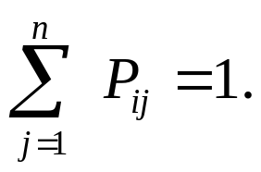
Markov chains
Clearly, for all i,
Markov chains are abstractions of random walks.
Exercise: represent the teleporting random walk from 3 slides ago as a Markov chain, for this case:
21.2.1

Slide 18
Ergodic Markov chains
A Markov chain is ergodic if
  you have a path from any state to any other
  For any start state, after a finite transient time T₀, the probability of being in any state at a fixed time T>T₀ is nonzero.
Not
ergodic
(even/
odd).
21.2.1

Slide 19
Ergodic Markov chains
For any ergodic Markov chain, there is a unique long-term visit rate for each state.
  Steady-state probability distribution.
Over a long time-period, we visit each state in proportion to this rate.
It doesn’t matter where we start.
21.2.1

Slide 20
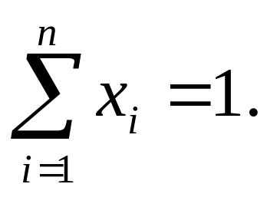
Probability vectors
A probability (row) vector x = (x₁, … x_{n}) tells us where the walk is at any point.
E.g., (000…1…000) means we’re in state i.
1
i
n
More generally, the vector x = (x₁, … x_{n}) means the walk is in state i with probability x_{i}.
21.2.1

Slide 21
Change in probability vector
If the probability vector is x = (x₁, … x_{n}) at this step, what is it at the next step?
Recall that row i of the transition prob. Matrix P tells us where we go next from state i.
So from x, our next state is distributed as xP.
21.2.1

Slide 22
Steady state example
The steady state looks like a vector of probabilities a = (a₁, … a_{n}):
  a_{i} is the probability that we are in state i.
3/4
1/4
1
2
3/4
1/4
For this example, a₁=1/4 and a₂=3/4.
21.2.1

Slide 23
How do we compute this vector?
Let a = (a₁, … a_{n}) denote the row vector of steady-state probabilities.
If we our current position is described by a, then the next step is distributed as aP.
But a is the steady state, so a=aP.
Solving this matrix equation gives us a.
  So a is the (left) eigenvector for P.
  (Corresponds to the “principal” eigenvector of P with the largest eigenvalue.)
  Transition probability matrices always have larges eigenvalue 1.
21.2.2

Slide 24
One way of computing a
Recall, regardless of where we start, we eventually reach the steady state a.
Start with any distribution (say x=(10…0)).
After one step, we’re at xP;
after two steps at xP² , then xP³ and so on.
“Eventually” means for “large” k, xP^{k} = a.
Algorithm: multiply x by increasing powers of P until the product looks stable.
21.2.2

Slide 25
Pagerank summary
Preprocessing:
  Given graph of links, build matrix P.
  From it compute a.
  The entry a_{i} is a number between 0 and 1: the pagerank of page i.
Query processing:
  Retrieve pages meeting query.
  Rank them by their pagerank.
  Order is query-independent.
21.2.2

Slide 26
The reality
Pagerank is used in google, but so are many other clever heuristics.

Slide 27
Pagerank: Issues and Variants
How realistic is the random surfer model?
  What if we modeled the back button?
  Surfer behavior sharply skewed towards short paths
  Search engines, bookmarks & directories make jumps non-random.
Biased Surfer Models
  Weight edge traversal probabilities based on match with topic/query (non-uniform edge selection)
  Bias jumps to pages on topic (e.g., based on personal bookmarks & categories of interest)

Slide 28
Topic Specific Pagerank
Conceptually, we use a random surfer who teleports, with say 10% probability, using the following rule:
    Selects a category (say, one of the 16 top level ODP categories) based on a query & user -specific distribution over the categories
    Teleport to a page uniformly at random within the chosen category
  Sounds hard to implement: can’t compute PageRank at query time!
21.2.3

Slide 29
Topic Specific Pagerank
Offline:Compute pagerank for individual categories
Query independent as before
Each page has multiple pagerank scores – one for each ODP category, with teleportation only to that category
Online: Distribution of weights over categories computed by query context classification
Generate a dynamic pagerank score for each page - weighted sum of category-specific pageranks
21.2.3

Slide 30
Influencing PageRank
(“Personalization”)
Input:
  Web graph W
  influence vector v
    v : (page → degree of influence)
Output:
  Rank vector r: (page → page importance wrt v)
r = PR(W , v)
21.2.3
Notes:
basis
web graph!!

Slide 31
Non-uniform Teleportation
Sports
Teleport with 10% probability to a Sports page
21.2.3

Slide 32
Interpretation of Composite Score
For a set of personalization vectors {v_{j}}
∑_{j} [w_{j} · PR(W , v_{j})] = PR(W , ∑_{j} [w_{j} · v_{j}])
Weighted sum of rank vectors itself forms a valid rank vector, because PR() is linear wrt v_{j}
21.2.3

Slide 33
Interpretation
Sports
10% Sports teleportation
21.2.3

Slide 34
Interpretation
Health
10% Health teleportation
21.2.3

Slide 35
Interpretation
Health
Sports
pr = (0.9 PR_{sports} + 0.1 PR_{health}) gives you:
9% sports teleportation, 1% health teleportation
21.2.3

Slide 36
Hyperlink-Induced Topic Search (HITS)
In response to a query, instead of an ordered list of pages each meeting the query, find two sets of inter-related pages:
  Hub pages are good lists of links on a subject.
    e.g., “Bob’s list of cancer-related links.”
  Authority pages occur recurrently on good hubs for the subject.
Best suited for “broad topic” queries rather than for page-finding queries.
Gets at a broader slice of common opinion.
21.3

Slide 37
Hubs and Authorities
Thus, a good hub page for a topic points to many authoritative pages for that topic.
A good authority page for a topic is pointed to by many good hubs for that topic.
Circular definition - will turn this into an iterative computation.
21.3

Slide 38
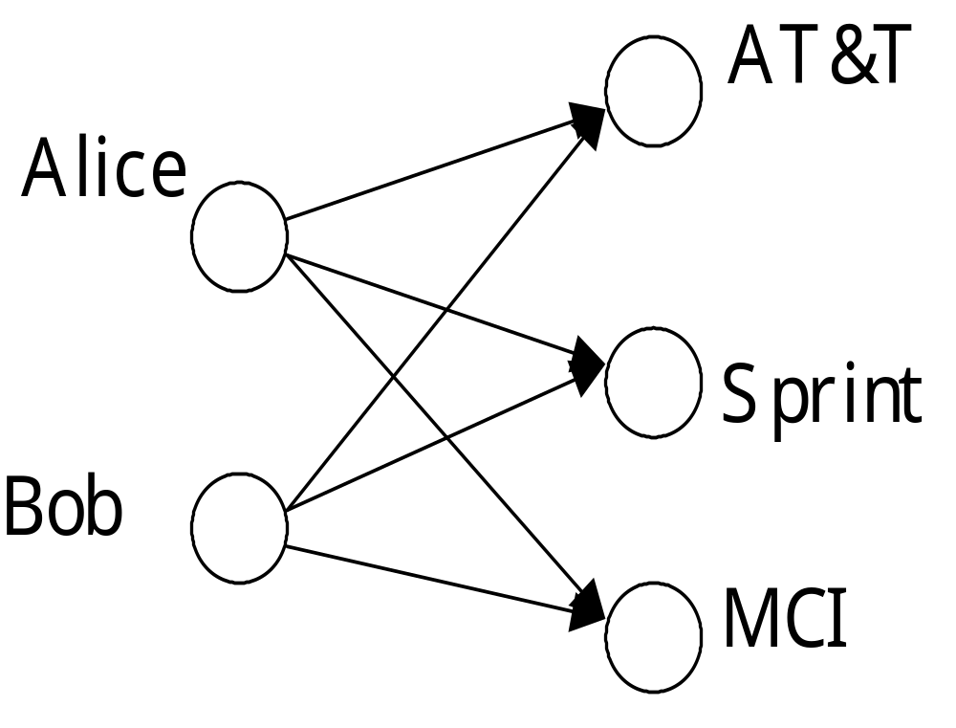
The hope
Authorities
Hubs
Long distance telephone companies
21.3

Slide 39
High-level scheme
Extract from the web a base set of pages that could be good hubs or authorities.
From these, identify a small set of top hub and authority pages;
  iterative algorithm.
21.3

Slide 40
Base set
Given text query (say browser), use a text index to get all pages containing browser.
  Call this the root set of pages.
Add in any page that either
  points to a page in the root set, or
  is pointed to by a page in the root set.
Call this the base set.
21.3

Slide 41
Visualization
Root
set
Base set
21.3

Slide 42
Assembling the base set
Root set typically 200-1000 nodes.
Base set may have up to 5000 nodes.
How do you find the base set nodes?
  Follow out-links by parsing root set pages.
  Get in-links (and out-links) from a connectivity server.
  (Actually, suffices to text-index strings of the form href=“URL” to get in-links to URL.)
21.3

Slide 43
Distilling hubs and authorities
Compute, for each page x in the base set, a hub score h(x) and an authority score a(x).
Initialize: for all x, h(x)←1; a(x) ←1;
Iteratively update all h(x), a(x);
After iterations
  output pages with highest h() scores as top hubs
  highest a() scores as top authorities.
Key
21.3

Slide 44
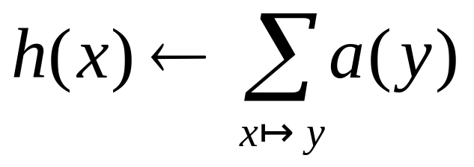
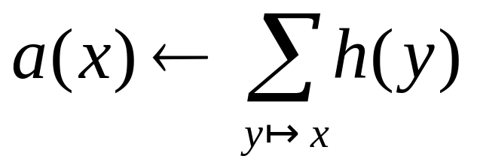
Iterative update
Repeat the following updates, for all x:
x
x
21.3

Slide 45
Scaling
To prevent the h() and a() values from getting too big, can scale down after each iteration.
Scaling factor doesn’t really matter:
  we only care about the relative values of the scores.
21.3

Slide 46
How many iterations?
Claim: relative values of scores will converge after a few iterations:
  in fact, suitably scaled, h() and a() scores settle into a steady state!
  proof of this comes later.
We only require the relative orders of the h() and a() scores - not their absolute values.
In practice, ~5 iterations get you close to stability.
21.3

Slide 47
Japan Elementary Schools
Hubs
Authorities
schools
LINK Page-13
“ú–{‚ÌŠwZ
a‰„¬ŠwZƒz[ƒƒy[ƒW
100 Schools Home Pages (English)
K-12 from Japan 10/...rnet and Education )
http://www...iglobe.ne.jp/~IKESAN
‚l‚f‚j¬ŠwZ‚U”N‚P‘g•¨Œê
ÒŠ—’¬—§ÒŠ—“Œ¬ŠwZ
Koulutus ja oppilaitokset
TOYODA HOMEPAGE
Education
Cay's Homepage(Japanese)
–y“ì¬ŠwZ‚Ìƒz[ƒƒy[ƒW
UNIVERSITY
‰J—³¬ŠwZ DRAGON97-TOP
Â‰ª¬ŠwZ‚T”N‚P‘gƒz[ƒƒy[ƒW
¶µ°é¼ÂÁ© ¥á¥Ë¥å¡¼ ¥á¥Ë¥å¡¼
The American School in Japan
The Link Page
‰ªès—§ˆä“c¬ŠwZƒz[ƒƒy[ƒW
Kids' Space
ˆÀés—§ˆÀé¼•”¬ŠwZ
‹{é‹³ˆç‘åŠw•‘®¬ŠwZ
KEIMEI GAKUEN Home Page ( Japanese )
Shiranuma Home Page
fuzoku-es.fukui-u.ac.jp
welcome to Miasa E&J school
_“ÞìŒ§E‰¡•ls—§’†ì¼¬ŠwZ‚Ìƒy
http://www...p/~m_maru/index.html
fukui haruyama-es HomePage
Torisu primary school
goo
Yakumo Elementary,Hokkaido,Japan
FUZOKU Home Page
Kamishibun Elementary School...
21.3

Slide 48
Things to note
Pulled together good pages regardless of language of page content.
Use only link analysis after base set assembled
  iterative scoring is query-independent.
Iterative computation after text index retrieval - significant overhead.
21.3

Slide 49
Proof of convergence
n×n adjacency matrix A:
  each of the n pages in the base set has a row and column in the matrix.
  Entry A_{ij} = 1 if page i links to page j, else = 0.
1 2 3
1
2
1
2
3
0 1 0
1 1 1
3
1 0 0
21.3

Slide 50
Hub/authority vectors
View the hub scores h() and the authority scores a() as vectors with n components.
Recall the iterative updates
21.3

Slide 51
Rewrite in matrix form
Recall A^{t} is the transpose of A.
h=Aa.
a=A^{t}h.
Substituting, h=AA^{t}h and a=A^{t}Aa.
Thus, h is an eigenvector of AA^{t} and a is an eigenvector of A^{t}A.
Further, our algorithm is a particular, known algorithm for computing eigenvectors: the power iteration method.
Guaranteed to converge.
21.3

Slide 52
Issues
Topic Drift
  Off-topic pages can cause off-topic “authorities” to be returned
    E.g., the neighborhood graph can be about a “super topic”
Mutually Reinforcing Affiliates
  Affiliated pages/sites can boost each others’ scores
    Linkage between affiliated pages is not a useful signal
21.3

Slide 53
Resources
IIR Chap 21
http://www2004.org/proceedings/docs/1p309.pdf
http://www2004.org/proceedings/docs/1p595.pdf
http://www2003.org/cdrom/papers/refereed/p270/kamvar-270-xhtml/index.html
http://www2003.org/cdrom/papers/refereed/p641/xhtml/p641-mccurley.html

