Slide 1
CS276
Information Retrieval and Web Search
Lecture 5 – Index compression

Slide 2
Administrivia
Problem set 1 due Thursday
Programming exercise 1 will be handed out today

Slide 3
Last lecture – index construction
Key step in indexing – sort
This sort was implemented by exploiting disk-based sorting
  Fewer disk seeks
  Hierarchical merge of blocks
Distributed indexing using MapReduce
Running example of document collection: RCV1

Slide 4
Today
Collection statistics in more detail (RCV1)
Dictionary compression
Postings compression

Slide 5
Recall Reuters RCV1
symbol statistic value
N documents 800,000
L avg. # tokens per doc 200
M terms (= word types) ~400,000
avg. # bytes per token 6
  (incl. spaces/punct.)
avg. # bytes per token 4.5
    (without spaces/punct.)
avg. # bytes per term 7.5
non-positional postings 100,000,000

Slide 6
Why compression?
Keep more stuff in memory (increases speed)
Increase data transfer from disk to memory
  [read compressed data and decompress] is faster than [read uncompressed data]
Premise: Decompression algorithms are fast
  True of the decompression algorithms we use

Slide 7
Compression in inverted indexes
First, we will consider space for dictionary
  Make it small enough to keep in main memory
Then the postings
  Reduce disk space needed, decrease time to read from disk
  Large search engines keep a significant part of postings in memory
(Each postings entry is a docID)

Slide 8
Index parameters vs. what we index (details Table 5.1 p80)
size of | word types (terms) |  |  | non-positional postings |  |  | positional postings
 | dictionary |  |  | non-positional index |  |  | positional index
 | Size (K) | ∆% | cumul % | Size (K) | ∆ % | cumul % | Size (K) | ∆ % | cumul %
Unfiltered | 484 |  |  | 109,971 |  |  | 197,879
No numbers | 474 | -2 | -2 | 100,680 | -8 | -8 | 179,158 | -9 | -9
Case folding | 392 | -17 | -19 | 96,969 | -3 | -12 | 179,158 | 0 | -9
30 stopwords | 391 | -0 | -19 | 83,390 | -14 | -24 | 121,858 | -31 | -38
150 stopwords | 391 | -0 | -19 | 67,002 | -30 | -39 | 94,517 | -47 | -52
stemming | 322 | -17 | -33 | 63,812 | -4 | -42 | 94,517 | 0 | -52
Exercise: give intuitions for all the ‘0’ entries. Why do some zero entries correspond to big deltas in other columns?

Slide 9
Lossless vs. lossy compression
Lossless compression: All information is preserved.
  What we mostly do in IR.
Lossy compression: Discard some information
Several of the preprocessing steps can be viewed as lossy compression: case folding, stop words, stemming, number elimination.
Chap/Lecture 7: Prune postings entries that are unlikely to turn up in the top k list for any query.
  Almost no loss quality for top k list.

Slide 10
Vocabulary vs. collection size
Heaps’ Law: M = kT^{b}
M is the size of the vocabulary, T is the number of tokens in the collection.
Typical values: 30 ≤ k ≤ 100 and b ≈ 0.5.
In a log-log plot of vocabulary vs. T, Heaps’ law is a line.

Slide 11
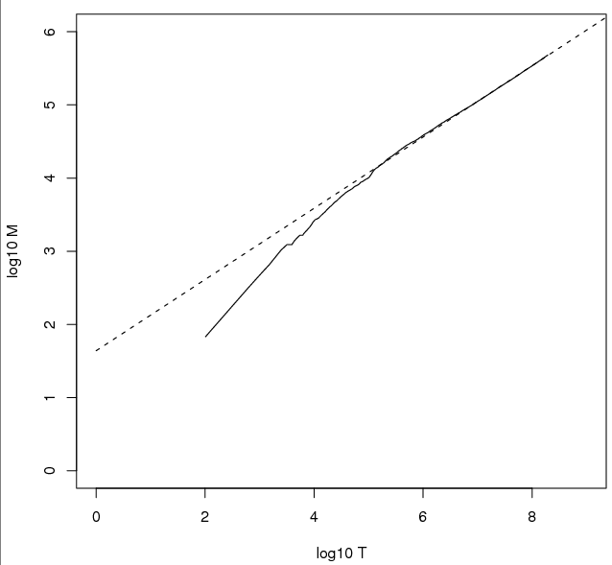
Heaps’ Law
Fig 5.1 p81
For RCV1, the dashed line
log₁₀M = 0.49 log₁₀T + 1.64 is the best least squares fit.
Thus, M = 10^{1.64}T^{0.49} so k = 10^{1.64} ≈ 44 and b = 0.49.

Slide 12
Exercise
What is the effect of including spelling errors, vs. automatically correcting spelling errors on Heaps’ law?

Slide 13
Zipf’s law
Heaps’ Law gives the vocabulary size in collections.
We also study the relative frequencies of terms.
In natural language, there are a few very frequent terms and very many very rare terms.
Zipf’s law: The ith most frequent term has frequency proportional to 1/i .
cf_{i} ∝ 1/i = c/i where c is a normalizing constant
cf_{i} is collection frequency: the number of occurrences of the term t_{i} in the collection.

Slide 14
Zipf consequences
If the most frequent term (the) occurs cf₁ times
  then the second most frequent term (of) occurs cf₁/2 times
  the third most frequent term (and) occurs cf₁/3 times …
Equivalent: cf_{i} = c/i where c is a normalizing factor, so
  log cf_{i} = log c - log i
  Linear relationship between log cf_{i} and log i

Slide 15
Compression
First, we will consider space for dictionary and postings
  Basic Boolean index only
  No study of positional indexes, etc.
  We will devise compression schemes

Slide 16
DICTIONARY COMPRESSION

Slide 17
Why compress the dictionary
Must keep in memory
  Search begins with the dictionary
  Memory footprint competition
  Embedded/mobile devices

Slide 18
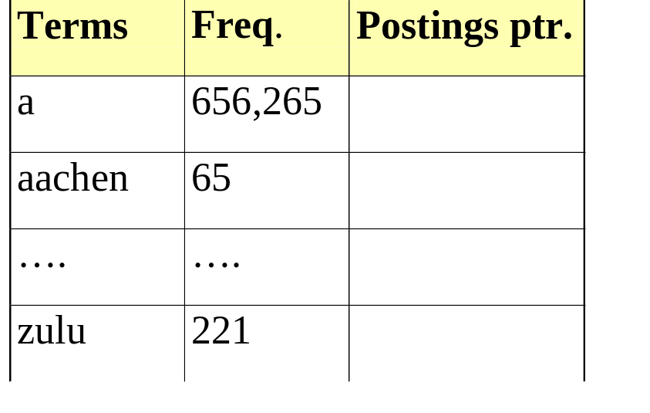
Dictionary storage - first cut
Array of fixed-width entries
  ~400,000 terms; 28 bytes/term = 11.2 MB.
Dictionary search
structure
20 bytes
4 bytes each

Slide 19
Fixed-width terms are wasteful
Most of the bytes in the Term column are wasted – we allot 20 bytes for 1 letter terms.
  And we still can’t handle supercalifragilisticexpialidocious.
Written English averages ~4.5 characters/word.
  Exercise: Why is/isn’t this the number to use for estimating the dictionary size?
Ave. dictionary word in English: ~8 characters
  How do we use ~8 characters per dictionary term?
Short words dominate token counts but not type average.

Slide 20
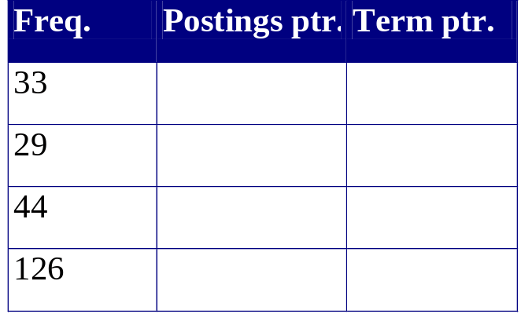
Compressing the term list:
Dictionary-as-a-String
Store dictionary as a (long) string of characters:
  Pointer to next word shows end of current word
  Hope to save up to 60% of dictionary space.
….systilesyzygeticsyzygialsyzygyszaibelyiteszczecinszomo….
Total string length =
400K x 8B = 3.2MB
Pointers resolve 3.2M
positions: log₂3.2M =
22bits = 3bytes

Slide 21
Space for dictionary as a string
4 bytes per term for Freq.
4 bytes per term for pointer to Postings.
3 bytes per term pointer
Avg. 8 bytes per term in term string
400K terms x 19 ⇒ 7.6 MB (against 11.2MB for fixed width)
⎫ Now avg. 11
⎬ bytes/term,
⎭ not 20.

Slide 22
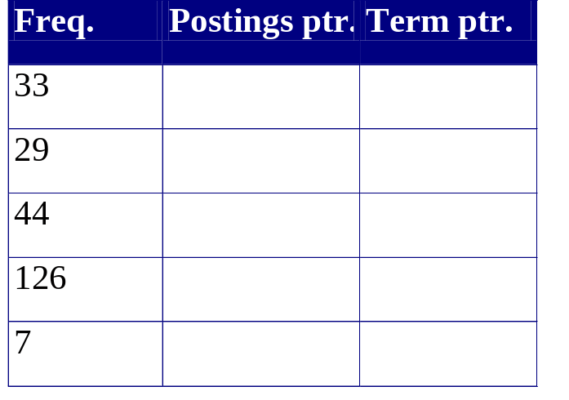
Blocking
Store pointers to every kth term string.
  Example below: k=4.
Need to store term lengths (1 extra byte)
….7systile9syzygetic8syzygial6syzygy11szaibelyite8szczecin9szomo….
⎫ Save 9 bytes
⎬ on 3
⎭ pointers.
Lose 4 bytes on
term lengths.

Slide 23
Net
Where we used 3 bytes/pointer without blocking
  3 x 4 = 12 bytes for k=4 pointers,
now we use 3+4=7 bytes for 4 pointers.
Shaved another ~0.5MB; can save more with larger k.
Why not go with larger k?

Slide 24
Exercise
Estimate the space usage (and savings compared to 7.6 MB) with blocking, for block sizes of k = 4, 8 and 16.

Slide 25
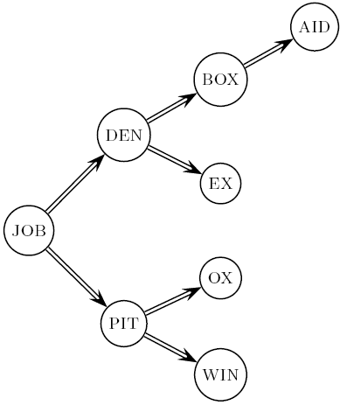
Dictionary search without blocking
Assuming each dictionary term equally likely in query (not really so in practice!), average number of comparisons = (1+2∙2+4∙3+4)/8 ~2.6

Slide 26
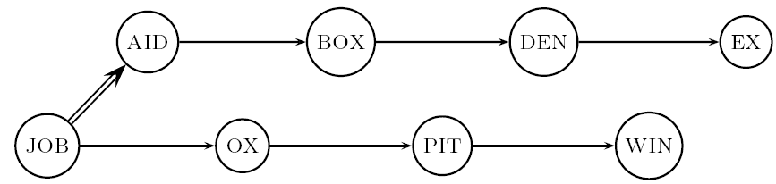
Dictionary search with blocking
Binary search down to 4-term block;
  Then linear search through terms in block.
Blocks of 4 (binary tree), avg. = (1+2∙2+2∙3+2∙4+5)/8 = 3 compares

Slide 27
Exercise
Estimate the impact on search performance (and slowdown compared to k=1) with blocking, for block sizes of k = 4, 8 and 16.

Slide 28
Front coding
Front-coding:
  Sorted words commonly have long common prefix – store differences only
  (for last k-1 in a block of k)
  8automata8automate9automatic10automation
→8automat*a1◊e2◊ic3◊ion
Encodes automat
Extra length
beyond automat.
Begins to resemble general string compression.

Slide 29
RCV1 dictionary compression
Technique | Size in MB
Fixed width | 11.2
String with pointers to every term | 7.6
Blocking k=4 | 7.1
Blocking + front coding | 5.9

Slide 30
POSTINGS COMPRESSION

Slide 31
Postings compression
The postings file is much larger than the dictionary, factor of at least 10.
Key desideratum: store each posting compactly.
A posting for our purposes is a docID.
For Reuters (800,000 documents), we would use 32 bits per docID when using 4-byte integers.
Alternatively, we can use log₂ 800,000 ≈ 20 bits per docID.
Our goal: use a lot less than 20 bits per docID.

Slide 32
Postings: two conflicting forces
A term like arachnocentric occurs in maybe one doc out of a million – we would like to store this posting using log₂ 1M ~ 20 bits.
A term like the occurs in virtually every doc, so 20 bits/posting is too expensive.
  Prefer 0/1 bitmap vector in this case

Slide 33
Postings file entry
We store the list of docs containing a term in increasing order of docID.
  computer: 33,47,154,159,202 …
Consequence: it suffices to store gaps.
  33,14,107,5,43 …
Hope: most gaps can be encoded/stored with far fewer than 20 bits.

Slide 34
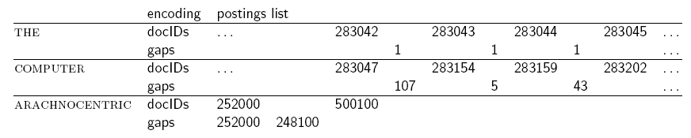
Three postings entries

Slide 35
Variable length encoding
Aim:
  For arachnocentric, we will use ~20 bits/gap entry.
  For the, we will use ~1 bit/gap entry.
If the average gap for a term is G, we want to use ~log₂G bits/gap entry.
Key challenge: encode every integer (gap) with ~ as few bits as needed for that integer.
Variable length codes achieve this by using short codes for small numbers

Slide 36
Variable Byte (VB) codes
For a gap value G, use close to the fewest bytes needed to hold log₂ G bits
Begin with one byte to store G and dedicate 1 bit in it to be a continuation bit c
If G ≤127, binary-encode it in the 7 available bits and set c =1
Else encode G’s lower-order 7 bits and then use additional bytes to encode the higher order bits using the same algorithm
At the end set the continuation bit of the last byte to 1 (c =1) and of the other bytes to 0 (c =0).

Slide 37
Example
docIDs | 824 | 829 | 215406
gaps |  | 5 | 214577
VB code | 00000110 10111000 | 10000101 | 00001101 00001100 10110001
Postings stored as the byte concatenation
000001101011100010000101000011010000110010110001
Key property: VB-encoded postings are
uniquely prefix-decodable.
For a small gap (5), VB
uses a whole byte.

Slide 38
Other variable codes
Instead of bytes, we can also use a different “unit of alignment”: 32 bits (words), 16 bits, 4 bits (nibbles) etc.
Variable byte alignment wastes space if you have many small gaps – nibbles do better in such cases.

Slide 39
Gamma codes
Can compress better with bit-level codes
  The Gamma code is the best known of these.
Represent a gap G as a pair length and offset
offset is G in binary, with the leading bit cut off
  For example 13 → 1101 → 101
length is the length of offset
  For 13 (offset 101), this is 3.
Encode length in unary code: 1110.
Gamma code of 13 is the concatenation of length and offset: 1110101

Slide 40
Gamma code examples
number | length | offset | γ-code
0 |  |  | none
1 | 0 |  | 0
2 | 10 | 0 | 10,0
3 | 10 | 1 | 10,1
4 | 110 | 00 | 110,00
9 | 1110 | 001 | 1110,001
13 | 1110 | 101 | 1110,101
24 | 11110 | 1000 | 11110,1000
511 | 111111110 | 11111111 | 111111110,11111111
1025 | 11111111110 | 0000000001 | 11111111110,0000000001

Slide 41
Gamma code properties
Uniquely prefix-decodable, like VB
All gamma codes have an odd number of bits
G is encoded using 2 ⎣log G⎦ +1 bits
  Almost within a factor of 2 of best possible

Slide 42
Gamma seldom used in practice
Machines have word boundaries – 8, 16, 32 bits
Compressing and manipulating at individual bit-granularity will slow down query processing
Variable byte alignment is potentially more efficient
Regardless of efficiency, variable byte is conceptually simpler at little additional space cost

Slide 43
RCV1 compression
Data structure | Size in MB
dictionary, fixed-width | 11.2
dictionary, term pointers into string | 7.6
with blocking, k = 4 | 7.1
with blocking & front coding | 5.9
collection (text, xml markup etc) | 3,600.0
collection (text) | 960.0
Term-doc incidence matrix | 40,000.0
postings, uncompressed (32-bit words) | 400.0
postings, uncompressed (20 bits) | 250.0
postings, variable byte encoded | 116.0
postings, γ−encoded | 101.0

Slide 44
Index compression summary
We can now create an index for highly efficient Boolean retrieval that is very space efficient
Only 4% of the total size of the collection
Only 10-15% of the total size of the text in the collection
However, we’ve ignored positional information
Hence, space savings are less for indexes used in practice
  But techniques substantially the same.

Slide 45
Resources
IIR 5
MG 3.3, 3.4.
F. Scholer, H.E. Williams and J. Zobel. 2002. Compression of Inverted Indexes For Fast Query Evaluation. Proc. ACM-SIGIR 2002.
V. N. Anh and A. Moffat. 2005. Inverted Index Compression Using Word-Aligned Binary Codes. Information Retrieval 8: 151–166.

