Slide 1
CS276
Information Retrieval and Web Mining
Lecture 6

Slide 2
Recap lecture 5
Collection and vocabulary statistics
  Heaps’ and Zipf’s laws
Dictionary compression for Boolean indexes
  Dictionary string, blocks, front coding
Postings compression
  Gap encoding using prefix-unique codes
  Variable-Byte and Gamma codes

Slide 3
This lecture; Sections 6.2-6.4.3
Scoring documents
Term frequency
Collection statistics
Weighting schemes
Vector space scoring

Slide 4
Ranked retrieval
Thus far, our queries have all been Boolean.
  Documents either match or don’t.
Good for expert users with precise understanding of their needs and the collection.
Also good for applications: Applications can easily consume 1000s of results.
  Not good for the majority of users.
  Most users incapable of writing Boolean queries (or they are, but they think it’s too much work).
Most users don’t want to wade through 1000s of results.
  This is particularly true of web search.

Slide 5
Problem with Boolean search: feast or famine
Boolean queries often result in either too few (=0) or too many (1000s) results.
Query 1: “standard user dlink 650” → 200,000 hits
Query 2: “standard user dlink 650 no card found”: 0 hits
It takes skill to come up with a query that produces a manageable number of hits.
With a ranked list of documents it does not matter how large the retrieved set is.

Slide 6
Scoring as the basis of ranked retrieval
We wish to return in order the documents most likely to be useful to the searcher
How can we rank-order the documents in the collection with respect to a query?
Assign a score – say in [0, 1] – to each document
This score measures how well document and query “match”.

Slide 7
Query-document matching scores
We need a way of assigning a score to a query/document pair
Let’s start with a one-term query
If the query term does not occur in the document: score should be 0
The more frequent the query term in the document, the higher the score (should be)
We will look at a number of alternatives for this.

Slide 8
Take 1: Jaccard coefficient
Recall from Lecture 3: A commonly used measure of overlap of two sets A and B
jaccard(A,B) = |A ∩ B| / |A ∪ B|
jaccard(A,A) = 1
jaccard(A,B) = 0 if A ∩ B = 0
A and B don’t have to be the same size.
Always assigns a number between 0 and 1.

Slide 9
Jaccard coefficient: Scoring example
What is the query-document match score that the Jaccard coefficient computes for each of the two documents below?
Query: ides of march
Document 1: caesar died in march
Document 2: the long march

Slide 10
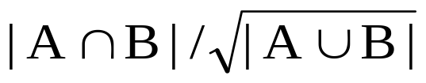
Issues with Jaccard for scoring
It doesn’t consider term frequency (how many times a term occurs in a document)
Rare terms in a collection are more informative than frequent terms. Jaccard doesn’t consider this information
We need a more sophisticated way of normalizing for length
Later in this lecture, we’ll use
. . . instead of |A ∩ B|/|A ∪ B| (Jaccard) for length normalization.

Slide 11

Recall (Lecture 1): Binary term-document incidence matrix
Each document is represented by a binary vector ∈ {0,1}^{|V|}

Slide 12
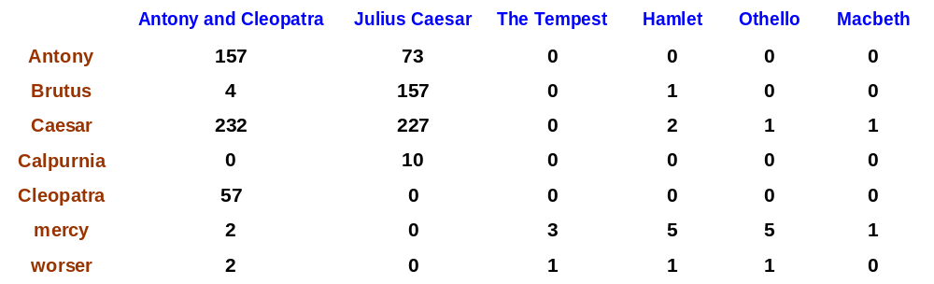
Term-document count matrices
Consider the number of occurrences of a term in a document:
  Each document is a count vector in ℕ^{v}: a column below

Slide 13
Bag of words model
Vector representation doesn’t consider the ordering of words in a document
John is quicker than Mary and Mary is quicker than John have the same vectors
This is called the bag of words model.
In a sense, this is a step back: The positional index was able to distinguish these two documents.
We will look at “recovering” positional information later in this course.
For now: bag of words model

Slide 14
Term frequency tf
The term frequency tf_{t,d} of term t in document d is defined as the number of times that t occurs in d.
We want to use tf when computing query-document match scores. But how?
Raw term frequency is not what we want:
  A document with 10 occurrences of the term is more relevant than a document with one occurrence of the term.
  But not 10 times more relevant.
Relevance does not increase proportionally with term frequency.

Slide 15
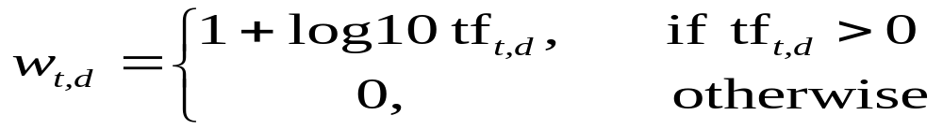

Log-frequency weighting
The log frequency weight of term t in d is
0 → 0, 1 → 1, 2 → 1.3, 10 → 2, 1000 → 4, etc.
Score for a document-query pair: sum over terms t in both q and d:
score
The score is 0 if none of the query terms is present in the document.

Slide 16
Document frequency
Rare terms are more informative than frequent terms
  Recall stop words
Consider a term in the query that is rare in the collection (e.g., arachnocentric)
A document containing this term is very likely to be relevant to the query arachnocentric
→ We want a high weight for rare terms like arachnocentric.

Slide 17
Document frequency, continued
Consider a query term that is frequent in the collection (e.g., high, increase, line)
A document containing such a term is more likely to be relevant than a document that doesn’t, but it’s not a sure indicator of relevance.
→ For frequent terms, we want positive weights for words like high, increase, and line, but lower weights than for rare terms.
We will use document frequency (df) to capture this in the score.
df (≤ N) is the number of documents that contain the term

Slide 18
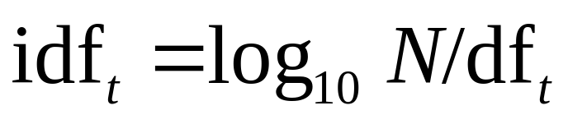
idf weight
df_{t} is the document frequency of t: the number of documents that contain t
  df is a measure of the informativeness of t
We define the idf (inverse document frequency) of t by
  We use log N/df_{t} instead of N/df_{t} to “dampen” the effect of idf.
Will turn out the base of the log is immaterial.

Slide 19
idf example, suppose N= 1 million
term | df_{t} | idf_{t}
calpurnia | 1 | 6
animal | 100 | 4
sunday | 1,000 | 3
fly | 10,000 | 2
under | 100,000 | 1
the | 1,000,000 | 0
There is one idf value for each term t in a collection.

Slide 20
Collection vs. Document frequency
The collection frequency of t is the number of occurrences of t in the collection, counting multiple occurrences.
Example:
Which word is a better search term (and should get a higher weight)?
Word | Collection frequency | Document frequency
insurance | 10440 | 3997
try | 10422 | 8760

Slide 21
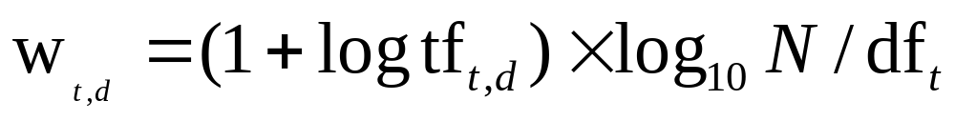
tf-idf weighting
The tf-idf weight of a term is the product of its tf weight and its idf weight.
Best known weighting scheme in information retrieval
Note: the “-” in tf-idf is a hyphen, not a minus sign!
Alternative names: tf.idf, tf x idf
Increases with the number of occurrences within a document
Increases with the rarity of the term in the collection

Slide 22

Binary → count → weight matrix
Each document is now represented by a real-valued vector of tf-idf weights ∈ R^{|V|}

Slide 23
Documents as vectors
So we have a |V|-dimensional vector space
Terms are axes of the space
Documents are points or vectors in this space
Very high-dimensional: hundreds of millions of dimensions when you apply this to a web search engine
This is a very sparse vector - most entries are zero.

Slide 24
Queries as vectors
Key idea 1: Do the same for queries: represent them as vectors in the space
Key idea 2: Rank documents according to their proximity to the query in this space
proximity = similarity of vectors
proximity ≈ inverse of distance
Recall: We do this because we want to get away from the you’re-either-in-or-out Boolean model.
Instead: rank more relevant documents higher than less relevant documents

Slide 25
Formalizing vector space proximity
First cut: distance between two points
  ( = distance between the end points of the two vectors)
Euclidean distance?
Euclidean distance is a bad idea . . .
. . . because Euclidean distance is large for vectors of different lengths.

Slide 26

Why distance is a bad idea
The Euclidean distance between q
and d₂ is large even though the
distribution of terms in the query q and the distribution of
terms in the document d₂ are
very similar.

Slide 27
Use angle instead of distance
Thought experiment: take a document d and append it to itself. Call this document d′.
“Semantically” d and d′ have the same content
The Euclidean distance between the two documents can be quite large
The angle between the two documents is 0, corresponding to maximal similarity.
Key idea: Rank documents according to angle with query.

Slide 28
From angles to cosines
The following two notions are equivalent.
  Rank documents in decreasing order of the angle between query and document
  Rank documents in increasing order of cosine(query,document)
Cosine is a monotonically decreasing function for the interval [0º, 180º]

Slide 29
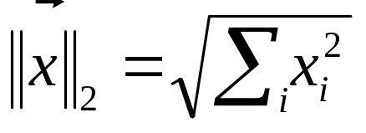
Length normalization
A vector can be (length-) normalized by dividing each of its components by its length – for this we use the L₂ norm:
Dividing a vector by its L₂ norm makes it a unit (length) vector
Effect on the two documents d and d′ (d appended to itself) from earlier slide: they have identical vectors after length-normalization.

Slide 30

cosine(query,document)
Dot product
Unit vectors
q_{i} is the tf-idf weight of term i in the query
d_{i} is the tf-idf weight of term i in the document
cos(q,d) is the cosine similarity of q and d … or,
equivalently, the cosine of the angle between q and d.

Slide 31
Cosine similarity amongst 3 documents
How similar are
the novels
SaS: Sense and
Sensibility
PaP: Pride and
Prejudice, and
WH: Wuthering
Heights?
term | SaS | PaP | WH
affection | 115 | 58 | 20
jealous | 10 | 7 | 11
gossip | 2 | 0 | 6
wuthering | 0 | 0 | 38
Term frequencies (counts)

Slide 32
3 documents example contd.
Log frequency weighting
After normalization
term | SaS | PaP | WH
affection | 3.06 | 2.76 | 2.30
jealous | 2.00 | 1.85 | 2.04
gossip | 1.30 | 0 | 1.78
wuthering | 0 | 0 | 2.58
term | SaS | PaP | WH
affection | 0.789 | 0.832 | 0.524
jealous | 0.515 | 0.555 | 0.465
gossip | 0.335 | 0 | 0.405
wuthering | 0 | 0 | 0.588
cos(SaS,PaP) ≈
0.789 ∗ 0.832 + 0.515 ∗ 0.555 + 0.335 ∗ 0.0 + 0.0 ∗ 0.0
≈ 0.94
cos(SaS,WH) ≈ 0.79
cos(PaP,WH) ≈ 0.69
Why do we have cos(SaS,PaP) > cos(SAS,WH)?

Slide 33

Computing cosine scores

Slide 34

tf-idf weighting has many variants
Columns headed ‘n’ are acronyms for weight schemes.
Why is the base of the log in idf immaterial?

Slide 35
Weighting may differ in queries vs documents
Many search engines allow for different weightings for queries vs documents
To denote the combination in use in an engine, we use the notation qqq.ddd with the acronyms from the previous table
Example: ltn.ltc means:
Query: logarithmic tf (l in leftmost column), idf (t in second column), no normalization …
Document logarithmic tf, no idf and cosine normalization
Is this a bad idea?

Slide 36
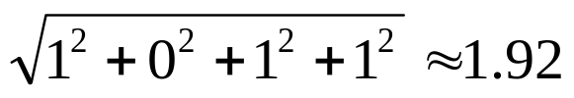
tf-idf example: ltn.lnc
Document: car insurance auto insurance
Query: best car insurance
Term | Query |  |  |  |  | Document |  |  |  | Prod
 | tf-raw | tf-wt | df | idf | wt | tf-raw | tf-wt | wt | n’lized
auto | 0 | 0 | 5000 | 2.3 | 0 | 1 | 1 | 1 | 0.52 | 0
best | 1 | 1 | 50000 | 1.3 | 1.3 | 0 | 0 | 0 | 0 | 0
car | 1 | 1 | 10000 | 2.0 | 2.0 | 1 | 1 | 1 | 0.52 | 1.04
insurance | 1 | 1 | 1000 | 3.0 | 3.0 | 2 | 1.3 | 0.68 | 1.3 | 2.04
Exercise: what is N, the number of docs?
Doc length =
Score = 0+0+1.04+2.04 = 3.08

Slide 37
Summary – vector space ranking
Represent the query as a weighted tf-idf vector
Represent each document as a weighted tf-idf vector
Compute the cosine similarity score for the query vector and each document vector
Rank documents with respect to the query by score
Return the top K (e.g., K = 10) to the user

Slide 38
Resources
IIR 6.2 – 6.4.3

