Slide 1
Introduction to
Information Retrieval and Web Search
Lecture 8:
Evaluation and Result Summaries

Slide 2
This lecture
Results summaries:
  Making our good results usable to a user
How do we know if our results are any good?
  Evaluating a search engine
    Benchmarks
    Precision and recall

Slide 3
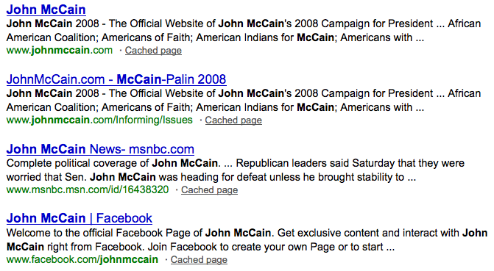
Result Summaries
Having ranked the documents matching a query, we wish to present a results list
Most commonly, a list of the document titles plus a short summary, aka “10 blue links”

Slide 4
Summaries
The title is typically automatically extracted from document metadata. What about the summaries?
  This description is crucial.
  User can identify good/relevant hits based on description.
Two basic kinds:
  Static
  Dynamic
A static summary of a document is always the same, regardless of the query that hit the doc
A dynamic summary is a query-dependent attempt to explain why the document was retrieved for the query at hand

Slide 5
Static summaries
In typical systems, the static summary is a subset of the document
Simplest heuristic: the first 50 (or so – this can be varied) words of the document
  Summary cached at indexing time
More sophisticated: extract from each document a set of “key” sentences
  Simple NLP heuristics to score each sentence
  Summary is made up of top-scoring sentences.
Most sophisticated: NLP used to synthesize a summary
  Seldom used in IR; cf. text summarization work

Slide 6




Dynamic summaries
Present one or more “windows” within the document that contain several of the query terms
  “KWIC” snippets: Keyword in Context presentation
Generated in conjunction with scoring
  If query found as a phrase, all or some occurrences of the phrase in the doc
  If not, document windows that contain multiple query terms
The summary itself gives the entire content of the window – all terms, not only the query terms – how?

Slide 7
Generating dynamic summaries
If we have only a positional index, we cannot (easily) reconstruct context window surrounding hits
If we cache the documents at index time, can find windows in it, cueing from hits found in the positional index
  E.g., positional index says “the query is a phrase in position 4378” so we go to this position in the cached document and stream out the content
Most often, cache only a fixed-size prefix of the doc
  Note: Cached copy can be outdated

Slide 8
Dynamic summaries
Producing good dynamic summaries is a tricky optimization problem
  The real estate for the summary is normally small and fixed
  Want short item, so show as many KWIC matches as possible, and perhaps other things like title
  Want snippets to be long enough to be useful
  Want linguistically well-formed snippets: users prefer snippets that contain complete phrases
  Want snippets maximally informative about doc
But users really like snippets, even if they complicate IR system design

Slide 9
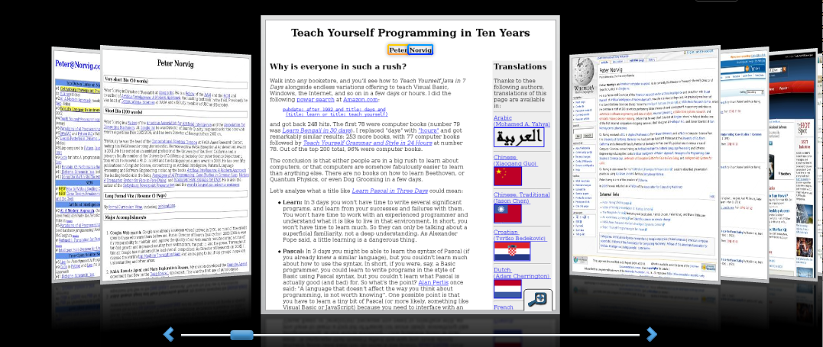
Alternative results presentations?
An active area of HCI research
An alternative: http://www.searchme.com / copies the idea of Apple’s Cover Flow for search results
Notes:
For the moment, the search engine market has really coalesced around one dominant style (consistency has strong benefits – Jakob Nielsen.

Slide 10
Evaluating search engines

Slide 11
Measures for a search engine
How fast does it index
  Number of documents/hour
  (Average document size)
How fast does it search
  Latency as a function of index size
Expressiveness of query language
  Ability to express complex information needs
  Speed on complex queries
Uncluttered UI
Is it free?

Slide 12
Measures for a search engine
All of the preceding criteria are measurable: we can quantify speed/size; we can make expressiveness precise
The key measure: user happiness
  What is this?
  Speed of response/size of index are factors
  But blindingly fast, useless answers won’t make a user happy
Need a way of quantifying user happiness

Slide 13
Measuring user happiness
Issue: who is the user we are trying to make happy?
  Depends on the setting
Web engine: user finds what they want and return to the engine
  Can measure rate of return users
eCommerce site: user finds what they want and make a purchase
  Is it the end-user, or the eCommerce site, whose happiness we measure?
  Measure time to purchase, or fraction of searchers who become buyers?

Slide 14
Measuring user happiness
Enterprise (company/govt/academic): Care about “user productivity”
  How much time do my users save when looking for information?
  Many other criteria having to do with breadth of access, secure access, etc.

Slide 15
Happiness: elusive to measure
Most common proxy: relevance of search results
But how do you measure relevance?
We will detail a methodology here, then examine its issues
Relevant measurement requires 3 elements:
  A benchmark document collection
  A benchmark suite of queries
  A usually binary assessment of either Relevant or Nonrelevant for each query and each document
    Some work on more-than-binary, but not the standard

Slide 16
Evaluating an IR system
Note: the information need is translated into a query
Relevance is assessed relative to the information need not the query
E.g., Information need: I'm looking for information on whether drinking red wine is more effective at reducing your risk of heart attacks than white wine.
Query: wine red white heart attack effective
You evaluate whether the doc addresses the information need, not whether it has these words

Slide 17
Standard relevance benchmarks
TREC - National Institute of Standards and Technology (NIST) has run a large IR test bed for many years
Reuters and other benchmark doc collections used
“Retrieval tasks” specified
  sometimes as queries
Human experts mark, for each query and for each doc, Relevant or Nonrelevant
  or at least for subset of docs that some system returned for that query

Slide 18
Unranked retrieval evaluation:
Precision and Recall
Precision: fraction of retrieved docs that are relevant = P(relevant|retrieved)
Recall: fraction of relevant docs that are retrieved = P(retrieved|relevant)
Precision P = tp/(tp + fp)
Recall R = tp/(tp + fn)
 | Relevant | Nonrelevant
Retrieved | tp | fp
Not Retrieved | fn | tn

Slide 19
Should we instead use the accuracy measure for evaluation?
Given a query, an engine classifies each doc as “Relevant” or “Nonrelevant”
The accuracy of an engine: the fraction of these classifications that are correct
Accuracy is a commonly used evaluation measure in machine learning classification work
Why is this not a very useful evaluation measure in IR?

Slide 20
Why not just use accuracy?
How to build a 99.9999% accurate search engine on a low budget….
People doing information retrieval want to find something and have a certain tolerance for junk.
Snoogle.com
Search for:
0 matching results found.

Slide 21
Precision/Recall
You can get high recall (but low precision) by retrieving all docs for all queries!
Recall is a non-decreasing function of the number of docs retrieved
In a good system, precision decreases as either the number of docs retrieved or recall increases
  This is not a theorem, but a result with strong empirical confirmation

Slide 22
Difficulties in using precision/recall
Should average over large document collection/query ensembles
Need human relevance assessments
  People aren’t reliable assessors
Assessments have to be binary
  Nuanced assessments?
Heavily skewed by collection/authorship
  Results may not translate from one domain to another

Slide 23
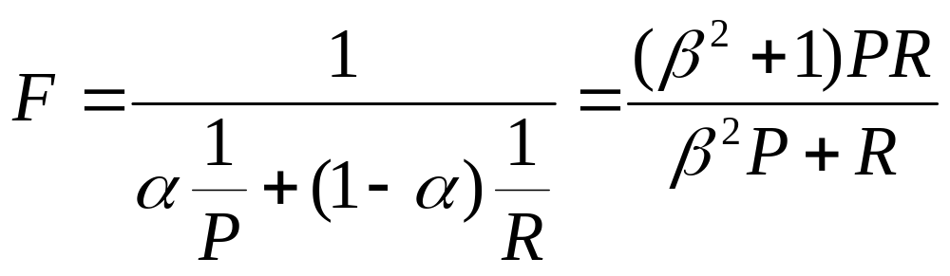
A combined measure: F
Combined measure that assesses precision/recall tradeoff is F measure (weighted harmonic mean):
People usually use balanced F₁ measure
  i.e., with β = 1 or α = ½
Harmonic mean is a conservative average
  See CJ van Rijsbergen, Information Retrieval

Slide 24
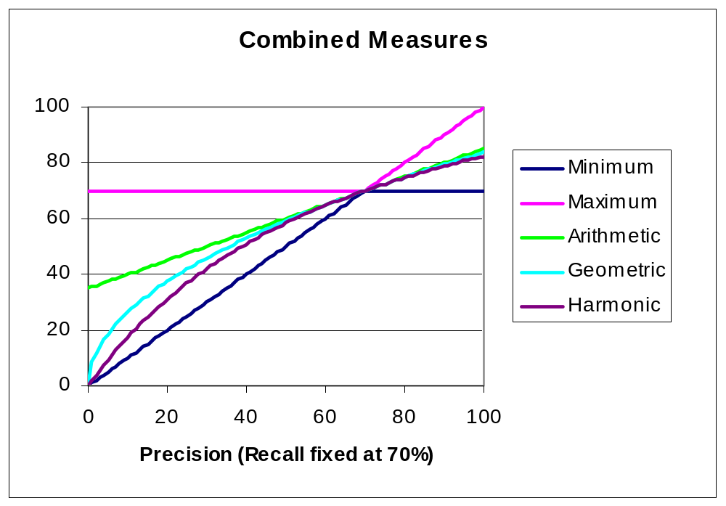
F₁ and other averages

Slide 25
Evaluating ranked results
Evaluation of ranked results:
  The system can return any number of results
  By taking various numbers of the top returned documents (levels of recall), the evaluator can produce a precision-recall curve

Slide 26
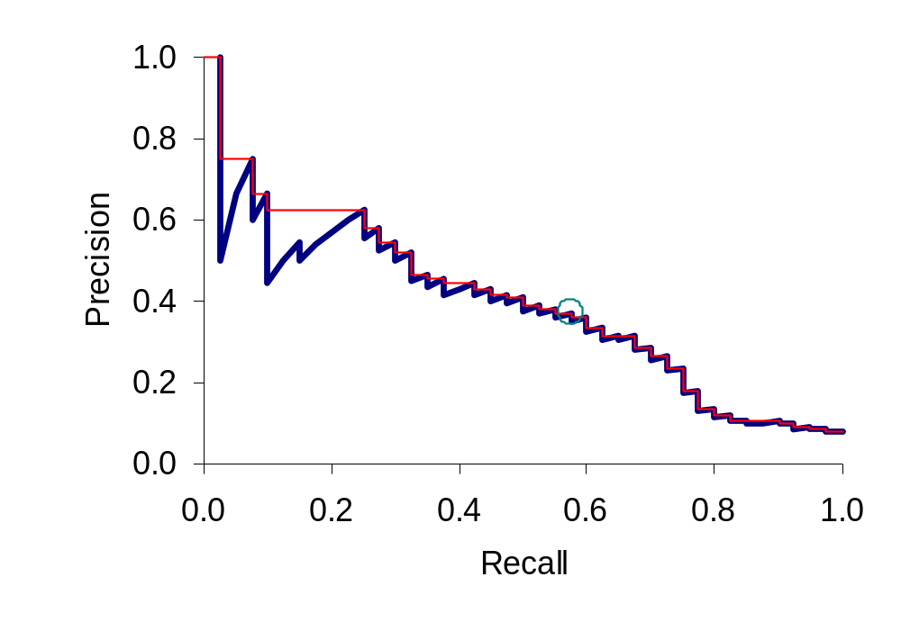
A precision-recall curve

Slide 27
Averaging over queries
A precision-recall graph for one query isn’t a very sensible thing to look at
You need to average performance over a whole bunch of queries.
But there’s a technical issue:
  Precision-recall calculations place some points on the graph
  How do you determine a value (interpolate) between the points?

Slide 28
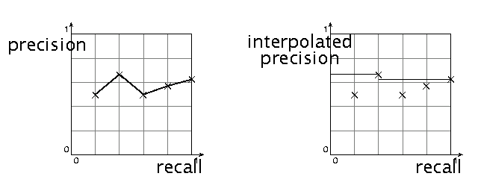
Interpolated precision
Idea: If locally precision increases with increasing recall, then you should get to count that…
So you max of precisions to right of value

Slide 29
Evaluation
Graphs are good, but people want summary measures!
  Precision at fixed retrieval level
    Precision-at-k: Precision of top k results
    Perhaps appropriate for most of web search: all people want are good matches on the first one or two results pages
    But: averages badly and has an arbitrary parameter of k
  11-point interpolated average precision
    The standard measure in the early TREC competitions: you take the precision at 11 levels of recall varying from 0 to 1 by tenths of the documents, using interpolation (the value for 0 is always interpolated!), and average them
    Evaluates performance at all recall levels

Slide 30
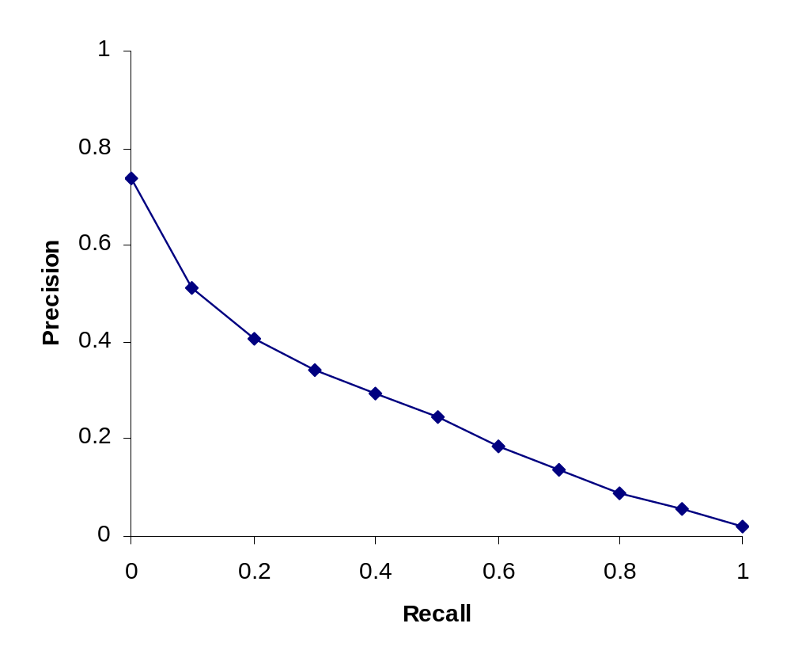
Typical (good) 11 point precisions
SabIR/Cornell 8A1 11pt precision from TREC 8 (1999)

Slide 31
Yet more evaluation measures…
Mean average precision (MAP)
  Average of the precision value obtained for the top k documents, each time a relevant doc is retrieved
  Avoids interpolation, use of fixed recall levels
  MAP for query collection is arithmetic ave.
    Macro-averaging: each query counts equally
R-precision
  If have known (though perhaps incomplete) set of relevant documents of size Rel, then calculate precision of top Rel docs returned
  Perfect system could score 1.0.

Slide 32
Variance
For a test collection, it is usual that a system does crummily on some information needs (e.g., MAP = 0.1) and excellently on others (e.g., MAP = 0.7)
Indeed, it is usually the case that the variance in performance of the same system across queries is much greater than the variance of different systems on the same query.
That is, there are easy information needs and hard ones!

Slide 33
Creating Test Collections for IR Evaluation

Slide 34
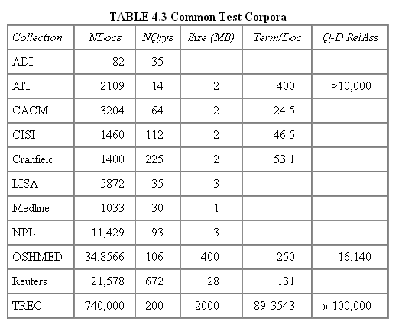
Test Collections

Slide 35
From document collections to test collections
Still need
  Test queries
  Relevance assessments
Test queries
  Must be germane to docs available
  Best designed by domain experts
  Random query terms generally not a good idea
Relevance assessments
  Human judges, time-consuming
  Are human panels perfect?

Slide 36
Unit of Evaluation
We can compute precision, recall, F, and ROC curve for different units.
Possible units
  Documents (most common)
  Facts (used in some TREC evaluations)
  Entities (e.g., car companies)
May produce different results. Why?

Slide 37
Kappa measure for inter-judge (dis)agreement
Kappa measure
  Agreement measure among judges
  Designed for categorical judgments
  Corrects for chance agreement
Kappa = [ P(A) – P(E) ] / [ 1 – P(E) ]
P(A) – proportion of time judges agree
P(E) – what agreement would be by chance
Kappa = 0 for chance agreement, 1 for total agreement.

Slide 38
Kappa Measure: Example
P(A)? P(E)?
Number of docs | Judge 1 | Judge 2
300 | Relevant | Relevant
70 | Nonrelevant | Nonrelevant
20 | Relevant | Nonrelevant
10 | Nonrelevant | relevant

Slide 39
Kappa Example
P(A) = 370/400 = 0.925
P(nonrelevant) = (10+20+70+70)/800 = 0.2125
P(relevant) = (10+20+300+300)/800 = 0.7878
P(E) = 0.2125^2 + 0.7878^2 = 0.665
Kappa = (0.925 – 0.665)/(1-0.665) = 0.776
Kappa > 0.8 = good agreement
0.67 < Kappa < 0.8 -> “tentative conclusions” (Carletta ’96)
Depends on purpose of study
For >2 judges: average pairwise kappas

Slide 40
TREC
TREC Ad Hoc task from first 8 TRECs is standard IR task
  50 detailed information needs a year
  Human evaluation of pooled results returned
  More recently other related things: Web track, HARD
A TREC query (TREC 5)
  <top>
  <num> Number: 225
  <desc> Description:
  What is the main function of the Federal Emergency Management Agency (FEMA) and the funding level provided to meet emergencies? Also, what resources are available to FEMA such as people, equipment, facilities?
  </top>

Slide 41
Standard relevance benchmarks: Others
GOV2
  Another TREC/NIST collection
  25 million web pages
  Largest collection that is easily available
  But still 3 orders of magnitude smaller than what Google/Yahoo/MSN index
NTCIR
  East Asian language and cross-language information retrieval
Cross Language Evaluation Forum (CLEF)
  This evaluation series has concentrated on European languages and cross-language information retrieval.
Many others

Slide 42
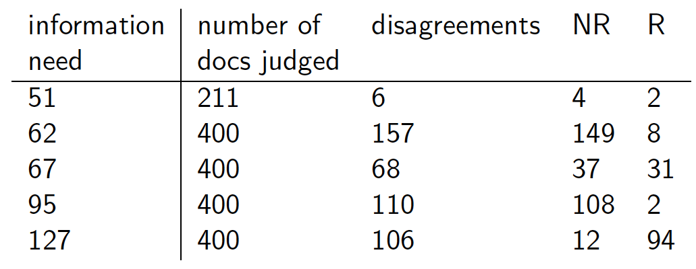
Interjudge Agreement: TREC 3
Notes:
Topic is TREC topic
Judged is number of documents that human assessors judged
Diff is the number that they disagreed on.
NR and R are whether those were eventually classified as relevant or nonrelevant.

Slide 43
Impact of Inter-judge Agreement
Impact on absolute performance measure can be significant (0.32 vs 0.39)
Little impact on ranking of different systems or relative performance
Suppose we want to know if algorithm A is better than algorithm B
A standard information retrieval experiment will give us a reliable answer to this question.

Slide 44
Critique of pure relevance
Relevance vs Marginal Relevance
  A document can be redundant even if it is highly relevant
  Duplicates
  The same information from different sources
  Marginal relevance is a better measure of utility for the user.
Using facts/entities as evaluation units more directly measures true relevance.
But harder to create evaluation set
See Carbonell reference

Slide 45
Can we avoid human judgment?
No
Makes experimental work hard
  Especially on a large scale
In some very specific settings, can use proxies
  E.g.: for approximate vector space retrieval, we can compare the cosine distance closeness of the closest docs to those found by an approximate retrieval algorithm
But once we have test collections, we can reuse them (so long as we don’t overtrain too badly)

Slide 46
Evaluation at large search engines
Search engines have test collections of queries and hand-ranked results
Recall is difficult to measure on the web
Search engines often use precision at top k, e.g., k = 10
. . . or measures that reward you more for getting rank 1 right than for getting rank 10 right.
  NDCG (Normalized Cumulative Discounted Gain)
Search engines also use non-relevance-based measures.
  Clickthrough on first result
    Not very reliable if you look at a single clickthrough … but pretty reliable in the aggregate.
  Studies of user behavior in the lab
  A/B testing
Notes:
Not very reliable if you look at a single clickthrough (you may
realize after clicking that the summary was misleading and the
document is nonrelevant) . . .

Slide 47
A/B testing
Purpose: Test a single innovation
Prerequisite: You have a large search engine up and running.
Have most users use old system
Divert a small proportion of traffic (e.g., 1%) to the new system that includes the innovation
Evaluate with an “automatic” measure like clickthrough on first result
Now we can directly see if the innovation does improve user happiness.
Probably the evaluation methodology that large search engines trust most
In principle less powerful than doing a multivariate regression analysis, but easier to understand

Slide 48
Resources for this lecture
IIR 8
MIR Chapter 3
MG 4.5
Carbonell and Goldstein 1998. The use of MMR, diversity-based reranking for reordering documents and producing summaries. SIGIR 21.

