Slide 1
Consumer A
Broker
Producer
Consumer B
Message
Queue
Consumer C

Slide 2
CRM Service
Customer Service
Delivery Service
Mail Service
Orchestration

Slide 3
CRM Service
Broker
Customer Service
Delivery Service
Event
Customer Queue
Mail Service
Choreography

Slide 4




Slide 5
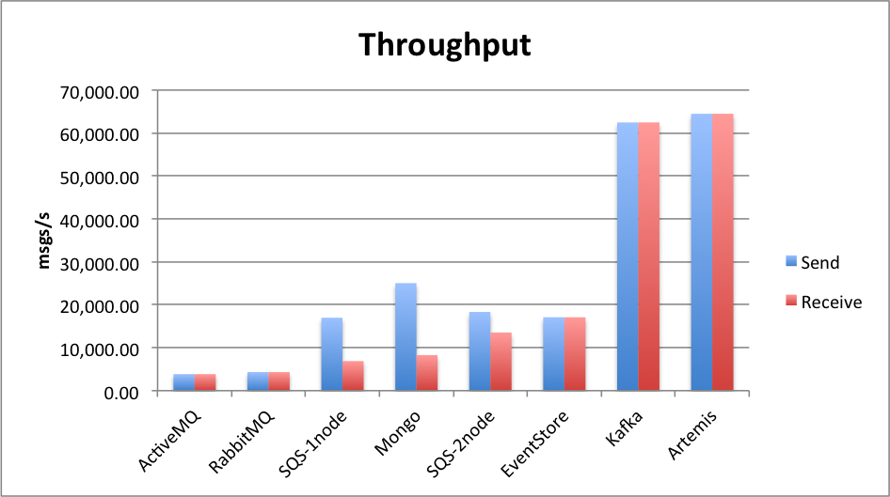

Slide 6
Node A
Node B
Node C
my-cluster-1
my-cluster-2

Slide 7
Node A(master)
journal A
Node B(slave)
journal B
sync

Slide 8
Node A(master)
Node B(slave)
Shared Store
for journal

