Slide 1

STUDENT TEACHER PROFLIE
SOFTWARE DEVELOPMENT 2
THITIPHAT PREEDEDILOK
SOPHOMORE
COMPUTER ENGINEERING
CHITRALADA TECHNOLOGY INSTITUTE
6410301024

Slide 2


OUR PROJECT GOAL
FAST AND EASY
GRADE SIMULATION

Slide 3



Main user
CHITRALADA TECHNOLOGY INSTITUTE
CREW MEMBER
STUDENT
TEACHER
STAFF

Slide 4
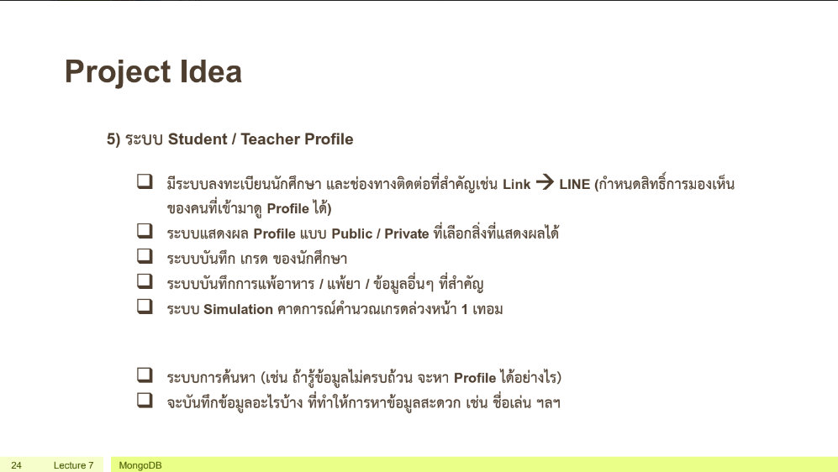

Slide 5
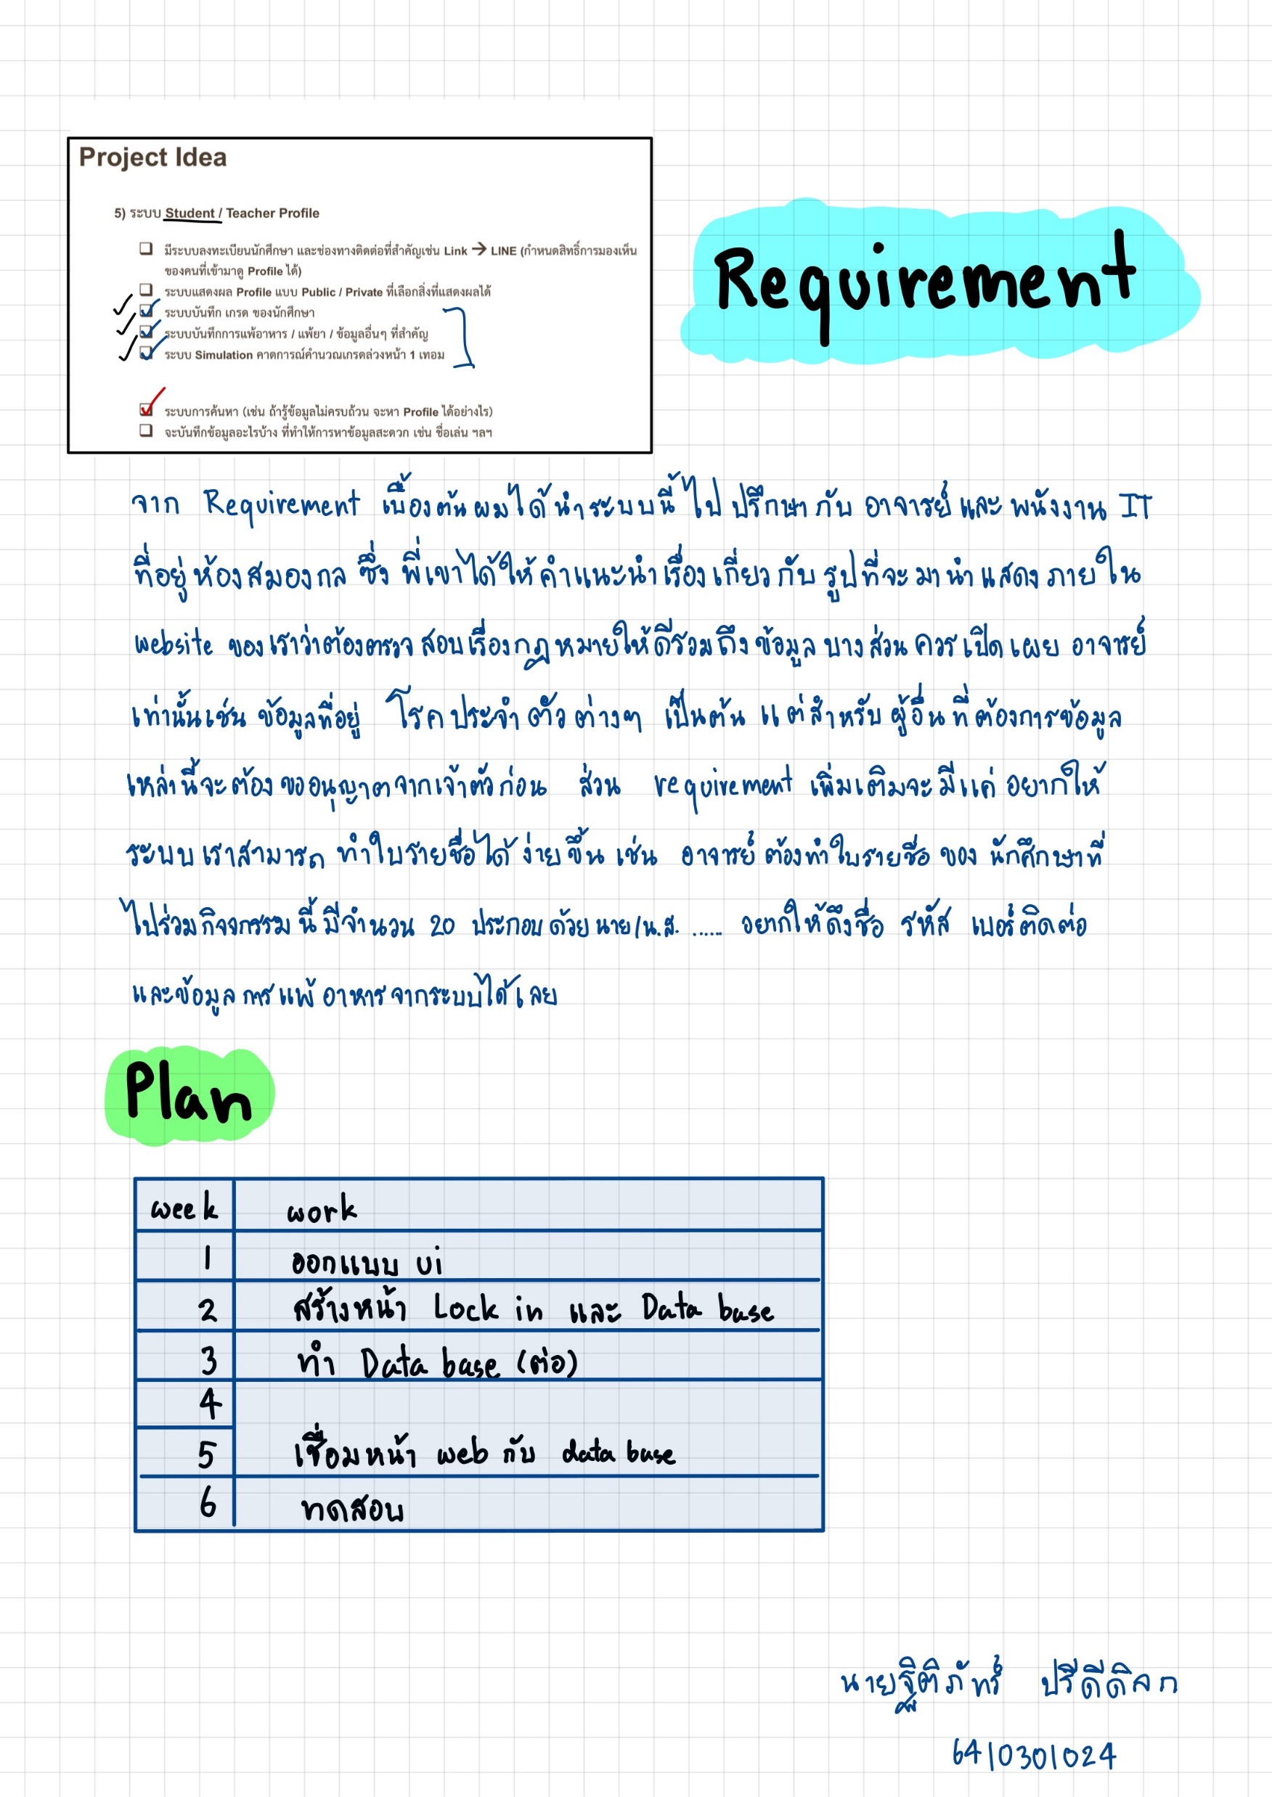
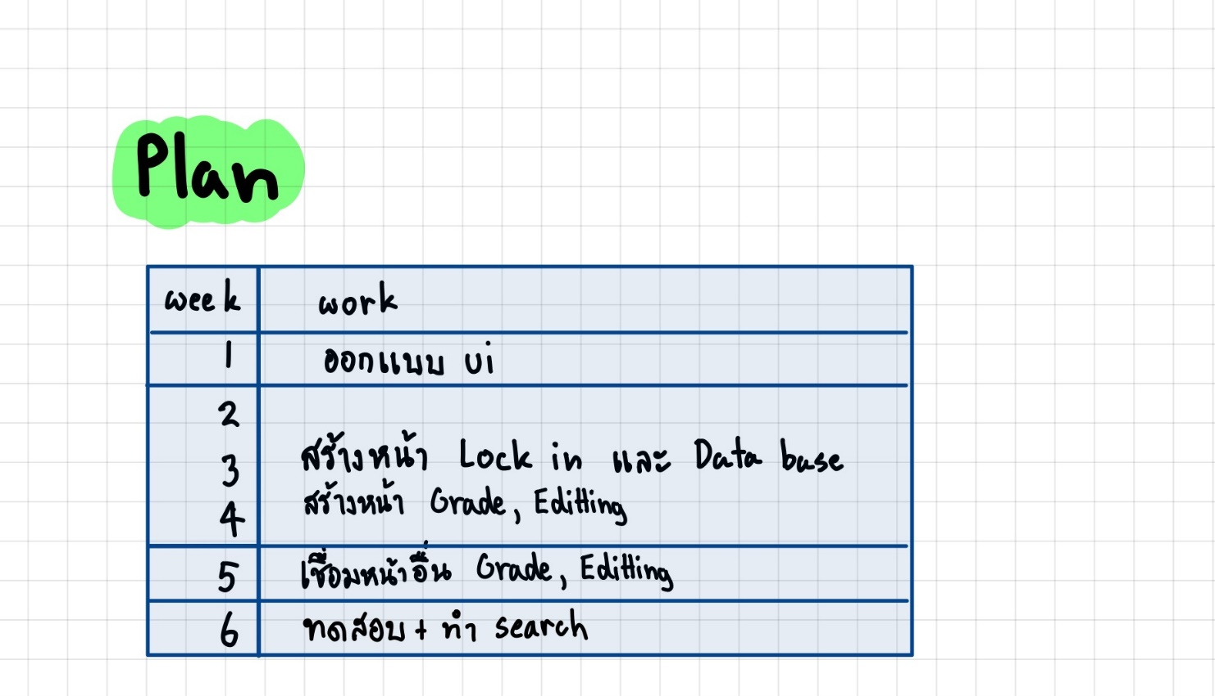
REQUIREMENT
TEACHER AND STAFF
LAW
IMAGE
PERSONAL DATA
CREATE NEW SHEET
NAME
PERSONAL DATA

Slide 6
SYSTEM
MAIN PAGE
STUDENT
PAGE
TEACHER & STAFF
PAGE
Profile page
Search page
Edit data
Grade
Show grade
Grade simulator
Profile page
Search page
Edit data

Slide 7
DEMO
GitHub link : https://github.com/emag51/softdevweb

Slide 8
Finish
Not complete
Only frontend

Slide 9
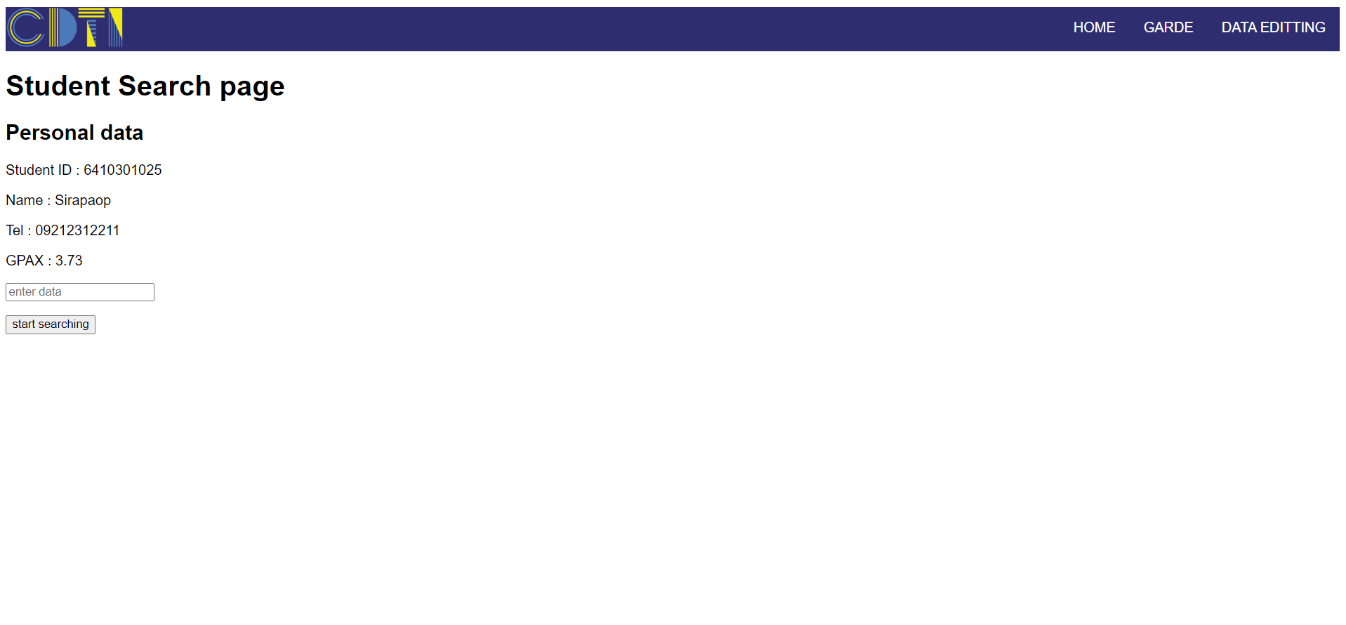
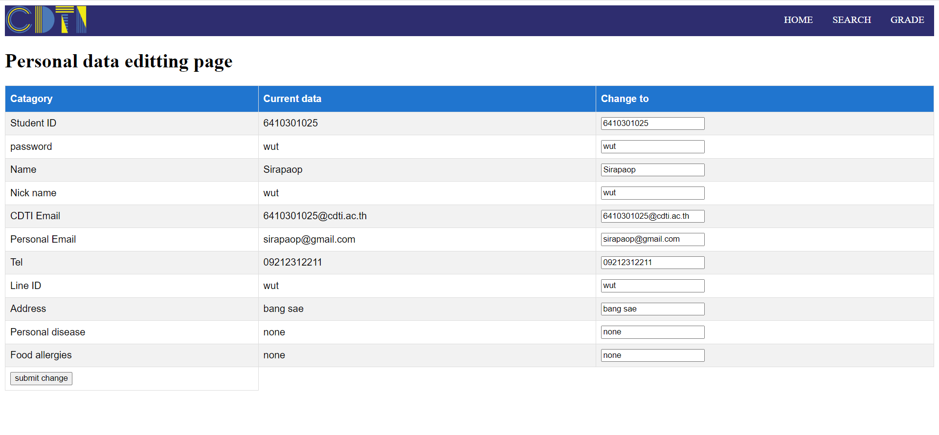
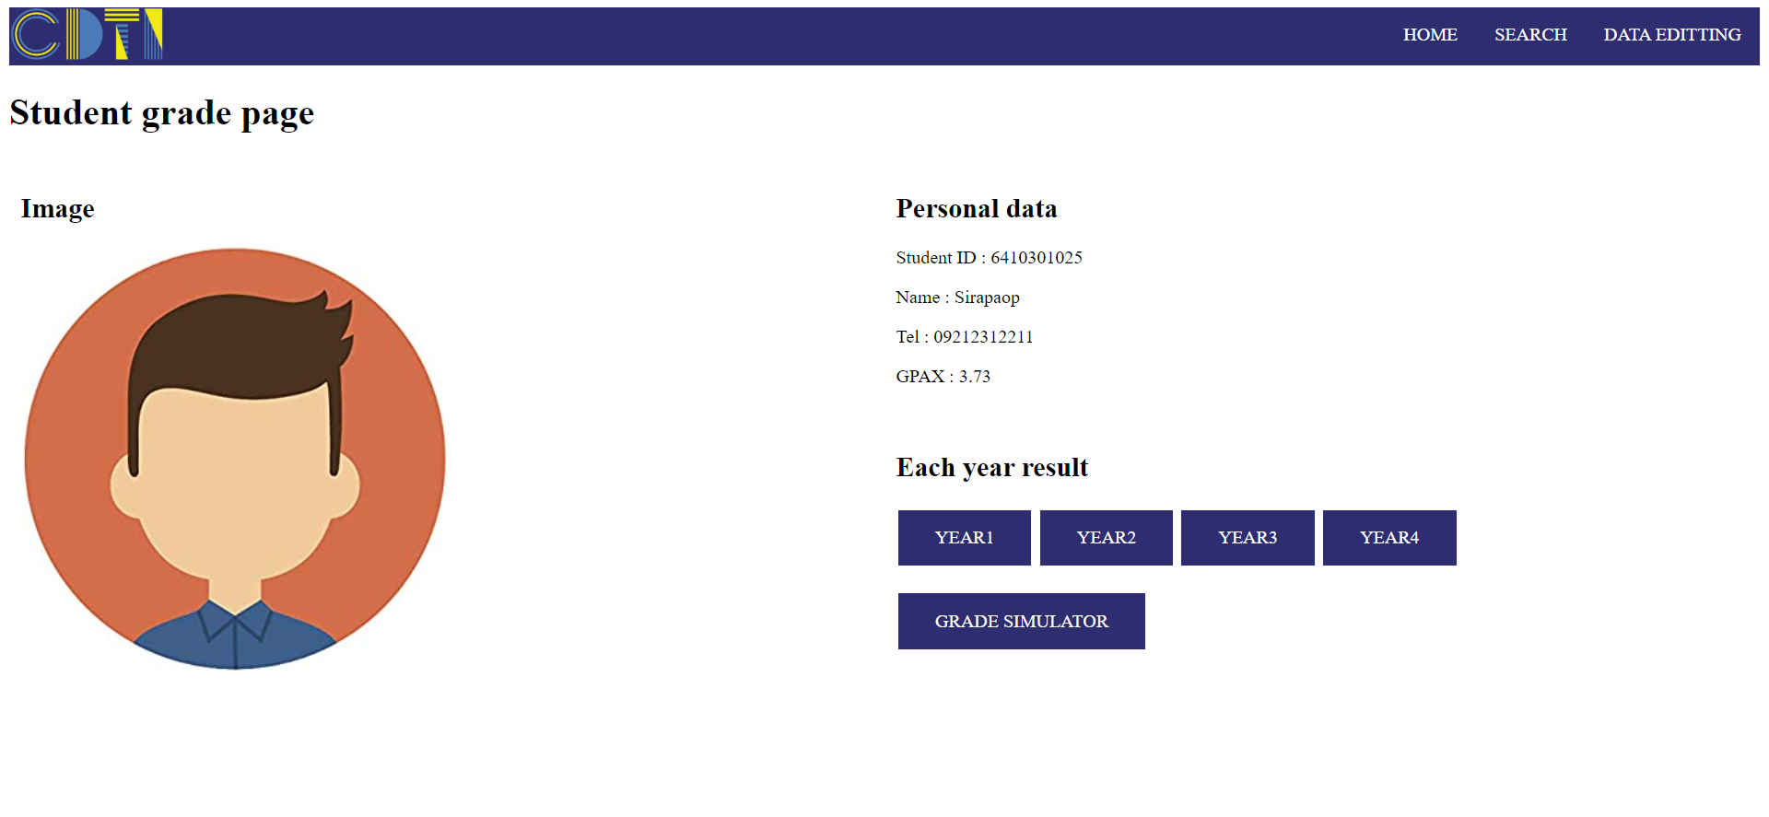
FUTURE
COMPLETE THE PROJECT
Complete more detail
Search function
Quick search
Name search
Wrong permission
Admin account
START THE REQUIREMENT
Finish image
Create sheet function

Slide 10
Q&A session

Slide 11

THANK YOU FOR YOUR ATTENTION

