Slide 1
EduJobBridge: Bridging the Gap Between University Skills and Industry Demands
Your Name • Project Title • Date
https://github.com/emagraceni/EduJobBridge.git

Slide 2
Problem Statement
• Students often graduate without the top skills employers ask for.
• Universities lack data to evaluate how job-ready their programs are.
→ We asked: Does this academic program really prepare students for the job market?

Slide 3
Project Goal
• Compare academic program skills vs. job market skills.
• Calculate a match score to help:
– Students pick better programs.
– Universities improve curricula.
– Employers find better-prepared talent.

Slide 4
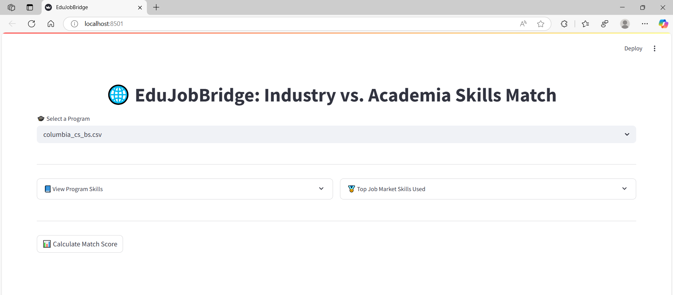
How It Works – Visual Demo
1. Select a program.
2. View academic skills vs. top job market skills.
3. Press 'Calculate Match Score' to see compatibility.

Slide 5
Dataset Overview
• Job Market Skills: ~180 unique skills from 50+ job postings.
• University Programs: CS and SE programs from Columbia, NYIT, Pace, etc.
• 10% of job market data was simulated for testing purposes.

Slide 6
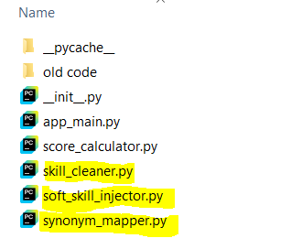
Data Cleaning & Preprocessing
✔️ Cleaning: Skills are lowercased and stripped of punctuation/extra spaces to ensure consistent comparison.
✔️ Synonym Mapping: Different terms (e.g., 'js' → 'javascript') are unified using a dictionary.
✔️ Fuzzy Matching: Skills with slight spelling differences are matched using string similarity. (e.g., ‘Python Programming ‘ →’Python)
✔️ Some Soft Skills Were Injected: Universities do not strictly state some skills that job postings do (e.g., ‘Communication’)

Slide 7

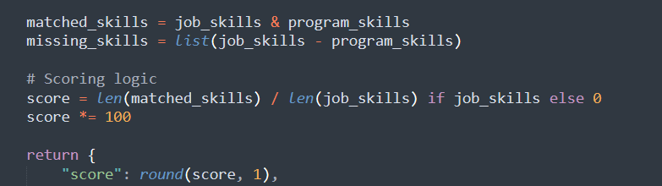
Scoring Logic – Simple Version
• Based only on skill overlap.
• No weighting or normalization.
→ Easy to compute, but lacks realism.
→ Resulted in low scores for most programs.

Slide 8
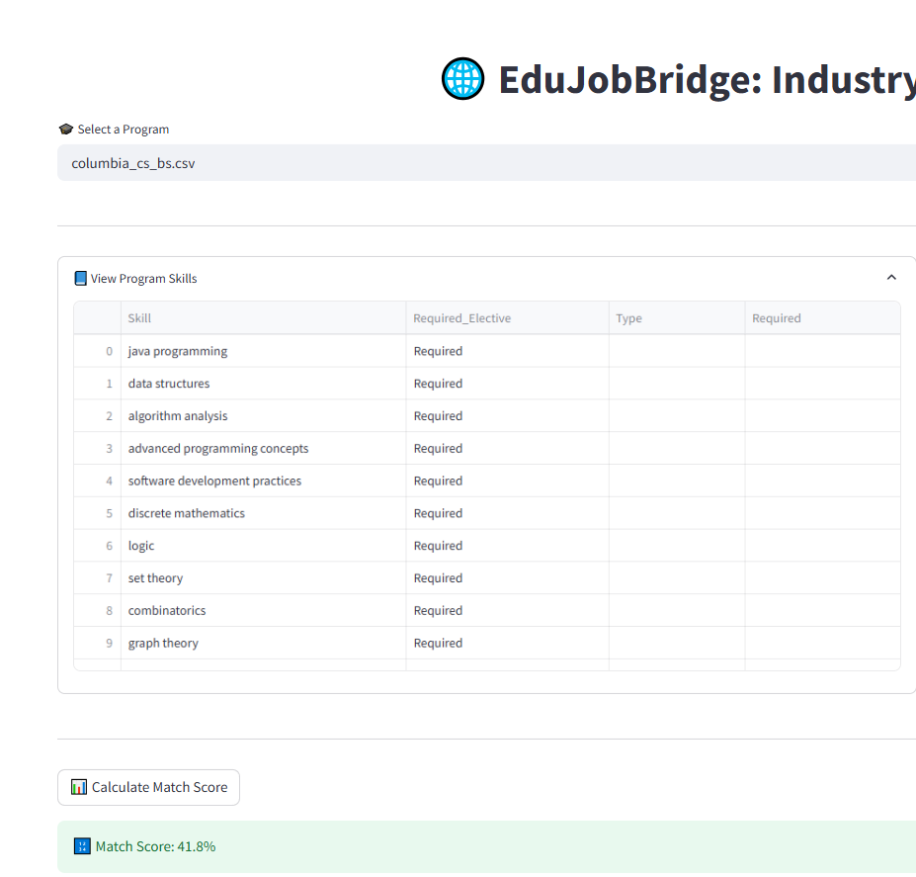
Simple Logic Results

Slide 9
Improved Scoring Logic
• Normalize skill frequency from job data.
• Weight required skills more than electives.
• Scale by demand and cap to 100%.
→ More realistic program scores.

Slide 10
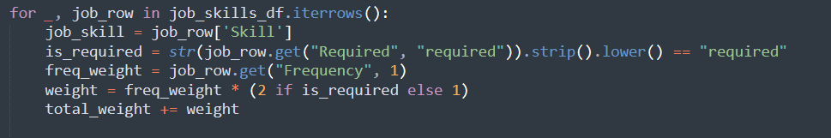
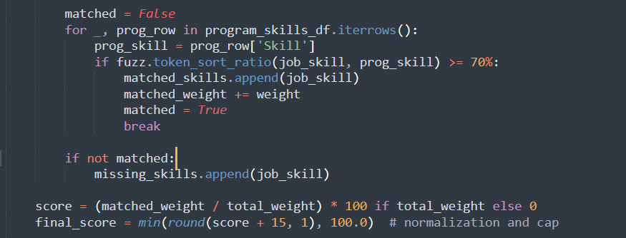
Improved Scoring Logic Code

Slide 11
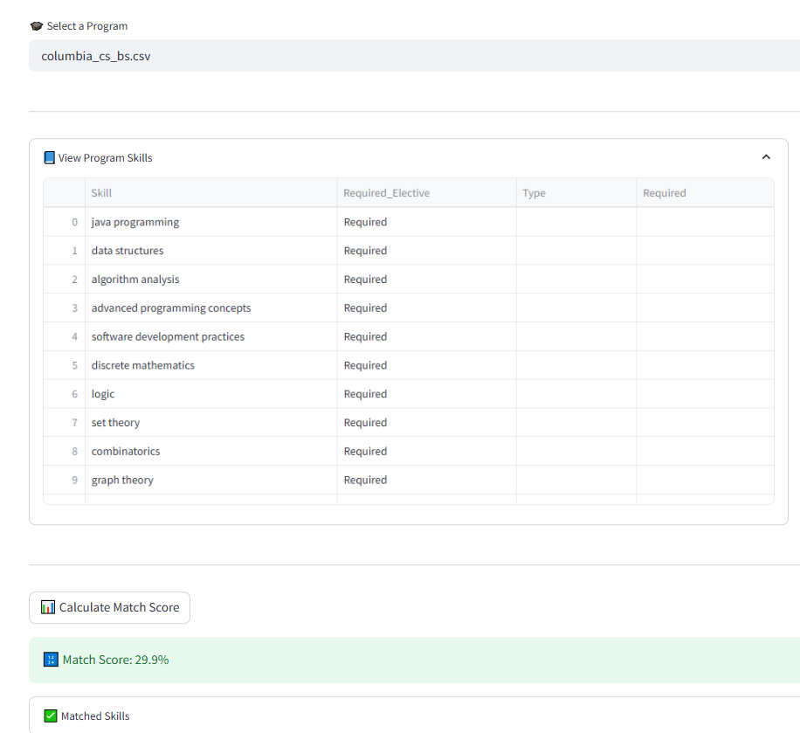
Results with Improved Scoring Algorithm
Non-weighted skills
Weighted skills

Slide 12
Insights and Impact
• Most academic programs miss 50–70% of job-required skills.
• Communication, teamwork, and latest tech skills are not easily measured.
• Tool can guide curriculum improvement and student advising.

Slide 13
Future Vision
Automate skill extraction using NLP or scraping APIs.
Include more programs and universities
Add role-specific or region-specific filters.
Build a public platform for use by students, deans, and advisors.

Slide 14
Conclusion & Questions
• Match score shows how job-ready a program is.
• Students, educators, and employers all benefit from this feedback.

Slide 15
→ Questions?

