Slide 1
Visual Analytics for Understanding Student Depression
Natalia Jiménez, Ema Gracia

Slide 2
Project Objectives
Identify key determinants associated with student depression.
Design interactive visualizations for dynamic data exploration.
Provide insights for early interventions by mental health practitioners.

Slide 3
Dataset Overview
Source: Kaggle (Student Depression Dataset.csv)
Number of Students: 27,900
Variables include:
- Demographic: gender, age, city
- Academic: study load, CGPA, satisfaction
- Lifestyle: sleep time, dietary habits
- Mental Health: family history, financial pressure

Slide 4
Methodology
1. Data Cleaning:
- Removed missing values.
- Encoded categorical variables numerically.
- Filtered outliers using percentiles.
2. Dimensionality Reduction:
- Applied t-SNE to project high-dimensional data.
3. Clustering:
- Used K-Means to identify subgroups within students.

Slide 5
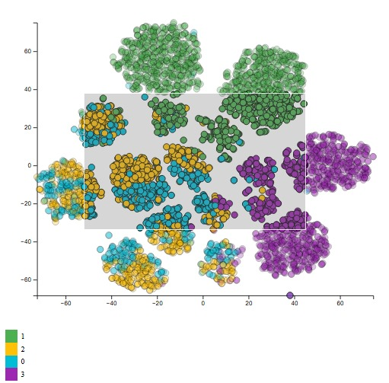
Visualizations
1. Scatterplot:
Visualizes t-SNE clusters to identify behavioral patterns.

Slide 6
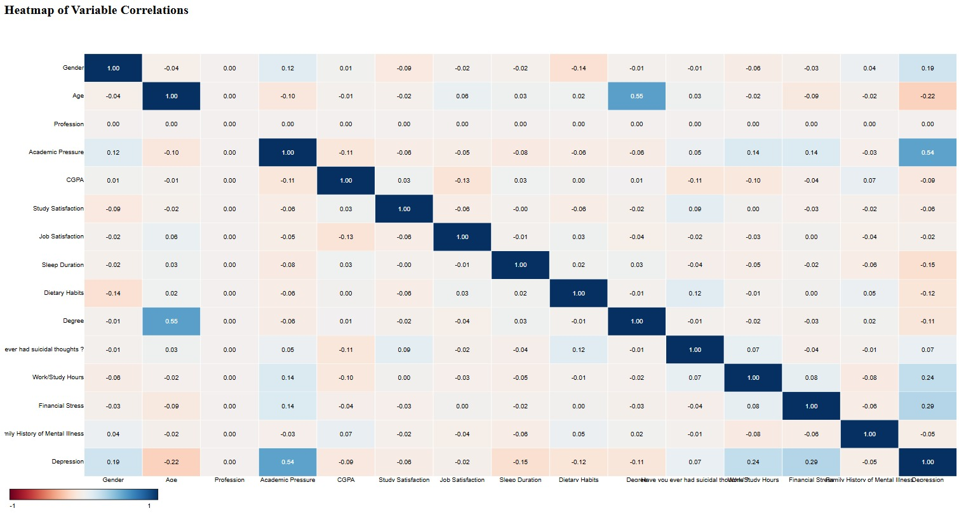
Visualizations
2. Heatmap:
Highlights correlations between variables.

Slide 7
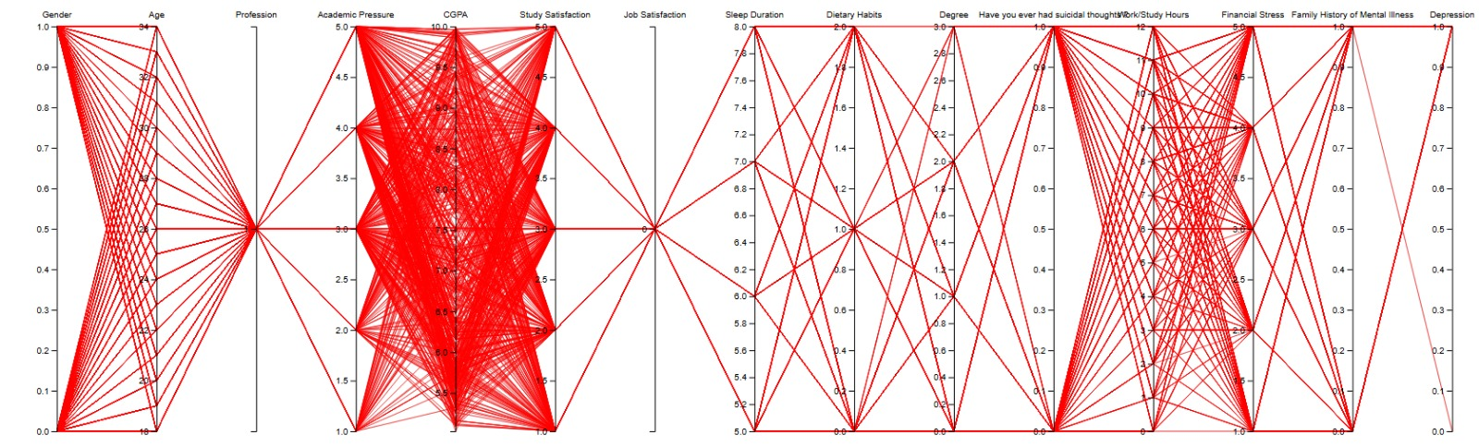
Visualizations
3. Parallel Coordinates Plot:
Explores relationships across multiple variables.

Slide 8
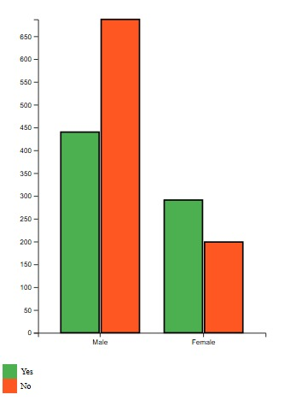
Visualizations
4. Bar Chart:
Shows demographic distributions of depression prevalence.

Slide 9
Insights
• Clusters reveal distinct patterns:
High academic pressure + insufficient sleep = higher depression rates.
• Gender Trends:
Female students show higher prevalence in certain clusters.
• Correlation Patterns:
Financial stability inversely correlated with mental health issues.

Slide 10
Conclusions
Visual Analytics provides valuable tools for understanding student depression.
Integrating t-SNE and clustering uncovered significant behavioral patterns.
Insights from this project can guide targeted interventions for mental health support.

Slide 11
References
Jones, A., et al. (2019). Depression Scale Recognition from Audio, Visual, and Text Analysis.
Smith, J., et al. (2020). See and Read: Detecting Depression Symptoms in Higher Education Students.
Kaggle: Student Depression Dataset.

