Slide 2
Learning Objectives
By the end of this lecture, you should be able to do the following:
Differentiate between the linear regression and regression tree algorithms.
Apply the recursive partitioning algorithm and split the data in a way such that the sum of squared residuals is minimized.
Address the overfitting issue using cost complexity pruning tree method.
Introduce the bagging and random forest trees with classification and regression problems.
Apply classification and regression trees models to real-life data using R.

Slide 3

Notes:
Poll Title: Do not modify the notes in this section to avoid tampering with the Poll Everywhere activity. More info at polleverywhere.com/support What is Decision Tree? https://www.polleverywhere.com/multiple_choice_polls/ZsoOY9UFS4ndPlOozBYrZ?state=opened&flow=Default&onscreen=persist

Slide 4
Decision Tree
Decision trees can be applied to both regression and classification problems. These involve stratifying or segmenting the predictor space into a number of simple regions.
Decision trees are generally plotted upside down where the root is the topmost node of the tree, and the terminal nodes (leaves) are at the bottom of this tree.
All observations go through this tree are assessed (ask a questions about the features of predictor variables) at a particular node:
proceed to the left if the statement logic at this node is “True”,
proceed to the right if the statement is “False”.
Root Node
Yes
No
Internal Node (Branch)
Internal Node (Branch)
Yes
No
Yes
No
Terminal Node (Leaf)
Terminal Node (Leaf)
Internal Node (Branch)
Terminal Node (Leaf)
Yes
No
Sub-tree
Terminal Node (Leaf)
Terminal Node (Leaf)

Slide 5
Classification and Regression Trees (CART)
Decision Trees
Same discrete class label output for each region
Same real continues value output for each region
Classification Tree
Regression Tree
Classification tree is used to predict a qualitative response.
For a classification tree, we predict that each observation belongs to the most commonly occurring class of training observations in the region to which it belongs.
Regression tree is used to predict a quantitative response.
The predicted response for an observation is given by the mean response of the training observations that belong to the same terminal node.
In interpreting the results of a classification tree, we are often interested not only in the class prediction corresponding to a particular terminal node region, but also in the class proportions among the training observations that fall into that region.

Slide 6
Regression Tree Versus Linear Regression
100
75
50
y
25
The average of y values
0
0
10
20
x
30
40
50

Slide 7
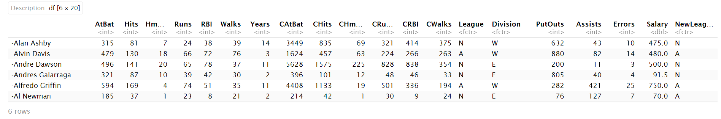
Example
Consider the Hitters baseball dataset from the ISLR package, which contains various information about 263 professional players on 20 variables:
Target variable: Salary - Baseball player’s salary (measured in thousands of dollars).
Predictors:
Years - The number of years that the player has played in the major leagues.
Hits - The number of hits that he made in the previous year.

Slide 8
250
200
Region 1
Region 3
150
Hits
117.5
100
50
Region 2
0
4.5
0
10
Years
20
Notes:
Poll Title: Do not modify the notes in this section to avoid tampering with the Poll Everywhere activity. More info at polleverywhere.com/support For k cross-validation, larger k value implies more bias. https://www.polleverywhere.com/multiple_choice_polls/Z43VE5hAsrF3nE9Z5bCRy?state=opened&flow=Default&onscreen=persist

Slide 9

Prediction Via Stratification of the Feature Space
250
Years < 4.5
200
Yes
No
Region 1
Region 3
Avg = $165,174
Avg = $845,346
Salary Average
165,174
Hits < 117.5
150
Hits
117.5
Yes
No
100
Salary Average
402,834
Salary Average
845,346
50
Salary = $1,000 $×e^{Years}$
Region 2
0
4.5
Avg = $402,834
0
10
Years
20

Slide 10
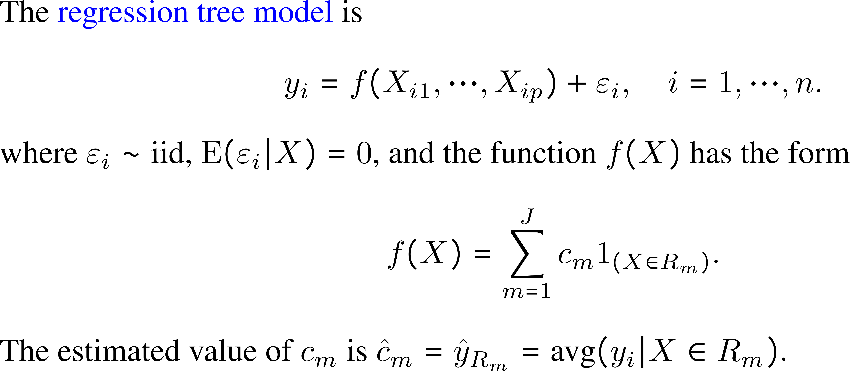
Process of Building a Regression Tree

Slide 11
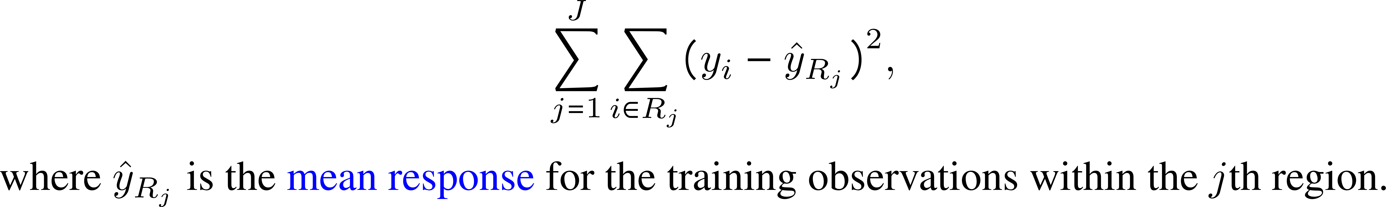
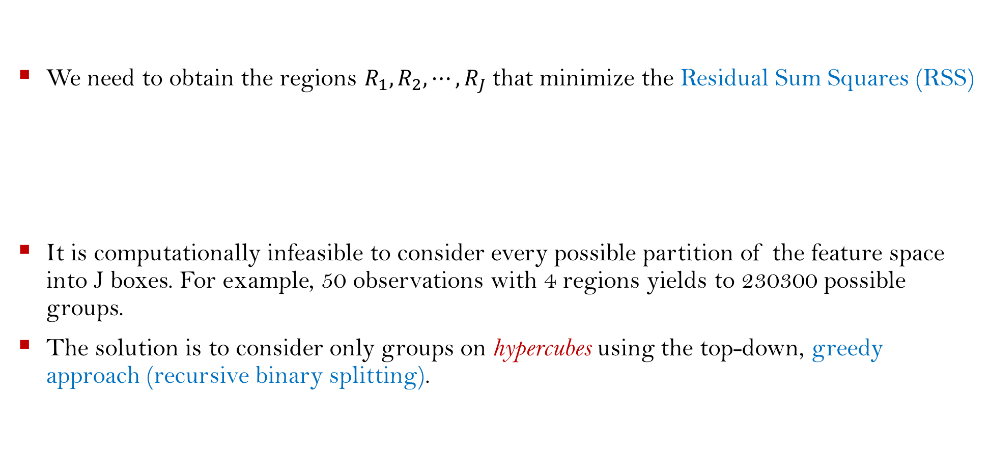
How We Construct the Regions $R_{1},R_{2}, ⋯,R_{J}$ ?
We need to obtain the regions $R_{1},R_{2}, ⋯,R_{J}$that minimize the Residual Sum Squares (RSS)
It is computationally infeasible to consider every possible partition of the feature space into J boxes. For example, 50 observations with 4 regions yields to 230300 possible groups.
The solution is to consider only groups on hypercubes using the top-down, greedy approach (recursive binary splitting).

Slide 12
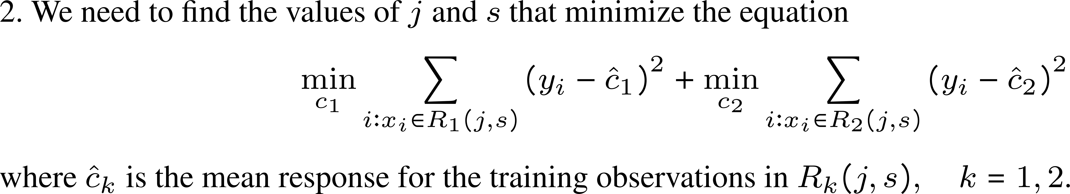




















Greedy Algorithm (Recursive Binary Splitting)
$$R_{5}$$
$$t_{4}$$
$$R_{1}$$
$$R_{2}$$
$$R_{4}$$
$$X_{2}$$
$$R_{3}$$
$$t_{2}$$
$$t_{1}$$
$$t_{3}$$
$$X_{1}$$
$$X_{1}≤t_{1}$$
$$X_{2}≤t_{2}$$
$$X_{1}≤t_{3}$$
$${ R}_{1}$$
$${ R}_{2}$$
$${ R}_{3}$$
$$X_{4}≤t_{4}$$
$${ R}_{4}$$
$${ R}_{5}$$

Slide 13
Greedy Approach
The name “greedy because at each step of the tree-building process, the best split is made at that particular step, rather than looking ahead and picking a split that will lead to a better tree in some future step” (Witten, James, Hastie, and Tibshirani, 2021)

Slide 14
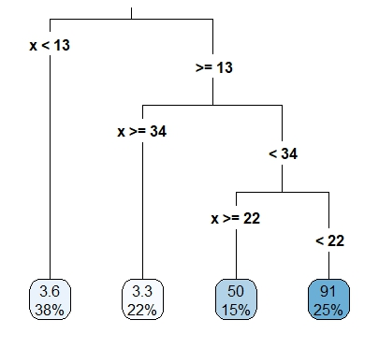

Tree Pruning
A full-sized tree may produce good predictions on the training set,
Thus, it will be good if we can find a smaller tree (subtree) with fewer splits (that is, fewer regions $R_{1},R_{2}, ⋯,R_{J}$) that leads to:
Large reduction in RSS (lower variance) and better interpretation at the cost of a little bias.
Optimize predictive performance on some unseen data.
but is likely to overfit the data, leading to poor test set performance.
100
75
y
50
Train
Test
25
0
0
10
20
x
30
40

Slide 15
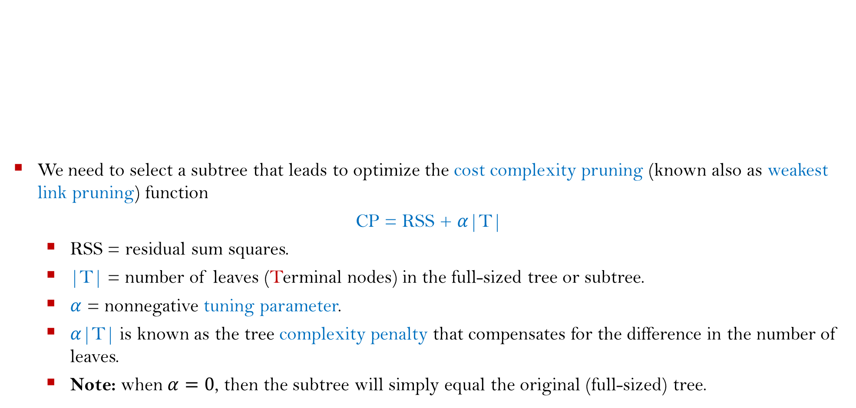
Cost Complexity Pruning (Weakest Link Pruning)
We need to select a subtree that leads to optimize the cost complexity pruning (known also as weakest link pruning) function
CP = RSS + $α$|T|
RSS = residual sum squares.
|T| = number of leaves (Terminal nodes) in the full-sized tree or subtree.
$α$ = nonnegative tuning parameter.
$α$|T| is known as the tree complexity penalty that compensates for the difference in the number of leaves.
Note: when $α=0$, then the subtree will simply equal the original (full-sized) tree.
Full-sized
Subtree 1
Subtree 2
Subtree 3

Slide 16
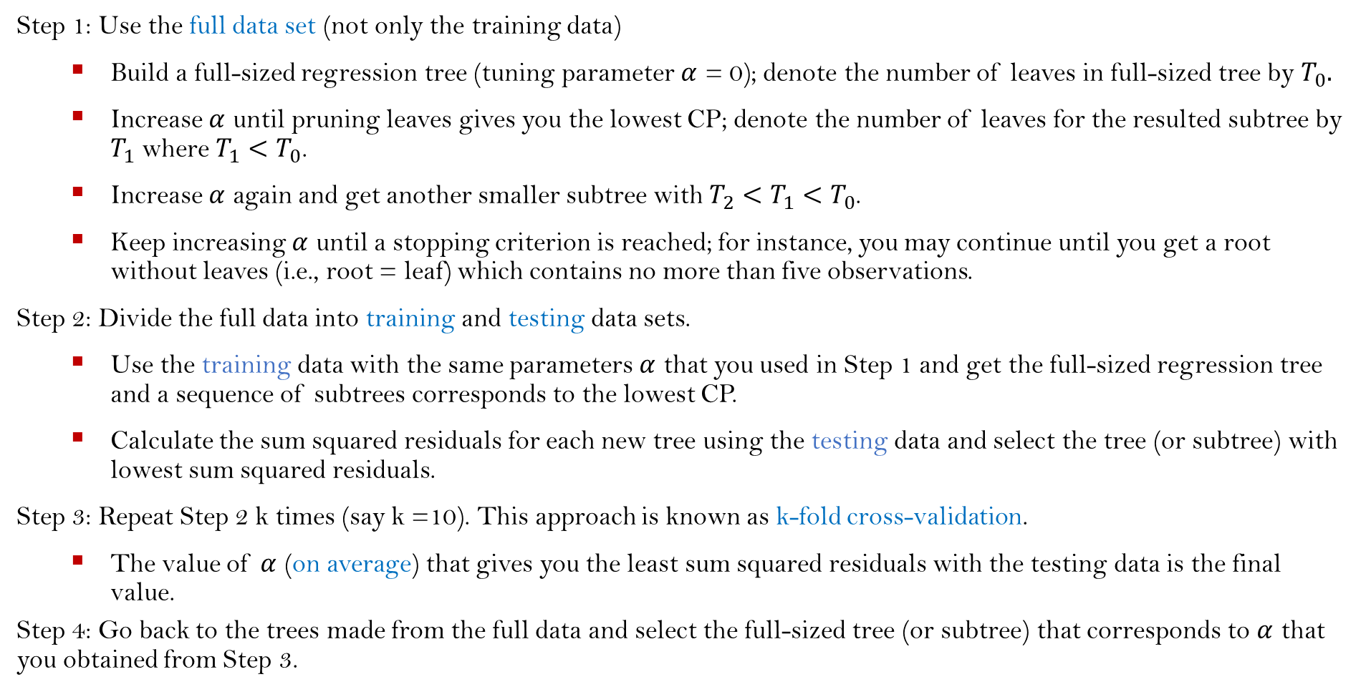
K-Fold Cross-Validation to Choose the Best $α$.
Step 1: Use the full data set (not only the training data)
Build a full-sized regression tree (tuning parameter $α$ = 0); denote the number of leaves in full-sized tree by $T_{0}.$
Increase $α$ until pruning leaves gives you the lowest CP; denote the number of leaves for the resulted subtree by $T_{1}$ where ${T_{1}<T}_{0}$.
Increase $α$ again and get another smaller subtree with ${T_{2}<T}_{1}{<T}_{0}$.
Keep increasing $α$ until a stopping criterion is reached; for instance, you may continue until you get a root without leaves (i.e., root = leaf) which contains no more than five observations.
Step 2: Divide the full data into training and testing data sets.
Use the training data with the same parameters $α$ that you used in Step 1 and get the full-sized regression tree and a sequence of subtrees corresponds to the lowest CP.
Calculate the sum squared residuals for each new tree using the testing data and select the tree (or subtree) with lowest sum squared residuals.
Step 3: Repeat Step 2 k times (say k =10). This approach is known as k-fold cross-validation.
The value of $α$ (on average) that gives you the least sum squared residuals with the testing data is the final value.
Step 4: Go back to the trees made from the full data and select the full-sized tree (or subtree) that corresponds to $α$ that you obtained from Step 3.

Slide 17
Advantages and Disadvantages of Regression Trees
Advantages:
Easy to understand and interpret, as they provides a clear visual representation of the decision-making process.
Regression trees are non-parametric and do not assume any particular distribution of the data.
Can handle the case that the predictor variables are not independent.
Can handle categorical predictor variables without the need for dummy coding.
Can handle nonlinear relationships between the predictors and response variables.
Disadvantages:
Regression trees are prone to overfitting, especially if the tree is too complex or if the data is noisy.
They are sensitive to small changes in the data, which can lead to different trees being generated.
They are hard to understand and interpret if the tree are too complex or contains many variables.

Slide 18
Fitting Regression Trees (Using the R package “tree”)
Step 1: Create a training data set (say 50% of the data).
Step 2: Fit the regression tree to the training data.
Step 3: Use the cross-validation algorithm and see whether pruning the tree will improve the performance.
3.1: Use the prune.tree() function if pruning the tree is needed (k = cost-complexity parameter).
3.2: Otherwise, use the unpruned tree to make predictions on the testing set.
set.seed(1)
Index <- sample(1:nrow(mydata), nrow(mydata)/2) #Index = location of records
library(tree)
fit <- tree(y ~ ., mydata, subset = Index)
summary(fit)
cv.fit <- cv.tree(fit) #default is 10-fold cross-validation
plot(cv.fit$size, cv.fit$dev, type = "b")
prune.fit <- prune.tree(fit, k = NULL, best = NULL) #best = # of terminal nodes
plot(prune.fit)
text(prune.fit, pretty = 0)
yhat <- predict(fit, newdata = mydata[-Index, ])
test.y <- mydata[-Index, "y"]
plot(yhat, test.y)
abline(0, 1)

Slide 19
Fitting Regression Trees (Using the R package “rpart”)
Step 1: Create a training set (say 50% of the data).
Step 2: Fit the regression tree to the training data.
Step 3: Find the optimal of cp (complexity parameter) that yields a corresponding pruned tree.
3.1: Use the prune.tree() function if pruning the tree is needed.
3.2: Otherwise, use the unpruned tree to make predictions on the test set.
set.seed(1)
Index <- sample(1:nrow(mydata), nrow(mydata)/2)
train.data <- mydata[Index,]
test.data <- mydata[-Index,]
library(rpart)
fit <- rpart(y ~ ., train.data, method = “anova”)
fit
(cp <- fit$cptable[which.min(fit$cptable[, "xerror"]), "CP"])
plotcp(fit) #plot a complexity parameter table for the rpart fit
prune.fit <- prune(fit, cp)
library(rpart.plot)
rpart.plot(prune.fit)
yhat <- predict(fit, newdata = test.data)
plot(yhat, test.data$medv)
abline(0, 1)
mean((yhat - test.data$medv)**2)

Slide 20
Classification Trees
Classification tree is very similar to a regression tree, except that it is used to predict a qualitative response rather than a quantitative one.
For a classification tree, we predict that each observation belongs to the most commonly occurring class of training observations in the region to which it belongs.
In interpreting the results of a classification tree, we are often interested not only in the class prediction corresponding to a particular terminal node region, but also in the class proportions among the training observations that fall into that region.
In the classification setting, RSS cannot be used as a criterion for making the binary splits. A natural alternative to RSS is the classification error rate, Gini index, or entropy.
Any of these three approaches might be used when pruning the tree, but the classification error rate is preferable if prediction accuracy of the final pruned tree is the goal.

Slide 21
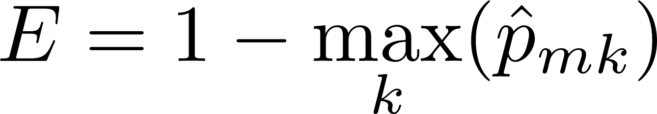
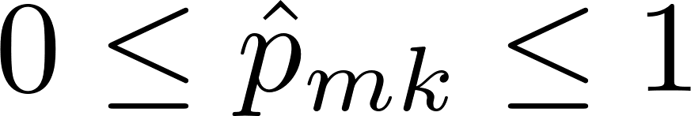
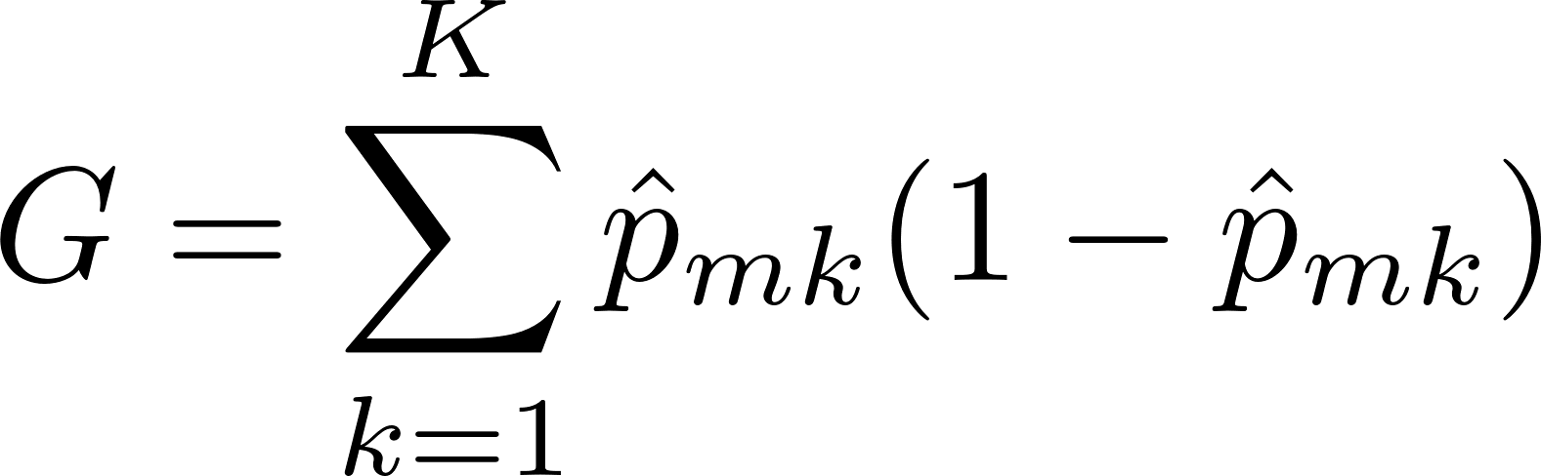
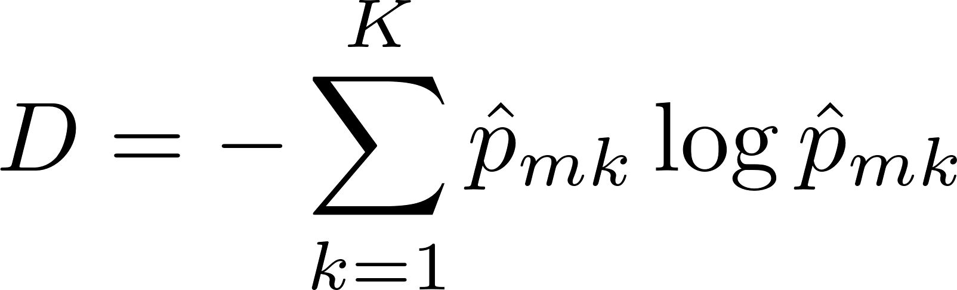
Classification Trees
Classification error rate is the fraction of the training observations in that region that do not belong to the most common class
where represents the proportion of training observations in the mth region that are from the kth class.
Gini index is a measure of total variance across the K classes. It is referred to as a measure of node purity. A small value indicates that a node contains predominantly observations from a single class, which is defined by
Entropy is given by
Like the Gini index, the entropy will take on a small value if the mth node is pure.

Slide 22
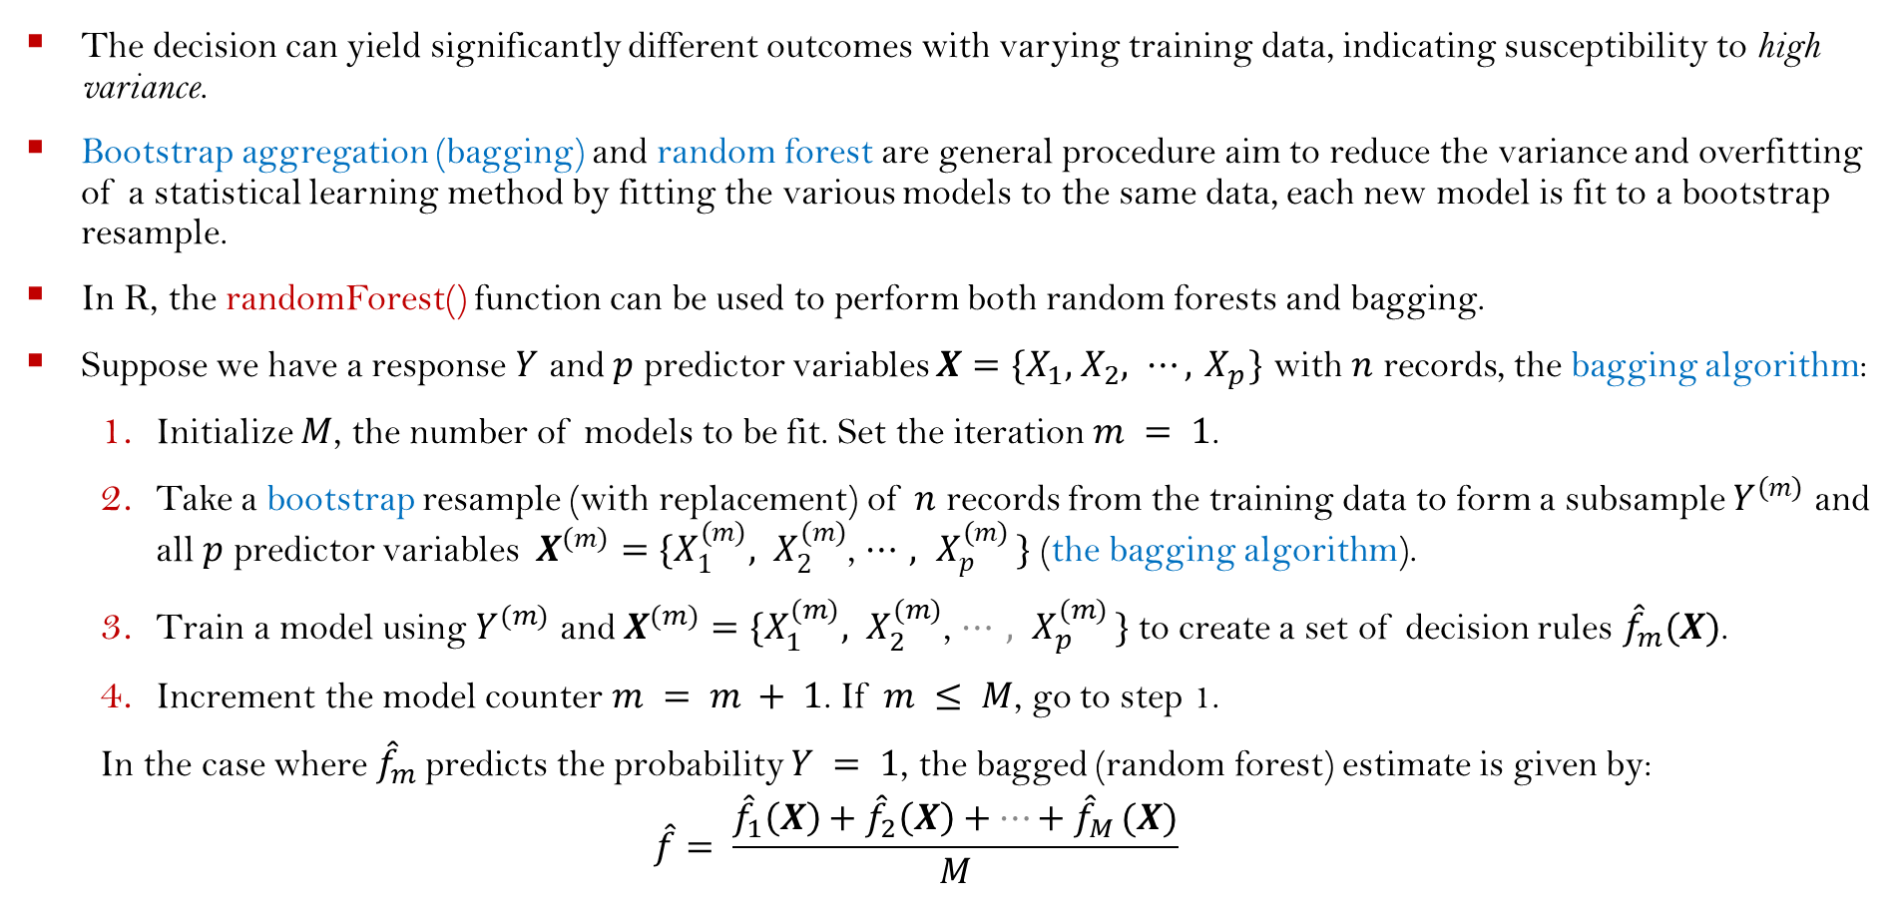
Bagging and Random Forests (Classification and Regression)
The decision can yield significantly different outcomes with varying training data, indicating susceptibility to high variance.
Bootstrap aggregation (bagging) and random forest are general procedure aim to reduce the variance and overfitting of a statistical learning method by fitting the various models to the same data, each new model is fit to a bootstrap resample.
In R, the randomForest() function can be used to perform both random forests and bagging.
Suppose we have a response $Y$ and $p$ predictor variables ${X=\{X}_{1}, { X}_{2}, ⋯,{ X}_{p}\}$ with $n$ records, the bagging algorithm:
Initialize $M$, the number of models to be fit. Set the iteration $m = 1$.
Take a bootstrap resample (with replacement) of $n$ records from the training data to form a subsample $Y^{(m)}$ and all $p$ predictor variables ${X^{(m)}=\{X}_{1}^{(m)}, X_{2}^{(m)}$, ${⋯, X}_{p}^{(m)}\}$ (the bagging algorithm).
Train a model using $Y^{(m)}$ and ${X^{(m)}=\{X}_{1}^{(m)}, X_{2}^{(m)}$, ${⋯, X}_{p}^{(m)}\}$to create a set of decision rules ${\hat{f}}_{m}(X)$.
Increment the model counter $m = m + 1$. If $m ≤ M$, go to step 1.
In the case where ${\hat{f}}_{m}$predicts the probability $Y = 1$, the bagged (random forest) estimate is given by:
$$\hat{f}= \frac{{\hat{f}}_{1}\left(X\right)+{\hat{f}}_{2}\left(X\right)+{⋯+\hat{f}}_{M}(X)}{M}$$

Slide 23
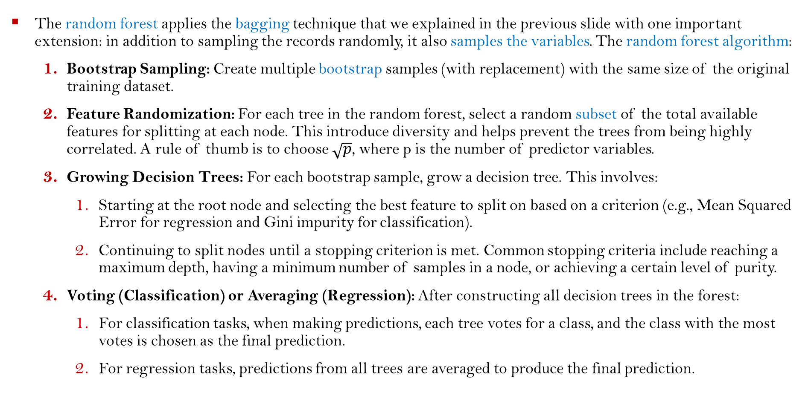
Random Forests
The random forest applies the bagging technique that we explained in the previous slide with one important extension: in addition to sampling the records randomly, it also samples the variables. The random forest algorithm:
Bootstrap Sampling: Create multiple bootstrap samples (with replacement) with the same size of the original training dataset.
Feature Randomization: For each tree in the random forest, select a random subset of the total available features for splitting at each node. This introduce diversity and helps prevent the trees from being highly correlated. A rule of thumb is to choose $\sqrt{p}$, where p is the number of predictor variables.
Growing Decision Trees: For each bootstrap sample, grow a decision tree. This involves:
Starting at the root node and selecting the best feature to split on based on a criterion (e.g., Mean Squared Error for regression and Gini impurity for classification).
Continuing to split nodes until a stopping criterion is met. Common stopping criteria include reaching a maximum depth, having a minimum number of samples in a node, or achieving a certain level of purity.
Voting (Classification) or Averaging (Regression): After constructing all decision trees in the forest:
For classification tasks, when making predictions, each tree votes for a class, and the class with the most votes is chosen as the final prediction.
For regression tasks, predictions from all trees are averaged to produce the final prediction.

Slide 24
Real-World Applications (See R Markdown)
Example 1: Fit a regression tree to the Boston dataset available from the ISLR2 package.
Example 2: Fit a classification tree to the Carseats dataset available from the ISLR2 package.

Slide 25
Suggested Exercise Questions
Q1: Read and understand the examples and code in Section 8.3 Lab: Tree-Based Methods from the textbook "An Introduction to Statistical Learning: With Applications in R“.
Q2: Consider the OJ data set (Orange Juice Data) from the package “ISLR2”. Use the package tree to solve this question!
Create a training set containing a random sample of 800 observations, and a test set containing the remaining observations.
Fit a tree to the training data, with Purchase as the response and the other variables as predictors. Use the summary() function to produce summary statistics about the tree, and describe the results obtained. What is the training error rate? How many terminal nodes does the tree have?
Type in the name of the tree object in order to get a detailed text output. Pick one of the terminal nodes, and interpret the information displayed.
Create a plot of the tree and interpret the results.
Predict the response on the test data.
Apply the cv.tree() function to the training set in order to determine the optimal tree size.
Produce a pruned tree corresponding to the optimal tree size obtained using cross-validation. If cross-validation does not lead to selection of a pruned tree, then create a pruned tree with five terminal nodes.
Compare the training error rates between the pruned and unpruned trees. Which is higher?
Compare the test error rates between the pruned and unpruned trees. Which is higher?

Slide 26
Recommended Reading
Books:
Daniela Witten, Gareth M. James, Trevor Hastie, Robert Tibshirani (2021). An introduction to statistical learning with applications in R (2nd edition).
Leo Breiman (1984). Classification and Regression Trees (1st edition).
R-Packages:
Brian Ripley (2023). tree: Classification and Regression Trees. https://cran.r-project.org/web/packages/tree/index.html.
Terry Therneau, Beth Atkinson, Brian Ripley (2022). rpart: Recursive Partitioning and Regression Trees. https://cran.r-project.org/web/packages/rpart/index.html.
Python:
https://python-course.eu/machine-learning/decision-trees-in-python.php

