Slide 1
Spark
Working with Key/Value Pairs
Notes:
Learning Spark safari books
Chapter 4. Working with Key/Value Pairs

Slide 2
Working with Key/Value Pairs
We see how to work with RDDs of key/value pairs, which are a common data type required for many operations in Spark.
Key/value RDDs are commonly used to perform aggregations, and often we will do some initial ETL (extract, transform, and load) to get our data into a key/value format.
Key/value RDDs expose new operations (e.g., counting up reviews for each product, grouping together data with the same key, and grouping together two different RDDs).
We also discuss an advanced feature that lets users control the layout of pair RDDs across nodes: partitioning.
Using controllable partitioning, applications can sometimes greatly reduce communication costs by ensuring that data will be accessed together and will be on the same node. This can provide significant speedups.
We illustrate partitioning using the PageRank algorithm as an example.
Choosing the right partitioning for a distributed dataset is similar to choosing the right data structure for a local one—in both cases, data layout can greatly affect performance.

Slide 3
Working with Key/Value Pairs
Motivation
Spark provides special operations on RDDs containing key/value pairs. These RDDs are called pair RDDs. Pair RDDs are a useful building block in many programs, as they expose operations that allow you to act on each key in parallel or regroup data across the network.
For example, pair RDDs have a reduceByKey() method that can aggregate data separately for each key, and a join() method that can merge two RDDs together by grouping elements with the same key.
It is common to extract fields from an RDD (representing, for instance, an event time, customer ID, or other identifier) and use those fields as keys in pair RDD operations.

Slide 4
Creating Pair RDDs
There are a number of ways to get pair RDDs in Spark.
Many formats we explore loading from this section will directly return pair RDDs for their key/value data.
In other cases we have a regular RDD that we want to turn into a pair RDD. We can do this by running a map() function that returns key/value pairs.
Python: The way to build key-value RDDs differs by language. In Python, for the functions on keyed data to work we need to return an RDD composed of tuples
Creating a pair RDD using the first word as the key in Python : pairs = lines.map(lambda x: (x.split(" ")[0], x))
Scala: In Scala, for the functions on keyed data to be available, we also need to return tuples. An implicit conversion on RDDs of tuples exists to provide the additional key/value functions.
Creating a pair RDD using the first word as the key in Scala
val pairs = lines.map(x => (x.split(" ")(0), x))
JAVA: Java doesn’t have a built-in tuple type, so Spark’s Java API has users create tuples using the scala.Tuple2 class.

Slide 5
Creating Pair RDDs
This class is very simple: Java users can construct a new tuple by writing new Tuple2(elem1, elem2) and can then access its elements with the ._1() and ._2() methods.
Java users also need to call special versions of Spark’s functions when creating pair RDDs. For instance, the mapToPair() function should be used in place of the basic map() function.
Creating a pair RDD using the first word as the key in Java
PairFunction<String, String, String> keyData =
new PairFunction<String, String, String>() {
public Tuple2<String, String> call(String x) {
return new Tuple2(x.split(" ")[0], x); } };
JavaPairRDD<String, String> pairs = lines.mapToPair(keyData);
When creating a pair RDD from an in-memory collection in Scala and Python, we only need to call SparkContext.parallelize() on a collection of pairs.
To create a pair RDD in Java from an in-memory collection, we instead use SparkContext.parallelizePairs().

Slide 6
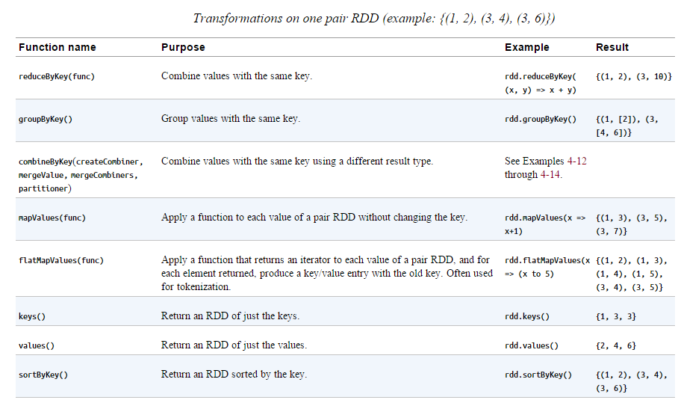
Transformations on Pair RDDs
Since pair RDDs contain tuples, we need to pass functions that operate on tuples rather than on individual elements.

Slide 7
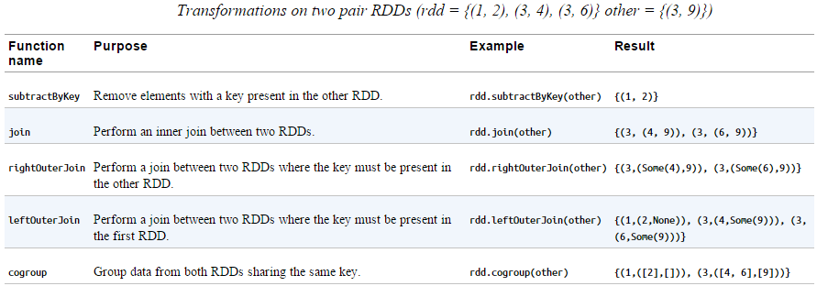
Transformations on Pair RDDs

Slide 8
Transformations on Pair RDDs
Pair RDDs are also still RDDs (of Tuple2 objects in Java/Scala or of Python tuples), and thus support the same functions as RDDs.
For instance, we can take our pair RDD from the previous section and filter out lines longer than 20 characters or more, as shown in below examples.
Simple filter on second element in Python:
result = pairs.filter(lambda keyValue: len(keyValue[1]) < 20)
Simple filter on second element in Scala:
pairs.filter{case (key, value) => value.length < 20}
Simple filter on second element in Java:
Function<Tuple2<String, String>, Boolean> longWordFilter =
new Function<Tuple2<String, String>, Boolean>() {
public Boolean call(Tuple2<String, String> keyValue) {
return (keyValue._2().length() < 20); } };
JavaPairRDD<String, String> result = pairs.filter(longWordFilter);

Slide 9
Transformations on Pair RDDs
Sometimes working with pairs can be awkward if we want to access only the value part of our pair RDD. Since this is a common pattern, Spark provides the mapValues(func) function, which is the same as map{case (x, y): (x, func(y))}. We will use this function in many of our examples.
We now discuss each of the families of pair RDD functions, starting with aggregations.
Aggregations:
When datasets are described in terms of key/value pairs, it is common to want to aggregate statistics across all elements with the same key.
We have looked at the fold(), aggregate(), and reduce() actions on basic RDDs, and similar per-key transformations exist on pair RDDs.
Spark has a similar set of operations that combines values that have the same key. These operations return RDDs and thus are transformations rather than actions.

