Slide 1
Spark
Introduction
Notes:
Learning Spark safari books

Slide 2
What is Spark?
Apache Spark is a cluster computing platform designed to be fast and general-purpose.
Speed – Spark extends MR model, and supports more types of computations other than batch.
Spark with the same engine, supports
Batch applications
Iterative algorithms
Interactive queries and
Streaming
Since it uses the same engine for different processing types, we can combine these processing types in easy and inexpensive way.
This reduces management burden of maintaining separate tools.

Slide 3
What is Spark? cont..
Spark offers simple APIs in below languages, that makes spark highly accessible.
Python
Java
Scala and
SQL.
Spark integrates closely with other BigData tools, and it can run in Hadoop clusters and can access any data source including Cassandra.

Slide 4
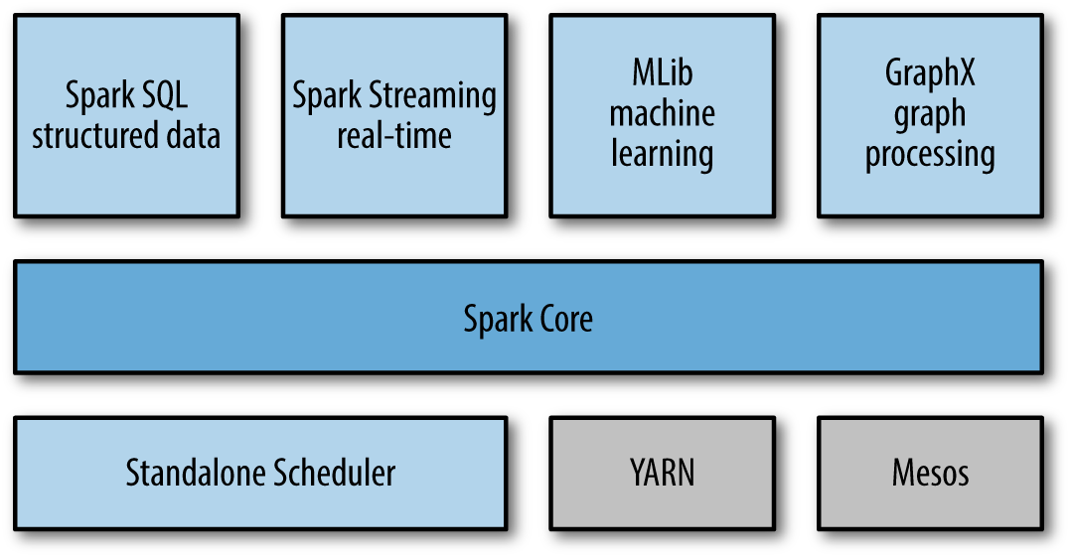
Spark Stack

Slide 5
Spark Stack – Spark Core
Includes Basic functionality of Spark like
Task Scheduling
Memory Management
Fault Recovery
Integration with diff Storage systems e.t.c.
Spark Core is home to the API that defines RDD
Resilient Distributed Datasets – Sprak’s main programming abstraction.
RDDs represents collection of items distributed across compute nodes that can be manipulated in parallel.
Spark Core provides API’s for building and manipulating these collections.

Slide 6
Spark Stack – Spark SQL
Spark SQL – Spark’s package for working with structured data.
Allows querying via SQL as well as Hive QL.
It supports many sources like,
Hive tables,
Parquet,
JSON
Spark SQL allows to intermix SQL queries with programmatic data manipulations supported by RDDs in Python, Java and Scala.
This tight integration makes Spark SQL, a DW tool.

Slide 7
Spark Stack – Spark Streaming
This component enables processing of live streams of data.
Example for live stream data sources are,
Logfiles generated by Production Web servers,
Queues of messages containing status updates posted by users of a web service.
This APIs closely resembles Spark Core’s RDD API, makes it easy for programmers to learn sot that they can easily work with data stored in memory, on disk, or arriving in real time.
Spark Streaming provides same degree of throughput, Scalability and fault tolerance as Spark Core.

Slide 8
Spark Stack – MLib
This Spark’s library comes with common Machine Learning (ML) functionalities.
MLlib provides ML algorithms such as
Classification
Regression
Clustering and
Collaborative filtering
Functionalities like
Model Evaluation and Data Import
MLlib also provides low-level ML primitives,
Generic gradient optimization algorithm
All the algorithms and functionalities scale out in a cluster.

Slide 9
Spark Stack – GraphX
Graphx is a Library to manipulate graphs and performing graph-parallel computations.
E.g. graph is Social network’s friend graph.
Like Spark Streaming and Spark SQL, GraphX extends the Spark RDD API.
You can create a directed graph with Vertex and Edge attached with arbitrary properties.
GraphX provides
various operators for manipulating graphs (e.g Subgraph and mapVerticies) and
Library of common graph algorithms (e.g PageRank and Triangle Counging)

Slide 10
Spark Stack – Cluster Management
Spark is designed to scaleup efficiently from one to many thousands of compute nodes.
Spark can run over a variety of cluster managers, like
Hadoop YARN,
Apache Mesos,
Simple cluster manager included in Spark (called Standalone Scheduler)
If you are just installing Spark on an empty set of machines, Standalone Scheduler provides an easy way to get started.

Slide 11
Spark – Use Cases
Spark is General purpose framework for cluster computing, hence it is used over a wide range of applications.
There are majorly two categories of use cases.
Data Science tasks
Data processing applications

Slide 12
Spark – Data Science Use Cases
Data Science, centers on analyzing data.
Data Scientist’s main task is to analyze and model data. They need experience on
SQL
Statistics,
Predictive modeling and Machine Learning
Programming in Python, Matlab or R
Data Scientist should have experience in Data Wrangling -transform data into formats that can be analyzed for insights.
Often the workflow involves adhoc analysis, so they need to perform interactive analysis and see the results of queries in less time.
Spark’s speed and simple API is best suited for this need and also provides built-in libraries that contains many algorithms.

Slide 13
Spark – Data Science Use Cases
Spark supports different tasks of data scientists with no of components.
SQL - spark sql allows to explore data using SQL
Statistics,
Predictive modeling and Machine Learning - MLlib
Programming in Python, Matlab or R – Spark Core provides interactive analysis using Python, Scala.
Spark Core have support to call external programs in Matlab ro R.
Once data scientists completes the exploration phase, it is the work of Data Engineer to productize the work of data scientist.

Slide 14
Spark – Data Processing Applications Use Cases
Developers need to design and build software systems that implement a business usecase.
Spark provides a simple way to parallelize these applications across clusters and hides the complexity of
distributed programming,
Network communication and
Fault tolerance.
The system gives them enough control to monitor, inspect and tune applications and also allows to implement common tasks quickly.
Modular nature of APIs makes it easy to factor work into reusable libraries and test each locally and idividullay.
Most users prefer Spark as it provides a wide variety of functionality, easy to learn and use, and mature and reliable.

Slide 15
Spark – History
Started in 2009 as a research project in UC Berkeley Lab, later become the AMPLab.
Spark designed on features where MapReduce was lacking/inefficient, which is interactive and iterative jobs.
Hence the Ideas like in-memory storage and efficient fault recovery were implemented in Spark.
See who are all using - https://cwiki.apache.org/confluence/display/SPARK/Powered+By+Spark
2011, AMPLabs developed higher-level components on Spark, such as Shark (Hive on Spark) and Spark Streaming. (Shark replaced by Spark SQL)
June 2013, transferred to Apache foundation.

Slide 16
Spark – Versions
Spark 1.6.0 (latest release)
Spark 1.5.2
Spark 1.5.1
Spark 1.5.0
Spark 1.4.1
Spark 1.4.0
Spark 1.3.1
Spark 1.3.0
Spark 1.2.1
Spark 1.1.1
Spark 1.0.2
Spark 0.9.2
Spark 0.8.1
Spark 0.7.3
Spark 0.6.2

Slide 17
Spark – Installation
Download the latest package of type “Pre-built for Hadoop 2.6 and later”
Un compress the tarballs
Windows – install spark in a directory with no space in the directory name.
No need to have Hadoop. If you have an existing Hadoop cluster or HDFS installation, download matching version.
Spark folder contains
Bin – contains executables that can be used to interact with spark, like Spark shell
Core, Streaming, Python – contains the source code of major components of Spark project
Examples – Spark standalone jobs that you can run and learn about the Spark API.
Tryout Spark’s Python and Scala shells.
First run some examples that come with Spark, and write,compile and run simple spark jobs.
We first see running the spark in local mode, that uses only single machine.
Spark cab also be run on Mesos, YARN or Standalone Scheduler(included in Spark distribution)
Notes:
https://databricks.com/spark/developer-resources Introduction to Apache Spark Workshop - download code+data download
http://training.databricks.com/workshop/usb.zip

Slide 18
Spark – Python and Scala Shells
Spark’s shells allow you to interact with data that is
Distributed on disk or
in memory across many machines,
Spark takes care of automatically distributing this processing.
Because Spark can load data into memory on the worker nodes, many distributed computations, even ones that process terabytes of data across dozens of machines, can run in a few seconds.
This makes the sort of iterative, ad hoc, and exploratory analysis commonly done in shells a good fit for Spark.
This makes the sort of iterative, ad hoc, and exploratory analysis commonly done in shells a good fit for Spark.
Interactive shells are available only in Python and Scala.
The API is similar in every language.
Notes:
Install Spark Plugin (Scala plugin ) in java EE IDE follow the steps:
http://www.ai.sri.com/~spark/eclipse/doc/spark-ide-install.html
Select Help->Software Updates->Find and Install Updates
Select Search for new features to install
Select New Remote Site
In the dialog box enter:Name: Spark Plugin URL: http://www.ai.sri.com/~spark/eclipse Under Sites to Include in Search you should now see SPARK Plugin
Check the checkbox next to SPARK Plugin under Sites to Include... and click Next
Select the latest version of SPARK Plugin for Eclipse and click Next
Select I accept the terms in the license agreement and click Next Finish.

Slide 19
Spark – Python and Scala Shells
Open spark shell
/bin/pyspark - python version of spark shell
/bin/spark-shell - scala version of spark shell
To control verbose:
make a copy of conf/log4j.properties.template called conf/log4j.properties and find the following line:
log4j.rootCategory=INFO, console
Then lower the log level so that we show only the WARN messages log4j.rootCategory=WARN, console

Slide 20
Spark – Basic program
In Spark, we express our computation through operations on distributed collections
These distributed collections are automatically parallelized across the cluster.
These collections are called resilient distributed datasets, or RDDs.
RDDs are Spark’s fundamental abstraction for distributed data and computation.
let’s create one RDD in the shell from a local text file and do some very simple ad hoc analysis.

Slide 21
Spark – Basic program
Scala line count
scala> val lines = sc.textFile(“../README.md") // Create an RDD called lines
(note that you need to give forward slash, unix style)
lines: spark.RDD[String] = MappedRDD[...]
scala> lines.count() // Count the number of items in this RDD
res0: Long = 127
scala> lines.first() // First item in this RDD, i.e. first line of README.md
res1: String = # Apache Spark
Python line count:
>>> lines = sc.textFile("README.md") # Create an RDD called lines
>>> lines.count() # Count the number of items in this RDD
>>> lines.first() # First item in this RDD, i.e. first line of README.md
http://localhost:4040/stages/ you can check the Spark UI.
Notes:
http://localhost:4040/stages/ you can check the Spark UI.

Slide 22
Spark-Introduction to Core Spark Concepts
At high level, every spark application consist of a “Driver program” that launches various parallel operations on a cluster.
Driver program contains,
application’s main function and
defines distributed datasets on the cluster, then
Applies operations to the distributed datasets.
In previous example, driver program is the spark shell itself, and you can just type the operations you want to run.
Driver programs access Spark through a “SparkContext” Object, represents a connection to a computer cluster.
In the shell, a SparkContext is automatically created for you as the variable called “sc”.
Type sc in the shell to see the sc variable.
org.apache.spark.SparkContext = org.apache.spark.SparkContext@209918

Slide 23
Spark-Introduction to Core Spark Concepts
Once you have a SparkContext, you can use it to build RDDs.
We called sc.textFile() to create an RDD representing the lines of text in a file.
We can then run various operations on these lines, such as count().
To run these operations, driver programs typically manage a number of nodes called executors.
For example, if we were running the count() operation on a cluster, different machines might count lines in different ranges of the file.

Slide 24
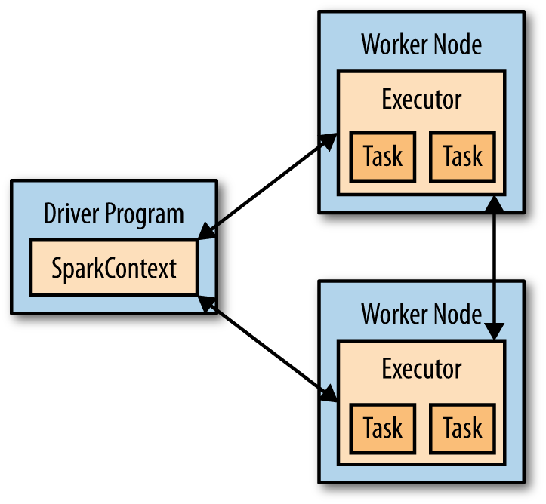
Spark-Introduction to Core Spark Concepts
Below fig shows the components of Spark.

Slide 25
Spark – Basic program cont..
To filter lines containing word, ‘Python’ :
Scala
scala> val lines = sc.textFile(“../README.md") // Create an RDD called lines
lines: spark.RDD[String] = MappedRDD[...]
scala> val pythonLines=lines.filter(line=>line.contains("Python"))
pythonLines: org.apache.spark.rdd.RDD[String] = FilteredRDD[3] at filter at <console>:14
Scala>pythonLines.first()
Python line count:
>>> lines = sc.textFile("README.md") # Create an RDD called lines
>>> pythonLines = lines.filter(lambda line: "Python" in line)
>>> pythonLines.first() # First item in this RDD

Slide 26
Spark – Basic program cont..
lambda or => syntax is a shorthand way to define functions inline in Python and Scala.
When using Spark in these languages, you can also define a function separately and then pass its name to Spark. For example, in Python:
def hasPython(line):
return "Python" in line
And use as below
pythonLines = lines.filter(hasPython)
Passing functions to Spark is also possible in Java, but in this case they are defined as classes, implementing an “interface” called Function. For example:
JavaRDD<String> pythonLines = lines.filter(
new Function<String, Boolean>() {
Boolean call(String line) { return line.contains("Python"); } } );
Java 8 introduces shorthand syntax called lambdas that looks similar to Python and Scala. Here is how the code would look with this syntax:
JavaRDD<String> pythonLines = lines.filter(line -> line.contains("Python"));

Slide 27
Spark – Basic program cont..
Spark automatically takes your function (e.g., line.contains("Python")) and ships it to executor nodes.
Thus, you can write code in a single driver program and automatically have parts of it run on multiple nodes.

Slide 28
Spark – Standalone Applications
How Spark is used it in standalone programs?
Apart from running interactively, Spark can be linked into standalone applications in either Java, Scala, or Python.
The main difference from using it in the shell is that you need to initialize your own SparkContext. After that, the API is the same. The process of linking to Spark varies by language.
In Java and Scala, you give your application a Maven dependency on the spark-core artifact.
Spark version is 1.3.0, and the Maven coordinates for the artifact are:
groupId = org.apache.spark
artifactId = spark-core_2.10
version = 1.3.0
In Python, you simply write applications as Python scripts, but
you must run them using the bin/spark-submit script included in Spark.
The spark-submit script includes the Spark dependencies for us in Python.
This script sets up the environment for Spark’s Python API to function.
Running a Python script
bin\spark-submit my_script.py

Slide 29
Spark – Initializing a SparkContext
Once you have linked an application to Spark, you need to import the Spark packages in your program and create a SparkContext.
You do so by first creating a SparkConf object to configure your application, and then building a SparkContext for it.
Initializing Spark in Python
from pyspark import SparkConf, SparkContext
conf = SparkConf().setMaster("local").setAppName("My App")
sc = SparkContext(conf = conf)
Initializing Spark in Scala
import org.apache.spark.SparkConf
import org.apache.spark.SparkContext
import org.apache.spark.SparkContext._
val conf = new SparkConf().setMaster("local").setAppName("My App")
val sc = new SparkContext(conf)

Slide 30
Spark – Initializing a SparkContext
Initializing Spark in Java
import org.apache.spark.SparkConf;
import org.apache.spark.api.java.JavaSparkContext;
SparkConf conf = new SparkConf().setMaster("local").setAppName("My App");
JavaSparkContext sc = new JavaSparkContext(conf);
These examples show the minimal way to initialize a SparkContext, where you pass two parameters:
A cluster URL, namely local in these examples, which tells Spark how to connect to a cluster.
local is a special value that runs Spark on one thread on the local machine, without connecting to a cluster.
An application name, namely My App in these examples.
This will identify your application on the cluster manager’s UI if you connect to a cluster.
After you have initialized a SparkContext, you can use all the methods we showed before to create RDDs (e.g., from a text file) and manipulate them.
Finally, to shut down Spark, you can either call the stop() method on your SparkContext, or simply exit the application (e.g., with System.exit(0) or sys.exit()).
This quick overview should be enough to let you run a standalone Spark application on your laptop.

Slide 31
Spark – Building Standalone Applications
On a single machine, implementing word count is simple, but in distributed frameworks it is a common example because it involves reading and combining data from many worker nodes.
We will look at building and packaging a simple word count example with both sbt and Maven.

Slide 32
Spark – Building Standalone Applications
Word count Java application:
// Create a Java Spark Context
SparkConf conf = new SparkConf().setAppName("wordCount");
JavaSparkContext sc = new JavaSparkContext(conf);
// Load our input data.
JavaRDD<String> input = sc.textFile(inputFile);
// Split up into words.
JavaRDD<String> words = input.flatMap(
new FlatMapFunction<String, String>() {
public Iterable<String> call(String x) {
return Arrays.asList(x.split(" "));
}});
// Transform into pairs and count.
JavaPairRDD<String, Integer> counts = words.mapToPair(
new PairFunction<String, String, Integer>(){
public Tuple2<String, Integer> call(String x){
return new Tuple2(x, 1);
}}).reduceByKey(new Function2<Integer, Integer, Integer>(){
public Integer call(Integer x, Integer y){ return x + y;}});
// Save the word count back out to a text file, causing evaluation.
counts.saveAsTextFile(outputFile);

Slide 33
Spark – Building Standalone Applications
Word count Scala application
// Create a Scala Spark Context.
val conf = new SparkConf().setAppName("wordCount")
val sc = new SparkContext(conf)
// Load our input data.
val input = sc.textFile(inputFile)
// Split it up into words.
val words = input.flatMap(line => line.split(" "))
// Transform into pairs and count.
val counts = words.map(word => (word, 1)).reduceByKey{case (x, y) => x + y}
// Save the word count back out to a text file, causing evaluation.
counts.saveAsTextFile(outputFile)

Slide 34
Spark – Building Standalone Applications
We can build these applications using very simple build files with both sbt and Maven.
sbt build file:
name := "learning-spark-mini-example"
version := "0.0.1"
scalaVersion := "2.10.4"
// additional libraries
libraryDependencies ++= Seq(
"org.apache.spark" %% "spark-core" % "1.3.0" % "provided“ )

Slide 35
Spark – Building Standalone Applications
Maven build file
<project>
<groupId>com.oreilly.learningsparkexamples.mini</groupId>
<artifactId>learning-spark-mini-example</artifactId>
<modelVersion>4.0.0</modelVersion>
<name>example</name> <packaging>jar</packaging> <version>0.0.1</version>
<dependencies>
<dependency> <!-- Spark dependency --> <groupId>org.apache.spark</groupId> <artifactId>spark-core_2.10</artifactId> <version>1.3.0</version>
<scope>provided</scope> </dependency>
</dependencies>
<properties> <java.version>1.6</java.version> </properties>
<build>
<pluginManagement>
<plugins>
<plugin> <groupId>org.apache.maven.plugins</groupId> <artifactId>maven-compiler-plugin</artifactId>
<version>3.1</version> <configuration>
<source>${java.version}</source> <target>${java.version}</target>
</configuration> </plugin> </plugins> </pluginManagement>
</build> </project>

Slide 36
Spark – Building Standalone Applications
Once we have our build defined, we can easily package and run our application using the bin/spark-submit script.
The spark-submit script sets up a number of environment variables used by Spark.
From the mini-complete-example directory we can build in both Scala and Java .
Scala build and run
sbt clean package
$SPARK_HOME/bin/spark-submit \
--class com.oreilly.learningsparkexamples.mini.scala.WordCount \
./target/...(as above) \
./README.md ./wordcounts
Maven build and run
mvn clean && mvn compile && mvn package
$SPARK_HOME/bin/spark-submit \
--class com.oreilly.learningsparkexamples.mini.java.WordCount \
./target/learning-spark-mini-example-0.0.1.jar \
./README.md ./wordcounts
For even more detailed examples of linking applications to Spark, refer to the Quick Start Guide in the official Spark documentation.

