Slide 1
Spark
Programming with RDDs
Notes:
Learning Spark safari books
Chapter 3. Programming with RDDs

Slide 2
Introduction to RDDs
RDDs are Spark’s core abstraction for working with data. Resilient distributed dataset.
An RDD is simply a Read-only(immutable) , distributed collection of elements.
An RDD is a fault-tolerant collection of elements that can be operated on in parallel.
RDDs are Immutable and partitioned collection of records, which can only be created by coarse grained (not refined/gross ) operations such as map, filter, group by etc.
By coarse grained operations , it means that the operations are applied on all elements in a datasets.
RDDs can only be created by reading data from a stable storage such as HDFS or by transformations on existing RDDs.
There are two ways to create RDDs:
parallelizing an existing collection in your driver program, or
referencing a dataset in an external storage system, such as a shared filesystem, HDFS, Hbase etc.
In Spark all work is expressed as either
creating new RDDs, transforming existing RDDs, or calling operations on RDDs to compute a result.
Spark automatically distributes the data contained in RDDs across your cluster and parallelizes the operations you perform on them.
Notes:
https://dzone.com/articles/what-is-rdd-in-spark-and-why-do-we-need-it
http://spark.apache.org/docs/latest/programming-guide.html#resilient-distributed-datasets-rdds

Slide 3
Introduction to RDDs
RDDs are huge collections of records with following properties –
Immutable
Fault tolerant –
Rdds are created by transformations. RDDs log transformations rather than data. Graph of these transformations is called lineage graph. Incase of failure replay the lineage.
Lazily evaluated –
computed only when they are accessed (action), otherwise the transformations are pipelined.
Type Inferred
Can be persisted (Cacheable)
RDDs which will be reused can be stored in memory or disk, makes RDDs useful for fast computations.
Partitioned –
partition is logical division of data
Created by coarse grained operations –
ops applied to all elements in the data set.
Notes:
https://dzone.com/articles/what-is-rdd-in-spark-and-why-do-we-need-it
http://spark.apache.org/docs/latest/programming-guide.html#resilient-distributed-datasets-rdds

Slide 4
RDD Basics
RDD is distributed collection of objects.
Each RDD is split into multiple partitions.
Each partition is computed on different nodes of the cluster.
RDDs can contain any type of Objects.
Python objects, Java Objects, Scala Objects
Or even user defined classes.
User can create RDDs in 2 ways:
Load external dataset (existing in HD, HDFS etc medium)
Or Distributing a collection of objects ( list, map, set ..)
We load or distributed in RDDs driver program.

Slide 5
RDD Basics
Creating an RDD of strings with textFile()
lines = sc.textFile("README.md") in Python
scala> val lines = sc.textFile(“../README.md") in scala
Once RDD is created it offers 2 types of operations
Transformations and Actions
Transformations:
This construct a new RDD from previous RDD
E.g. filter(), create a new RDD, with the lines containing word Python.
pythonLines = lines.filter(lambda line: "Python" in line)
val pythoLines=lines.filter(line=>line.contains("Python"))
Notes:
http://localhost:4040/stages/ you can check the Spark UI.

Slide 6
RDD Basics - Transformations
map - map(func) Pass each element through func.
flatMap - Similar to map, (with some differences)
filter - filter the results based on function
mapPartitions , mapPartitionsWithIndex
sample - Return a random sample subset RDD of the input RDD
union - Return the union of two RDDs
intersection - Similar to union but return the intersection of two RDDs
distinct - Return a new RDD with distinct elements within a source RDD
groupByKey - When called on a dataset of (K, V) pairs, returns dataset of (K, Iterable<V>) pairs
reduceByKey - Operates on (K,V) pairs
aggregateByKey
sortByKey - This simply sorts the (K,V) pair by K.
join - It’s joining of two datasets
Notes:
http://www.supergloo.com/fieldnotes/apache-spark-examples-of-transformations/

Slide 7
RDD Basics - Actions
Actions compute a result based on an RDD.
The results are either returned to Driver program or save it to external storage like HDFS.
E.g pythonlines.first() – same in both scala and python.
reduce - Aggregate the elements of a dataset
collect - returns the elements of the dataset as an array back to the driver program.
count - Number of elements in the RDD
first - Return the first element in the RDD
take - Return an array with the first n elements of the dataset
takeSample - Similar to take, in return type of array with size of n.
countByKey - This is only available on RDDs of (K,V) and returns a hashmap of (K, count of K)
saveAsTextFile - Write out the elements of the data set as a text file in a filepath directory on the filesystem, HDFS or any other Hadoop-supported file system.
Notes:
http://www.supergloo.com/fieldnotes/apache-spark-examples-of-actions/

Slide 8
RDD Basics
Spark computes RDDs in a lazy fashion - that is, the first time they are used in an action.
This approach makes a lot of sense when you are working with Big Data.
E.g. first() require only scanning the data until it finds the first matching line. If spark executes lines=sc.textfile() and lines.filter() then there will be a waste of lot of storage space.
PERSIST:
Spark’s RDDs are by default recomputed each time you run an action on them.
If you would like to reuse an RDD in multiple actions, you can ask Spark to persist it using RDD.persist().
Notes:
http://www.supergloo.com/fieldnotes/apache-spark-examples-of-actions/

Slide 9
RDD Basics
The behavior of not persisting by default is, if you will not reuse the RDD in big data sets, there’s no reason to waste storage space and, Spark could instead stream through the data once and just compute the result.
In practice, you will often use persist() to load a subset of your data into memory and query it repeatedly.
Persisting an RDD in memory: (in python)
>>>pythonLines.persist
>>> pythonLines.count()
>>> pythonLines.first()
NOTE : cache() is the same as calling persist() with the default storage level.
Notes:
http://www.supergloo.com/fieldnotes/apache-spark-examples-of-actions/

Slide 10
RDD Basics
To summarize, every Spark program and shell session will work as follows:
Create some input RDDs from external data.
Transform them to define new RDDs using transformations like filter().
Ask Spark to persist() any intermediate RDDs that will need to be reused.
Launch actions such as count() and first() to kick off a parallel computation, which is then optimized and executed by Spark.
Notes:
http://www.supergloo.com/fieldnotes/apache-spark-examples-of-actions/

Slide 11
CREATING RDDs
We can create RDDs in TWO ways:
Loading an external dataset and
Parallelizing a collection in Driver program.
Simplest way to create RDD is
take an existing collection in the program and
Pass it to Spark Context’s parallelize() method.
This method is limited to prototyping and testing and is not widely used, since it requires that the entire collection dataset in memory on one machine.
lines = sc.parallelize(["pandas", "i like pandas"]) - python
val lines = sc.parallelize(List("pandas", "i like pandas")) - scala
JavaRDD<String> lines = sc.parallelize(Arrays.asList("pandas", "i like pandas")); - java

Slide 12
CREATING RDDs
A more common way to create RDDs is to load data from external storage.
One example is using SparkContext.textFile(), loads a text file as an RDD of strings.
lines = sc.textFile("/path/to/README.md") - python
val lines = sc.textFile("/path/to/README.md") - scala
JavaRDD<String> lines = sc.textFile("/path/to/README.md"); - java

Slide 13
RDD Operations:
RDDs supports 2 types of operations
transformations and actions.
Transformations on RDDs return a new RDD, such as map() and filter().
Actions return a result to the driver program or write the result to storage and kicks off a computation, such as count(), first().
To distinguish Transformation from action check the return type. Transformations return RDDs, and action return some other data type.
Transformed RDDs are computed lazily.
Many transformations are element-wise, i.e they work on one element at a time.
E.g filter() transformation does not mutate the existing RDD. It returns a pointer to an entirely new RDD.
Notes:
http://techbus.safaribooksonline.com/9781449359034/idp1989024_html?percentage=0.0&reader=html#X2ludGVybmFsX0h0bWxWaWV3P3htbGlkPTk3ODE0NDkzNTkwMzQlMkZpZHAxOTg5MDI0X2h0bWwmcXVlcnk9

Slide 14
RDD Operations:
Filter() in 3 languages:
inputRDD = sc.textFile("log.txt")
errorsRDD = inputRDD.filter(lambda x: "error" in x)
val inputRDD = sc.textFile("log.txt")
val errorsRDD = inputRDD.filter(line => line.contains("error"))
JavaRDD<String> inputRDD = sc.textFile("log.txt");
JavaRDD<String> errorsRDD = inputRDD.filter(
new Function<String, Boolean>() {
public Boolean call(String x) { return x.contains("error"); } } });
The inputRDD is not got mutated due to transformation and can still be reused in the protram.
E.g reusing inputRDD – and using another transformation UNION
errorsRDD = inputRDD.filter(lambda x: "error" in x)
warningsRDD = inputRDD.filter(lambda x: "warning" in x)
badLinesRDD = errorsRDD.union(warningsRDD)

Slide 15
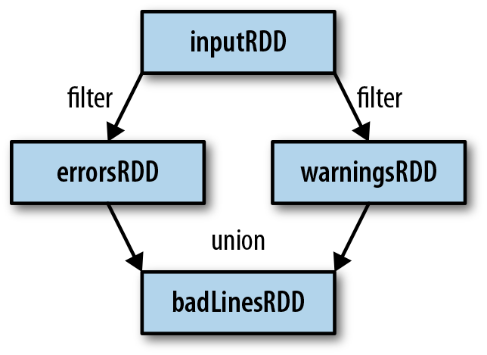
RDD Operations:
Spark keeps track of the set of dependencies between different RDDs, as you keep deriving new RDDs from each other using transformation.
This is called lineage graph. Below shows the RDD lineage graph created during log analysis.
Spark uses this info to compute each RDD on demand and to recover lost data if part of a persistent RDD is lost.

Slide 16
RDD Operations:
Actions:
Actions are the second type of operation. These return a final value to driver program or write data to an external storage system.
Actions force the evaluation of the transformations required for the RDD they were called on, and produces output.
E.g – to print info about badLinesRDD, we will use two actions, count() – ret the count as a number and take() collects a no of elements from the RDD.
Take() will retrieve a small no of elements in the RDD at the driver program.
Collect() function will retrieve the entire RDD. This is useful if your program filters RDDs down to a very small size and so that you deal with it locally.
Keep in mind that your entire data set must fit in memory on a single machine to use collect(), so collect() should not be used on large datasets.

Slide 17
RDD Operations:
Python error count using actions:
print "Input had " + badLinesRDD.count() + " concerning lines"
print "Here are 10 examples:"
for line in badLinesRDD.take(10):
print line
Scala error count using actions
println("Input had " + badLinesRDD.count() + " concerning lines")
println("Here are 10 examples:")
badLinesRDD.take(10).foreach(println)
Java error count using actions
System.out.println("Input had " + badLinesRDD.count() + " concerning lines")
System.out.println("Here are 10 examples:")
for (String line: badLinesRDD.take(10)) {
System.out.println(line);
}

Slide 18
RDD Operations:
In most cases RDDs, can’t just be collect() ed to the driver because they are too large.
In these cases, it is common to write data out to a distributed storage such as HDFS or Amazon s3.
You can save contents of RDD using saveAsTextFile() action, saveAsSequenceFile(), or any of actions available for built-in formats.
Note that each time you call a new action, entire RDD must be computed “from scratch”. To Avoid this inefficiency, users can persist intermediate results.
Lazy Evaluation:
Transformations on RDDs are lazily evaluated, means spark will not begin execution until it sees an action.
Lazy evaluation means, Spark internally records metadata to indicate that this operation has been requested.
Spark thinks RDDs consisting of instructions on how to compute the data rather than data.
Loading data into an RDD is lazily evaluated in the same way transformations are.
Hence when we call sc.textFile() , the data is not loaded until necessary.

Slide 19
RDD Operations:
Similar to transformations, the data operations (here reading the data) can occur multiple times.
Easy way to test our program is running an action at any point of time, like count().
Spark uses lazy evaluation to reduce the number of passes it has to take over our data by grouping operations together.
In systems like Hadoop MapReduce, developers often have to spend a lot of time considering how to group together operations to minimize the number of MapReduce passes.
In Spark, there is no substantial benefit to writing a single complex map instead of chaining together many simple operations. Thus, users are free to organize their program into smaller, more manageable operations.

Slide 20
Passing functions to Spark
In most of Spark’s transformations, and some of its actions, we pass functions.
These functions are used by Spark to compute data.
Each of the core languages has a slightly different way/mechanism for passing functions to spark.
Python – passing functions:
We have 3 options for passing functions into spark.
shorter functions – we can use lambda
word = rdd.filter(lambda s: "error" in s)
def containsError(s):
return "error" in s
word = rdd.filter(containsError)
We can pass top–level functions or
Locally defined functions

Slide 21
Passing functions to Spark
We should take care below points while passing functions
When we pass functions, we are accidentally/without intention , serializing the object containing the function.
This is because, when you pass a function that is member of an object or function containing reference to fields in an object (e.g. self.field), then spark sends the entire object to worker nodes, which can be much larger than the information you need.
E.g. passing a function with field reference, (don’t do this)
class SearchFunctions(object):
def __init__(self, query):
self.query = query
def isMatch(self, s):
return self.query in s
def getMatchesFunctionReference(self, rdd):
# Problem: references all of "self" in "self.isMatch"
return rdd.filter(self.isMatch)
def getMatchesMemberReference(self, rdd):
# Problem: references all of "self" in "self.query"
return rdd.filter(lambda x: self.query in x)

Slide 22
Passing functions to Spark
Instead, just extract the fields you need from your object into a local variable and pass that in, as shown in next example.
Python function passing without field references
class WordFunctions(object):
...
def getMatchesNoReference(self, rdd):
# Safe: extract only the field we need into a local variable
query = self.query
return rdd.filter(lambda x: query in x)

Slide 23
Passing functions to Spark
Scala – passing functions:
We can pass in functions
defined INLINE,
references to methods or
Static functions
The other considerations are – the functions we pass and the data referenced in functions need to be serializable (implementing Java’s serializable interface).
The problem with python(forced to write self) is less problematic in scala as we are forced to use ‘self’.
As we did in the python example, extract the fields we need as local variables and avoid needing to pass the whole object containing them.(seen in next example)
If NotSerializableException occurs in Scala, a reference to a method or field in a nonserializable class is usually the problem.
Note that passing in local serializable variables or functions that are members of a top-level object is always safe.

Slide 24
Passing functions to Spark
Scala passing functions example:
class SearchFunctions(val query: String) {
def isMatch(s: String): Boolean = {
s.contains(query)
}
def getMatchesFunctionReference(rdd: RDD[String]): RDD[Boolean] = {
// Problem: "isMatch" means "this.isMatch", so we pass all of "this"
rdd.map(isMatch)
}
def getMatchesFieldReference(rdd: RDD[String]): RDD[Array[String]] = {
// Problem: "query" means "this.query", so we pass all of "this"
rdd.map(x => x.split(query))
}
def getMatchesNoReference(rdd: RDD[String]): RDD[Array[String]] = {
// Safe: extract just the field we need into a local variable
val query_ = this.query
rdd.map(x => x.split(query_))
} }

Slide 25
Passing functions to Spark
Java – Passing functions:
In Java, functions are specified as objects that implement one of Spark’s function interfaces from the org.apache.spark.api.java.function package.
There are a number of different interfaces based on the return type of the function.
most basic function interfaces are shown below:
Standard Java function interfaces:
Function name --- Method to implement --- Usage
Function<T, R> --- R call(T) --- Take in one input and return one output, for use with operations like map() and filter().
Function2<T1, T2, R> --- R call(T1, T2) --- Take in two inputs and return one output, for use with operations like aggregate() or fold().
FlatMapFunction<T, R> --- Iterable<R> call(T) --- Take in one input and return zero or more outputs, for use with operations like flatMap().

Slide 26
Passing functions to Spark
We can either define our function classes inline as anonymous innter class (i) or create a named class (ii)
(i) Java function passing with anonymous inner class
RDD<String> errors = lines.filter(new Function<String,Boolean>() {
public Boolean call(String x) { return x.contains("error"); } });
(ii) Java function passing with named class
class ContainsError implements Function<String, Boolean>() {
public Boolean call(String x) { return x.contains("error"); } }
We pass the above functions as below
RDD<String> errors = lines.filter(new ContainsError());

Slide 27
Passing functions to Spark
The style to choose is a personal preference.
But we find that top-level named functions are ofter cleaner for organizing large programs.
Another benefit of top-level functions is that you can give them constructor parameters, as shown below.
(Iii)Java function class with parameters
class Contains implements Function<String, Boolean>() {
private String query;
public Contains(String query) { this.query = query; }
public Boolean call(String x) { return x.contains(query); }
} and we can pass the function as
RDD<String> errors = lines.filter(new Contains("error"));

Slide 28
Passing functions to Spark
Java 8, you can also use lambda expressions to easily implement the function interfaces.
(iv)function passing with lambda expression in Java 8
RDD<String> errors = lines.filter(s -> s.contains("error"));
Refer http://bit.ly/1ywZBs4, databrics blog post on how to use lambdas with spark.
Both anonymous inner classes and lambda expressions in Java can reference any final variables in the method enclosing them, so you can pass these variables to Spark just as in Python and Scala.

Slide 29
Common Transformations and Actions
Basic RDDs: we will discuss common transformations and actions can be performed on all RDDs regardless of data.
(RDDs with certain types of data, additional operations can be performed.)
Element-wise transformations:
The two most common transformations we will be using are map() and filter().
Map()
The map() transformation takes in a function and applies it to each element in the RDD, result contains new value for each element in the RDD.
filter()
The filter() transformation takes in a function and returns an RDD that only has elements that pass the filter() function.

Slide 30
Common Transformations and Actions
We can use map() to do any number of things.
Python squaring the values in an RDD:
nums = sc.parallelize([1, 2, 3, 4])
squared = nums.map(lambda x: x * x).collect()
for num in squared:
print "%i " % (num)
Scala squaring the values in an RDD:
val input = sc.parallelize(List(1, 2, 3, 4))
val result = input.map(x => x * x)
println(result.collect().mkString(","))
Java squaring the values in an RDD:
JavaRDD<Integer> rdd = sc.parallelize(Arrays.asList(1, 2, 3, 4));
JavaRDD<Integer> result = rdd.map(new Function<Integer, Integer>() { public Integer call(Integer x) { return x*x; } });
System.out.println(StringUtils.join(result.collect(), ","));

Slide 31
Common Transformations and Actions
Produce multiple output elements for each input element. The operation to do this is called flatMap().
Similar to map(), the function we provide to flatMap() is called individually for each element in our input RDD.
Instead of returning a single element, we return an iterator with our return values.
Rather than producing an RDD of iterators, we get back an RDD that consists of the elements from all of the iterators.
A simple usage of flatMap() is splitting up an input string into words.
flatMap() in Python, splitting lines into words:
lines = sc.parallelize(["hello world", "hi"])
words = lines.flatMap(lambda line: line.split(" "))
words.first() # returns "hello"

Slide 32
Common Transformations and Actions
flatMap() in Scala, splitting lines into multiple words:
val lines = sc.parallelize(List("hello world", "hi"))
val words = lines.flatMap(line => line.split(" "))
words.first() // returns "hello"
flatMap() in Java, splitting lines into multiple words:
JavaRDD<String> lines = sc.parallelize(Arrays.asList("hello world", "hi"));
JavaRDD<String> words = lines.flatMap(new FlatMapFunction<String, String>() {
public Iterable<String> call(String line) {
return Arrays.asList(line.split(" ")); } });
words.first(); // returns "hello"

Slide 33
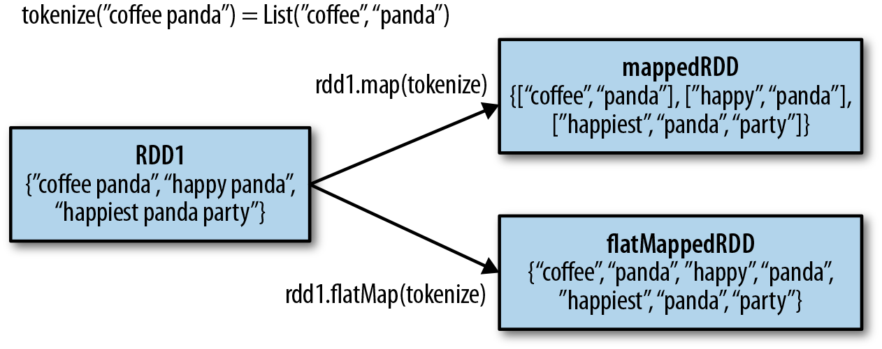
Common Transformations and Actions
Difference between map() and flatmap() shown below.
You can think of flatMap() as “flattening” the iterators returned to it.

Slide 34
Common Transformations and Actions
Pseudo set operations:
RDDs support many of the operations of mathematical sets, such as union and intersection, even when the RDDs themselves are not properly sets.
we can use the RDD.distinct() transformation to produce a new RDD with only distinct items.
Note that distinct() is expensive, however, as it requires shuffling all the data over the network to ensure that we receive only one copy of each element.
Shuffling, and how to avoid it, is discussed in more detail in later sections.
The simplest set operation is union(other), which gives back an RDD consisting of the data from both sources.
Unlike the mathematical union(), if there are duplicates in the input RDDs, the result of Spark’s union() will contain duplicates.

Slide 35
Common Transformations and Actions
Pseudo set operations: cont..
Spark also provides an intersection(other) method, which returns only elements in both RDDs. It also removes all duplicates (including duplicates from a single RDD) while running.
While intersection() and union() are two similar concepts, the performance of intersection() is much worse since it requires a shuffle over the network to identify common elements.
The subtract(other) function takes in another RDD and returns an RDD that has only values present in the first RDD and not the second RDD. Like intersection(), it performs a shuffle.
We can also compute a Cartesian product between two RDDs.
The cartesian(other) transformation returns all possible pairs of (a, b) where a is in the source RDD and b is in the other RDD.
The Cartesian product can be useful when we wish to consider the similarity between all possible pairs. We can also take the Cartesian product of an RDD with itself, which can be useful for tasks like user similarity. Warning – the Cartesian product is very expensive for large RDDs.

Slide 36
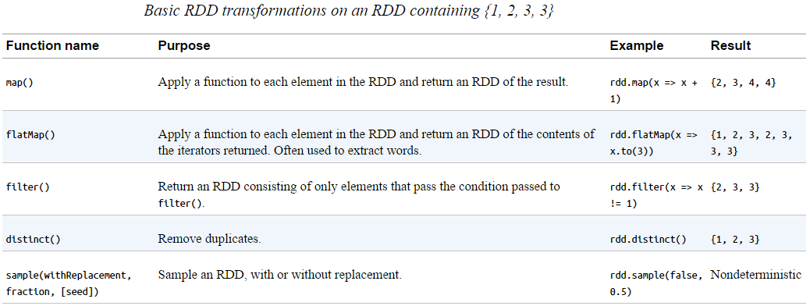
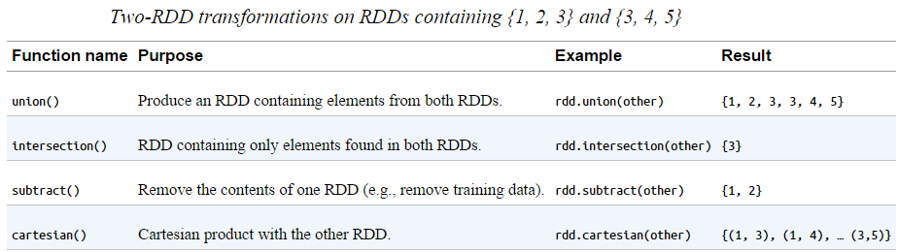
Common Transformations and Actions

Slide 37
Common Transformations and Actions
Actions:
The most common action on basic RDDs you will likely use is reduce(),
which takes a function that operates on two elements of the type in your RDD and returns a new element of the same type.
A simple example of such a function is +, which we can use to sum our RDD.
With reduce(), we can easily sum the elements of our RDD, count the number of elements, and perform other types of aggregations
reduce() in Python: sum = rdd.reduce(lambda x, y: x + y)
reduce() in Scala: val sum = rdd.reduce((x, y) => x + y)
reduce() in Java:
Integer sum = rdd.reduce(new Function2<Integer, Integer, Integer>() { public Integer call(Integer x, Integer y) { return x + y; } });

Slide 38
Common Transformations and Actions
Similar to reduce() is fold(), in addition to function provided to reduce(), it takes a ZERO value to be used for the initial call on 'each partition‘.
The zero value you provide should be the identity element for your operation; that is, applying it(zero value) multiple times with your function should not change the value.
E.g identity elements are : (e.g., 0 for +, 1 for *, or an empty list for concatenation).
You can minimize object creation in fold() by modifying and returning the first of the two parameters in place. However, you should not modify the second parameter.
Both fold() and reduce() require that the return type of our result be the same type as that of the elements in the RDD we are operating over.

Slide 39
Common Transformations and Actions
aggregate() function frees us from the constraint of having the return be the same type as the RDD we are working on. For aggregate also, we need to supply initial zero value of the type we want to return. We then supply a function to combine the elements from our RDD with the accumulator.
Finally, we need to supply a second function to merge two accumulators, given that each node accumulates its own results locally.
We can use aggregate() to compute the average of an RDD, avoiding a map() before the fold(), as shown below.
aggregate() in Python
sumCount = nums.aggregate((0, 0),
(lambda acc, value: (acc[0] + value, acc[1] + 1)),
(lambda acc1, acc2: (acc1[0] + acc2[0], acc1[1] + acc2[1])))
return sumCount[0] / float(sumCount[1])

Slide 40
Common Transformations and Actions
aggregate() in Scala
val result = input.aggregate((0, 0))(
(acc, value) => (acc._1 + value, acc._2 + 1),
(acc1, acc2) => (acc1._1 + acc2._1, acc1._2 + acc2._2))
val avg = result._1 / result._2.toDouble
aggregate() in Java
class AvgCount implements Serializable {
public AvgCount(int total, int num) {
this.total = total; this.num = num; }
public int total; public int num;
public double avg() { return total / (double) num; }
}
Function2<AvgCount, Integer, AvgCount> addAndCount =
new Function2<AvgCount, Integer, AvgCount>() {
public AvgCount call(AvgCount a, Integer x) {
a.total += x; a.num += 1; return a; }
};
Function2<AvgCount, AvgCount, AvgCount> combine =
new Function2<AvgCount, AvgCount, AvgCount>() {
public AvgCount call(AvgCount a, AvgCount b) {
a.total += b.total; a.num += b.num; return a; }
};
AvgCount initial = new AvgCount(0, 0);
AvgCount result = rdd.aggregate(initial, addAndCount, combine);
System.out.println(result.avg());

Slide 41
Common Transformations and Actions
Some actions on RDDs return some or all of the data to our driver program in the form of a regular collection or value.
The simplest and most common operation that returns data to our driver program is collect(), which returns the entire RDD’s contents.
collect() suffers from the restriction that all of your data must fit on a single machine, as it all needs to be copied to the driver.
take(n) returns n elements from the RDD and attempts to minimize the number of partitions it accesses, so it may represent a biased collection.
we can also extract the top elements from an RDD using top(). top() will use the default ordering on the data, but we can supply our own comparison function to extract the top elements.
takeSample(withReplacement, num, seed) function allows us to take a sample of our data either with or without replacement.
Sometimes it is useful to perform an action on all of the elements in the RDD, but without returning any result to the driver program.
A good example of this would be posting JSON to a webserver or inserting records into a database.
In either case, the foreach() action lets us perform computations on each element in the RDD without bringing it back locally.
count() returns a count of the elements, and countByValue() returns a map of each unique value to its count.

Slide 42
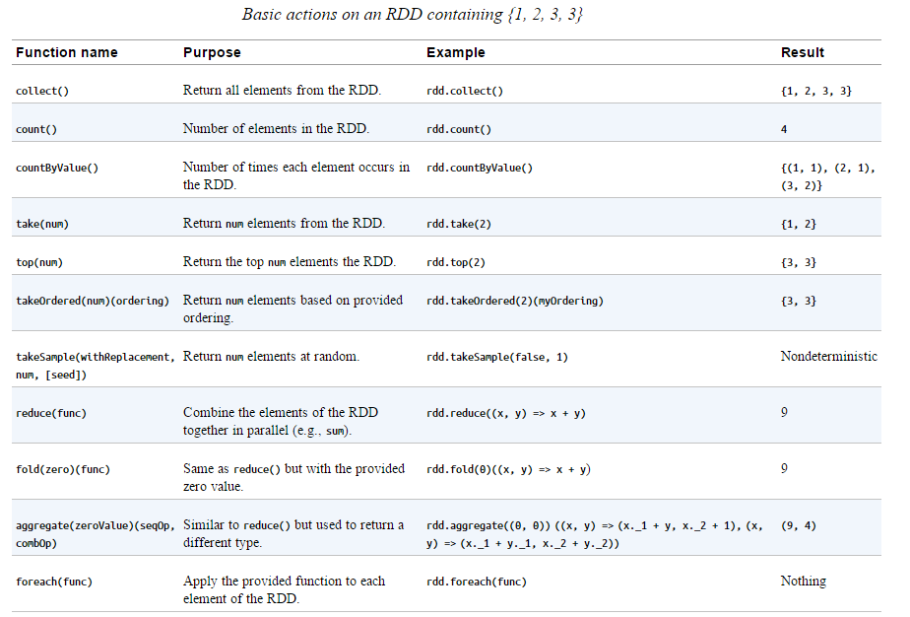
Common Transformations and Actions

Slide 43
Common Transformations and Actions
Converting Between RDD Types:
Some functions are available only on certain types of RDDs, such as mean() and variance() on numeric RDDs or join() on key/value pair RDDs.
In Scala and Java, these methods aren’t defined on the standard RDD class, so to access this additional functionality we have to make sure we get the correct specialized class.
Scala: the conversion to RDDs with special functions (e.g., to expose numeric functions on an RDD[Double]) is handled automatically using implicit conversions.
we need to add import org.apache.spark.SparkContext._ for these conversions to work.
You can see the implicit conversions listed in the SparkContext object’s ScalaDoc. http://spark.apache.org/docs/latest/api/scala/index.html#org.apache.spark.SparkContext$
These implicits turn an RDD into various wrapper classes, such as DoubleRDDFunctions (for RDDs of numeric data) and PairRDDFunctions (for key/value pairs), to expose additional functions such as mean() and variance().

Slide 44
Common Transformations and Actions
Implicits, while quite powerful, can sometimes be confusing.
If you call a function like mean() on an RDD, you might look at the Scaladocs for the RDD class and notice there is no mean() function.
The call manages to succeed because of implicit conversions between RDD[Double] and DoubleRDDFunctions.
When searching for functions on your RDD in Scaladoc, make sure to look at functions that are available in these wrapper classes.
JAVA :
In Java the conversion between the specialized types of RDDs is a bit more explicit.
In particular, there are special classes called JavaDoubleRDD and JavaPairRDD for RDDs of these types, with extra methods for these types of data.
This has the benefit of giving you a greater understanding of what exactly is going on, but can be a bit more cumbersome.

Slide 45
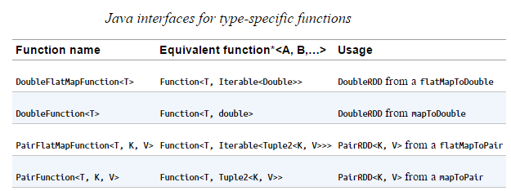
Common Transformations and Actions
To construct RDDs of these special types, instead of always using the Function class we will need to use specialized versions.
If we want to create a DoubleRDD from an RDD of type T, rather than using Function<T, Double> we use DoubleFunction<T>.
Below table shows the specialized functions and their uses.

Slide 46
Common Transformations and Actions
We also need to call different functions on our RDD (so we can’t just create a DoubleFunction and pass it to map()).
When we want a DoubleRDD back, instead of calling map(), we need to call mapToDouble() with the same pattern all of the other functions follow.
We can modify below example where we squared an RDD of numbers, to produce a JavaDoubleRDD, as shown in Example DoubleRDD.
This gives us access to the additional DoubleRDD specific functions like mean() and variance().
Java squaring the values in an RDD
JavaRDD<Integer> rdd = sc.parallelize(Arrays.asList(1, 2, 3, 4));
JavaRDD<Integer> result = rdd.map(new Function<Integer, Integer>() {
public Integer call(Integer x) { return x*x; }
});
System.out.println(StringUtils.join(result.collect(), ","));
Modified as shown in example on next page:

Slide 47
Common Transformations and Actions
Creating DoubleRDD in Java
JavaDoubleRDD result = rdd.mapToDouble(
new DoubleFunction<Integer>() {
public double call(Integer x) {
return (double) x * x;
}
});
System.out.println(result.mean());
Python
The Python API is structured differently than Java and Scala. In Python all of the functions are implemented on the base RDD class but will fail at runtime if the type of data in the RDD is incorrect.

Slide 48
Common Transformations and Actions
Persistence (Caching):
Spark RDDs are lazily evaluated, and sometimes we may wish to use the same RDD multiple times.
If we do this naively, Spark will recompute the RDD and all of its dependencies each time we call an action on the RDD.
This can be especially expensive for iterative algorithms, which look at the data many times. Like below,
Double execution in Scala
val result = input.map(x => x*x)
println(result.count())
println(result.collect().mkString(","))
To avoid computing an RDD multiple times, we can ask Spark to persist the data.
When we ask Spark to persist an RDD, the nodes that compute the RDD store their partitions.

Slide 49
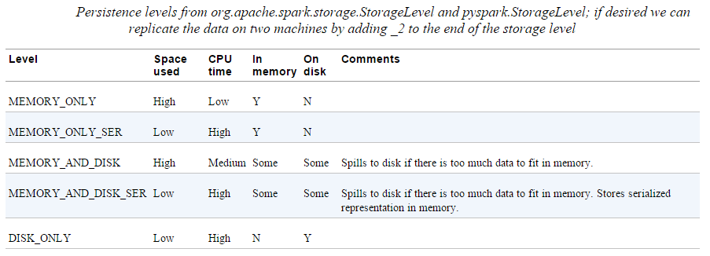
Common Transformations and Actions
Persistence (Caching): cont..
If a node that has data persisted on it fails, Spark will recompute the lost partitions of the data when needed.
We can also replicate our data on multiple nodes if we want to be able to handle node failure without slowdown.
Spark has many levels of persistence to choose from based on what our goals are, as shown below.

Slide 50
Common Transformations and Actions
Persistence (Caching): cont..
In Scala and Java, the default persist() will store the data in the JVM heap as unserialized objects.
In Python, we always serialize the data that persist stores, so the default is instead stored in the JVM heap as pickled objects.
When we write data out to disk or off-heap storage, that data is also always serialized.
Off-heap caching is experimental and uses Tachyon. If you are interested in off-heap caching with Spark, take a look at the Running Spark on Tachyon guide.
(Alluxio, formerly known as Tachyon, is a memory speed virtual distributed storage system)
persist() in Scala
import org.apache.spark.storage.StorageLevel
val result = input.map(x => x * x)
result.persist(StorageLevel.DISK_ONLY)
println(result.count())
println(result.collect().mkString(","))

Slide 51
Common Transformations and Actions
Persistence (Caching): cont..
Notice that we called persist() on the RDD before the first action.
The persist() call on its own doesn’t force evaluation.
If you attempt to cache too much data to fit in memory, Spark will automatically evict old partitions using a Least Recently Used (LRU) cache policy.
For the memory-only storage levels, it will recompute these partitions the next time they are accessed, while for the memory-and-disk ones, it will write them out to disk.
In either case, this means that you don’t have to worry about your job breaking if you ask Spark to cache too much data.
However, caching unnecessary data can lead to eviction of useful data and more recomputation time.
Finally, RDDs come with a method called unpersist() that lets you manually remove them from the cache.

