Slide 1
Spark
Introduction

Slide 2
What is Spark?
Apache Spark is a cluster computing platform designed to be fast and general-purpose.
Speed – Spark extends MR model, and supports more types of computations other than batch.
Spark with the same engine, supports
Batch applications
Iterative algorithms
Interactive queries and
Streaming
Since it uses the same engine for different processing types, we can combine these processing types in easy and inexpensive way.
This reduces management burden of maintaining separate tools.

Slide 3
What is Spark? cont..
Spark offers simple APIs in below languages, that makes spark highly accessible.
Python
Java
Scala and
SQL.
Spark integrates closely with other BigData tools, and it can run in Hadoop clusters and can access any data source including Cassandra.

Slide 4
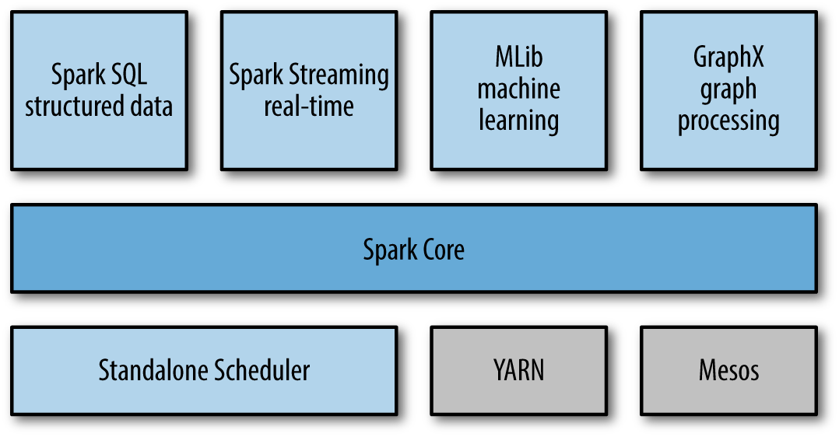
Spark Stack

Slide 5
Spark Stack – Spark Core
Includes Basic functionality of Spark like
Task Scheduling
Memory Management
Fault Recovery
Integration with diff Storage systems e.t.c.
Spark Core is home to the API that defines RDD
Resilient Distributed Datasets – Sprak’s main programming abstraction.
RDDs represents collection of items distributed across compute nodes that can be manipulated in parallel.
Spark Core provides API’s for building and manipulating these collections.

Slide 6
Spark Stack – Spark SQL
Spark SQL – Spark’s package for working with structured data.
Allows querying via SQL as well as Hive QL.
It supports many sources like,
Hive tables,
Parquet,
JSON
Spark SQL allows to intermix SQL queries with programmatic data manipulations supported by RDDs in Python, Java and Scala.
This tight integration makes Spark SQL, a DW tool.

Slide 7
Spark Stack – Spark Streaming
This component enables processing of live streams of data.
Example for live stream data sources are,
Logfiles generated by Production Web servers,
Queues of messages containing status updates posted by users of a web service.
This APIs closely resembles Spark Core’s RDD API, makes it easy for programmers to learn sot that they can easily work with data stored in memory, on disk, or arriving in real time.
Spark Streaming provides same degree of throughput, Scalability and fault tolerance as Spark Core.

Slide 8
Spark Stack – MLib
This Spark’s library comes with common Machine Learning (ML) functionalities.
MLlib provides ML algorithms such as
Classification
Regression
Clustering and
Collaborative filtering
Functionalities like
Model Evaluation and Data Import
MLlib also provides low-level ML primitives,
Generic gradient optimization algorithm
All the algorithms and functionalities scale out in a cluster.

Slide 9
Spark Stack – GraphX
Graphx is a Library to manipulate graphs and performing graph-parallel computations.
E.g. graph is Social network’s friend graph.
Like Spark Streaming and Spark SQL, GraphX extends the Spark RDD API.
You can create a directed graph with Vertex and Edge attached with arbitrary properties.
GraphX provides
various operators for manipulating graphs (e.g Subgraph and mapVerticies) and
Library of common graph algorithms (e.g PageRank and Triangle Counging)

Slide 10
Spark Stack – Cluster Management
Spark is designed to scaleup efficiently from one to many thousands of compute nodes.
Spark can run over a variety of cluster managers, like
Hadoop YARN,
Apache Mesos,
Simple cluster manager included in Spark (called Standalone Scheduler)
If you are just installing Spark on an empty set of machines, Standalone Scheduler provides an easy way to get started.

Slide 11
Spark – Use Cases
Spark is General purpose framework for cluster computing, hence it is used over a wide range of applications.
There are majorly two categories of use cases.
Data Science tasks
Data processing applications

Slide 12
Spark – Data Science Use Cases
Data Science, centers on analyzing data.
Data Scientist’s main task is to analyze and model data. They need experience on
SQL
Statistics,
Predictive modeling and Machine Learning
Programming in Python, Matlab or R
Data Scientist should have experience in Data Wrangling -transform data into formats that can be analyzed for insights.
Often the workflow involves adhoc analysis, so they need to perform interactive analysis and see the results of queries in less time.
Spark’s speed and simple API is best suited for this need and also provides built-in libraries that contains many algorithms.

Slide 13
Spark – Data Science Use Cases
Spark supports different tasks of data scientists with no of components.
SQL - spark sql allows to explore data using SQL
Statistics,
Predictive modeling and Machine Learning - MLlib
Programming in Python, Matlab or R – Spark Core provides interactive analysis using Python, Scala.
Spark Core have support to call external programs in Matlab ro R.
Once data scientists completes the exploration phase, it is the work of Data Engineer to productize the work of data scientist.

Slide 14
Spark – Data Processing Applications Use Cases
Developers need to design and build software systems that implement a business usecase.
Spark provides a simple way to parallelize these applications across clusters and hides the complexity of
distributed programming,
Network communication and
Fault tolerance.
The system gives them enough control to monitor, inspect and tune applications and also allows to implement common tasks quickly.
Modular nature of APIs makes it easy to factor work into reusable libraries and test each locally and idividullay.
Most users prefer Spark as it provides a wide variety of functionality, easy to learn and use, and mature and reliable.

Slide 15
Spark – History
Started in 2009 as a research project in UC Berkeley Lab, later become the AMPLab.
Spark designed on features where MapReduce was lacking/inefficient, which is interactive and iterative jobs.
Hence the Ideas like in-memory storage and efficient fault recovery were implemented in Spark.
See who are all using - https://cwiki.apache.org/confluence/display/SPARK/Powered+By+Spark
2011, AMPLabs developed higher-level components on Spark, such as Shark (Hive on Spark) and Spark Streaming. (Shark replaced by Spark SQL)
June 2013, transferred to Apache foundation.

Slide 16
Spark – Versions
Spark 1.6.0 (latest release)
Spark 1.5.2
Spark 1.5.1
Spark 1.5.0
Spark 1.4.1
Spark 1.4.0
Spark 1.3.1
Spark 1.3.0
Spark 1.2.1
Spark 1.1.1
Spark 1.0.2
Spark 0.9.2
Spark 0.8.1
Spark 0.7.3
Spark 0.6.2

Slide 17
Spark – Installation
Download the latest package of type “Pre-built for Hadoop 2.6 and later”
Un compress the tarballs
Windows – install spark in a directory with no space in the directory name.
No need to have Hadoop. If you have an existing Hadoop cluster or HDFS installation, download matching version.
Spark folder contains
Bin – contains executables that can be used to interact with spark, like Spark shell
Core, Streaming, Python – contains the source code of major components of Spark project
Examples – Spark standalone jobs that you can run and learn about the Spark API.
Tryout Spark’s Python and Scala shells.
First run some examples that come with Spark, and write,compile and run simple spark jobs.
We first see running the spark in local mode, that uses only single machine.
Spark cab also be run on Mesos, YARN or Standalone Scheduler(included in Spark distribution)

Slide 18
Spark – Python and Scala Shells

