Slide 1
TS20180906 Introduction to Programming
Chao Zhang, zhangchk@hku.hk
Rm418, CYM Physics Building

Slide 2
Course Website
https://husisy.github.io/PHYS4150-2018/
lecture note
lecture PPT
course notification
session tutorials materials (mainly code)
etc.

Slide 3
Course Website
How to view files online
How to download files
More details see Instruction

Slide 4
Course Information (see website)
Course contents
Course assessments methods and weights
assignments (20%)
examination: mid + final (40%)
presentation (15%)
project report (25%)
Reading materials

Slide 5
Tutorial Session time slots
(every week) Thursday 11:30-12:20 (10:30-11:20 for lecture)
Additional tutorial sessions, MBG07, Main Building
Sep 12 , Wed, 11:30-12:20
Sep 26 , Wed, 11:30-12:20
Oct 10 , Wed, 11:30-12:20
Oct 31 , Wed, 11:30-12:20
Nov 21, Wed, 11:30-13:20
(also on the course website)
bring your computer to class every tutorial session

Slide 6
programming language advice
(shortly): octave is totally enough for the course requirements
(in detail)
octave (free) is almost compatible with MATLAB (commercial, 55 USD for student license)
MATLAB is more convenient and has a larger community
I will use MATLAB for presentation, but I guarantee that all codes used in presentation could also run in octave

Slide 7
Octave Installation
Official website: https://www.gnu.org/software/octave/
Click download
Select OS
(windows) download xxxx-installer.exe and run it
(macOS) follow the instruction as stated
(linux) follow the instruction as stated

Slide 8
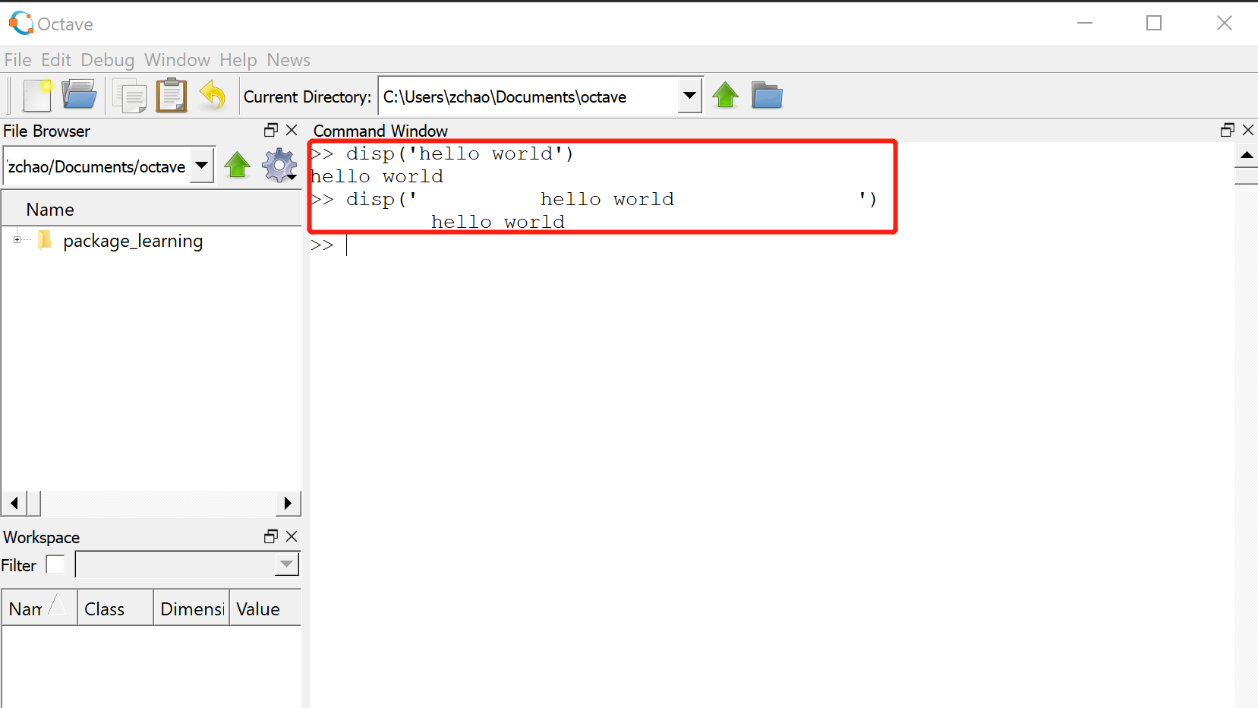
Octave UI
Type command in the command window

Slide 9
Programming advice
Do not be afraid of programming, just like how you use your first calculator
press button 1 + 1
click =
This is same in programming. typing the code as you think what it should be, if error, read the error information, it will tell you how to fix it.

Slide 10
doc and help
doc(‘sin’)
doc(‘clc’)
doc(‘plot’)
doc(‘create diagonal matrix’)
doc(‘matrix transpose’)
doc(‘.’)
doc(‘any function you get confused’)
MATLAB documentation is available online

Slide 11
Octave get-started work through
(see TS20180912.mlx)
GNU Octave wiki: https://wiki.octave.org/GNU_Octave_Wiki
Using Octave: https://wiki.octave.org/Using_Octave
If Octave cannot be installed, you could
Use octave online: https://octave-online.net
Read PHYS4150-2018/tutorial_material/TS20180912/TS20180912.pdf

Slide 12
Task
Go through Octave or MATLAB get-started
MATLAB Desktop Basics: https://www.mathworks.com/help/matlab/learn_matlab/desktop.html
Octave Programming Tutorials / Getting started: https://en.wikibooks.org/wiki/Octave_Programming_Tutorial/Getting_started
Type the code yourself and see the results. If not understand the code, use doc(bulabula) to get help
(ungraded and nothing need to submit)

Slide 13
Take home message
Bring your PC to class every tutorial session
Set up octave or MATLAB before next tutorial session
Remember to take additional tutorial sessions
Check website notification frequently
Enjoy materials on the course website

