Slide 1
PHYS4150-TS20181031 Chapter 3 summary
Chao Zhang, zhangchk@hku.hk
Rm418, CYM Physics Building

Slide 2
Homework 11 12 13 14
You homework 11,12,13,14 have been graded, please go to collect your homework at the students box outside the physics department office.
The solutions have been uploaded to course website

Slide 3
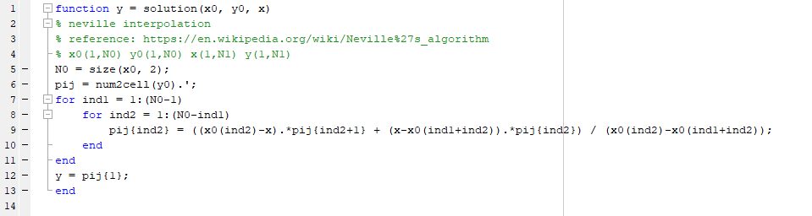
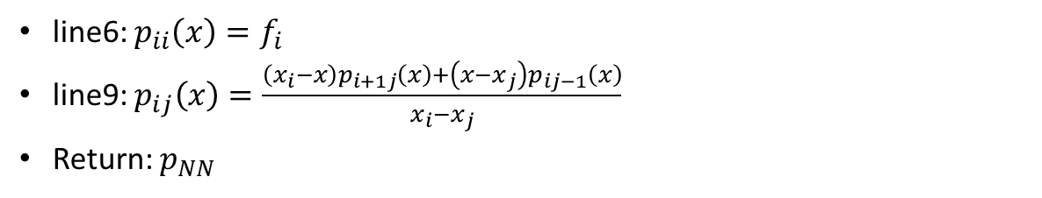
Hwk11 Neville interpolation
line6: $p_{ii}\left(x\right)=f_{i}$
line9: $p_{ij}\left(x\right)=\frac{\left(x_{i}−x\right)p_{i+1j}\left(x\right)+\left(x−x_{j}\right)p_{ij−1}\left(x\right)}{x_{i}−x_{j}}$
Return: $p_{NN}$

Slide 4
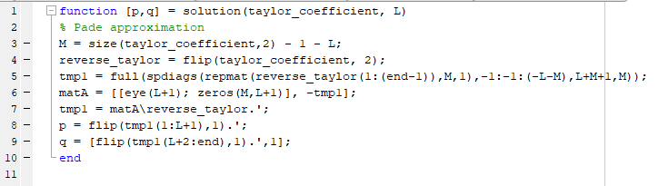
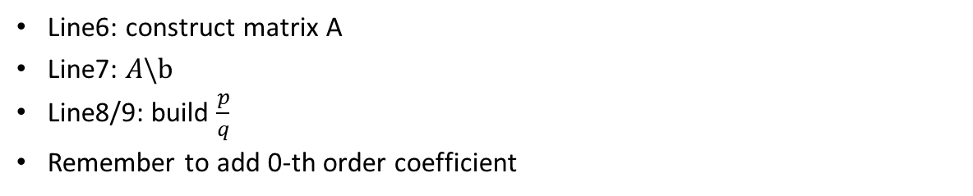
Hwk12 Pade approximation
Line6: construct matrix A
Line7: $A\backslash b$
Line8/9: build $\frac{p}{q}$
Remember to add 0-th order coefficient

Slide 5
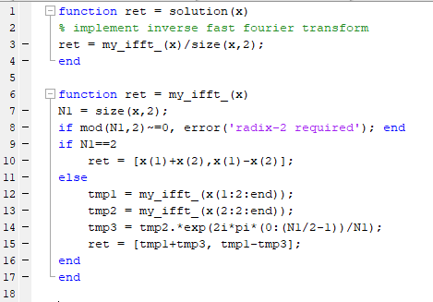
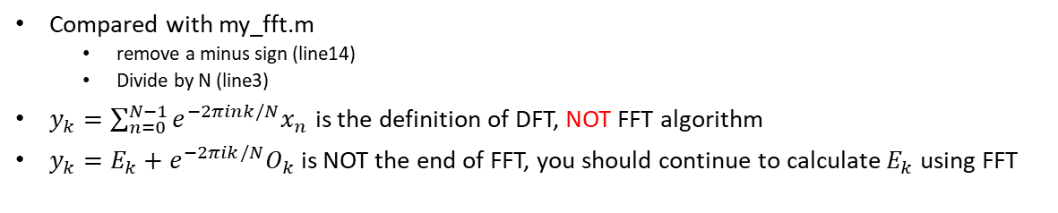
Hwk12 ifft
!Great Idea! See owen.m
Compared with my_fft.m
remove a minus sign (line14)
Divide by N (line3)
$y_{k}=\sum_{n=0}^{N−1}{e^{−2πink/N}x_{n}}$ is the definition of DFT, NOT FFT algorithm
$y_{k}=E_{k}+e^{−2πik/N}O_{k}$ is NOT the end of FFT, you should continue to calculate $E_{k}$ using FFT

Slide 6
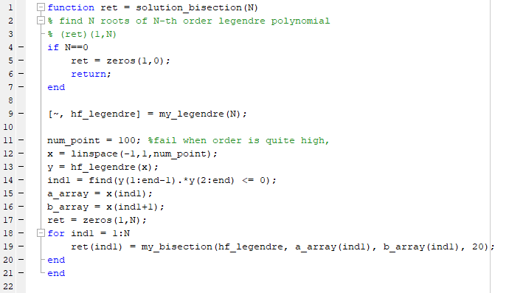
Hwk14 Legendre Root
Generate a series x grid points to find coarse range where function value change sign (line12)
For each coarse interval, use my_bisection.m or my_newton_raphson.m to find finer roots (line19)

Slide 7

Interpolation-cubic spline
Given a series pairs of function value $x_{0},x_{1},…,x_{N}$, $f_{0},f_{1},…,f_{N}$, estimate function value at some intermediate point $x$
Cubic spline: interpolation function should be continuous in first and second order derivatives

Slide 8

Cubic spline
Interval: $h_{i}=x_{i+1}−x_{i}$
Auxiliary function: $λ_{i}=\frac{x_{i+1}−x}{h_{i}}$, $ω_{i}=1−λ_{i}$
$λ_{i}\left(x_{i}\right)=ω\left(x_{i+1}\right)=1$
$λ_{i}\left(x_{i+1}\right)=ω\left(x_{i}\right)=0$
$λ_{i}^{′}\left(x_{i}\right)=λ_{i}^{′}\left(x_{i+1}\right)=−1/h_{i}$
$ω_{i}^{′}\left(x_{i}\right)=ω_{i}^{′}\left(x_{i+1}\right)=1/h_{i}$

Slide 9
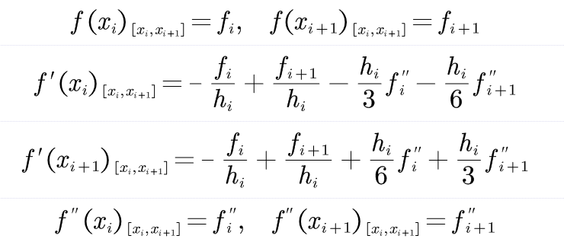

Cubic spline
Interpolation function: $f_{\left[x_{i},x_{i+1}\right]}=f_{i}λ_{i}+f_{i+1}ω_{i}+\frac{h_{i}^{2}f_{i}^{′′}}{6}\left(λ_{i}^{3}−λ_{i}\right)$ $+\frac{h_{i}^{2}f_{i+1}^{′′}}{6}\left(ω_{i}^{3}−ω_{i}\right)$
Sorry, no times to make ppt, paste picture here (TODO)

Slide 10

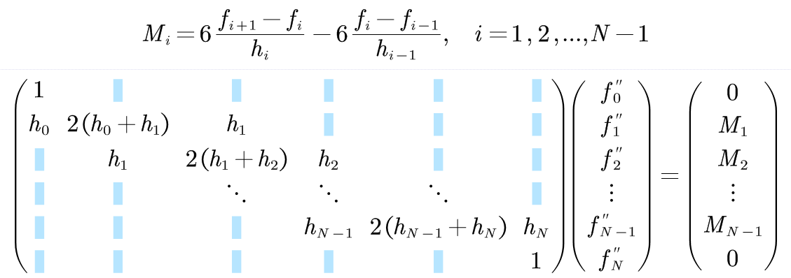
Cubic spline
Equations of first order derivative continuity
Natural boundary condition

Slide 11
Cubic spline
See TS20181031_cubic_spline.mlx
See TS20181031_cubic_spline.pdf

Slide 12
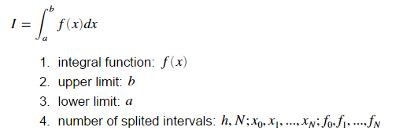
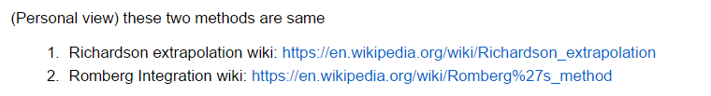
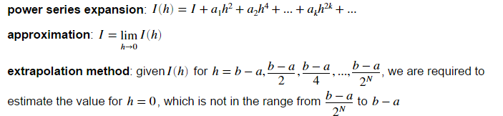
Romberg Integration

Slide 13
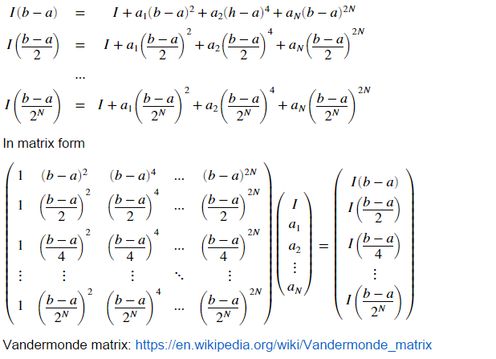
Naïve Romberg Integration

Slide 14
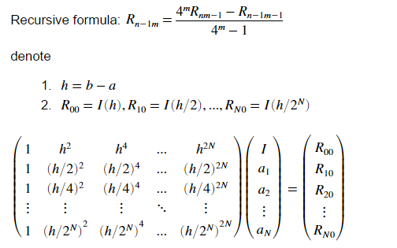
Romberg Integration

Slide 15
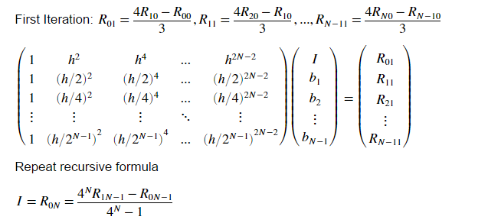
Romberg Integration

Slide 16
Romberg Integration
See TS20181031_Romberg_integration.mlx
See TS20181031_Romberg_integration.pdf

Slide 17
Chapter3 summary
interpolation
Lagrangian method
Neville method
Cubic spline
Function approximation: Pade approximation
FFT
Root finding algorithm
Bisection
Newton-Raphson method
Extrapolation (integration method)
Richardson’s deferred method
Romberg integration

