Slide 1
PHYS4150-TS20181108 Eigenvalue – Jacobi method
Chao Zhang, zhangchk@hku.hk
Rm418, CYM Physics Building

Slide 2
Eigenvalue problem
Wiki: https://en.wikipedia.org/wiki/Eigenvalues_and_eigenvectors
definition: a non-zero vector that changes by only a scalar factor when that linear transformation is applied to it

Slide 3
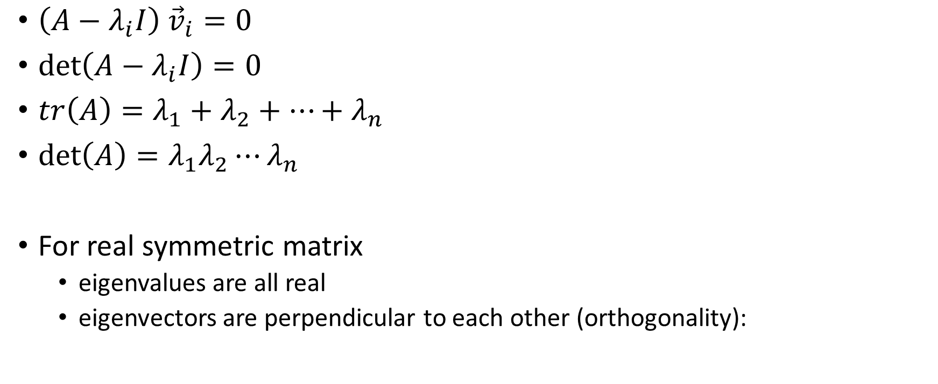
Eigenvalue property
$\left(A−λ_{i}I\right) {\vec{v}}_{i}=0$
$\det\left(A−λ_{i}I\right)=0$
$tr\left(A\right)=λ_{1}+λ_{2}+⋯+λ_{n}$
$\det\left(A\right)=λ_{1}λ_{2}⋯λ_{n}$
For real symmetric matrix
eigenvalues are all real
eigenvectors are perpendicular to each other (orthogonality):

Slide 4

Jacobi method
Wiki: https://en.wikipedia.org/wiki/Jacobi_eigenvalue_algorithm
Givens matrix $G_{i,j,θ}$

Slide 5
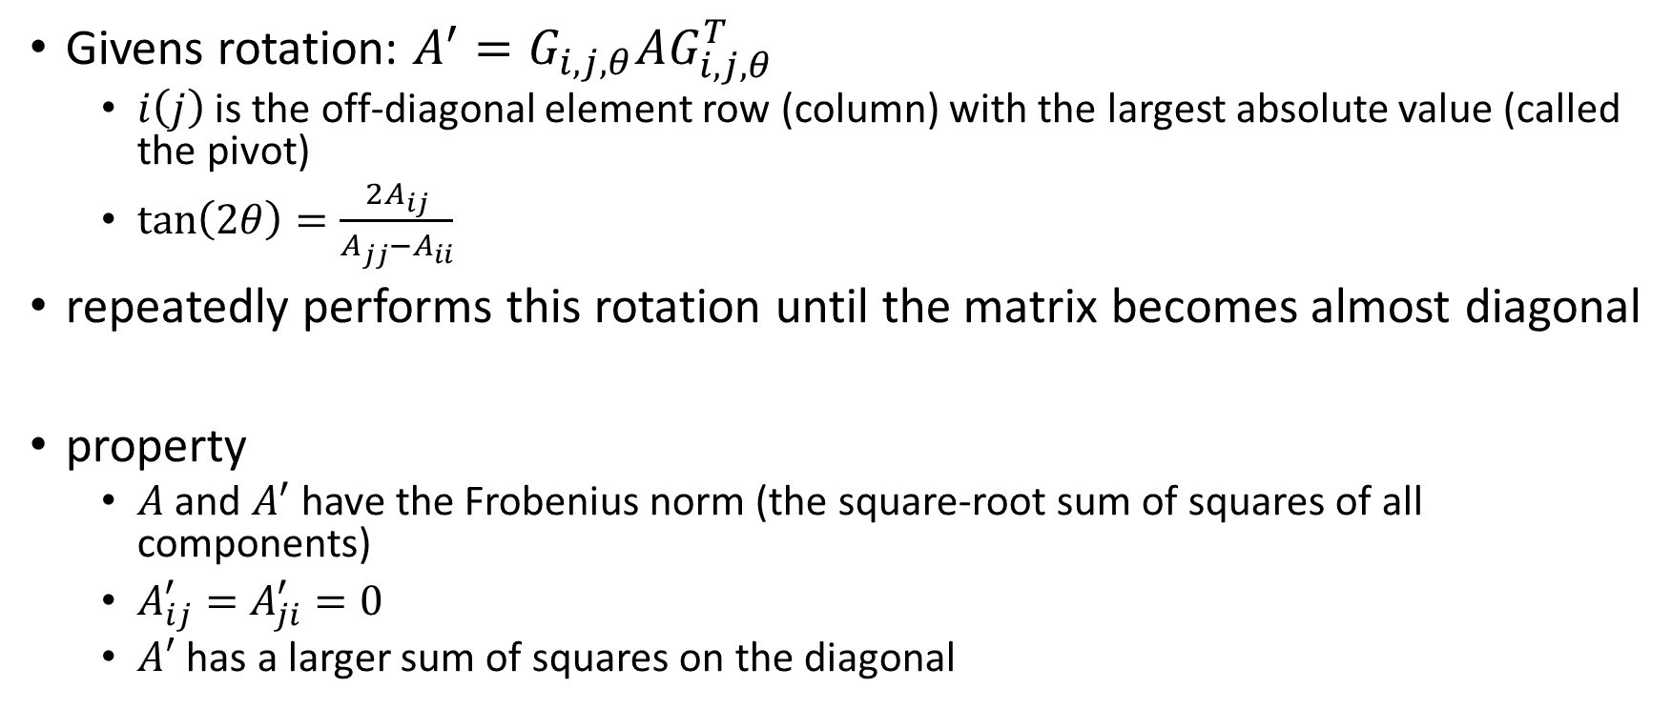
Jacobi method – procedure
Givens rotation: $A^{′}=G_{i,j,θ}AG_{i,j,θ}^{T}$
$i\left(j\right)$ is the off-diagonal element row (column) with the largest absolute value (called the pivot)
$\tan\left(2θ\right)=\frac{2A_{ij}}{A_{jj}−A_{ii}}$
repeatedly performs this rotation until the matrix becomes almost diagonal
property
$A$ and $A^{′}$ have the Frobenius norm (the square-root sum of squares of all components)
$A_{ij}^{′}=A_{ji}^{′}=0$
$A′$ has a larger sum of squares on the diagonal

Slide 6
Eigenvalue
See TS20181108/TS20181108.mlx
See TS20181108/TS20181108.pdf
See TS20181108/demo_jacobi.m

Slide 7
Take-home message
Eigenvalue problem
MATLAB Built-in method
Jacobi method
Householder-Sturm Sequence method (code uploaded, maybe next tutorial)
Reminder: hwk15, due time 20181115 23:59

