Slide 1
PHYS4150-TS20181025 Chapter 2 summary
Chao Zhang, zhangchk@hku.hk
Rm418, CYM Physics Building

Slide 2
Homework 78910
You homework 7,8,9,10 have been graded, please go to collect your homework at the students box outside the physics department office.
The solutions have been uploaded to course website

Slide 3
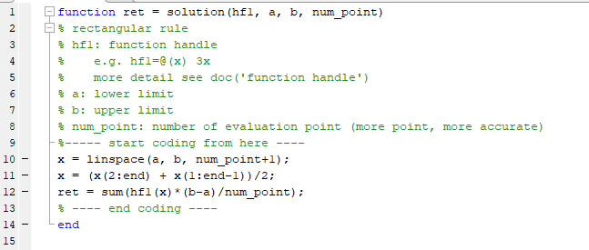
Hwk7 Rectangular rule
Generate subinterval
Generate x-points (the middle point of each subinterval)
Sum up the function values at these x-points

Slide 4
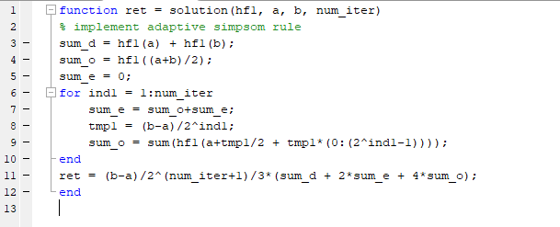
Hwk8 Simpsom rule
Compared with my_adaptive_trapezoidal_rule in tutorial material, you only need to change the coefficient in the final summation

Slide 5
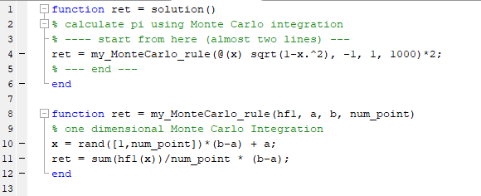
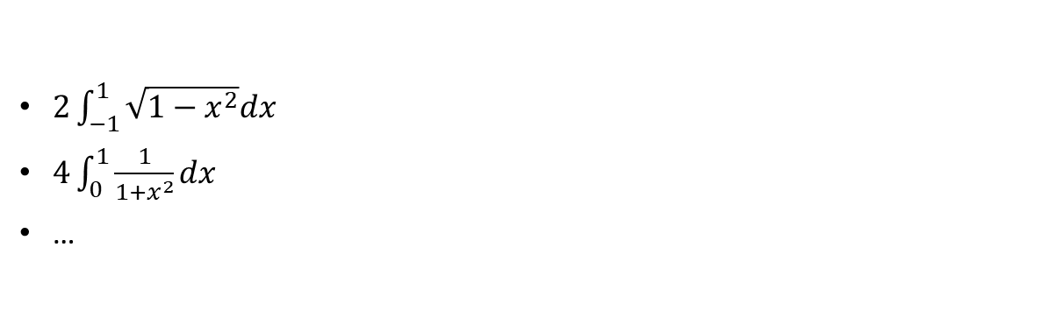
Hwk9 Monte Carlo Integration
$2\int_{−1}^{1}{\sqrt{1−x^{2}}dx}$
$4\int_{0}^{1}{\frac{1}{1+x^{2}}dx}$
…

Slide 6
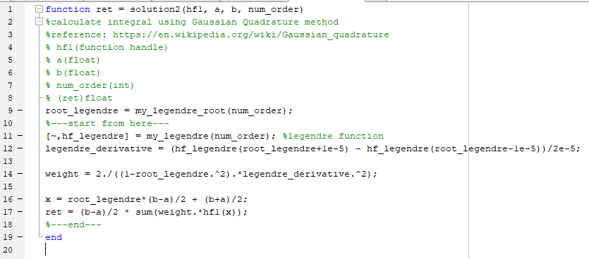
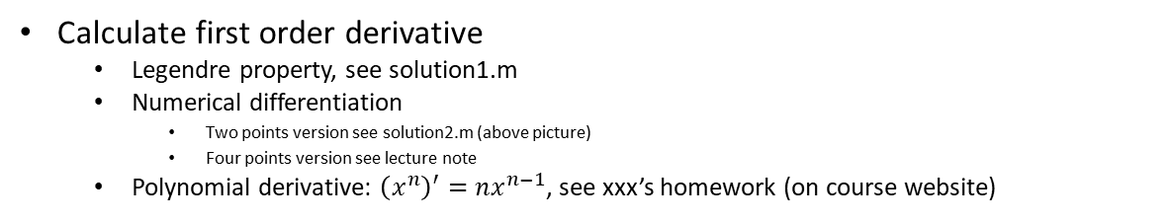
Hwk10 Gauss Quadrature
Calculate first order derivative
Legendre property, see solution1.m
Numerical differentiation
Two points version see solution2.m (above picture)
Four points version see lecture note
Polynomial derivative: ${\left(x^{n}\right)}^{′}=nx^{n−1}$, see xxx’s homework (on course website)

Slide 7
Chapter2 summary
Integration
Rectangular rule
Trapezoidal rule
Simpsom’s rule
Monte Carlo integration
Gauss-Qradrature integration
differentiation
First order
Second order

Slide 8
Reminder
homework 11, 12, 13, 14 are due at 20181025 23:59
Course project due date: 20181121 23:59
Final exam is supposed to be MUCH HARDER than past
Please start reviewing the lecture notes as soon as possible
You could find past examination papers of this course on ExamBase
http://exambase.lib.hku.hk.eproxy.lib.hku.hk/exhibits/show/exam/home
Or search “exambase hku” in google

