Slide 1
PHYS4150-TS20181010 Chapter 3 Pade, FFT, Root Finding
Chao Zhang, zhangchk@hku.hk
Rm418, CYM Physics Building

Slide 2
hwk solution correction

Slide 3
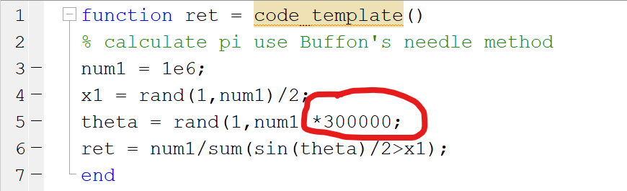

Hwk4 solution correction
Calculate pi with Buffon’s Needle method
Could avoid use $π$ explicitly
Generate random angle $θ$ from uniform distribution $U\left(0,a\right)$ where a is a LARGE number

Slide 4
Function Approximation (FA)
wiki: https://en.wikipedia.org/wiki/Function_approximation
definition: select a function among a well-defined class that closely matches ("approximates") a target function in a task-specific way

Slide 5

FA – Taylor Series
wiki: https://en.wikipedia.org/wiki/Taylor_series
Definition: $f\left(x\right)≈\sum{\frac{1}{n!}f^{\left(n\right)}x^{n}}$
A special case of Pade approximation

Slide 6
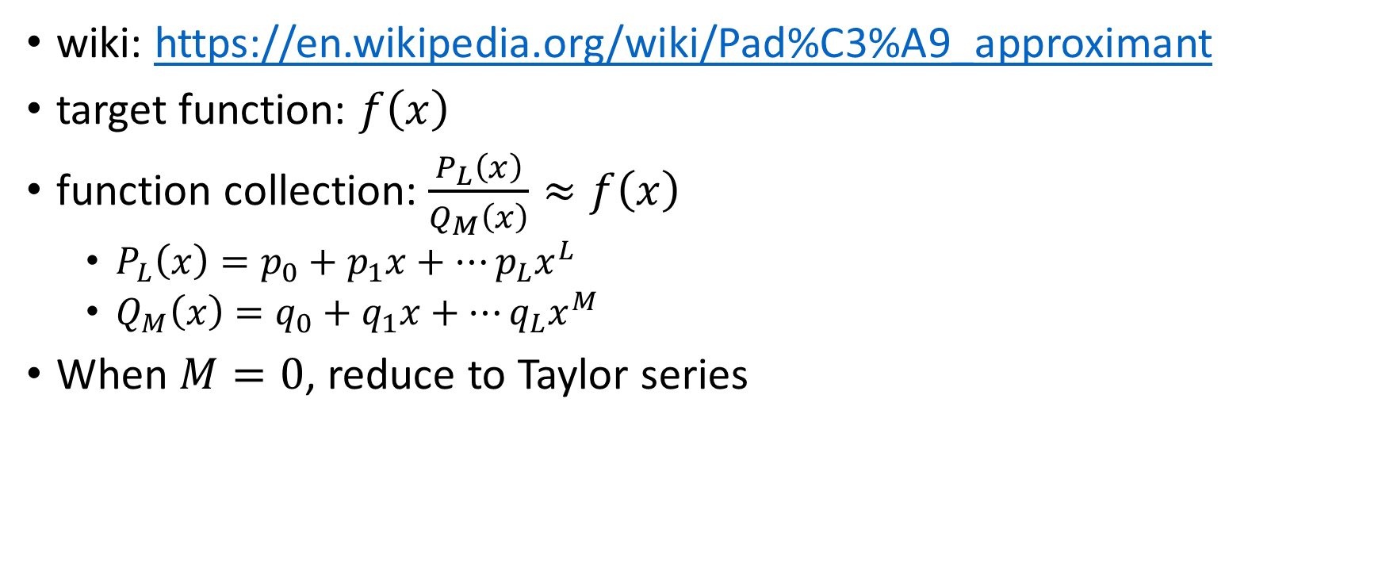
FA – Pade Approximation
wiki: https://en.wikipedia.org/wiki/Pad%C3%A9_approximant
target function: $f\left(x\right)$
function collection: $\frac{P_{L}\left(x\right)}{Q_{M}\left(x\right)}≈f\left(x\right)$
$P_{L}\left(x\right)=p_{0}+p_{1}x+…p_{L}x^{L}$
$Q_{M}\left(x\right)=q_{0}+q_{1}x+…q_{L}x^{M}$
When $M=0$, reduce to Taylor series

Slide 7

Pade Approximation
Taylor expansion:$\frac{P_{L}\left(x\right)}{Q_{M}\left(x\right)}≈f\left(x\right)≈A_{0}+A_{1}x+…+A_{L+M}x^{L+M}$
Then: $P_{L}\left(x\right)≈\left(A_{0}+A_{1}x+…+A_{L+M}x^{L+M}\right)Q_{M}\left(x\right)$
$P_{L}\left(x\right)=p_{0}+p_{1}x+…p_{L}x^{L}$
$Q_{M}\left(x\right)=q_{0}+q_{1}x+…q_{L}x^{M}$
We will learn matrix linear equations $Ax=b$ in next chapter, here we use MATLAB built-in $x=A\backslash b$

Slide 8
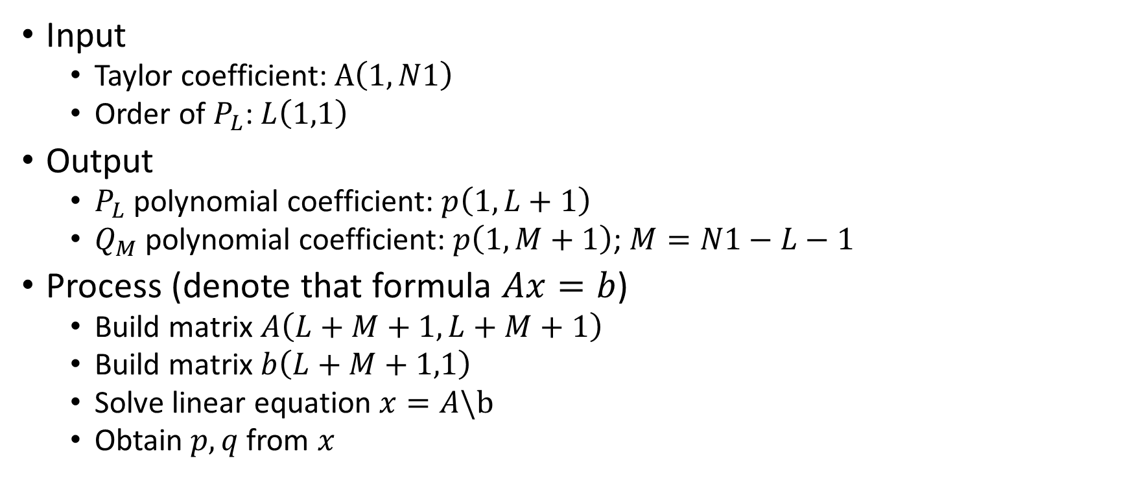
Pade Approximation
Input
Taylor coefficient: $A\left(1,N1\right)$
Order of $P_{L}$: $L\left(1,1\right)$
Output
$P_{L}$ polynomial coefficient: $p\left(1,L+1\right)$
$Q_{M}$ polynomial coefficient: $p\left(1,M+1\right)$; $M=N1−L−1$
Process (denote that formula $Ax=b$)
Build matrix $A\left(L+M+1,L+M+1\right)$
Build matrix $b\left(L+M+1,1\right)$
Solve linear equation $x=A\backslash b$
Obtain $p,q$ from $x$

Slide 9
Pade Approximation
See
TS20181011/TS20181011_pade.mlx
TS20181011/TS20181011_pade.pdf

Slide 10
homework12
Implement Pade approximation
If your code is correct, you will see…; otherwise, you will see…
Useful material
TS20181011.pptx page 6-7 shows algorithm steps
lecture03.pdf and wiki gives detailed algorithm explanation
due time: 20181025 23:59

Slide 11
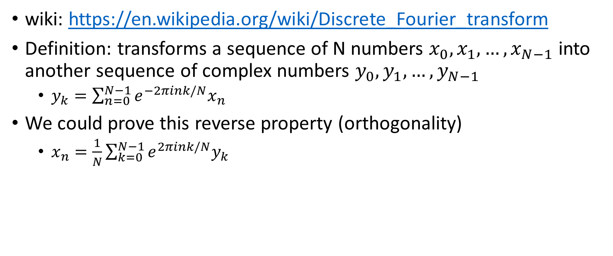
Discrete Fourier Transform (DFT)
wiki: https://en.wikipedia.org/wiki/Discrete_Fourier_transform
Definition: transforms a sequence of N numbers $x_{0},x_{1},…,x_{N−1}$ into another sequence of complex numbers $y_{0},y_{1},…,y_{N−1}$
$y_{k}=\sum_{n=0}^{N−1}{e^{−2πink/N}x_{n}}$
We could prove this reverse property (orthogonality)
$x_{n}=\frac{1}{N}\sum_{k=0}^{N−1}{e^{2πink/N}y_{k}}$

Slide 12
Fast Fourier Transform (FFT)
wiki: https://en.wikipedia.org/wiki/Fast_Fourier_transform
algorithm (detail see wiki)
Cooley–Tukey algorithm
Prime-factor FFT algorithm
Bruun's FFT algorithm
Rader's FFT algorithm
Bluestein's FFT algorithm
Hexagonal Fast Fourier Transform

Slide 13
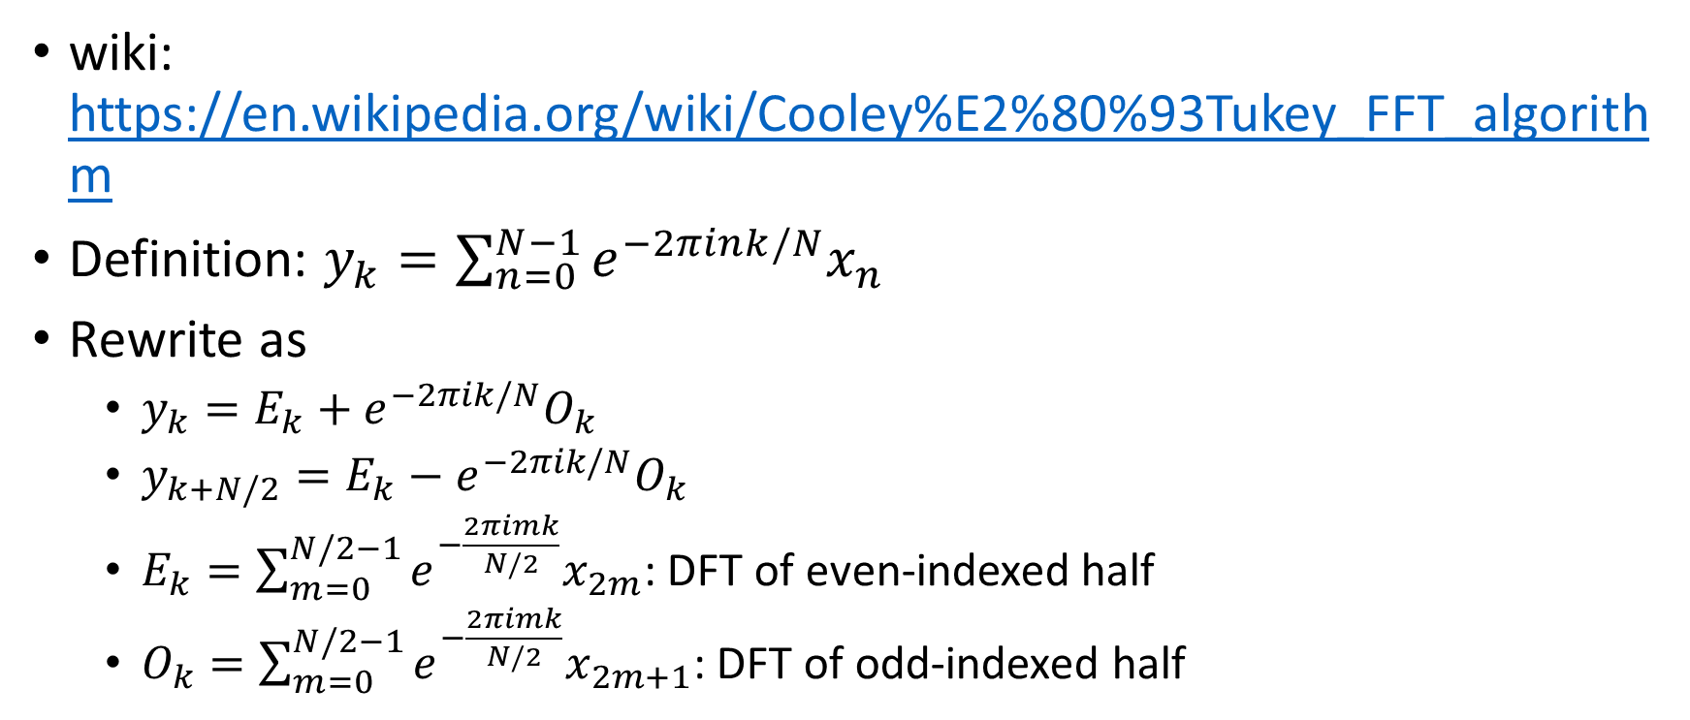
Cooley–Tukey FFT algorithm
wiki: https://en.wikipedia.org/wiki/Cooley%E2%80%93Tukey_FFT_algorithm
Definition: $y_{k}=\sum_{n=0}^{N−1}{e^{−2πink/N}x_{n}}$
Rewrite as
$y_{k}=E_{k}+e^{−2πik/N}O_{k}$
$y_{k+N/2}=E_{k}−e^{−2πik/N}O_{k}$
$E_{k}=\sum_{m=0}^{N/2−1}{e^{−\frac{2πimk}{N/2}}x_{2m}}$: DFT of even-indexed half
$O_{k}=\sum_{m=0}^{N/2−1}{e^{−\frac{2πimk}{N/2}}x_{2m+1}}$: DFT of odd-indexed half

Slide 14
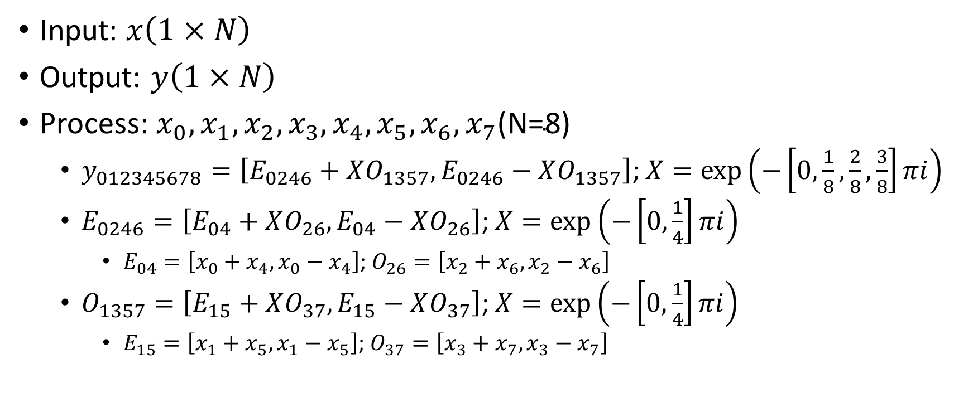
Cooley–Tukey FFT
Input: $x\left(1×N\right)$
Output: $y\left(1×N\right)$
Process: $x_{0},x_{1},x_{2},x_{3},x_{4},x_{5},x_{6},x_{7}\text{(}\text{N}\text{=8)}$
$y_{012345678}=\left[E_{0246}+XO_{1357},E_{0246}−XO_{1357}\right]$; $X=\exp\left(−\left[0,\frac{1}{8},\frac{2}{8},\frac{3}{8}\right]πi\right)$
$E_{0246}=\left[E_{04}+XO_{26},E_{04}−XO_{26}\right]$; $X=\exp\left(−\left[0,\frac{1}{4}\right]πi\right)$
$E_{04}=\left[x_{0}+x_{4},x_{0}−x_{4}\right]$; $O_{26}=\left[x_{2}+x_{6},x_{2}−x_{6}\right]$
$O_{1357}=\left[E_{15}+XO_{37},E_{15}−XO_{37}\right]$; $X=\exp\left(−\left[0,\frac{1}{4}\right]πi\right)$
$E_{15}=\left[x_{1}+x_{5},x_{1}−x_{5}\right]$; $O_{37}=\left[x_{3}+x_{7},x_{3}−x_{7}\right]$

Slide 15
Cooley-Tukey FFT demo
See
TS20181011/TS20181011_FFT.mlx
TS20181011/TS20181011_FFT.pdf

Slide 16
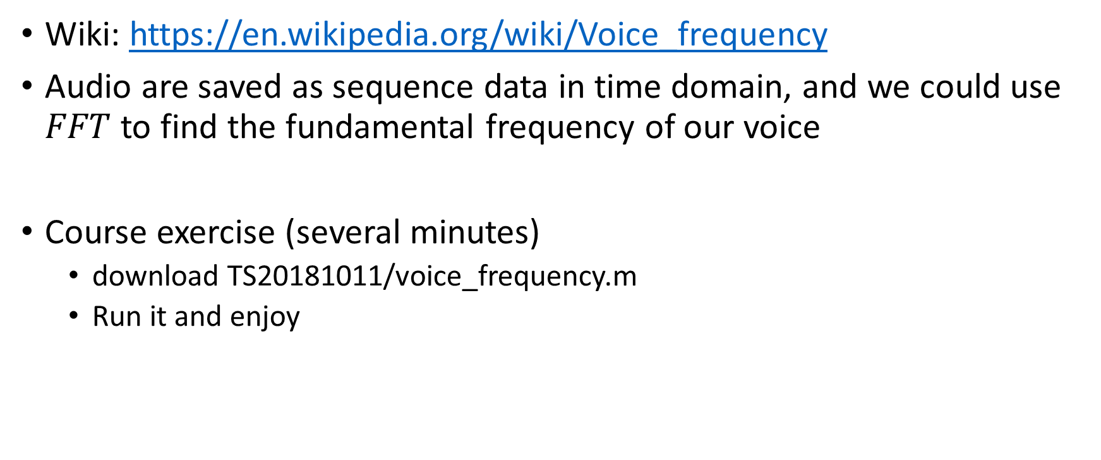
Voice Fundamental Frequency
Wiki: https://en.wikipedia.org/wiki/Voice_frequency
Audio are saved as sequence data in time domain, and we could use $FFT$ to find the fundamental frequency of our voice
Course exercise (several minutes)
download TS20181011/voice_frequency.m
Run it and enjoy

Slide 17
homework13 (optional)
Implement Inverse Fast Fourier Transformation (IFFT)
Almost same as FFT
Useful material
my_fft.m: code of fft
TS20181011.pptx page12 shows detailed algorithm steps
lecture03.pdf and wiki give algorithm explanation
due time: 20181025 23:59

Slide 18
Root Finding
Wiki: https://en.wikipedia.org/wiki/Root-finding_algorithm
Definition: finding roots of continuous functions

Slide 19
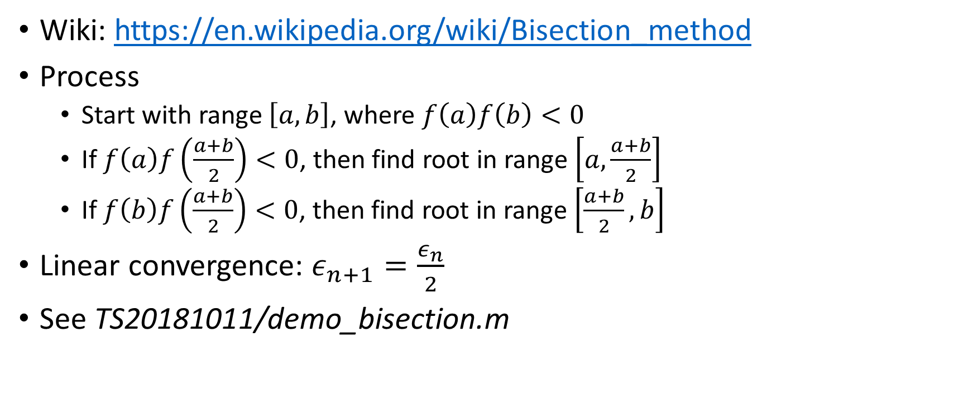
Bisection method
Wiki: https://en.wikipedia.org/wiki/Bisection_method
Process
Start with range $\left[a,b\right]$, where $f\left(a\right)f\left(b\right)<0$
If $f\left(a\right)f\left(\frac{a+b}{2}\right)<0$, then find root in range $\left[a,\frac{a+b}{2}\right]$
If $f\left(b\right)f\left(\frac{a+b}{2}\right)<0$, then find root in range $\left[\frac{a+b}{2},b\right]$
Linear convergence: $ε_{n+1}=\frac{ε_{n}}{2}$
See TS20181011/demo_bisection.m

Slide 20
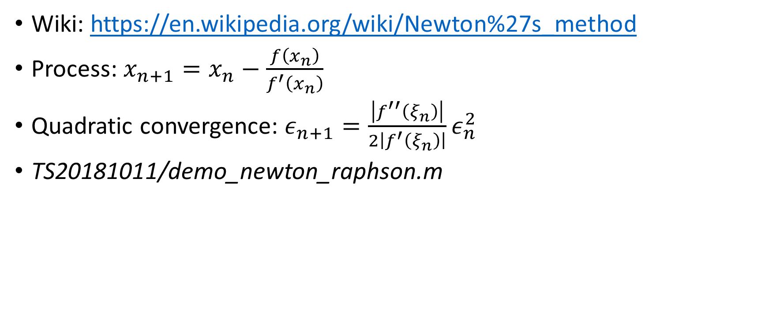
Newton Raphson method
Wiki: https://en.wikipedia.org/wiki/Newton%27s_method
Process: $x_{n+1}=x_{n}−\frac{f\left(x_{n}\right)}{f^{′}\left(x_{n}\right)}$
Quadratic convergence: $ε_{n+1}=\frac{\left|f^{′′}\left(ξ_{n}\right)\right|}{2\left|f^{′}\left(ξ_{n}\right)\right|}ε_{n}^{2}$
TS20181011/demo_newton_raphson.m

Slide 21
homework14
In hwk10, Gauss Quadrature integral, you have implemented part of the whole algorithm (first order derivative). In this hwk, you are required to find N roots of N-order Legendre polynomial using bisection or Newton-Raphson method, instead of using my_legedre_root.m as in hwk10.
Useful materials
my_bisection.m and my_newton_raphson.m are provided
Materials will be uploaded after hwk10 due time
due time: 20181025 23:59

Slide 22
Take home message
Function interpolation
Lagrangian interpolation
Neville method
Function approximation
Taylor Series
Pade Approximation
Cooley–Tukey FFT
Root finding
Bisection method
Newton-Raphson method
hwk11(optional), hwk12, hwk13(optional), hwk14
Reminder: hwk7, 8, 9, 10 are due at 20181011 23:59

