Slide 1
PHYS4150-TS20181101 Matrix
Chao Zhang, zhangchk@hku.hk
Rm418, CYM Physics Building
I apologize: most codes in this session cannot run in Octave. It seems really hard to draw animation in Octave

Slide 2
TS20181031
interpolation
Lagrangian method
Neville method
Cubic spline
Function approximation: Pade approximation
FFT
Root finding algorithm
Bisection
Newton-Raphson method
Extrapolation (integration method)
Richardson’s deferred method
Romberg integration

Slide 3
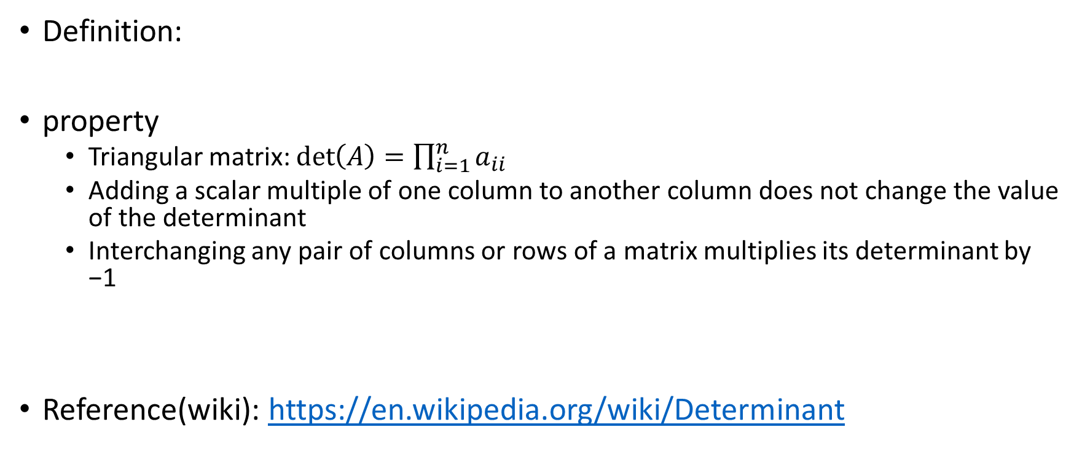
Determinant
Definition:
property
Triangular matrix: $\det\left(A\right)=\prod_{i=1}^{n}{a_{ii}}$
Adding a scalar multiple of one column to another column does not change the value of the determinant
Interchanging any pair of columns or rows of a matrix multiplies its determinant by −1
Reference(wiki): https://en.wikipedia.org/wiki/Determinant

Slide 4
Determinant : Gauss-Jordan Elimination
use the property of determinant above to eliminate the off-diagonal elements
See TS20181101/demo_det0.m

Slide 5
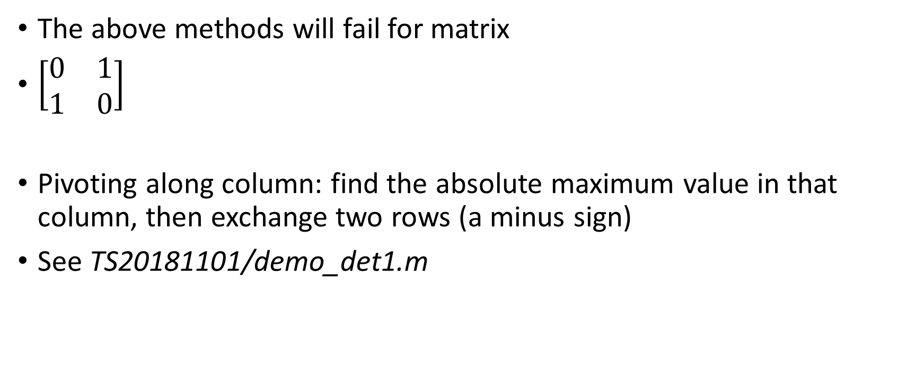
Determinant - Pivot
The above methods will fail for matrix
$\left[\begin{matrix}0 & 1 \\ 1 & 0\end{matrix}\right]$
Pivoting along column: find the absolute maximum value in that column, then exchange two rows (a minus sign)
See TS20181101/demo_det1.m

Slide 6
Determinant - Pivot
Find the pivot in the remaining matrix
See TS20181101/demo_det2.m

Slide 7
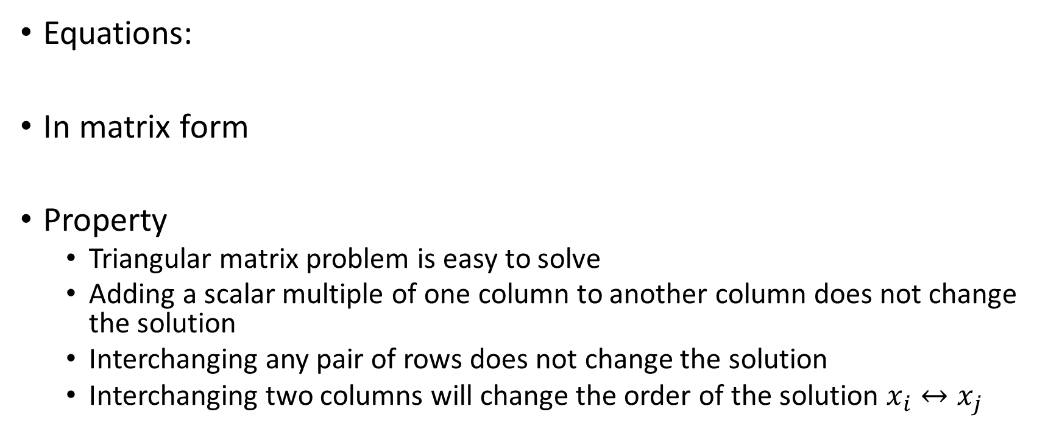
Linear equations
Equations:
In matrix form
Property
Triangular matrix problem is easy to solve
Adding a scalar multiple of one column to another column does not change the solution
Interchanging any pair of rows does not change the solution
Interchanging two columns will change the order of the solution $x_{i}↔x_{j}$

Slide 8
Linear equations: Gauss-Jordan Elimination
Use the above property to convert the matrix A into triangular form
See TS20181101/demo_Ab0.m

Slide 9
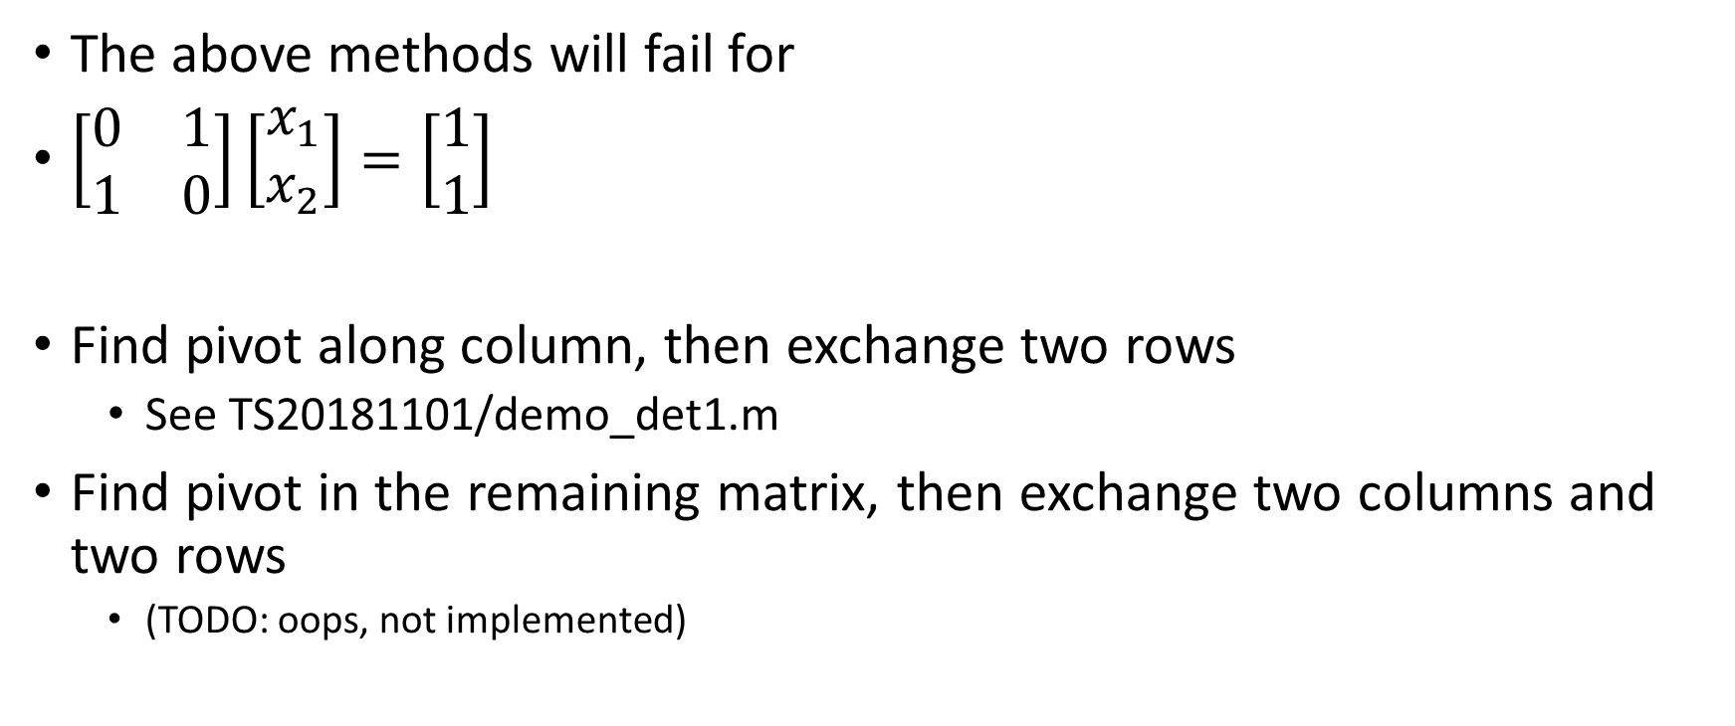
Linear equations: pivot
The above methods will fail for
$\left[\begin{matrix}0 & 1 \\ 1 & 0\end{matrix}\right]\left[\begin{matrix}x_{1} \\ x_{2}\end{matrix}\right]=\left[\begin{matrix}1 \\ 1\end{matrix}\right]$
Find pivot along column, then exchange two rows
See TS20181101/demo_det1.m
Find pivot in the remaining matrix, then exchange two columns and two rows
(TODO: oops, not implemented)

Slide 10

Matrix Inverse: Gauss-Jordan Elimination
JUST replace the vector $b$ above to unit matrix $I$
See TS20181101/demo_invA.m

Slide 11
LU decomposition
Factor a matrix as the product of a lower triangular matrix and an upper triangular matrix. The LU decomposition can be viewed as the matrix form of Gaussian elimination

Slide 12
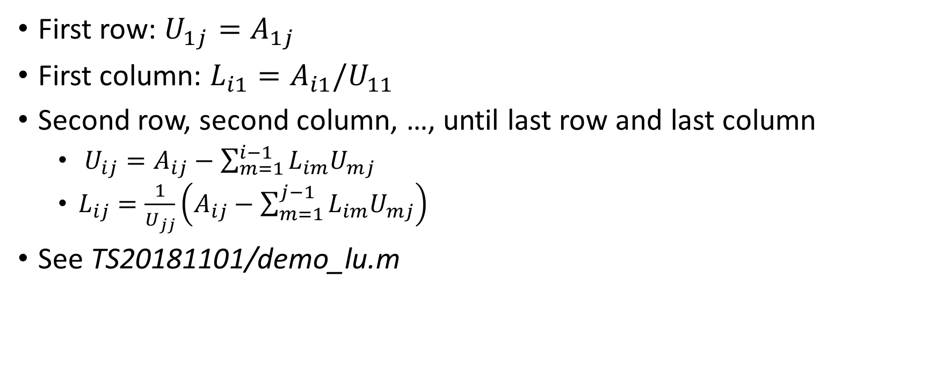
LU decomposition
First row: $U_{1j}=A_{1j}$
First column: $L_{i1}=A_{i1}/U_{11}$
Second row, second column, …, until last row and last column
$U_{ij}=A_{ij}−\sum_{m=1}^{i−1}{L_{im}U_{mj}}$
$L_{ij}=\frac{1}{U_{jj}}\left(A_{ij}−\sum_{m=1}^{j−1}{L_{im}U_{mj}}\right)$
See TS20181101/demo_lu.m

Slide 13
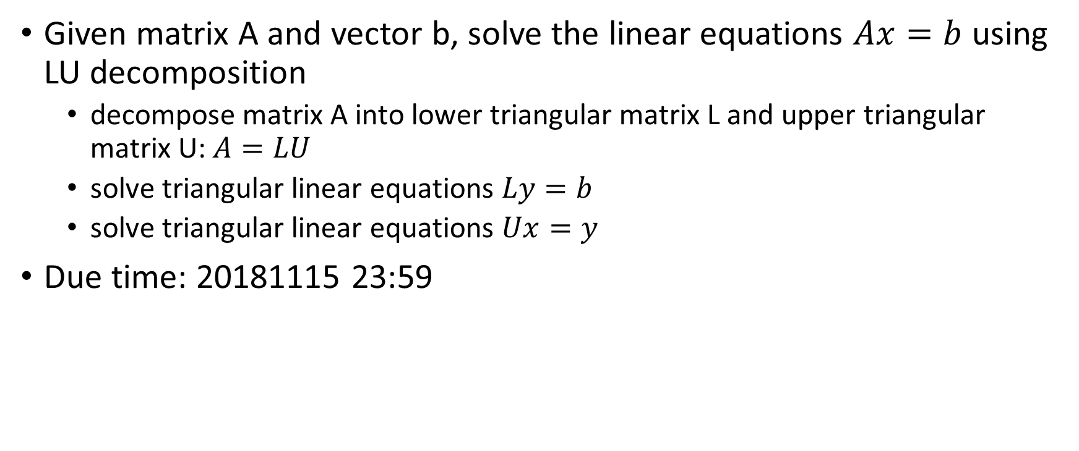
Hwk11: lu-linear-equation
Given matrix A and vector b, solve the linear equations $Ax=b$ using LU decomposition
decompose matrix A into lower triangular matrix L and upper triangular matrix U: $A=LU$
solve triangular linear equations $Ly=b$
solve triangular linear equations $Ux=y$
Due time: 20181115 23:59

Slide 14
Take home message
Determinant
Gauss-Jordan (naïve)
Gauss-Jordan + Pivot along column
Gauss-Jordan + Pivot in the remaining matrix
Linear equations
Gauss-Jordan: naïve and pivot
Matrix inverse
LU decomposition
LU decomposition (hwk15)

