Slide 1
PHYS4150-TS20180927 Integration and Differentiation
Chao Zhang, zhangchk@hku.hk
Rm418, CYM Physics Building

Slide 2
TS20180926-recap
Integration method
Rectangular (optional homework)
Trapezoidal
Simpsom
Adaptive Simpsom
Monte Carlo Integral

Slide 3
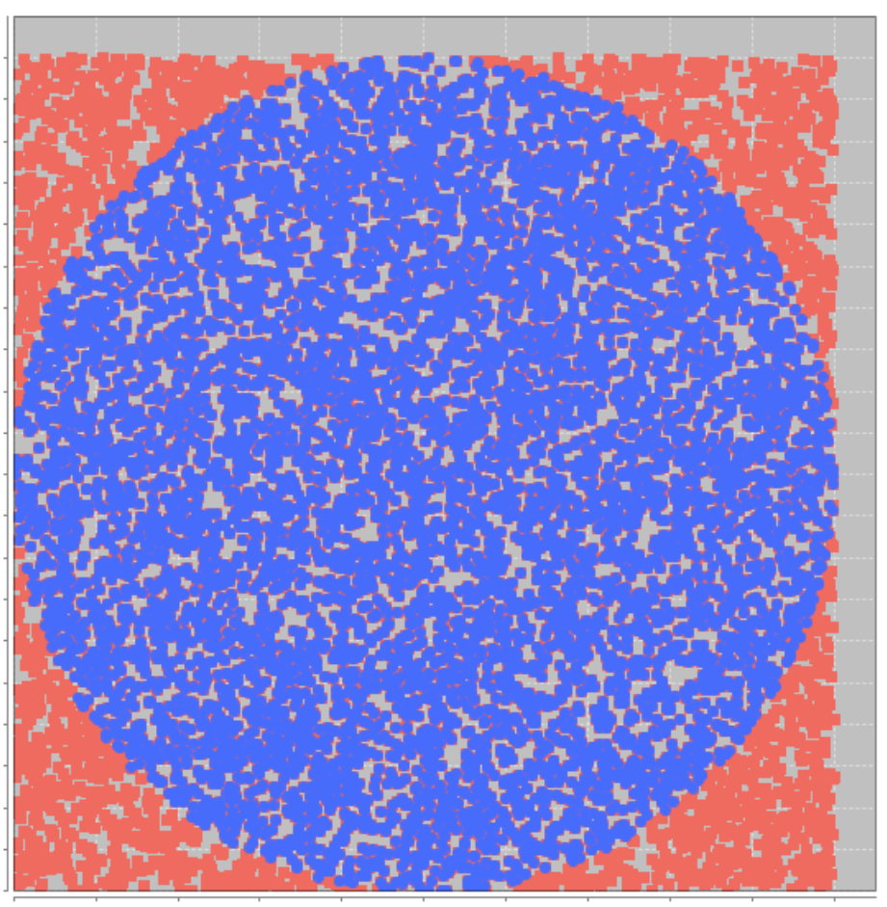
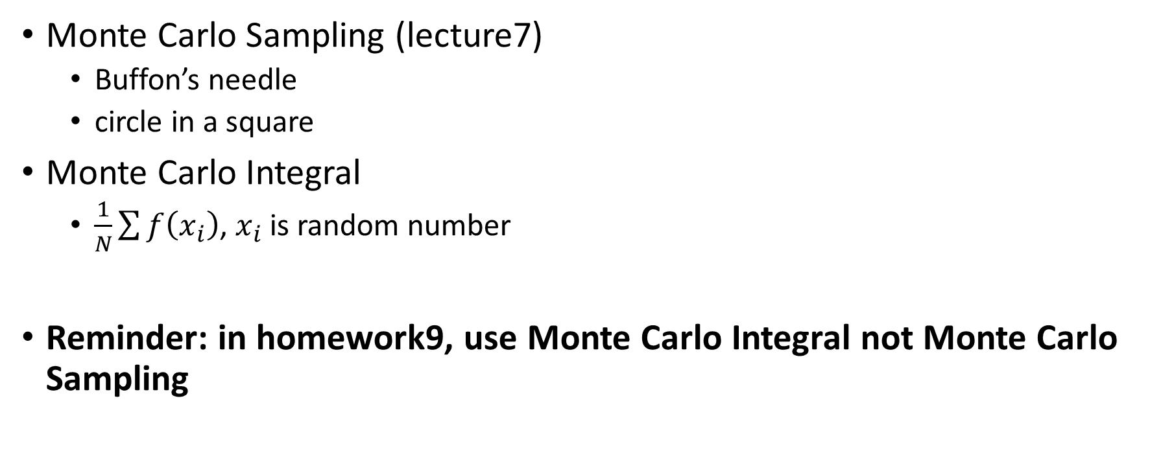
Monte Carlo Sampling ? Integral
Monte Carlo Sampling (lecture7)
Buffon’s needle
circle in a square
Monte Carlo Integral
$\frac{1}{N}\sum{f\left(x_{i}\right)}$, $x_{i}$ is random number
Reminder: in homework9, use Monte Carlo Integral not Monte Carlo Sampling

Slide 4
Course coding (10min)
Integral method - Rectangular rule: homework7(optional)
download the code_template.m and unittest.m
complete the code_template.m and use unittest.m to help debug
(will used sooner)

Slide 5
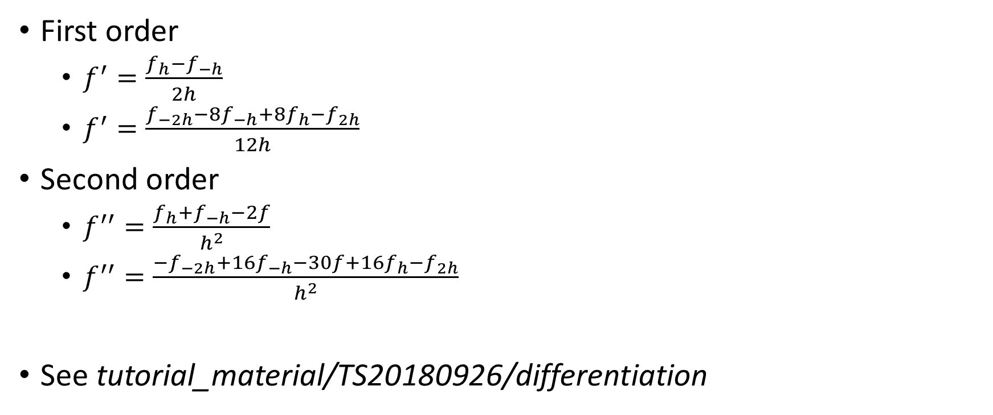
Differentiation
First order
$f^{′}=\frac{f_{h}−f_{−h}}{2h}$
$f^{′}=\frac{f_{−2h}−{8f}_{−h}+{8f}_{h}−f_{2h}}{12h}$
Second order
$f^{′′}=\frac{f_{h}+f_{−h}−2f}{h^{2}}$
$f^{′′}=\frac{−f_{−2h}+{16f}_{−h}−30f+16f_{h}−f_{2h}}{h^{2}}$
See tutorial_material/TS20180926/differentiation

Slide 6
Legendre Polynomial
See tutorial_material/TS20180926/legendre_notebook

Slide 7
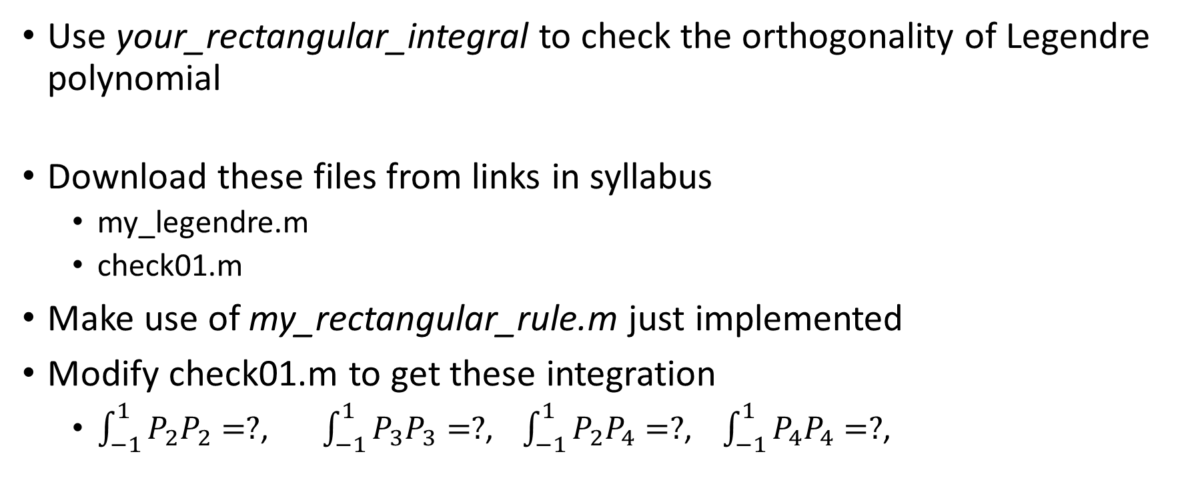
Course coding – orthogonality (10min)
Use your_rectangular_integral to check the orthogonality of Legendre polynomial
Download these files from links in syllabus
my_legendre.m
check01.m
Make use of my_rectangular_rule.m just implemented
Modify check01.m to get these integration
$\int_{−1}^{1}{P_{2}P_{2}}=?$, $\int_{−1}^{1}{P_{3}P_{3}}=?$, $\int_{−1}^{1}{P_{2}P_{4}}=?$, $\int_{−1}^{1}{P_{4}P_{4}}=?$,

Slide 8
Gaussian Quadrature
See tutorial_material/TS20180926/legendre_notebook

Slide 9
Homework10 - Gaussian Quadrature
You need
calculate the first-order derivative with either numerical differentiation method or recursion relations
calculate the weight and then integration following the Gaussian Quadrature formula
Due at 20181011 23:59

Slide 10
Take home message
Legendre polynomial property
Gaussian quadrature integral method
Numerical differentiation
homework10

