Slide 1
PHYS4150-TS20181004 Chapter 1 summary
Chao Zhang, zhangchk@hku.hk
Rm418, CYM Physics Building

Slide 2
Homework 2345
You homework 2,3,4,5 have been graded, please go to collect your homework at the students box outside the physics department office.
The solutions have been uploaded to course website
Click view on Github
Click homework folder
go to the corresponding question folder

Slide 3
Homework demo
Most of you agree to put homework on the course website, I strongly advise you go to course website to see is there any more efficient code implementation.
some high order MATLAB programming skills in your submissions
advanced function: find(x<num1/2)
matrix indexing: mat(1:ceil(len(mat)/2))

Slide 4
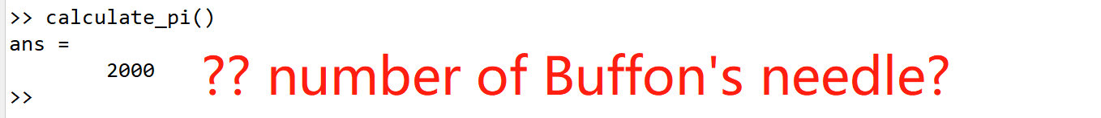
some problems in the first assignment
forget to choose whether put on course website or not
may not give score next time
select to put on course website but forget to complete right reserve information
if you use code_template, please also use unittest to check your code run correctly
if your code is correct, run unittest you will see something like unittest passed. otherwise, you will get an error, which means some bugs in your code.

Slide 5
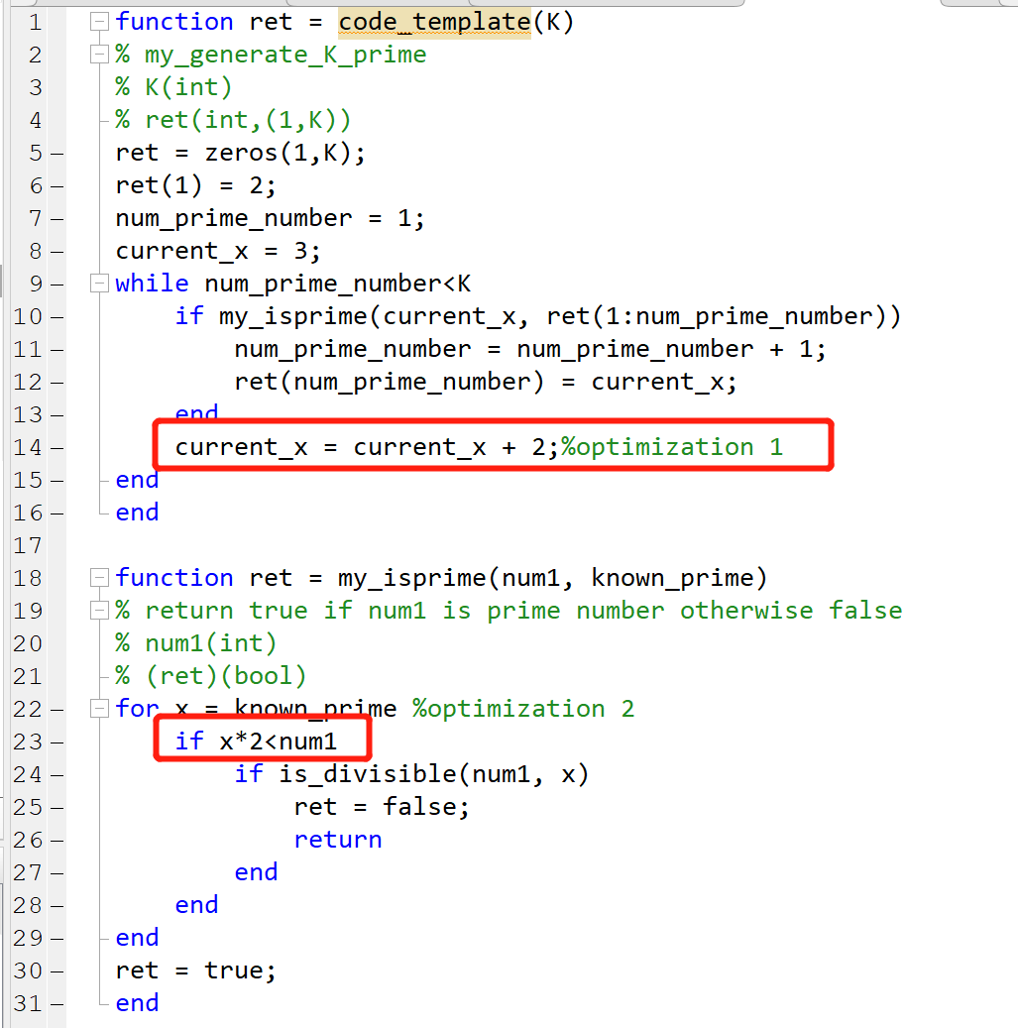
homework2
Add two optimization to improve naïve my_generate_K_prime()
Change 1 to 2
Add an if-condition clause

Slide 6
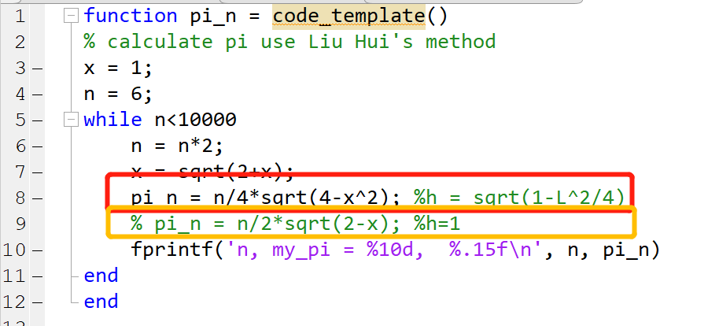
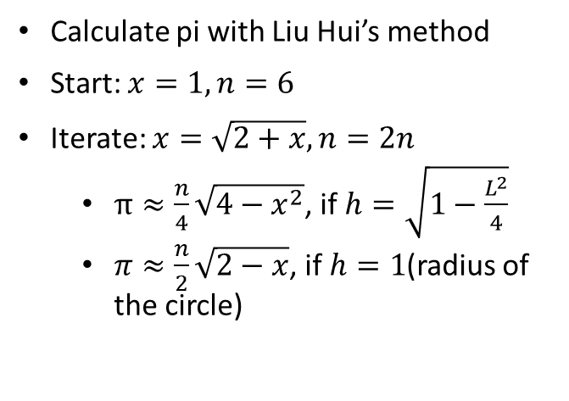
Homework3
Calculate pi with Liu Hui’s method
Start: $x=1, n=6$
Iterate: $x=\sqrt{2+x}, n=2n$
$π≈\frac{n}{4}\sqrt{4−x^{2}}$, if $h=\sqrt{1−\frac{L^{2}}{4}}$
$π≈\frac{n}{2}\sqrt{2−x}$, if $h=1$(radius of the circle)

Slide 7
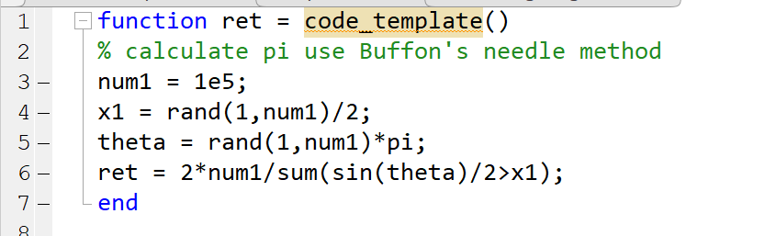

Homework4
Calculate pi with Buffon’s Needle method
Generate random $y$ position (x doesn’t matter) from uniform distribution $U\left(0,0.5\right)$
Generate random angle $θ$ from uniform distribution $U\left(0,pi\right)$
inevitable to use $π$ here
Count the needles crossing the line $x<\sin\left(θ\right)$

Slide 8
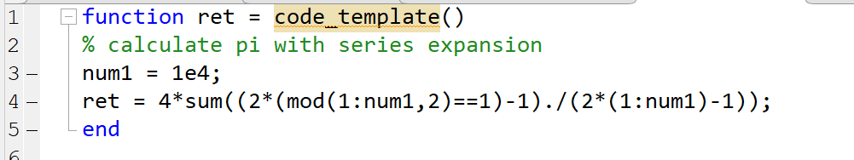

homework5
Calculate $π$ using series expansion
Using for-loop to do the calculation

Slide 9
Chapter1 summary
Prime number
Two optimizations
Calculate pi
Liu Hui’s method
Buffon’s needle method
Series expansion
(Chapter2) Monte Carlo Integration

