Slide 1
PHYS 4150
Computational Physics
2017
J. Wang
Department of Physics
The University of Hong Kong

Slide 2
Lecture 01:
Introduction

Slide 3
outline
0) History of Computation
Computational and Computer Science
Computational Physics
Computing Platforms
Programming Languages
Summary

Slide 4
outline
0) History of Computation
Computational and Computer Science
Computational Physics
Computing Platforms
Programming Languages
Summary

Slide 5
History of Computation
Charles Babbage (1791-1871) developed the theory of
automated calculations, inventor of the first mechanical
computer in 1837
George Boole formalized Boolean Algebra, the basis for
digital logic and computer science, in 1847-1854
John von Neumann formulated the von Neumann architecture
on which most modern computers are based
The basic ingredient of computer hardware is a device called
transistor, and the history of computation is directly connected
to the history of transistors

Slide 6
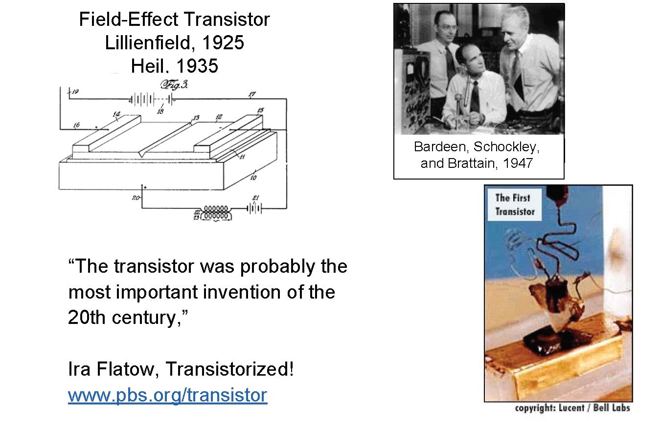
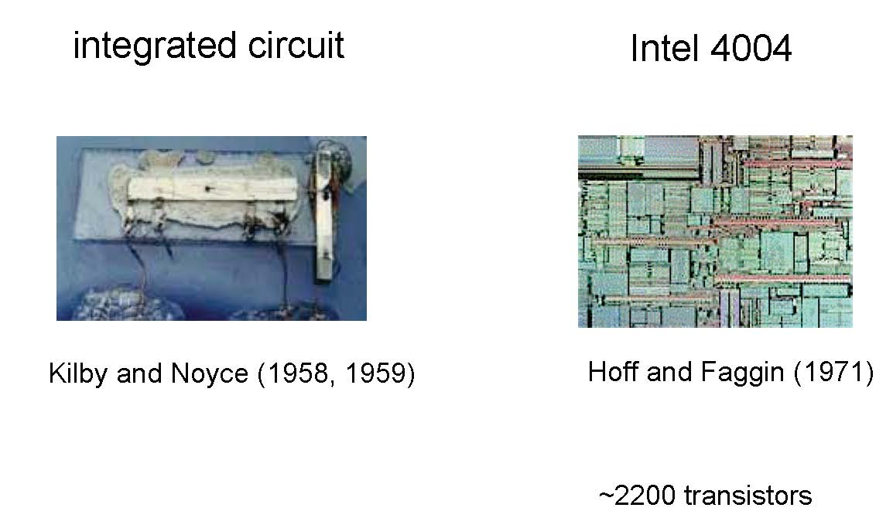
History of Computation

Slide 7
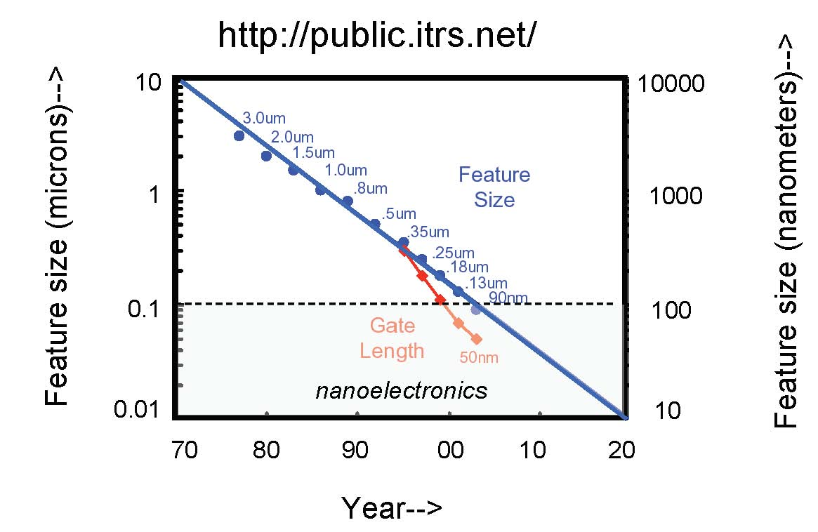
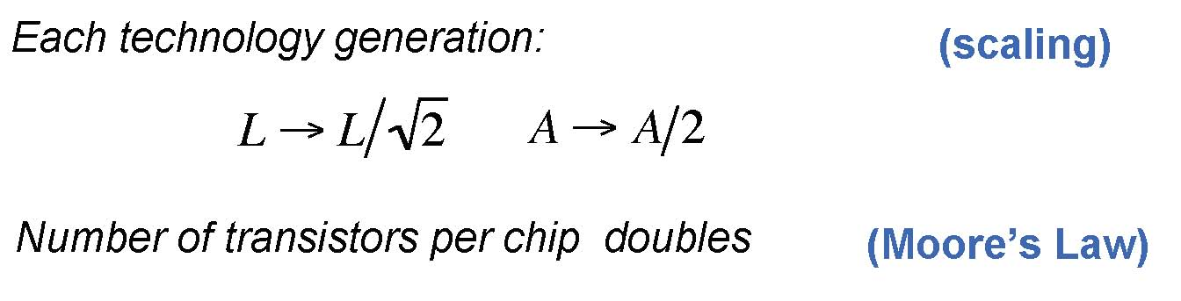
History of Computation

Slide 8
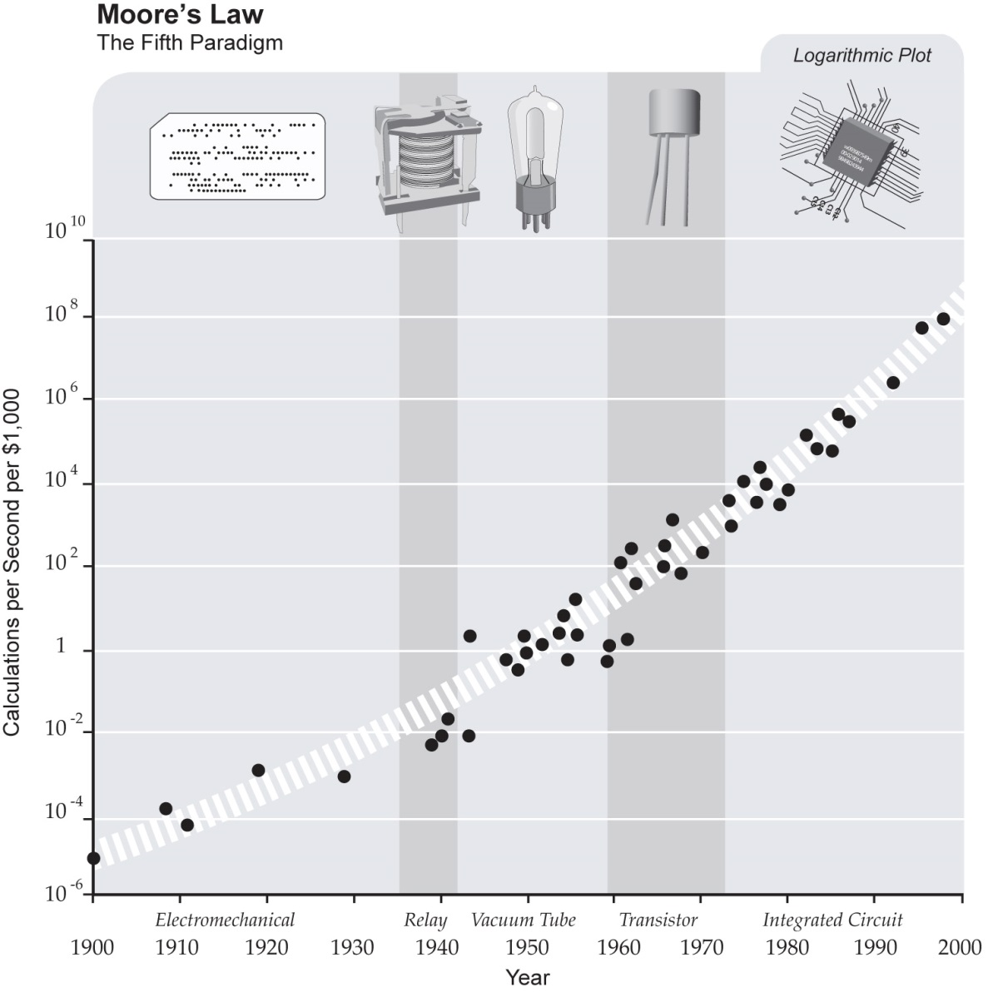
History of Computation
Extension of Moore’s Law
as the Fifth paradigm by
Ray Kurzweil

Slide 9
outline
✓
0) History of Computation
Computational and Computer Science
Computational Physics
Computing Platforms
Programming Languages
Summary

Slide 10
computational and computer science
Computer Science or Computing Science is a broad subject
which deals with the systematic treatment and manipulation
of information and data
Computational Science or Scientific Computing is the application
of computational models to many different disciplines of science
Main focus in Computational Science is the final results that are
obtained by the application of mathematical models to a particular
problem, whereas in Computer Science it is the computational
models and the algorithms which are of particular interest
There is an overlap between the two, both require developing
algorithms for numerical analysis

Slide 11
outline
✓
0) History of Computation
Computational and Computer Science
Computational Physics
Computing Platforms
Programming Languages
Summary
✓

Slide 12
computational physics
Computational Physics is the application of computational
Science to physics problems i.e. application of mathematical models
and techniques to solve problems related to Physics
Many problems in Physics (specially nonlinear problems) are
difficult to solve using the traditional analytical approach without
some approximations. Computational Physics provide numerical
solutions to these problems
Computational techniques can also be useful for linear problems
with many degrees of freedom for which analytical solutions are
tedious and time-consuming

Slide 13
computational physics
With the rapid development of computing performance there is a
dramatic increase in the range of physical problems that can be
solved with computers
Few new applications of computer and computational techniques:
i) simulating “Experiments” in virtual world before setting up
the actual real life Experiment
ii) high performance computing for large scale device simulations
iii) advanced programming languages allow problems to be solved
symbolically as well as numerically
iv) others: graphical representation, data storage etc.

Slide 14
computational physics
Computation is the third component of Physics along with Theory
and Experiment
The sophistication of Experimental techniques has led to huge
increase in the cost of experimental set-up which in turn increase
the usefulness of theoretical and computational modeling
Computational Physics plays an important role by acting as an
interface between Experimental and Theoretical Physics
Virtual simulations of Experiments before the actual experimentation
process can save lot of money and time
Zahid PHYS4150 F14

Slide 15
computational physics
For successful simulations of Experiments a computational physicist
must understand not only the physics that is being studied, but also
the capabilities and limitations of the proposed experiment intended
to make the measurements. In this way, computational physicists
straddle the line between experiment and theory.

Slide 16
outline
✓
0) History of Computation
Computational and Computer Science
Computational Physics
Computing Platforms
Programming Languages
Summary
✓
✓

Slide 17
computer system
Two basic components: hardware and software
Here we will focus on the software only
Computer software has two main components:
1) computing platforms and 2) programming languages

Slide 18
computing platforms
Platforms can be categorized in two ways: by the type of the CPU
and by the operating system (OS) installed
We will focus here on the operating systems only
There are three main operating systems used in the world today.
They are: UNIX, Mac-OS and MS-Windows. Each has its own
strengths and weaknesses

Slide 19
UNIX
Oldest of the three operating systems, developed in 1969 with
the following in minds:
1) simple, 2) written in high level language and 3) easy to reuse
Advantages
Originally developed in a scientific research community, and thus
convenient for scientific computation. Besides, it has a large base
support among the scientists
Multi-user and multi-threaded environment with high degree of
system stability
Zahid PHYS4150 F14

Slide 20
UNIX
Multi-user and multi-threaded environment with high degree of
system stability
Since UNIX OS is written in C, patching, extending and augmenting
of the OS becomes especially simple
Most UNIX workstations use chipsets that employ Reduced
Instruction Set Computing (RISC). This typically results in smaller
number of instructions per line of code with subsequent reduction
in execution in time
Portable, almost all the major workstations support UNIX

Slide 21
UNIX
Disadvantages
Portability of UNIX OS can also be a weakness. Each vendor
has produced their own variant or flavor of UNIX. Thus, there are
many different versions of UNIX OS are available. The lack of
unified OS standard prevented widespread acceptance of the
UNIX system.
UNIX system is heavily relied on the command line interfaces. This
Issue has been partially alleviated with X Window interface.

Slide 22
Mac-OS
Mac is the operating system for the Macintosh computer
introduced in 1984 by Apple Inc. (established in 1976). Mac
Computers are built around the Motorola 68000 chip
Advantages
First OS to introduce Graphical User Interface (GUI)
Motorola chip tends to be faster than the equivalent Intel chip,
so the Mac OS can handle a heavier computational load
Superior graphic representation

Slide 23
Mac-OS
Disadvantages
Strict copyright protection of the manufacturing process
prevents other computer manufacturers from ‘cloning’ the
Mac computers. This limits the extent in which Apple Inc.
can compete in the computer market
Single user machine, less secure compared to UNIX, data
sharing more difficult

Slide 24
MS-Windows
MS-Windows is the operating system for personal computers
(PC) introduced by Microsoft company in 1985
Advantages
Most popular and widely used computers in the world. Over
90% of the computers in the world use some version of
Windows, and the number of applications available for use
with Windows greatly surpasses those of its competitors
It provides both single and multi-user environment. This allows
Windows to operate in a wide range of computing environments.

Slide 25
MS-Windows
Disadvantages
Windows remains tied to the Intel 80 x 86 chips, which employ
Complex Instruction Set Computing (CISC) that requires more
instructions on average compared to a RISC machine.
Notoriously unstable and prone to major security risk

Slide 26
outline
✓
0) History of Computation
Computational and Computer Science
Computational Physics
Computing Platforms
Programming Languages
Summary
✓
✓
✓

Slide 27
Programming Languages
There are many different programming languages available. These
languages are typically classified according to the advances that
they incorporate. Each major step-up is represented as a new
generation.
First generation of languages are called machine languages. This
is the most basic and primitive form where the code is written as
A string of binary numbers which computer hardware can interpret
as instructions. All higher level of languages must be converted
to machine language before the CPU can process them.

Slide 28
Programming Languages
Second generation languages are called the assembly languages.
They use English acronyms instead of binary number, and thus easier
to understand compared to the machine language but still quite
arcane compared to higher level of languages. Assembly languages
are used just for direct translation of machine level code in English.
Third generation languages are known as ‘high level’ languages. A
compiler (a computer code written beforehand) is needed to convert
the codes written in high level languages to machine level code.
Most computational physicist need expertise in third generation
languages. Two most important examples for high level language for
scientific computation are: Fortran and C/C++.

Slide 29
Programming Languages
Fourth generation languages are called the interpreted language, and
rely on interpreter which translates the codes in real time to machine
codes. Interpreted languages do not usually produce stand-alone
executables, and are typically slower than third generation
languages. Few examples are: Interactive Data Language (IDL),
Physics Analysis Workbench (PAW), Mahematica, Maple and
Matlab
Fifth generation languages are the latest set of computing languages.
These languages use a graphical interface to generate the source
code which is then compiled via compiler or interpreter of lower
level languages. Prolog, OPS5 and Mercury are examples of fifth
generation languages.

Slide 30
Fortran
Fortran is the oldest of the scientific computing languages, and
is still the most widely used.
Originally released in 1954. Then it went through several
modifications. Fortran II was released in 1958. Fortran III was
a short-lived release. Fortran IV released in 1962 became the
mainstay of scientific computing. Other major releases are
Fortran 77 (ANSI Fortran) in 1977 and then Fortran 90 (pointer
and other additions) in 1990.
Two major reasons of popularity of Fortran are: built-in data
types such as real, double and complex, and wide variety of
controlling and branching structures.

Slide 31
C/C++
C is a more recent entry into the field of scientific programming.
It was released in 1971, and was designed to provide computing
environment.
C is largely developed as system programming language for UNIX,
and the kernel of UNIX OS is written in C. This made C a logical
choice for high level language in UNIX systems. In addition, the
use of header files and longer variable names made code
documentation easier in C.
With the advance in computer science the idea of object oriented
programming was developed. This concept is incorporated in C++.
C++ can be considered a superset of C language, and is almost
completely compatible with the C program structure.

Slide 32
outline
✓
0) History of Computation
Computational and Computer Science
Computational Physics
Computing Platforms
Programming Languages
Summary
✓
✓
✓
✓

Slide 33
summary
The history of computation is around 200 years old
Heart of the computer CPU is a device called
transistors which are integrated in chips
The exponential growth in computing power is
represented by the Moore’s Law
Computer software: different operating systems and
programming languages

