Slide 1
PHYS 4150
Computational Physics
J. Wang
Department of Physics
The University of Hong Kong

Slide 2
Lecture 02:
Computational Methods

Slide 3
outline
0) Recap
Programming basics
Data representation
Examples of coding
i. prime numbers
ii. value of π
4) Summary

Slide 4
outline
0) Recap
Programming basics
Data representation
Examples of coding
i. prime numbers
ii. value of π
4) Summary

Slide 5
recap
0) History of Computation
Computational and Computer Science
Computational Physics
Computing Platforms
Programming Languages
Summary

Slide 6
recap
The history of computation is around 200 years old
Heart of the computer CPU is a device called
transistors which are integrated in chips
The exponential growth in computing power is
represented by the Moore’s Law
Computer software: different operating systems and
programming languages

Slide 7
outline
✓
0) Recap
Programming basics
Data representation
Examples of coding
i. prime numbers
ii. value of π
4) Summary

Slide 8
programming basics
First step is to choose the appropriate language for coding
Devise the algorithm to solve the problem
Aim for the followings:
i) error free, ii) readable, and iii) efficient (time and memory)
Structured programming: use subroutines (functions) for each
major task and make the code modular and readable. There
should always be a ‘main’ code which will contain the outline
of the whole program.

Slide 9
programming basics
Use descriptive names for variables and subroutines
Insert as many comments as possible in the code
It is good practice to use up-to-date library functions and
well-tested previously written subroutines in the code
Debugging: after the coding is done it is very important to
spend enough time to debug the code thoroughly. Check the
output against known results or analytical values (if available).
Vary the values of different variables and step sizes to make
sure the outputs are reasonable in all cases.

Slide 10
outline
✓
0) Recap
Programming basics
Data representation
Examples of coding
i. prime numbers
ii. value of π
4) Summary
✓

Slide 11
data representation
Nearly all computers make a clear distinction between integers and floating numbers. The reason for differentiating between these two types of numbers comes from the structure of the computer memory.
Representation of number
There are many different number systems to represent numbers. The four relevant ones are:
Binary: based on power of 2
Octal: based on power of 8
Decimal: based on power of 10
Hexadecimal: based on power of 16

Slide 12
data representation
Decimal Hexadecimal Octal Binary
0 0 0 0
1 1 1 1
2 2 2 10
3 3 3 11
4 4 4 100
5 5 5 101
6 6 6 110
7 7 7 111
8 8 10 1000
9 9 11 1001
10 A 12 1010
11 B 13 1011
12 C 14 1100
13 D 15 1101
14 E 16 1110
15 F 17 1111

Slide 13
data representation
Binary number system has two symbols: 0 and 1. These are called bits (binary digits). A byte is consists of 8 bits.
Computer uses binary system for storing data. The reason computers use the base-2 system is because it makes it a lot easier to implement them with the current electronic technology. The two possible states (on and off) of a transistor can represent two numerical values 0 (off) and 1 (on).
Computer uses a fixed number of bits to represent a piece of data, which could be a number, a character, or others. An n-bit storage location can represent up to 2^{n} distinct entities.

Slide 14
integer
Integers are whole numbers or fixed-point numbers with the radix point fixed after the least-significant bit.
Computers use a fixed number of bits to represent an integer. The commonly-used bit-lengths for integers are 8-bit, 16-bit, 32-bit or 64-bit. Besides bit-lengths, there are two representation schemes for integers: unsigned and signed.
Signed integers can represent zero, negative and positive integers. One bit is used to represent the sign of the integer. For
an n-bit memory location the maximum number is 2^{n-1} – 1 and
minimum number is -2^{n-1}.

Slide 15
floating point
A floating-point number is a real number. It can represent a very large (1.23×10⁸⁸) or a very small (1.23×10⁻⁸⁸) value. It could also represent very large negative number (-1.23×10⁸⁸) and very small negative number (-1.23×10⁻⁸⁸).
A floating-point number is typically expressed in the scientific notation, with a fraction (F), and an exponent (E) of a certain radix (r), in the form of F×r^E. Decimal numbers use radix of 10 (F×10^E); while binary numbers use radix of 2 (F×2^E).

Slide 16
floating point
In computers, floating-point numbers are represented in scientific notation of fraction (F) and exponent (E) with a radix of 2, in the form of F×2^E. Both E and F can be positive as well as negative. Modern computers adopt IEEE 754 standard for representing floating-point numbers. There are two representation schemes: 32-bit single-precision and 64-bit double-precision.
In 32-bit single-precision floating-point representation, the most significant bit is the sign bit (S), with 0 for positive numbers and 1 for negative numbers. The following 8 bits represent exponent (E). The remaining 23 bits represents fraction (F).

Slide 17
floating point
It is important to note that floating-point numbers suffer from
loss of precision when represented with a fixed number of bits (e.g., 32-bit or 64-bit). This is because there are infinite number of real numbers (even within a small range of says 0.0 to 0.1). On the other hand, an n-bit binary pattern can represent finite 2^{n} distinct numbers. Hence, not all the real numbers can be represented. The nearest approximation will be used instead, resulted in loss of accuracy.
If we get a number whose absolute value is too small to be represented in a computer, an underflow condition is created. When this happens, the number is replaced by zero. If we get a number whose absolute value is larger than maximum value , an overflow condition is created. In this case, the machine is to suspend the calculation.

Slide 18
outline
✓
0) Recap
Programming basics
Data representation
Examples of coding
i. prime numbers
ii. value of π
4) Summary
✓
✓

Slide 19
prime numbers
A prime number is defined as an integer that is divisible only by
unity and the number itself. As an example of integer calculation,
let us consider a simple way to find a list of prime numbers.
In ordinary calculation,
5/2 = 2.5
In integer mode,
5/2 = 2
where the fractional part is truncated.

Slide 20
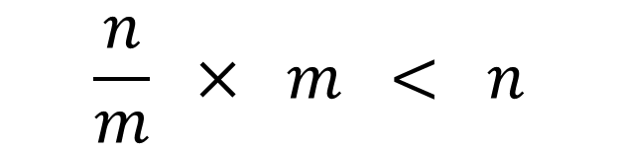
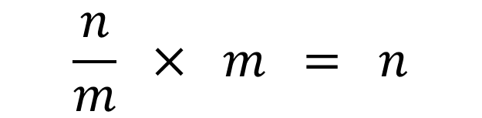
prime numbers
Therefore, if an integer n is divisible, we have,
$$\frac{n}{m} × m = n$$
If n is not divisible by m then,
$$\frac{n}{m} × m < n$$

Slide 21
prime numbers
Let us assume that we have already found the first n_{p}
prime numbers, p₁ , p₂ , · · ·, p_{max} , arranged in ascending
order according to size.
To find the next prime number, we start with an integer
N = p_{max} + 1, where p_{max} is the largest the prime number
known so far.
We can test whether N is divisible by dividing it with all the members of the first n_{p} prime numbers. If N is divisible by any of the existing prime number, it is not a prime number. We shall therefore increase N by one and repeat the process.

Slide 22
prime numbers
This process goes on until we reach a value of N that is not divisible for all the existing prime number. Such a number is a new prime number and can be added to the list as the largest prime number.
Prime number: 1, 2, 3, 5, 7, 11, 13, 17, 19, 23, 29 31, 37 … …

Slide 23
prime numbers
A few improvements may be incorporated into the method to make it more efficient.
(1) We recognize that 2 is prime number. As a result all other
even numbers are not prime numbers. For these reason, when we look for the next integer (> 2) to be tested we can increase N by 2 each time, rather than by 1. In this way the speed of the search is increased by a factor of 2.
(2) We do not need to go through the entire list of the existing prime numbers in our test. Obviously, if N is not divisible by any member up to p_{i} > N /2, it will not be divisible of any of the prime numbers in the list that are larger than p_{i}·

Slide 24
prime numbers
Algorithm
Initialization
Set K as the total number of prime numbers required.
Set N_BEG as the number of prime numbers to start with.
Input the first N_BEG prime numbers explicitly
(1) Store the last prime number in the list as NEW.

Slide 25
prime numbers
(2) Construct a new integer by NEW = NEW + 2.
(3) Test if NEW is prime by dividing it by all existing prime number < NEW/2.
(a) If divisible, try a new integer by adding 2 to NEW and
repeat the test.
(b) If not divisible, it is a new prime number.
(i) Add the new one to the list.
(ii) Increase the number of members by one.
(4) Repeat steps 2 and 3 to find the next prime number in the list.
(5) Stop if the total number is K.

Slide 26
outline
✓
0) Recap
Programming basics
Data representation
Examples of coding
i. prime numbers
ii. value of π
4) Summary
✓
✓
✓

Slide 27
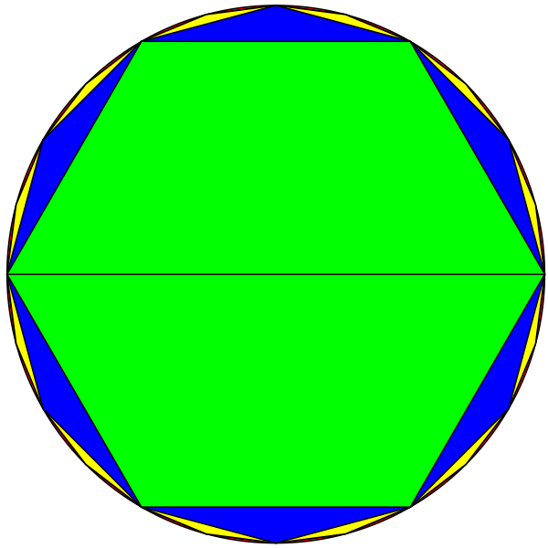
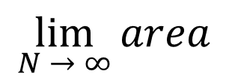
value of π
(1) Liu Hui’s method
$$\lim_{N → ∞}{area}$$
of N-gon = area of circle = π (for unit radius)

Slide 28
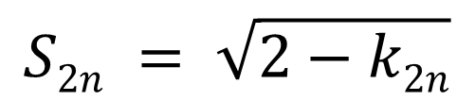
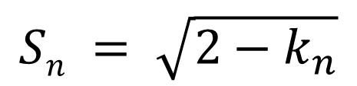
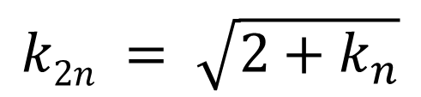
value of π
Liu Hui found a simple formula to find the side
length of an inscribed polygon of 2n sides,
if the side length of a polygon with n sides is
known with k as a temporary variable and S_{n}
as the side length of n-gon:
$$Sn = \sqrt{2−k_{n}}$$
$$k2n = \sqrt{2+k_{n}}$$
$$S2n = \sqrt{2−k2n}$$

Slide 29
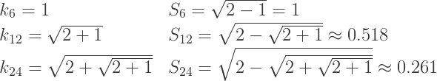
value of π
We start with a hexagon. The radius of the circle
is 1, area is π and the side length of the
hexagon is 1.

Slide 30
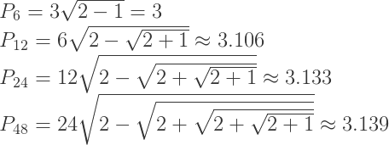
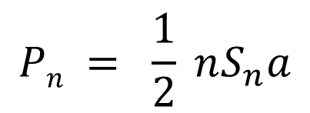
value of π
The area of a polygon with side n is given by:
$$Pn = \frac{1}{2} nS_{n}a$$
where a = apothem ≈ 1

Slide 31
value of π
# of sides π
6 3.0
12 3.1058285412302498
24 3.132628613281237
48 3.139350203046872
96 3.14103195089053
192 3.1414524722853443
384 3.141557607911622
768 3.141583892148936

Slide 32
value of π
(2) Buffon’s needle method
Buffon's Needle is one of the oldest problems in the field of geometrical probability. It was first stated by the French naturalist Buffon in 1733. It involves dropping a needle on a lined sheet of paper and determining the probability of the needle crossing one of the lines. The remarkable result is that the probability is directly related to the value of π.

Slide 33
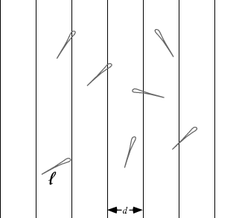
value of π

Slide 34
value of π
We will look at the simple case. In this case, the length
of the needle is one unit and the distance between the
lines is also one unit. There are two variables, the angle
at which the needle falls (θ) and the distance from
the center of the needle to the closest line (D). The
angle can vary from 0 to 180 degrees and is measured
against a line parallel to the lines on the paper. The
distance from the center to the closest line can never
be more than half of the distance between the lines.
The graph below depicts this situation.

Slide 35
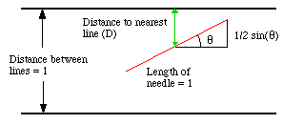
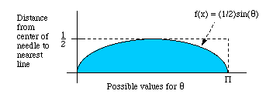
value of π
Figure 1
Figure 2

Slide 36
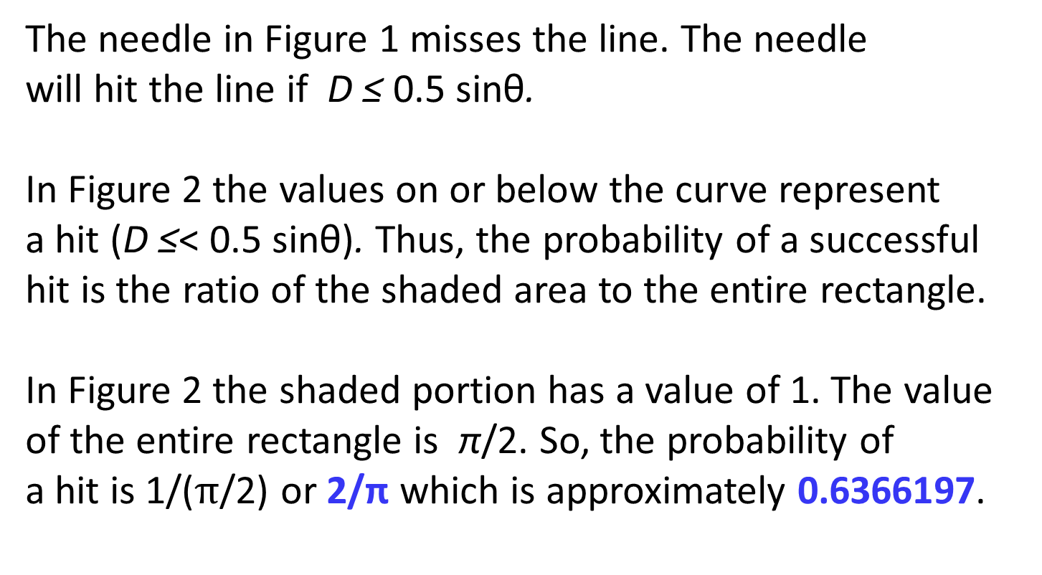
value of π
The needle in Figure 1 misses the line. The needle
will hit the line if D ≤ 0.5 sinθ.
In Figure 2 the values on or below the curve represent
a hit (D ≤< 0.5 sinθ). Thus, the probability of a successful
hit is the ratio of the shaded area to the entire rectangle.
In Figure 2 the shaded portion has a value of 1. The value
of the entire rectangle is π/2. So, the probability of
a hit is 1/($π$/2) or 2/π which is approximately 0.6366197.

Slide 37
value of π
To calculate π from the needle drops, simply take the
number of drops and multiply it by two, then divide by
the number of hits, i.e.
2(total drops)/(number of hits) = π (approximately).

Slide 38
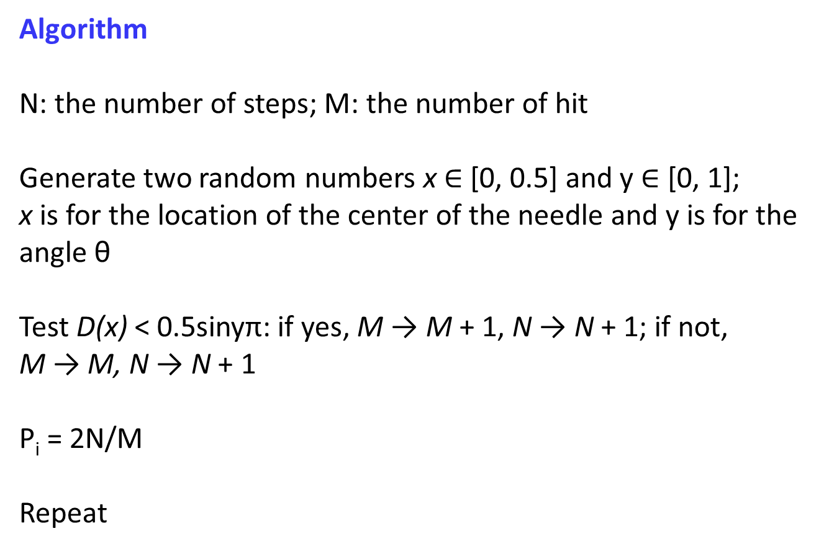
value of π
Algorithm
N: the number of steps; M: the number of hit
Generate two random numbers x $∈$ [0, 0.5] and y $∈$ [0, 1];
x is for the location of the center of the needle and y is for the
angle θ
Test D(x) < 0.5sinyπ: if yes, M → M + 1, N → N + 1; if not,
M → M, N → N + 1
P_{i} = 2N/M
Repeat

Slide 39

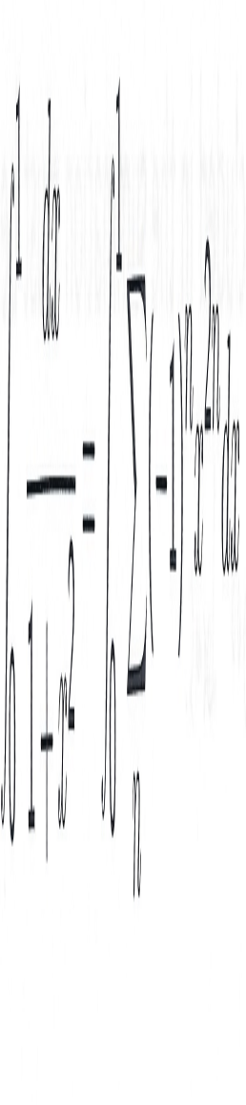
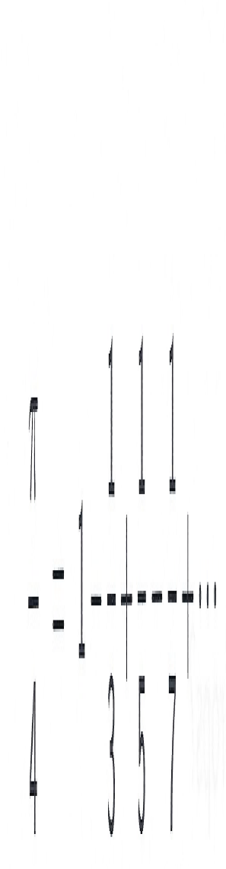
value of π
(3) Series expansion

Slide 40
value of π
It is fairly straightforward to program the summation.
All we need to do is create a simple loop that alternates
between adding to and subtracting from the sum of
inverse of the next odd integer.
If we wish to achieve an accuracy of 10⁻⁵, the last term
to be included in the summation must be much smaller
than 10⁻⁵ which means a number of terms of 250,000.

Slide 41

value of π
Alternate expression:
In this way the number of terms required to achieve
the same accuracy of 10⁻⁵ is decreased to 62,500,
a factor of 4 reduction.

Slide 42
outline
✓
0) Recap
Programming basics
Data representation
Examples of coding
i. prime numbers
ii. value of π
4) Summary
✓
✓
✓
✓
✓

Slide 43
summary
Basics of programming: right language, structured,
efficiency, documentation, and proper debugging
Binary system is adopted in computer computation,
different representations for integer and floating points
in terms of binary digits (bits)
Two examples of coding: (i) finding prime numbers and
(ii) calculating the value of π

