Slide 1
PHYS4150-TS20181010 Chapter 3 interpolation
Chao Zhang, zhangchk@hku.hk
Rm418, CYM Physics Building

Slide 2
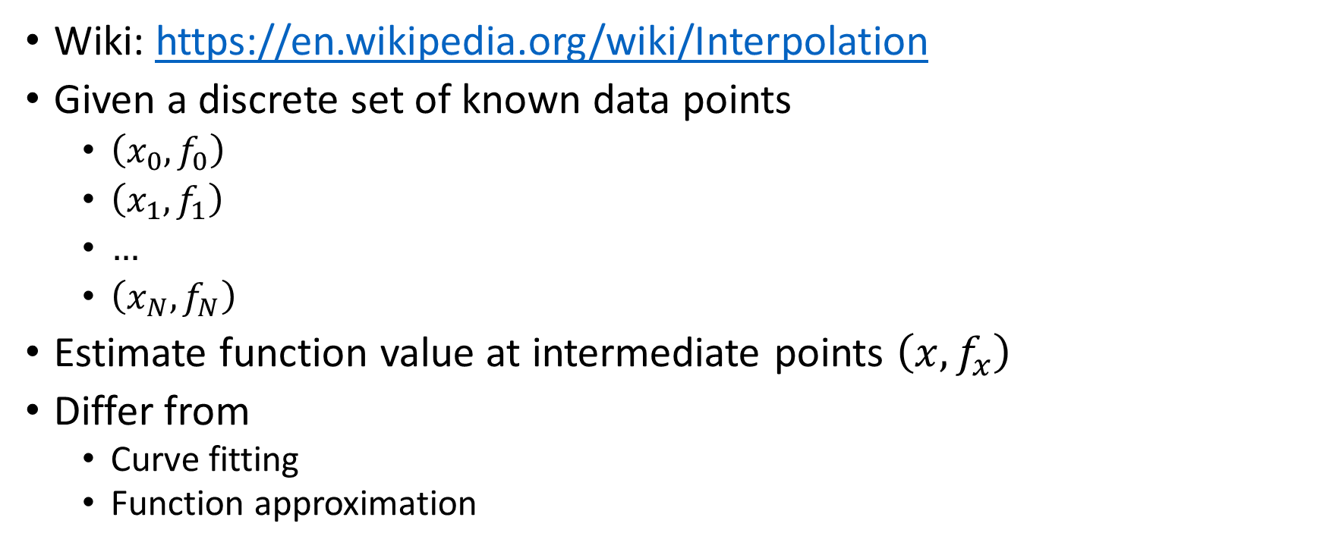
Interpolation definition
Wiki: https://en.wikipedia.org/wiki/Interpolation
Given a discrete set of known data points
$\left(x_{0},f_{0}\right)$
$\left(x_{1},f_{1}\right)$
$…$
$\left(x_{N},f_{N}\right)$
Estimate function value at intermediate points $\left(x,f_{x}\right)$
Differ from
Curve fitting
Function approximation

Slide 3
MATLAB built-in method
doc(‘interp1’)
See
TS20181010/TS20181010.mlx
TS20181010/TS20181010.pdf

Slide 4
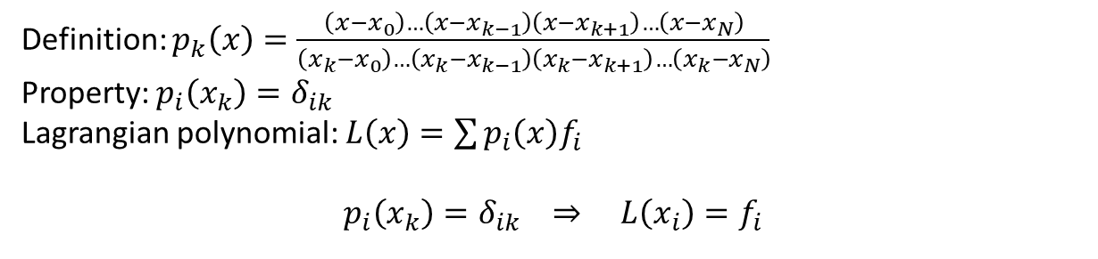
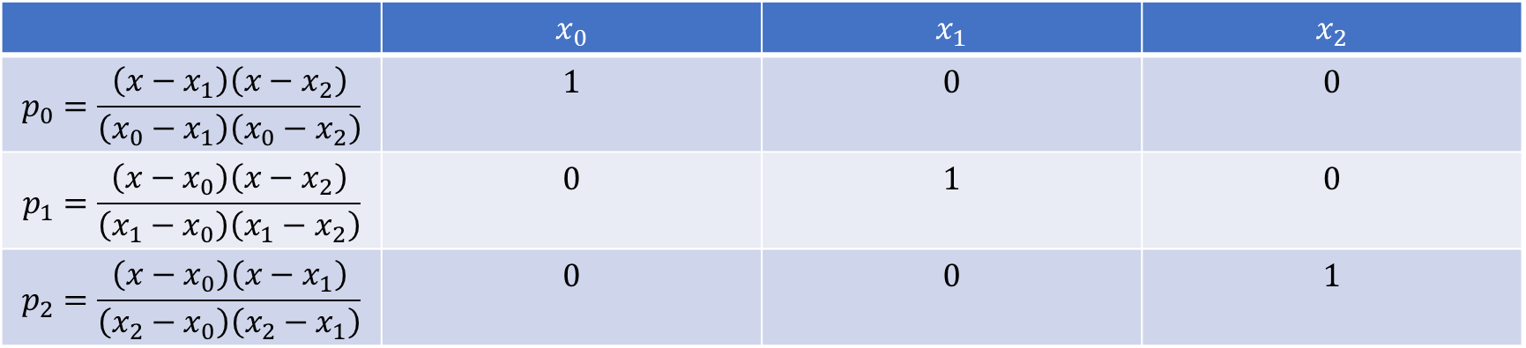
Lagrangian interpolation
Definition: $p_{k}\left(x\right)=\frac{\left(x−x_{0}\right)…\left(x−x_{k−1}\right)\left(x−x_{k+1}\right)…\left(x−x_{N}\right)}{\left(x_{k}−x_{0}\right)…\left(x_{k}−x_{k−1}\right)\left(x_{k}−x_{k+1}\right)…\left(x_{k}−x_{N}\right)}$
Property: $p_{i}\left(x_{k}\right)=δ_{ik}$
Lagrangian polynomial: $L\left(x\right)=\sum{p_{i}\left(x\right)f_{i}}$
$$p_{i}\left(x_{k}\right)=δ_{ik} ⇒ L\left(x_{i}\right)=f_{i}$$
 | $$x_{0}$$ | $$x_{1}$$ | $$x_{2}$$
$$p_{0}=\frac{\left(x−x_{1}\right)\left(x−x_{2}\right)}{\left(x_{0}−x_{1}\right)\left(x_{0}−x_{2}\right)}$$ | $$1$$ | $$0$$ | $$0$$
$$p_{1}=\frac{\left(x−x_{0}\right)\left(x−x_{2}\right)}{\left(x_{1}−x_{0}\right)\left(x_{1}−x_{2}\right)}$$ | $$0$$ | $$1$$ | $$0$$
$$p_{2}=\frac{\left(x−x_{0}\right)\left(x−x_{1}\right)}{\left(x_{2}−x_{0}\right)\left(x_{2}−x_{1}\right)}$$ | $$0$$ | $$0$$ | $$1$$

Slide 5
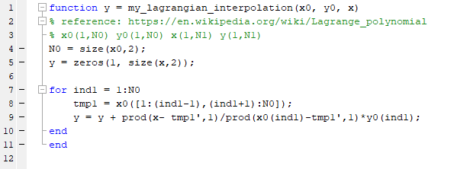
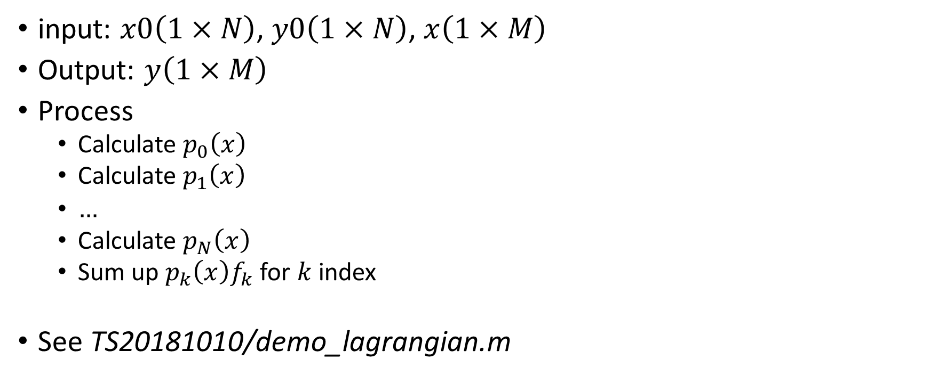
Lagrangian interpolation
input: $x0\left(1×N\right)$, $y0\left(1×N\right)$, $x\left(1×M\right)$
Output: $y\left(1×M\right)$
Process
Calculate $p_{0}\left(x\right)$
Calculate $p_{1}\left(x\right)$
$…$
Calculate $p_{N}\left(x\right)$
Sum up $p_{k}\left(x\right)f_{k}$ for $k$ index
See TS20181010/demo_lagrangian.m

Slide 6
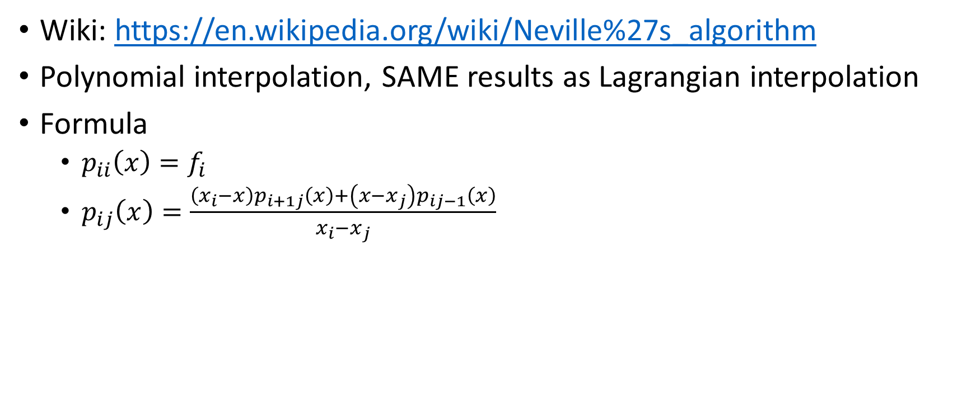
Neville interpolation
Wiki: https://en.wikipedia.org/wiki/Neville%27s_algorithm
Polynomial interpolation, SAME results as Lagrangian interpolation
Formula
$p_{ii}\left(x\right)=f_{i}$
$p_{ij}\left(x\right)=\frac{\left(x_{i}−x\right)p_{i+1j}\left(x\right)+\left(x−x_{j}\right)p_{ij−1}\left(x\right)}{x_{i}−x_{j}}$

Slide 7
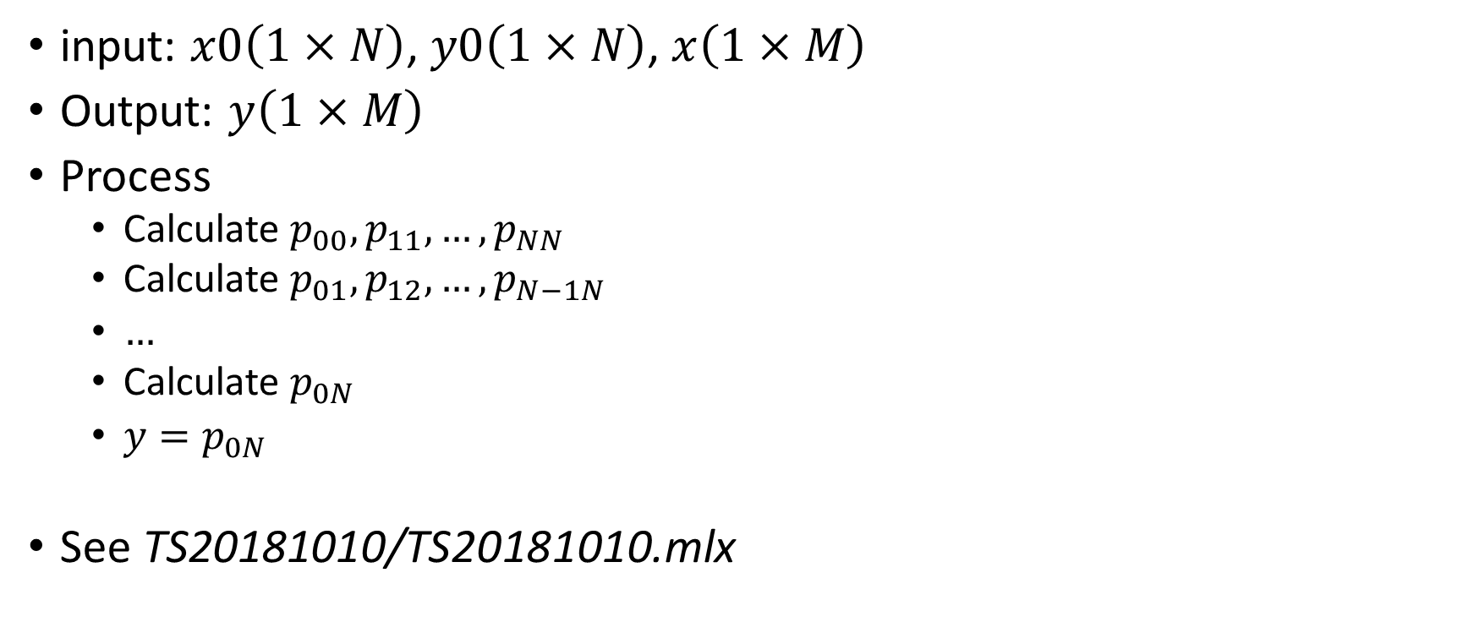
Neville interpolation
input: $x0\left(1×N\right)$, $y0\left(1×N\right)$, $x\left(1×M\right)$
Output: $y\left(1×M\right)$
Process
Calculate $p_{00}, p_{11},…,p_{NN}$
Calculate $p_{01},p_{12},…,p_{N−1N}$
$…$
Calculate $p_{0N}$
$y=p_{0N}$
See TS20181010/TS20181010.mlx

Slide 8
Homework11 (optional)
Implement Neville interpolation method

Slide 9
Take home message
Reminder: hw7,8,9,10 are due tomorrow
Interpolation
Lagrangian method
Neville method
Homework11 (optional)

