Slide 1
PHYS4150-TS20181121 Eigenvalue & Chapter 3 Summary
Chao Zhang, zhangchk@hku.hk
Rm418, CYM Physics Building

Slide 2
Homework 15
You homework 15 have been graded, please go to collect your homework at the students box outside the physics department office.
The solutions have been uploaded to course website
Simple but tedious (maybe the longest code in all past homework); Skip the explanation here, please go to see the solution or others’ homework.

Slide 3
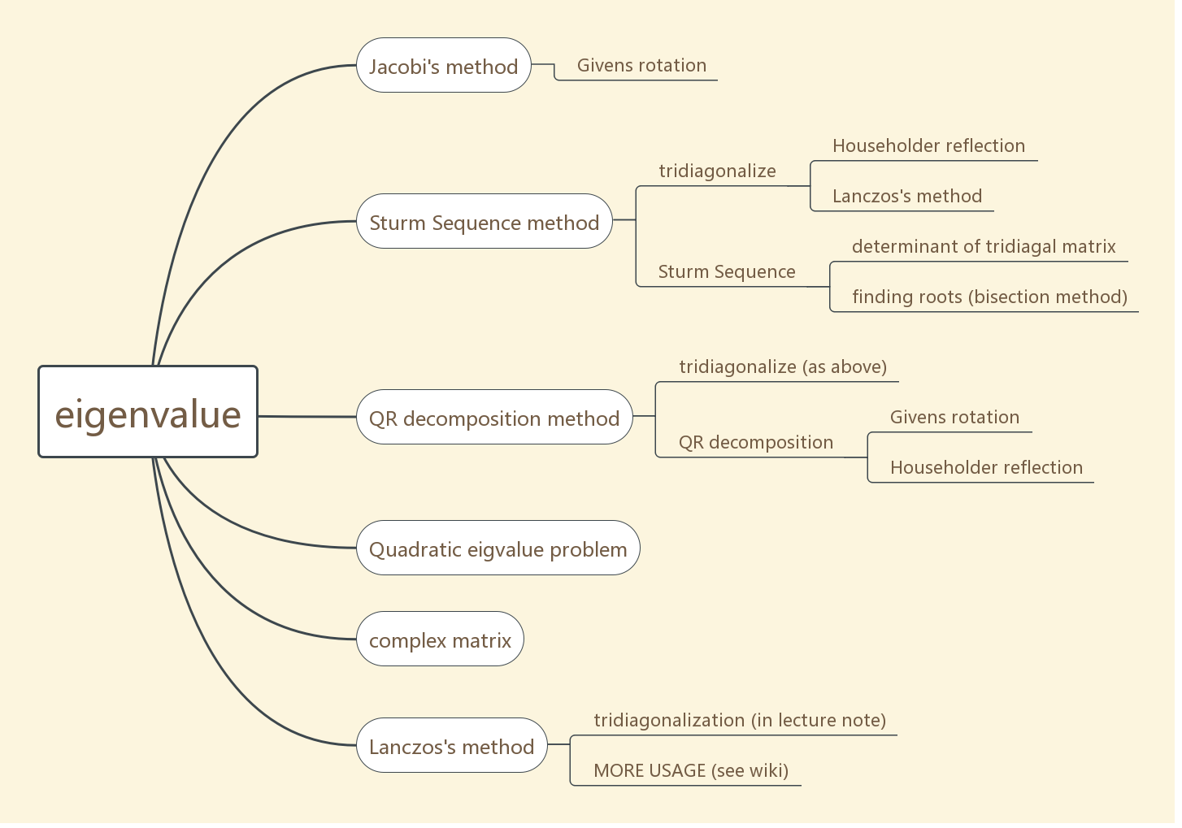

Eigenvalue problem
Solve $A\vec{v}=λ\vec{v}$ where $A$ is Hermitian matrix

Slide 4
Skip Part
Jocabi’s method: see TS20181108
Lanczos’s method: not implement yet…..

Slide 5
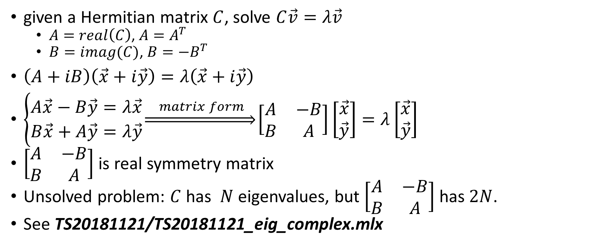
Eigenvalue of Hermitian Matrix
given a Hermitian matrix $C$, solve $C\vec{v}=λ\vec{v}$
$A=real\left(C\right)$, $A=A^{T}$
$B=imag(C)$, $B=−B^{T}$
$\left(A+iB\right)\left(\vec{x}+i\vec{y}\right)=λ\left(\vec{x}+i\vec{y}\right)$
$\left\{\begin{aligned}A\vec{x}−B\vec{y}=λ\vec{x} \\ B\vec{x}+A\vec{y}=λ\vec{y}\end{aligned}\right.\underset{⇒}{ matrix form }\left[\begin{matrix}A & −B \\ B & A\end{matrix}\right]\left[\begin{matrix}\vec{x} \\ \vec{y}\end{matrix}\right]=λ\left[\begin{matrix}\vec{x} \\ \vec{y}\end{matrix}\right]$
$\left[\begin{matrix}A & −B \\ B & A\end{matrix}\right]$ is real symmetry matrix
Unsolved problem: $C$ has $N$ eigenvalues, but $\left[\begin{matrix}A & −B \\ B & A\end{matrix}\right]$ has $2N$.
See TS20181121/TS20181121_eig_complex.mlx

Slide 6
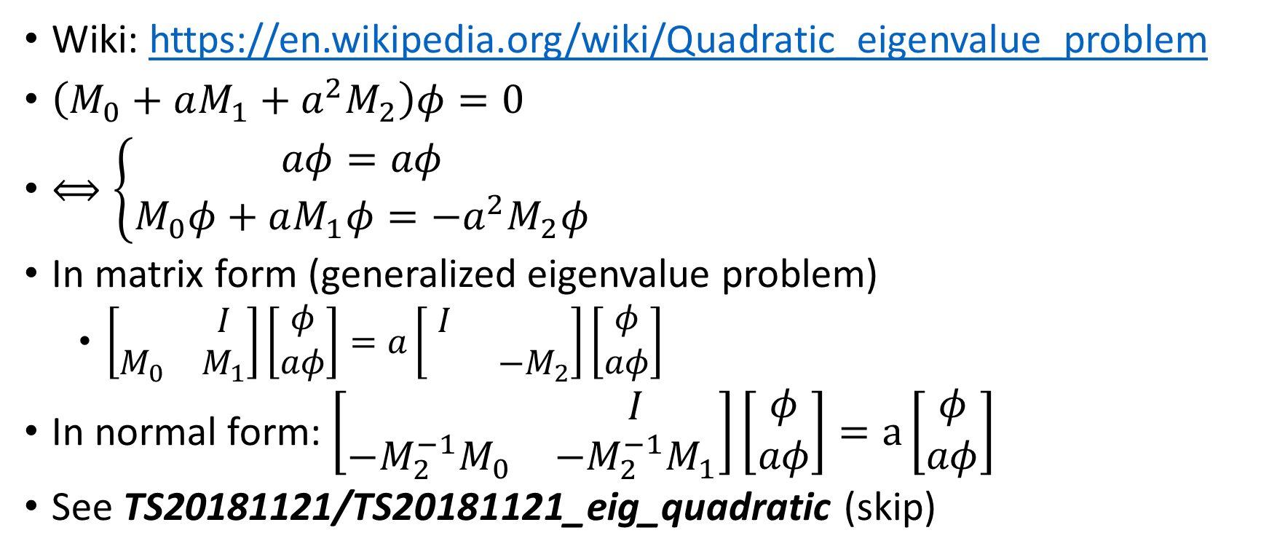
Quadratic Eigenvalue Problem
Wiki: https://en.wikipedia.org/wiki/Quadratic_eigenvalue_problem
$\left(M_{0}+aM_{1}+a^{2}M_{2}\right)φ=0$
$⟺\left\{\begin{aligned}aφ=aφ \\ M_{0}φ+aM_{1}φ=−a^{2}M_{2}φ\end{aligned}\right.$
In matrix form (generalized eigenvalue problem)
$\left[\begin{matrix} & I \\ M_{0} & M_{1}\end{matrix}\right]\left[\begin{matrix}φ \\ aφ\end{matrix}\right]=a\left[\begin{matrix}I & \\ & −M_{2}\end{matrix}\right]\left[\begin{matrix}φ \\ aφ\end{matrix}\right]$
In normal form: $\left[\begin{matrix} & I \\ {−M_{2}^{−1}M}_{0} & −M_{2}^{−1}M_{1}\end{matrix}\right]\left[\begin{matrix}φ \\ aφ\end{matrix}\right]=a\left[\begin{matrix}φ \\ aφ\end{matrix}\right]$
See TS20181121/TS20181121_eig_quadratic (skip)

Slide 7
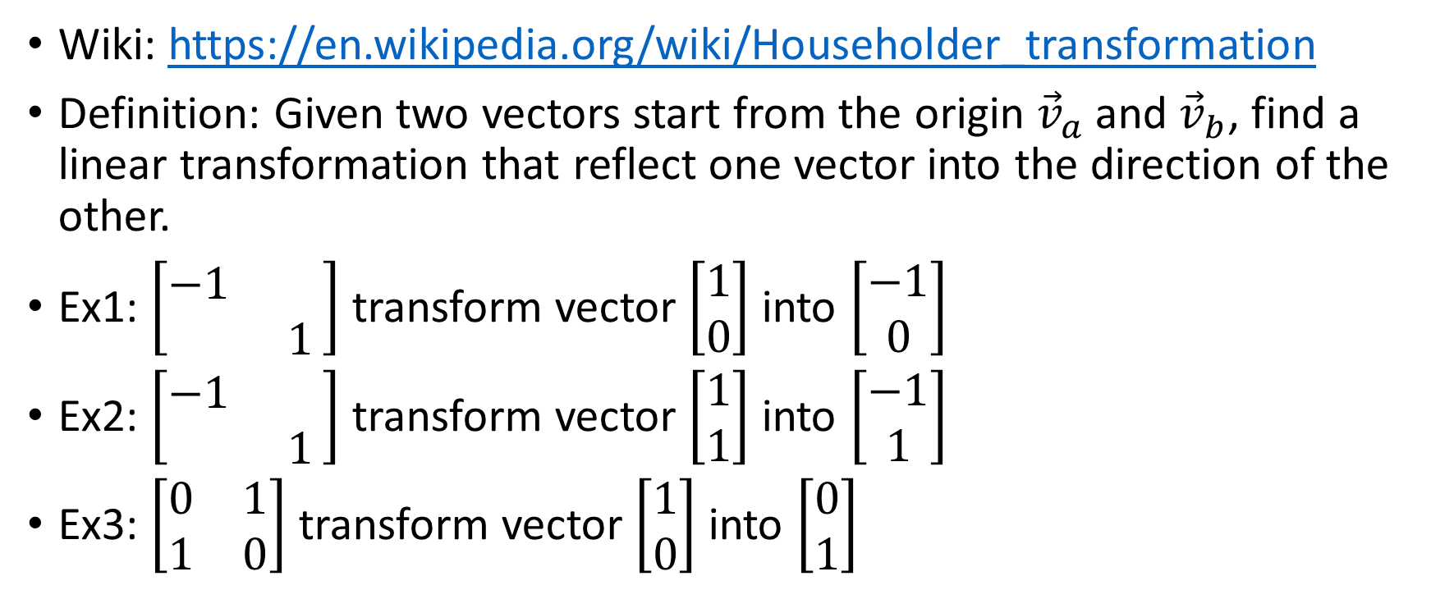
Householder Transformation (Reflection)
Wiki: https://en.wikipedia.org/wiki/Householder_transformation
Definition: Given two vectors start from the origin ${\vec{v}}_{a}$ and ${\vec{v}}_{b}$, find a linear transformation that reflect one vector into the direction of the other.
Ex1: $\left[\begin{matrix}−1 & \\ & 1\end{matrix}\right]$ transform vector $\left[\begin{aligned}1 \\ 0\end{aligned}\right]$ into $\left[\begin{aligned}−1 \\ 0\end{aligned}\right]$
Ex2: $\left[\begin{matrix}−1 & \\ & 1\end{matrix}\right]$ transform vector $\left[\begin{aligned}1 \\ 1\end{aligned}\right]$ into $\left[\begin{aligned}−1 \\ 1\end{aligned}\right]$
Ex3: $\left[\begin{matrix}0 & 1 \\ 1 & 0\end{matrix}\right]$ transform vector $\left[\begin{aligned}1 \\ 0\end{aligned}\right]$ into $\left[\begin{aligned}0 \\ 1\end{aligned}\right]$

Slide 8
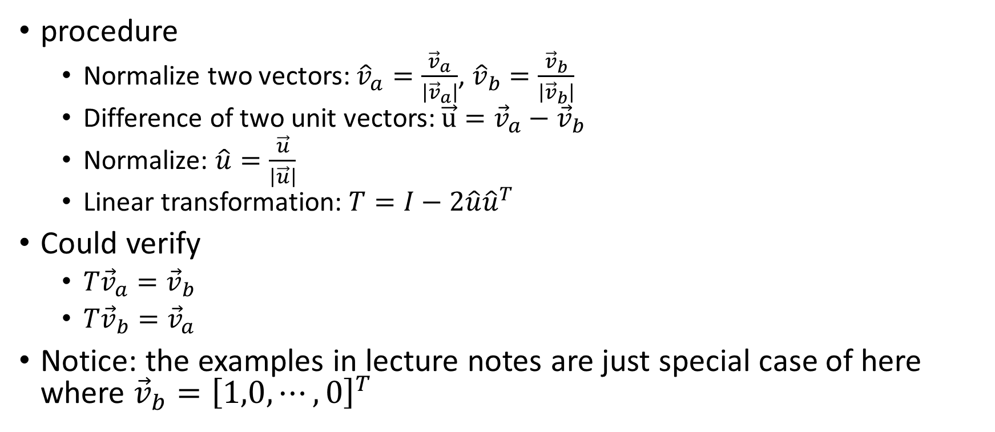
Householder Transformation
procedure
Normalize two vectors: ${\hat{v}}_{a}=\frac{{\vec{v}}_{a}}{\left|{\vec{v}}_{a}\right|}$, ${\hat{v}}_{b}=\frac{{\vec{v}}_{b}}{\left|{\vec{v}}_{b}\right|}$
Difference of two unit vectors: $\vec{u}={\vec{v}}_{a}−{\vec{v}}_{b}$
Normalize: $\hat{u}=\frac{\vec{u}}{\left|\vec{u}\right|}$
Linear transformation: $T=I−2\hat{u}{\hat{u}}^{T}$
Could verify
$T{\vec{v}}_{a}={\vec{v}}_{b}$
$T{\vec{v}}_{b}={\vec{v}}_{a}$
Notice: the examples in lecture notes are just special case of here where ${\vec{v}}_{b}={\left[1,0,⋯,0\right]}^{T}$

Slide 9
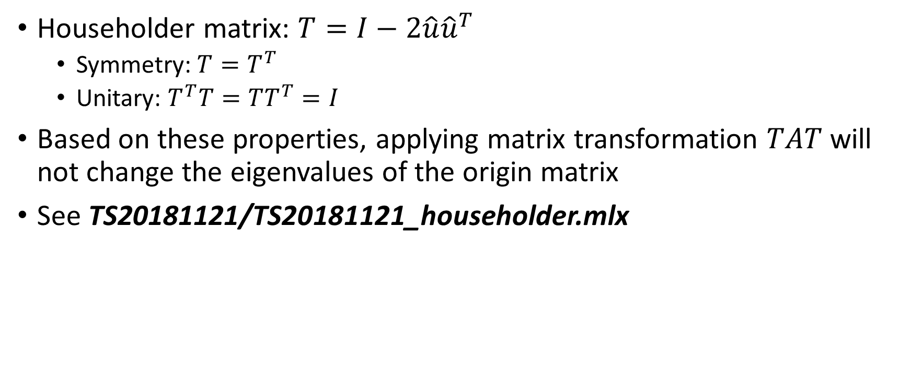
Householder Matrix property
Householder matrix: $T=I−2\hat{u}{\hat{u}}^{T}$
Symmetry: $T=T^{T}$
Unitary: $T^{T}T=TT^{T}=I$
Based on these properties, applying matrix transformation $TAT$ will not change the eigenvalues of the origin matrix
See TS20181121/TS20181121_householder.mlx

Slide 10
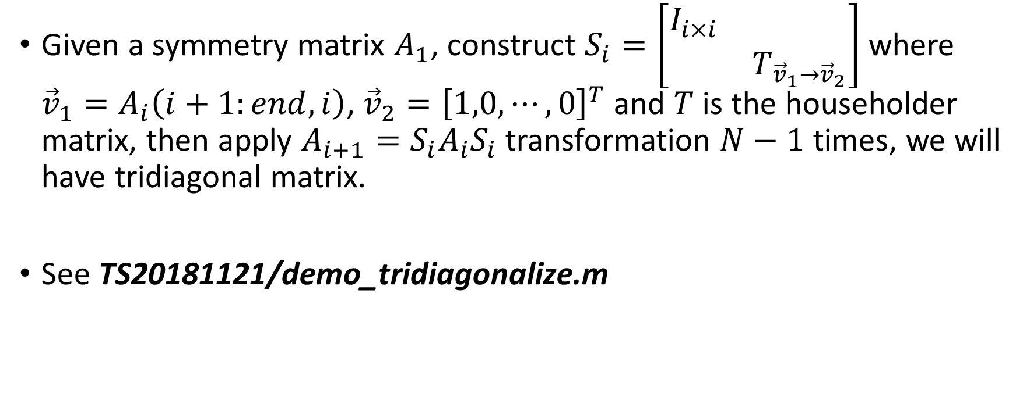
Tridiagonalization
Given a symmetry matrix $A_{1}$, construct $S_{i}=\left[\begin{matrix}I_{i×i} & \\ & T_{{\vec{v}}_{1}→{\vec{v}}_{2}}\end{matrix}\right]$ where ${\vec{v}}_{1}=A_{i}\left(i+1:end,i\right)$, ${\vec{v}}_{2}={\left[1,0,⋯,0\right]}^{T}$ and $T$ is the householder matrix, then apply $A_{i+1}=S_{i}A_{i}S_{i}$ transformation $N−1$ times, we will have tridiagonal matrix.
See TS20181121/demo_tridiagonalize.m

Slide 11
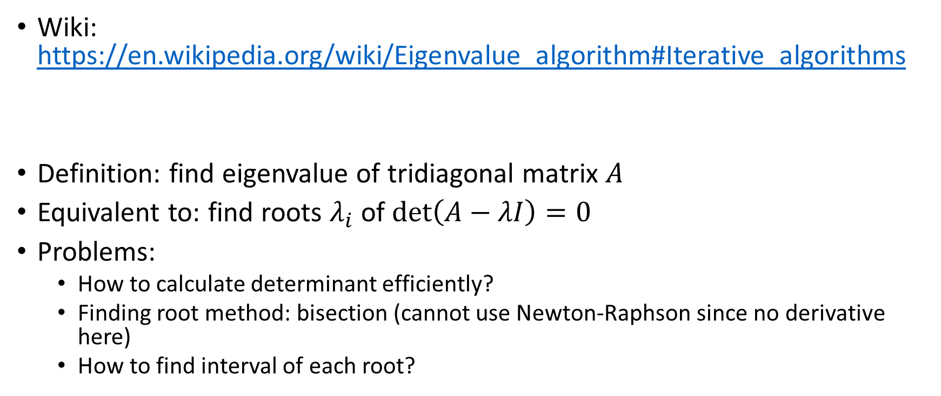
Sturm Sequence
Wiki: https://en.wikipedia.org/wiki/Eigenvalue_algorithm#Iterative_algorithms
Definition: find eigenvalue of tridiagonal matrix $A$
Equivalent to: find roots $λ_{i}$ of $\det\left(A−λI\right)=0$
Problems:
How to calculate determinant efficiently?
Finding root method: bisection (cannot use Newton-Raphson since no derivative here)
How to find interval of each root?

Slide 12
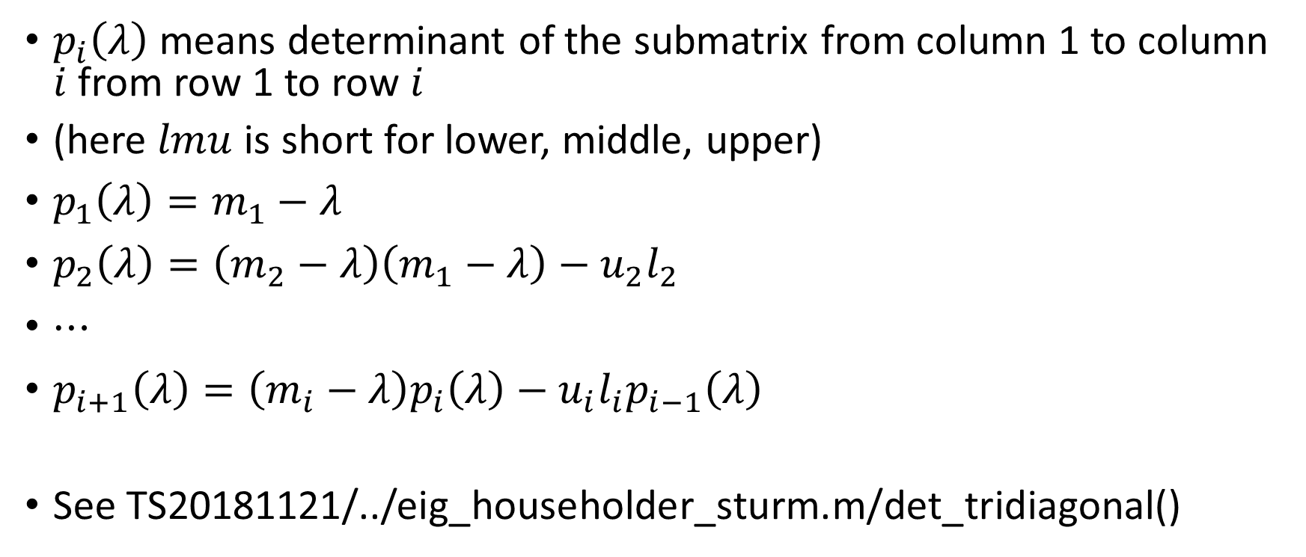
Sturm Sequence - determinant
$p_{i}\left(λ\right)$ means determinant of the submatrix from column 1 to column $i$ from row 1 to row $i$
(here $lmu$ is short for lower, middle, upper)
$p_{1}\left(λ\right)=m_{1}−λ$
$p_{2}\left(λ\right)=\left(m_{2}−λ\right)\left(m_{1}−λ\right)−u_{2}l_{2}$
$⋯$
$p_{i+1}\left(λ\right)=\left(m_{i}−λ\right)p_{i}\left(λ\right)−u_{i}l_{i}p_{i−1}\left(λ\right)$
See TS20181121/../eig_householder_sturm.m/det_tridiagonal()

Slide 13
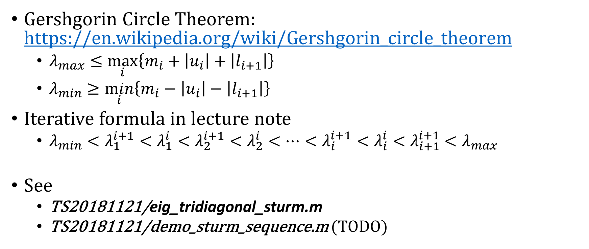
Sturm Sequence - Interval of Each Root
Gershgorin Circle Theorem: https://en.wikipedia.org/wiki/Gershgorin_circle_theorem
$λ_{max}≤\max_{i}\left\{m_{i}+\left|u_{i}\right|+\left|l_{i+1}\right|\right\}$
$λ_{min}≥\min_{i}\left\{m_{i}−\left|u_{i}\right|−\left|l_{i+1}\right|\right\}$
Iterative formula in lecture note
$λ_{min}<λ_{1}^{i+1}<λ_{1}^{i}<λ_{2}^{i+1}<λ_{2}^{i}<⋯<λ_{i}^{i+1}<λ_{i}^{i}<λ_{i+1}^{i+1}$ $<λ_{max}$
See
TS20181121/eig_tridiagonal_sturm.m
TS20181121/demo_sturm_sequence.m (TODO)

Slide 14
QR decomposition
The animation code not finished not yet… please go to see the plain code
TS20181121/qr_decomposition

Slide 15
QR – Givens Rotation
The animation code not finished not yet… please go to see the plain code
TS20181121/qr_decomposition/qr_tridiagonal_givens.m
TS20181121/qr_decomposition/qr_full_givens.m

Slide 16
QR – Householder Transformation
The animation code not finished not yet… please go to see the plain code
TS20181121/qr_decomposition/qr_tridiagonal_householder.m
TS20181121/qr_decomposition/qr_full_ householder.m

Slide 17
Eigenvalue – QR Decomposition
The animation code not finished not yet… please go to see the plain code
TS20181121/eig_householder_qr.m

Slide 18
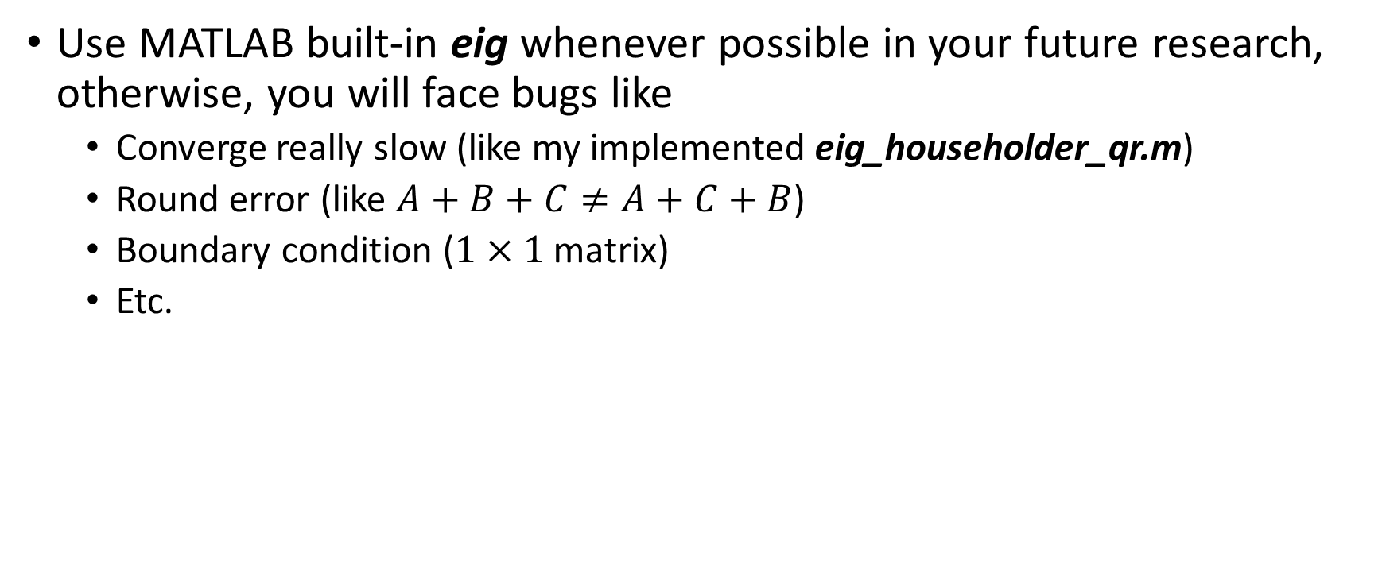
Personal advice
Use MATLAB built-in eig whenever possible in your future research, otherwise, you will face bugs like
Converge really slow (like my implemented eig_householder_qr.m)
Round error (like $A+B+C≠A+C+B$)
Boundary condition ($1×1$ matrix)
Etc.

Slide 19
Chapter 3 summary
Gauss-Jordan Elimation
Determinant
Linear equations
LU decomposition to solve linear equations
Eigenvalue problems

Slide 20
Course Project
PLEASE put the code at separate files, NOT paste code at the end of the your report
The PHYS4150 course on 20181126 and 20181129 will be used for project presentation
Submit your report and code via email before 20181121 23:59
Submit your presentation slide via email before 20181125 23:59

