Slide 1
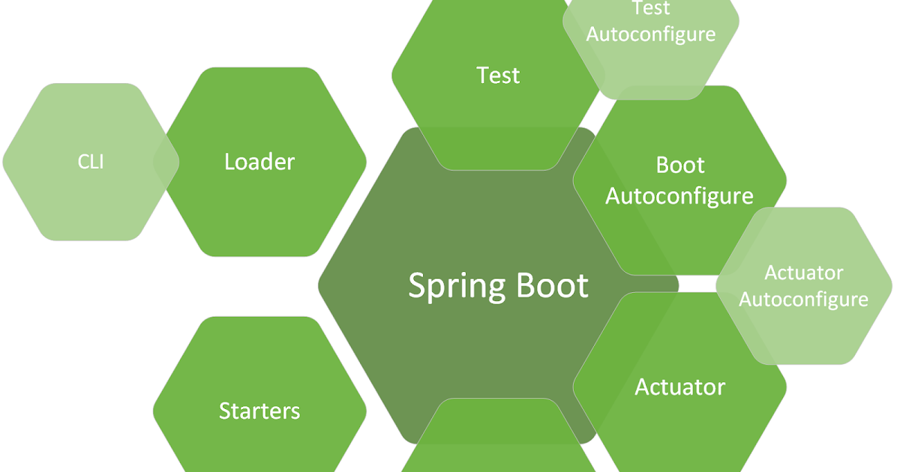

Spring Data JPA
Query Making Process

Slide 2
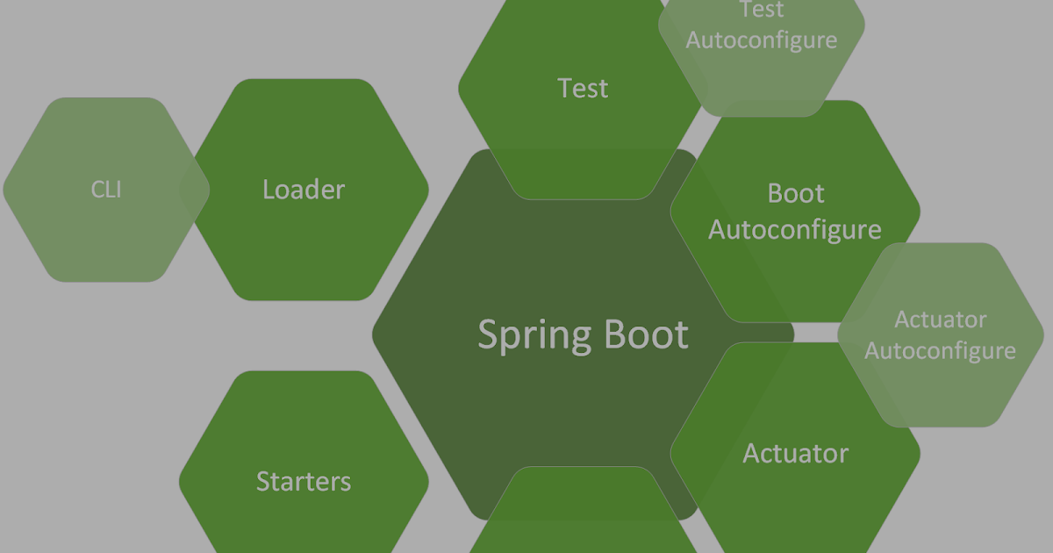
Project Setup
Dependency
Spring Web
Lombok
Spring Data JPA
Spring Boot DevTools
MySQL Driver
Or
H2 Database
application.properties - H2 DB
spring.datasource.url=jdbc:h2:mem:h2db
##Incase you want to use file for H2 DB then comment above and uncomment below
##spring.datasource.url=jdbc:h2:file:path/database_name.db
spring.datasource.driver-class-name=org.h2.Driver
spring.datasource.username=admin
spring.datasource.password=admin
spring.h2.console.enabled=true
##########JPA properties#############
spring.jpa.show-sql=true
spring.jpa.hibernate.ddl-auto=update

Slide 3
One step deeper to project
com.reed.dao.entities
Entities are classes for which corresponding table either created or exists into DB.
com.reed.dao.repos
Repository are used to manage entities by using different set of CRUD methods.
com.reed.service
Service layer which will make use of repo to persist entity data into underlying DB.
com.reed.controller
Rest controller will act as front layer to route the request to service and respond to client.
Entity or domain object we are using in this project
@Id
@GeneratedValue(strategy = GenerationType.IDENTITY)
private long empId;
private String empName;
@JsonFormat(pattern = "dd-mm-yyyy")
private Date dob;
private String role;
@Column(unique = true)
private String email;

Slide 4
@NamedQuery
Here using @NamedQuery we need to define name parameter which will have method name - domain class name + . + method name and query parameter.
And then corresponding method will be in repository.
@Entity
@NamedQuery(name = "Employee.findByEmail",query = "select e from Employee e where e.email=?1")
public class Employee {
}
public interface EmployeeRepo extends JpaRepository<Employee, Long>{
public Employee findByEmail(String email);
}
In any query Domain class name and property name should exactly same
as defined in Entity or Domain Class (case sensitive)

Slide 5
@QUERY
Managing multiple NamedQuery is bit difficult, and also it makes entity class bulky.
So we can make use of @Query, where method is mapped to query directly, within repository itself.
Here you will supply parameter based on index, ?1 - first index,
?2 - 2nd index .. like that ?n - nth index. This is position based parameter binding.
@Query(value = "select E from Employee E where E.empName like ?1%")
public List<Employee> findByEmpNameStartBy(String startingParameter);
@Query(value = "select e from Employee e where e.email=?1 and e.empName=?2")
public Employee findByEmailAndEmpName(String email,String empname);
Parameter name can be anything because query is mapped using
index not name

Slide 6
@QUERY using Named Parameters
Position based parameter binding is error prone, and hence you can use named parameter
This is based on logical name of domain property(case sensitive)
@Query(value = "select E from Employee E where E.empName like :empname% or E.email like :email%)
public List<Employee> findByEmpNameOrEmailStartBy(@Param("empname")
String empName,String email);
Based on this name, parameter name should be defined. If you are using some
other name then @Param can be used to map the name.
Here we have not used @param because parameter of method exactly match with name we
have used in query
@QUERY using SpEL - have a look
@Query(value = "select E from #{#entityName} E where E.empName like ?1%")
public List<Employee> findByEmpNameStartBy(String startingParameter);

Slide 7
@QUERY native query
@Query(value = "select * from employee order by emp_name desc",nativeQuery = true)
public List<Employee> findAllEmployeeSortedNative();
You can use Pageable as well, which can respond with Page for getting the pages data
@Query(value = "select E from Employee E where E.empName like :empname%")
public Page<Employee> findByEmpNameStartsWith(String empname,Pageable pageable);

Slide 8
@QUERY for delete or update
If @Transactional is not there
javax.persistence.TransactionRequiredException: Executing an update/delete query requires transaction
If @Modifying is not there
org.hibernate.hql.internal.QueryExecutionRequestException: Not supported for DML operations [delete from com.reed.dao.entities.Employee E where E.empName = :empname]
Return type should be either int or void
Modifying queries can only use void or int/Integer as return type! Offending method:
@Query(value = "delete from Employee E where E.empName = :empname")
@Modifying
@Transactional
public void deleteByEmpName(String empname);
@Query(value = "update Employee E set E.empName = :newempname where E.empName = :empname")
@Modifying
@Transactional
public int updateByEmpName(String newempname,String empname);

