Slide 1



Byborg’s Screening Test
Ema Ilić, MSc. Applying for the role of an AI Engineer.

Slide 2
Q1: Handling categorical variables with high cardinality

Slide 3

High Cardinality
High cardinality of categorical variables means that the categorical feature of our dataset contains too many unique values. This can be a problem in terms of space: one-hot encoding doesn’t work as well, i.e. it takes up a lot of memory. It alsobrings up the curse of dimensionality - relatively small amount of instances compared to a high amount of features causes numerous issues in generalizing our models. This can lead to overfitting.

Slide 4
Solutions
01
02
03
04
05
Target Encoding.
Replace categories with the mean of the target variable. Works well for high-cardinality data but requires regularization to prevent leakage.
Aggregation function.
Leave instances belonging to a value with high frequency as they are and replace all the other instances with a new category which we call other.
Feature Hashing.
Hash categories into a fixed number of bins. Useful when the number of unique values is too large to store in memory.
Embedding Layers.
Convert categories into dense vectors using embeddings, commonly used in NLP and recommendation systems.
One-hot Encoding + PCA.
Apply a dimensionality reduciton technique like PCA to reduce dimentsionality after one-hot encoding.

Slide 5
Q2: Scaling Model Inference for high traffic
Deploying deep learning models at scale means handling high request volume with low latency. Some of the challenges involve handling slow inference speed, high hardware costs, bottlenecks in request handling (synchronization, batching), and dynamic scaling to handle fluctuating traffic.

Slide 6
Solutions
01
02
03
Infrastructure.
Kubernetes allow for autoscaling, i.e. dynamically adjusting inference instances.
NVIDIA Triton server enables efifcient model serving with dynamic batching. Deploying on TFUs reuces latency for real-time applications.
Serverless inference like AWS Lambda + GPY backed instances autoscales well.
Optimizations for inference.
Model pruning - reducing the model size without sacrificing accuracy. Batching requests: combining multiple queries to maximize GPU/TPU efficiency.
We could also profile model performance before deployment, e.g. TensorRT benchmarking. That way we are aware of the inference speed before we put it into production. We could roll it out with feature flags in a controlled manner.

Slide 7
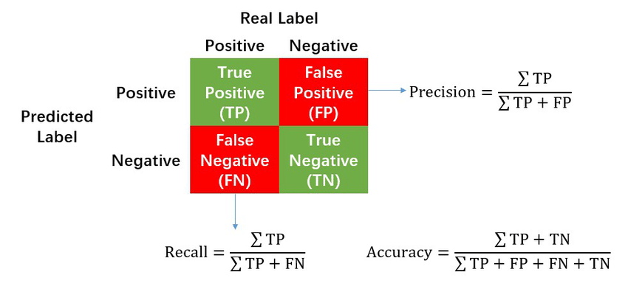
Q3: Precision, Recall, Accuracy
The effectiveness of machine learning models depends on how we assess their performance. While model accuracy is often used as a quick evaluation metric, it is not often the best choice in terms of depth and comprehensiveness.
It measures the overall number of correct predictions made by the model across the entire dataset. However, it does not provide insights into class-specific performance, such as which class boundaries were well-learned or where the model struggled.

Slide 8
Precision, Recall, Accuracy: Differences and use cases:
01
02
03
Precision. We try to make sure that what we are classifying as the positive class is a positive class sample indeed, which in turn reduces recall. For example: in recommender systems, reducing the number of false positive is the most important. If the user sees recommendations they don’t like, they will close the app. Useful in cases of imbalanced datasets.
Recall. We are trying not to miss out on any positive class samples, which allows many false positives to creep in, thus reducing precision.We use it when we want to be very aware of false negatives, like in the case of cancer detection. If our patient is classified as a false negative, the consequences for their health can be detrimental. Useful in cases of imbalanced datasets.
Accuracy tells us how many times our model got its prediction correct as a ratio of the total times the model was used for predictions. However, it makes sense to use a metric like an accuracy only when the dataset is balanced

Slide 9
References
Han, S., et al. (2015). Deep Compression: Compressing Deep Neural Networks with Pruning, Trained Quantization, and Huffman Coding
Jouppi, N. P., et al. (2017). In-Datacenter Performance Analysis of a Tensor Processing Unit.
NVIDIA Triton Inference Server
Precision & Recall Guide
NVIDIA TensorRT

Slide 10
Dear hiring manager, Thank you for the chance to participate in Byborg’s hiring process. Hoping to hear back from you soon!
Ema

