Slide 1

Image Super Resolution
Using SRCNN
Anshika Jhalani 21BLC1033
Nishu Singh 21BLC1579

Slide 2

Overview
This project uses an SRCNN to upscale low-resolution images.
Trained on paired high-res and low-res examples, the model predicts high-resolution versions for new low-res images.
The final output displays the original low-res image, the predicted high-res version, and the actual high-res image for comparison.

Slide 3
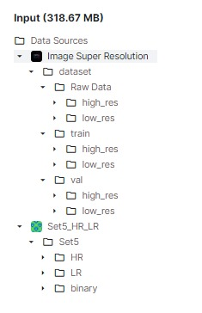
Dataset
The dataset is divided into 2 main folders:
train and val.
Inside these 2 folders, there are subdirectories called high_res & low_res which correspond to high-resolution images and low-resolution images respectively.

Slide 4
Initial Setup
Importing various libraries and defining the initial setup for the project.
os: Used for managing file paths (likely for loading image data).
tensorflow.keras: Core library for building and training the image processing model (likely a CNN).
cv2 (OpenCV): For reading and manipulating image data (potential pre-processing).
numpy (np): Provides numerical arrays and random number generation (essential for image data representation and model training).
matplotlib.pyplot (plt): Used for visualization purposes (potentially displaying training results or processed images).

Slide 5
Load Dataset
Loading and pre-processing high-resolution (HR) and low-resolution (LR) image pairs from the dataset.
Filename Sorting: The sorted_alphanumeric function ensures filenames are sorted consistently, considering both characters and numbers.
Image Size: A constant SIZE (e.g., 256) defines the desired image size for resizing.
HR Image Loading & LR Image Loading
Divide dataset: The code splits the pre-processed high-resolution (HR) and low-resolution (LR) images into training, validation, and testing sets. It then reshapes them into NumPy arrays with the format (number of images, image height, image width, color channels).

Slide 6
Architecture
Input: Takes a low-resolution image (256x256, 3 channels).
Feature Extraction:
Two convolutional layers with ReLU activations:
1st layer: 64 filters, 9x9 kernel size (extracts features).
2nd layer: 32 filters, 1x1 kernel size (reduces dimensionality or refines features).
Reconstruction:
Final convolutional layer with ReLU activation:
3 filters, 5x5 kernel size (reconstructs high-resolution image with 3 color channels).

Slide 7
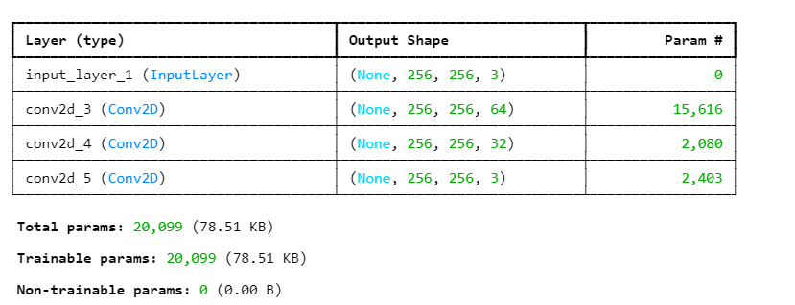
Architecture

Slide 8
Training the Model
the code iteratively trains the model on low-resolution and high-resolution image pairs, minimizing the reconstruction error between predicted and actual high-resolution images.
The validation set helps prevent overfitting by monitoring performance on unseen data.
epochs = 20: Number of times to iterate through the entire training set.
batch_size = 1: Number of images processed per update (single image in this case).
validation_data = (validation_low_image, validation_high_image): Tuple containing validation data

Slide 9
Prediction of HR Image
Prediction Loop: The code iterates over a specific range of test images (16 to 24). For each image:
It reshapes the low-resolution test image to match the model's input format.
It feeds the reshaped image into the SRCNN model to get a predicted high-resolution image.
The predicted image is post-processed (clipped between 0 and 1) and reshaped back to its original size.
Evaluation and Display: The code calculates two quality metrics (PSNR and SSIM) for the predicted image compared to the actual high-resolution image.
Finally, it calls the plot_images function to display all three images (high-res, low-res, predicted) for visual assessment.

Slide 10
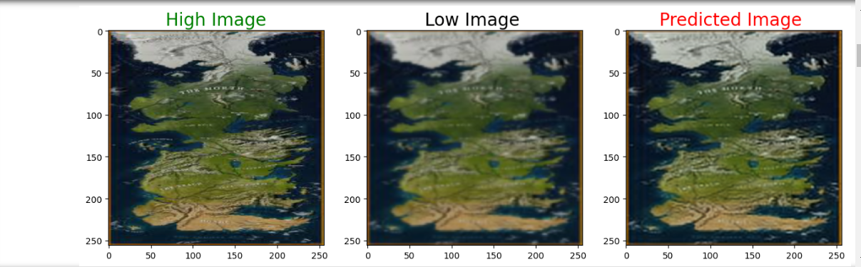
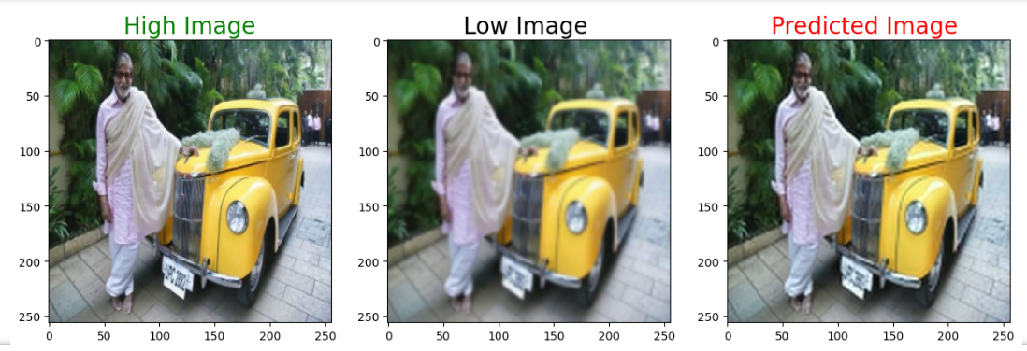
Prediction of HR Image

Slide 11
thank you ;)

