Slide 1
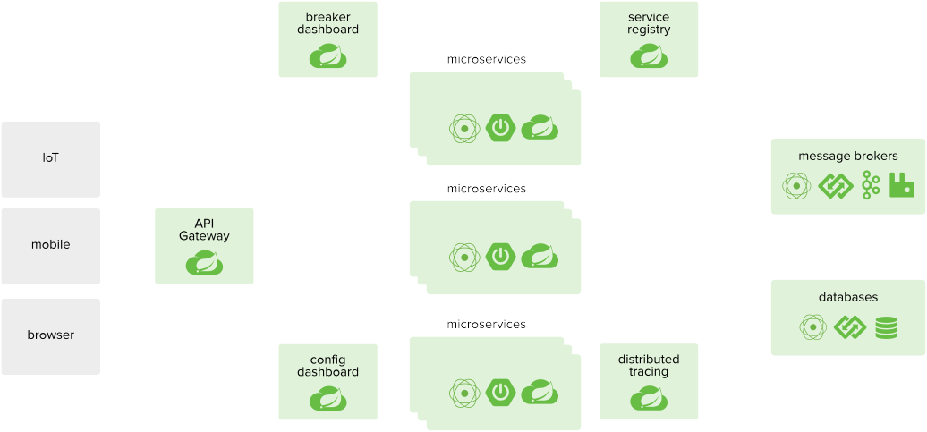
Configuration & Credential
Management Patterns in Distributed Applications
Hands on Work Shop
to experience the OpenShift/Kubernetes Configuration Management Objects

Slide 2
The Twelve-Factor App
III. Config
Store config in the environment
An app’s config is everything that is likely to vary between deploys (staging, production, developer environments, etc)
This includes:
Resource handles to the database, Memcached, and other backing services
Credentials to external services such as Amazon S3 or Twitter
Per-deploy values such as the canonical hostname for the deploy

Slide 3
ConfigMap
Many applications require configuration via some combination of config files, command line arguments, and environment variables
These configuration artifacts should be decoupled from image content in order to keep containerized applications portable
The ConfigMap API resource provides mechanisms to inject containers with configuration data while keeping containers agnostic of Kubernete

Slide 4
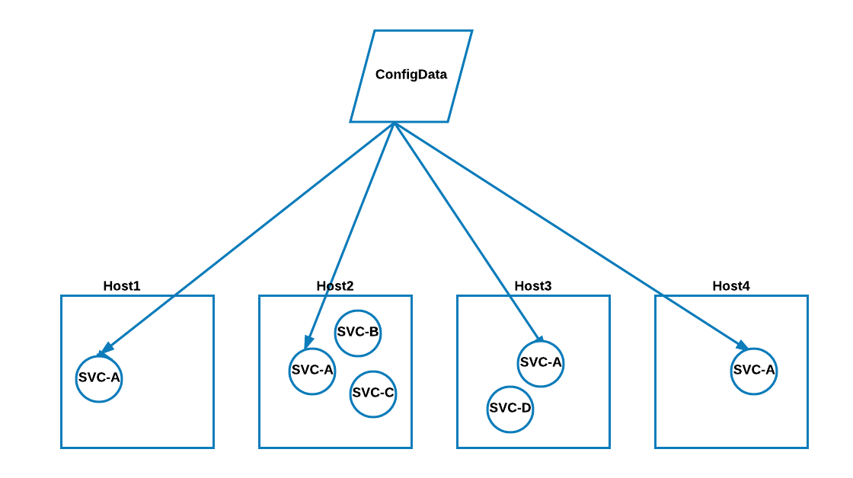
ConfigMap : Basic Illustartion

Slide 5
Secrets
A Secret is an object that contains a small amount of sensitive data such as a password, a token, or a key.
Secret object allows for more control over such objects and reduces the risk of accidental exposure.
To use a secret, a pod needs to reference the secret.
A secret can be used with a pod in two ways:
1.Files in a volume mounted on one or more of its containers
2.Used by kubelet when pulling images for the pod.

Slide 6
init Containers
A Pod can have multiple Containers running apps within it
Init Containers, run before the app Containers are started
They run to completion before any app Containers start, whereas app Containers run in parallel, so Init Containers provide an easy way to block or delay the startup of app Containers until some set of preconditions are met.

Slide 7
init Container Use Cases
Wait for a service to be created with a shell command like, for i in {1..100}; do sleep 1; if dig myservice; then exit 0; fi; done; exit 1
Register this Pod with a remote server from the downward API with a command like:
curl -X POST http://$MANAGEMENT_SERVICE_HOST:$MANAGEMENT_SERVICE_PORT/register -d ‘instance=$()&ip=$()’
Wait for some time before starting the app Container with a command like sleep 60
Clone a git repository into a volume
Place values into a configuration file and run a template tool to dynamically generate a configuration file for the main app Container. For example, place the POD_IP value in a configuration and generate the main app configuration file using Jinja

Slide 8
Lab Time...

Slide 9
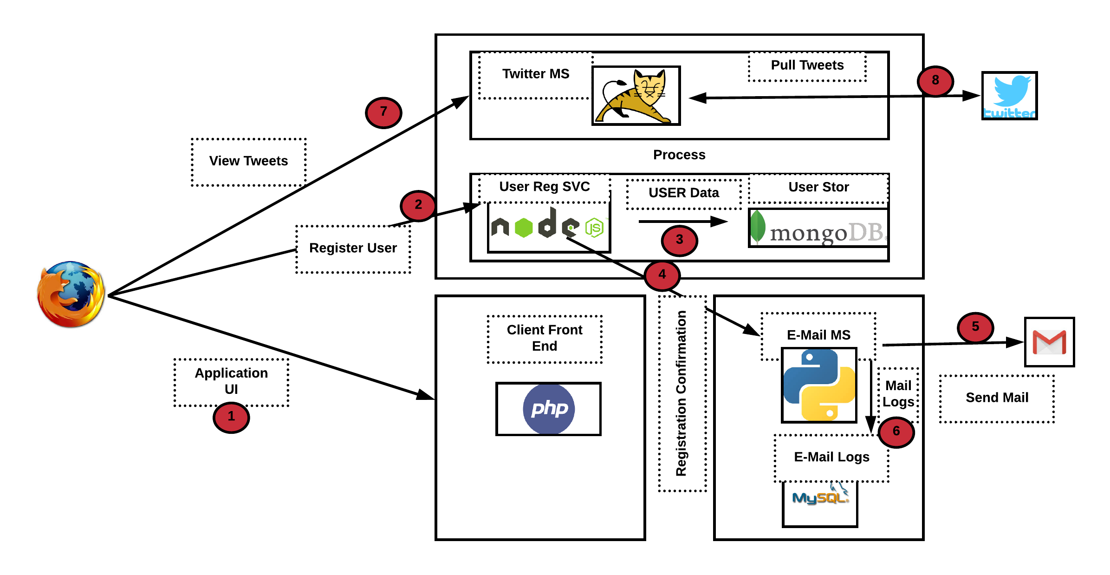
Test Application Topology

Slide 10
Lab Instructions
$git clone https://github.com/emailtovinod/devconf-demo.git
OpenShift Cloud API :
OpenShift Client: #docker run -it docker.io/vinoalex/oc:3.9 /bin/bash
Login to the OpenShift Cluster: oc login -u <user-id> <API>
OpenShift Access Credentials: r3dh4t1!
Master.1fe9.openshift.opentlc.com

Slide 11
Q&A
Attributions: https://github.com/VeerMuchandi/microservices-on-openshift.git
Designing Distributed Systems by Brendan Burns(O’Reilly) https://kubernetes.io https://docs.openshift.com/ http://spring.io/

