Slide 1
UT & TDD

Slide 2
What are UTs
Automated tests
Testing single functionality at once
Test cases (mini-scenarios)
SOLID

Slide 3
Why UTs
Testing as soon as possible (fewer bugs, less time for debugging, prevent logic defects from getting integrated)
No fear to refactor → cheaper maintenance
Documentation
SOLID → cheaper maintenance

Slide 4
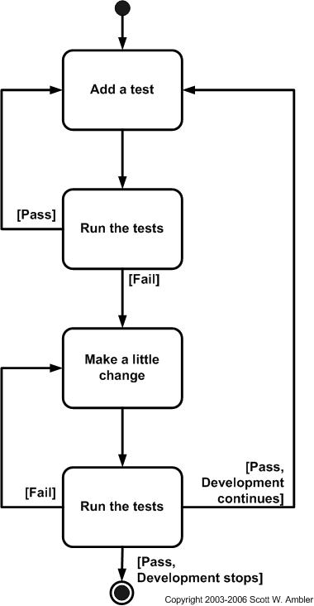
What is TDD

Slide 5
Why TDD
Specification driven programming
Better coverage
Better design (refactor → codebase well organised and readable)
Tests not affected with actual algorithm implementation
Simple rhythm, continuous progress
High confidence
Confidential

Slide 6
How to write UTs
Blackbox/code oriented
Cover each code branch
One test is for one feature (not always one assert, duplication in TC may indicate it tests more)
Self-descriptive Tcs names
One test per one equivallent class of scenarios (same red/grean pattern)
Do not extend tested class/function for only testing sake
Clean code, avoid duplication, only the scenario
Confidential

Slide 7
Googletest
TEST
TEST_F, fixture (lifecycle, default methods, what to put into them)
Mocks
Matchers
Confidential

Slide 8
How to do TDD
Cycle
Minimal failing TC
Implementation only covers the failing TC
Refactor – how often (when we need cooperator/mock, when code/test gets ugly – duplication etc.)
Adding failure cases to the implementation (when generalised, there shouldn’t be more than one branch added at once)
Confidential

Slide 9
Test smells that identify bad design
Private method needs a test
Difficulty in writing tests - too many dependencies that require too much setup code
Excess tests for a single unit → classes have too much responsibility
Excess assertions → one method is doing too many things or tests are written at the wrong level (sth should be mocked)
Cascading effects of code modification on unrelated tests: This is the case when a change in code, leads to changes required in other unrelated tests. This happens due to unnecessary mocking or testing at the wrong level. For example a change in the code for the model requires changes in the controller tests without any of the controller code having changed.
Confidential

Slide 10
Reading
https://www.linkedin.com/pulse/how-know-tdd-working-rob-myers
Kent Beck “Test Driven Development: By Example”
https://groups.yahoo.com/neo/groups/testdrivendevelopment/files
Uncle Bob
Gole expecty, typy wrapperow na mocka
Confidential

