Slide 1
ZCASH
Cryptography
CS282B
Ekta Malkan
Explaining crypto is hard, explaining crypto in simple words is harder
Notes:
Zerocash: Decentralized Anonymous Payments from Bitcoin
Eli Ben-Sasson, Alessandro Chiesay, Christina Garmanz, Matthew Greenz, Ian Miers, Eran Tromer, Madars Virzay
2014 IEEE Synopsium

Slide 2
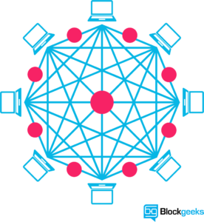
What is Blockchain?
The Blockchain is a historical record of ordered and timestamped transactions, shared amongst a number of computers rather than being stored on a central server.
Usually stores financial transactions
Secure Distributed Ledger
Exists over peer-to-peer network
Digital Signatures and Cryptography techniques
Once initiated, extremely difficult to be undone.

Slide 3
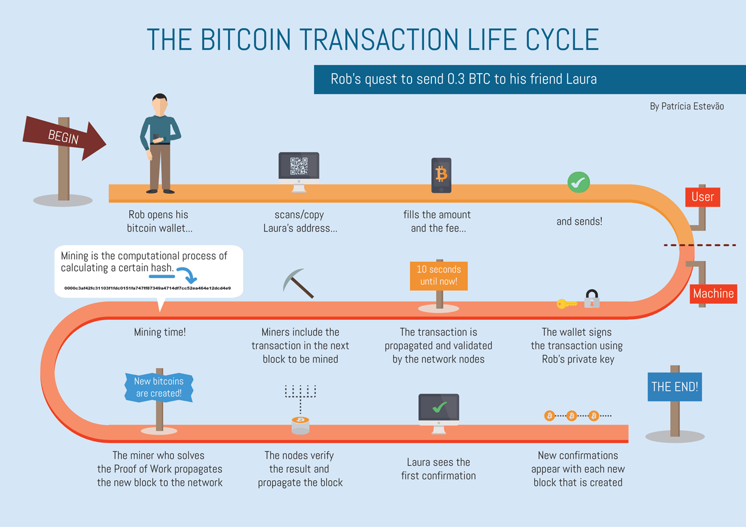
Bitcoin BlockChain

Slide 4
Advantages of Bitcoin
Solves the “Double Spending” Problem
Solves the “Trusted Third Party” problem
Decentralization
User Controlled Network (80 % Consensus For Upgrade)

Slide 5
Drawbacks
Cannot offer Strong Privacy Guarantee
Consumer purchases
Account Balance
Merchant Cash Flows
Most users use a single address or very few addresses
Transaction Graph can be analyzed (Information harvesting)
Coin fungibility
Notes:
Bitcoin and other cryptocurrencies are not fungible. Because they are public,
A good is fungible if one unit of the good is substantially equivalent to another unit of the same good of the same quality at the same time and place.
A dollar is a dollar, regardless of its history.
For bitcoins, value may be different for different people. New coins may be valued more than old coins etc. There is no central party too determine the coins value.

Slide 6
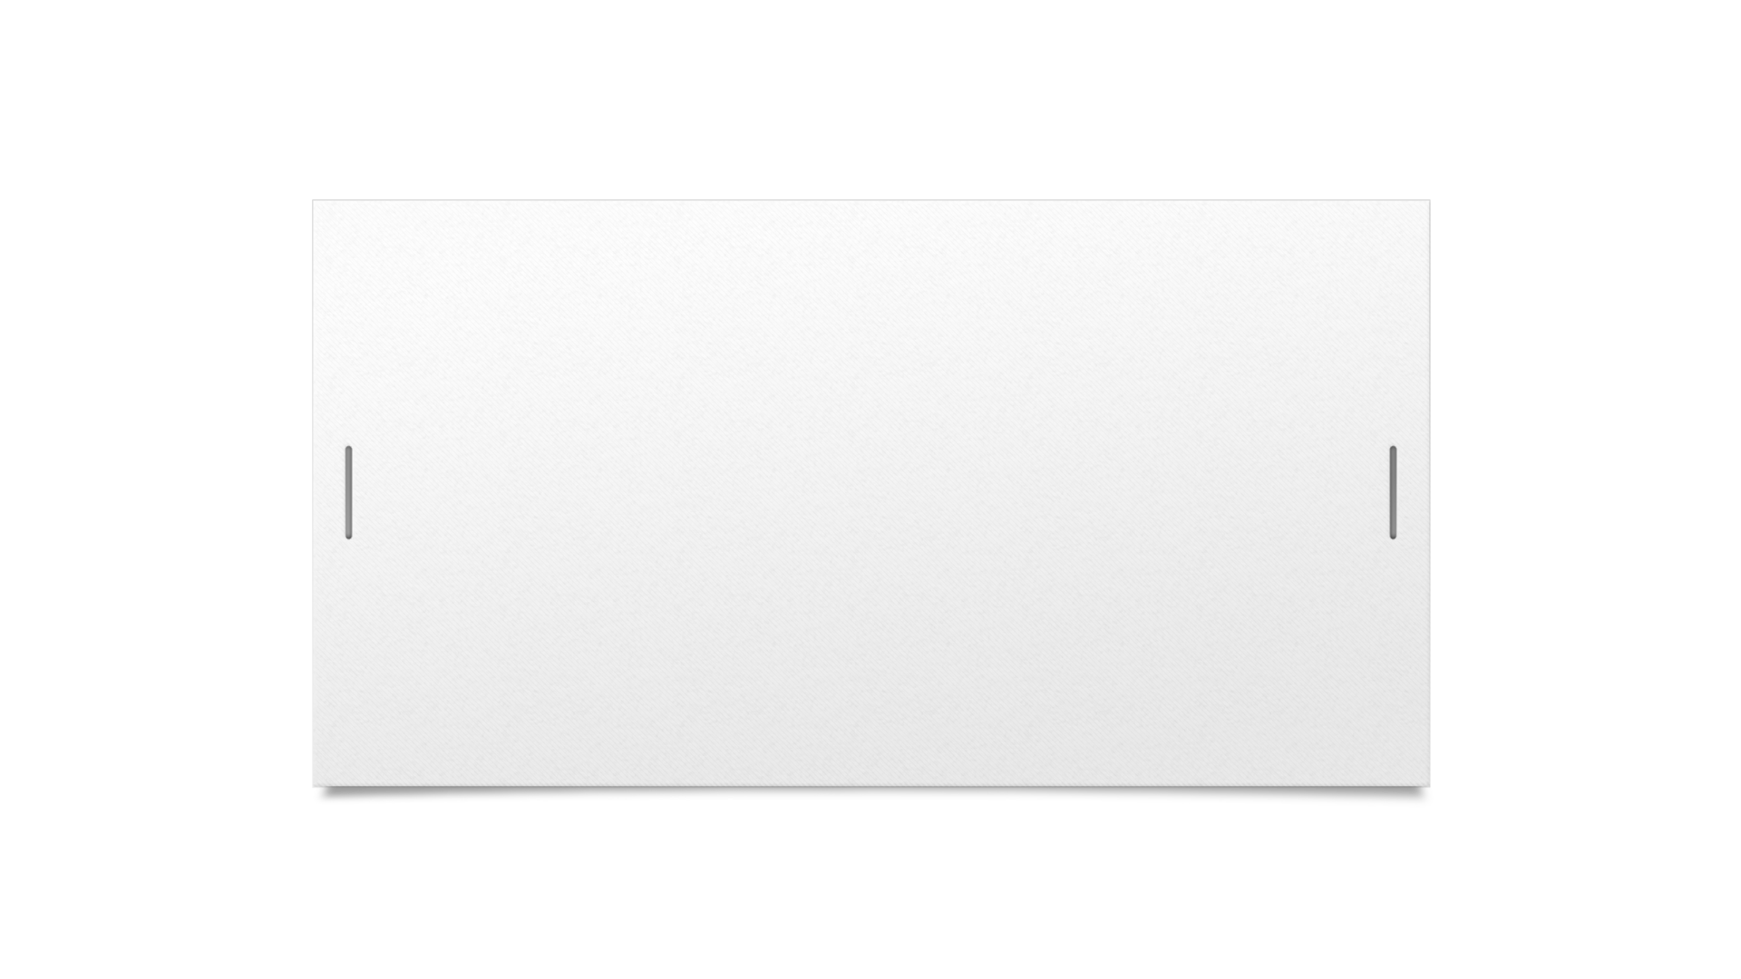

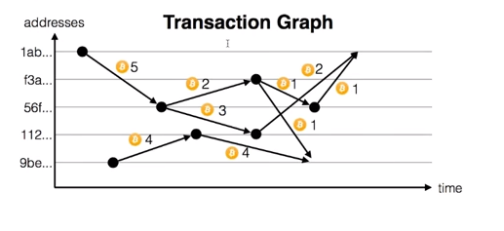

Aren’t we using Public Addresses?
Transaction Graph from blockchain + Side Info
= Addresses and Names of People.
Examples :
FBI Silk Road Investigation
IRS Subpoena Coinbase, etc.

Slide 7
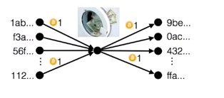
Solutions to the Privacy problem
Use a new public address for each transaction
Mixes and Tumblers
Notes:
Past solutions:
Mixes and Tumblers
A centralized party is entrusted with coins. It mixes them and returns net set of coins
Issues :
1) IT can cheat/steal.
2) There needs to be sufficient time to pass before new set received for mix to happen properly.
3) the mix can trace coins – privacy breach again.
4) Tracks do remain open, not completely secure
We need an instant risk-free solution such that 1) no compromise privacy. 2) users can keep spending habits private from peers 3) no extra fees to be given to the Mix.

Slide 8

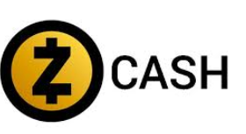
What is ZCASH?
Fully Anonymous
Solves Bitcoin Privacy Issues
Divisible Payments of any amount (vs ZeroCoin, fixed amount payments).
Standalone currency / Top of any existing Ledger
Notes:
supports shielded (private) transactions where sender, receiver and amount are not revealed;
and yet, an outside observer can still distinguish between a valid and non-valid transaction.
The “cryptographic engine” that enables these shielded transactions is a zero-knowledge Succinct Non-interactive Argument of Knowledge (zk-SNARK); currently,
Zcash uses the Pinocchio zk-SNARK [PHGR16], or more precisely, the variant of it described in [BCTV14] as implemented in libsnark[lib].

Slide 9

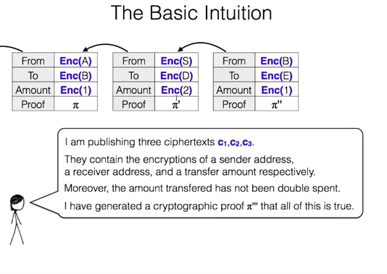

How ZCash solves it
Unlinking Transactions from payments origin. (Source hidden)
Uses DAP Scheme (Decentralized Anonymous Payment Scheme)
Image source: Google Talk slides- “ZeroCash: Addressing Bitcoin's Privacy Problem” by Alessandro Chiesa

Slide 10
Gadgets
Pairing based Elliptic Curve Cryptography
Knowledge of exponent

Slide 11
ZK - SNARKS
Zero-knowledge - nothing is revealed beyond the truth of the statement
Succinct indicates that the zero-knowledge proof is short and can be verified quickly.
Non-interactive - verifier does not have to interact with the prover. Instead, the prover can publish (write) their proof in advance, and a verifier can ensure its correctness.
Argument – computationally sound proofs (Prover is not infinitely powerful)
of Knowledge means a proof of knowledge of some defined computation.
Notes:
Difference between proof and argument?
Individuals could use zk-SNARK proofs to prove their bank accounts hold a certain amount of money. But the proofs wouldn’t reveal the exact amount of money in the accounts. Only that they did—or did not—meet a certain monetary threshold.

Slide 12
Algorithms
KeyGen is typically run by the verifier. It takes as input 1^k (k being the security parameter) and outputs some keypair, priv and pub.
P (the proving algorithm) takes as input pub, a word x∈L and a NP-witness w for x, and outputs the proof π.
V (the verifying algorithm) takes as input priv, x and π, and returns 0 or 1 depending on whether the verifier "accepts" the proof that x is in L.
Source: https://crypto.stackexchange.com/questions/19884/what-are-snarks

Slide 13
Properties of zk-SNARKS
Perfect Completeness
Succinctness
Computational Soundness
Extractability

Slide 14
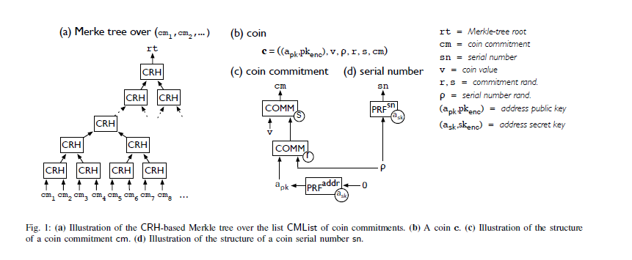
Data Structures

Slide 15
In ZCash a user constructs a proof to show that, with high probability:
The input values sum to the output values for each transaction.
The sender proves that they have the private keys of the input, which gives a user the authority to spend.
The private spending keys of the input are cryptographically linked to a signature that pertains to the entire transaction, in a manner in which a transaction cannot be modified by a party who did not know these private keys.

Slide 16
DAP
Decentralized Anonymous Payment scheme.
BaseCoin Ledger
Public Parameters
Addresses
Coins
CmListT
SnListT
Notes:
At any given time T, allusers have access to LT , the ledger at time T, which is a sequence of transactions. The ledger is append-only (i.e., T < T0 implies that LT is a prefix of LT0 ).10 The transactions in the ledger include both Basecoin transactions as well as two new transaction types described below.
Public parameters. A list of public parameters pp is available to all users in the system. These are generated by a trusted party at the “start of time” and are used by the system’s algorithms.
Each user generates at least one address key pair (addrpk; addrsk). The public key addrpk is published and enables others to direct payments to the user. The secret key
addrsk is used to receive payments sent to addrpk. A user may generate any number of address key pairs.
CMListT denotes the list of all coin commitments appearing in mint and pour transactions in LT ;
SNListT denotes the list of all serial numbers appearing in pour transactions in LT .

Slide 17
Coins
Coin Commitment
Coin Value
Coin Serial Number
Coin Address

Slide 18
New Transaction Types
Mint Transactions : (cm; v; *)
Pour Transactions :

Slide 19
Algorithms
Setup
Creating Payment address
Minting Coins
Pouring Coins
Verifying transactions
Receiving Coins

Slide 20
Derivation
( 6 attempts)

Slide 21
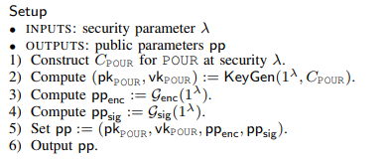
How it works?

Slide 22
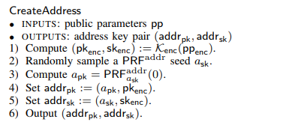

Slide 23
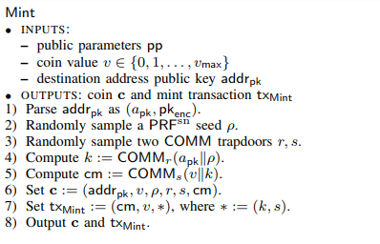

Slide 24
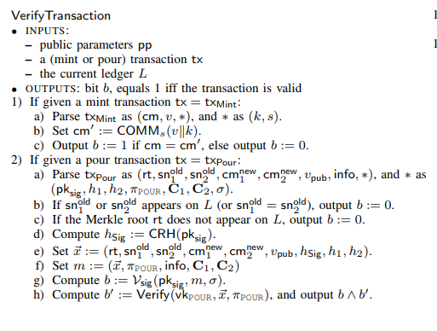

Slide 25
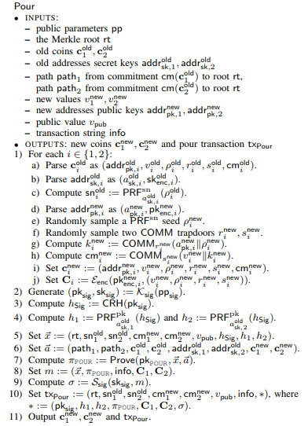

Slide 26
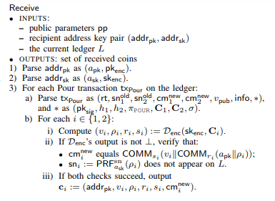

Slide 27
Properties
Completeness
Security
Ledger Indistinguishability
Transaction Non-malleability
Balance
Notes:
Ledger Indistinguishability : This means that nothing is revealed besides public information, even by chosen transaction adversary
Transaction NM: Cannot manipulate transactions en-route to the ledger
Balance: Cant own more money than received or minted

Slide 28
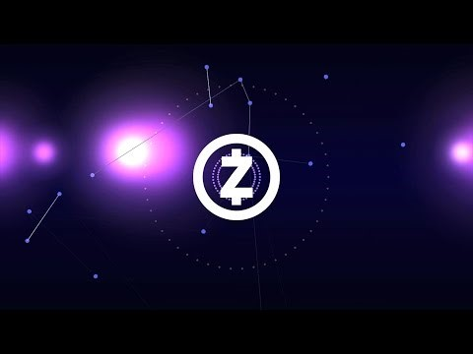
Powers of Tau
Notes:
Parameter Generation Ceremony
First one had six participants, used for zcash
Later they created this ceremony which can be used by anyone to implement MOC for ZK Snarks
A potential weakness of Zcash, is that if anybody obtained the trapdoor information corresponding to the Common Reference String (CRS) used for constructing and verifying the SNARKs, they could forge unlimited amounts of the currency, potentially without anyone detecting they are doing so.
a multi-party protocol for generating the CRS of the Pinocchio zk-SNARK [PHGR16],
such that as long as at least one participating party is not malicious,
no party can later construct fraudulent proofs except with negligible probability. T
he protocol also provides a strong zero-knowledge guarantee even in the case that all participants are malicious.
This method has been used in practice to generate the required CRS for the Zcash cryptocurrency blockchain.

Slide 29
Implementation
1. Building Blocks (DAPP Construction)
CRH
PRF
COMM from SHA256

Slide 30
2. Instantiating the NP Statement of POUR

Slide 31
Instantiating SIG
ECDSA is used (~ to Bitcoin)
Problem : (r,s) and (r,-s) are verified as valid signatures
Solution:
Non malleable ECDSA used,
S is restricted to lower half of field values

Slide 32
Instantiating Enc
Key-private Elliptic-Curve Integrated Encryption Scheme

Slide 33
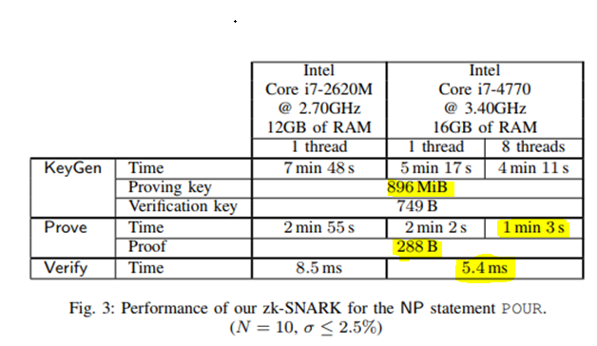
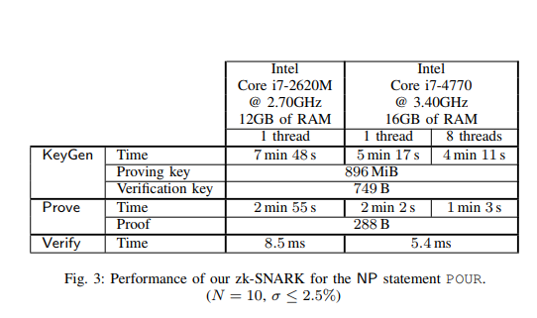
Performance of ZCash

Slide 34
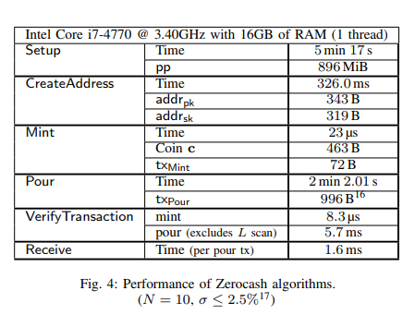
Performance of ZCash

Slide 35
Integration with Bitcoin
Replacing the Base Currency
Hybrid Currency
Notes:
B. Integration by hybrid currency A different approach is to extend Bitcoin with a parallel, anonymized currency of “zerocoins,” existing alongside bitcoins, using the same ledger, and with the ability to convert freely between the two. The behavior and functionality of regular bitcoins is unaltered; in particular, they may support functionality such as scripting. In this approach, the Bitcoin ledger consists of Bitcoin-style transactions, containing inputs and outputs [20]. Each input is either a pointer to an output of a previous transaction (as in plain Bitcoin), or a Zerocash pour transaction (which contributes its public value, vpub, of bitcoins to this transaction). Outputs are either an amount and destination public address/script (as in plain Bitcoin), or a Zerocash mint transaction (which consumes the input bitcoins to produce zerocoins). The usual invariant over bitcoins is maintained and checked in plain view: the sum of bitcoin inputs (including pours’ vpub) must be at least the sum of bitcoin outputs (including mints’ v), and any difference is offered as a transaction fee. However, the accounting for zerocoins consumed and produced is done separately and implicitly by the DAP scheme

Slide 36
Drawbacks over Bitcoin
Cost of generating zk-SNARK Proof
Loss of Scripting feature of Bitcoin
No ability to spend coins of unconfirmed transactions
Zerocash only anonymizes the transaction ledger not IP addresses.
Notes:
Zerocash only anonymizes the transaction ledger. Network traffic used to announce transactions, retrieve blocks, and contact merchants will still leak identifying information (e.g., IP addresses). Thus users need some anonymity network to safely use Zerocash.

Slide 37
References
Eli Ben-Sasson , Alessandro Chiesa , Christina Garman , Matthew Green , Ian Miers , Eran Tromer , Madars Virza , Zerocash: Decentralized Anonymous Payments from Bitcoin, 2014 IEEE Symposium on Security and Privacy.
Sean Bowe, Ariel Gabizon, Matthew D. Green, A multi-party protocol for constructing the public parameters of the Pinocchio zk-SNARK
Rosario Gennaro, Craig Gentry, Bryan Parno, Mariana Raykova, Quadratic Span Programs and Succinct NIZKs without PCPs

Slide 38

Questions?

