Slide 1

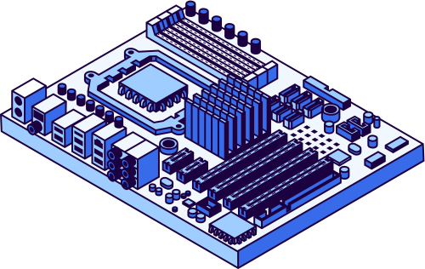
Rimberio
2027
PARALLEL & DISTRIBUTED COMPUTING
Project Title: Serverless Application using AWS Lambda

Slide 2





Rimberio
2027
Group Members :
Eman
Waheed (027)
Fatima
Sabir (034)
Laiba
Rani (053)
Sania
Shafique (078)
Sania
Arshad (098)

Slide 3



Rimberio
2027
Abstract
Implementation of a serverless application using AWS Lambda & API Gateway
No need to manage servers
Event-driven execution model
REST API created using API Gateway
Demonstrates scalable and cost-effective cloud computing

Slide 4



Rimberio
2027
Introduction
Cloud computing provides on-demand resources
Traditional systems require:
Server setup
Maintenance
Scaling
Serverless computing removes these responsibilities
AWS Lambda runs code automatically in response to events

Slide 5


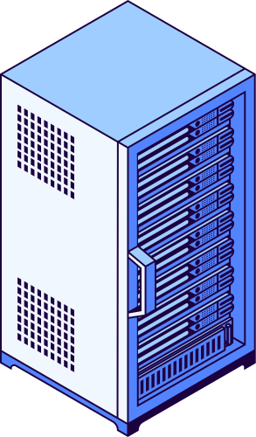
Rimberio
2027
Problem Statement
Traditional deployment leads to:
High cost
Maintenance burden
Increased complexity
Need for a system that eliminates server management

Slide 6





Rimberio
2027
Objectives
Understand serverless computing
Learn AWS Lambda deployment
Integrate API Gateway
Create and test APIs
Explore event-driven architecture

Slide 7


Rimberio
2027
Serverless Computing
Cloud model without server management
Infrastructure handled by provider
Key Features:
Auto scaling
Pay-per-use
High availability
Event-driven execution
Reduced maintenance

Slide 8

Rimberio
2027
Tools & Technologies
AWS Lambda → Run backend code
API Gateway → Create API endpoints
Python → Programming language
AWS Free Tier → Cost-free usage
Browser → Testing

Slide 9
Rimberio
2027
System Architecture
Flow:
Client → API Gateway → AWS Lambda → Process → Response
API Gateway receives request
Lambda processes it
Response sent back to user

Slide 10


Rimberio
2027
Working Flow
User sends request:
/hello?name=Sania
API Gateway triggers Lambda
Lambda processes input
Output returned:
“Hello Sania, Serverless working!”

Slide 11
Rimberio
2027
Implementation Steps
AWS Account Setup
Lambda Function Creation
Writing Lambda Code
Testing Function
API Gateway Integration
Deployment
Browser Testing

Slide 12

Rimberio
2027
Lambda Function Code
DEF LAMBDA_HANDLER(EVENT, CONTEXT):
name="Guest"
if 'queryStringParameters' in event:
name=event['queryStringParameters'].get('name','Guest')
return {
'statusCode':200,
'body': f"Hello {name}, Serverless working!"
}

Slide 13
Rimberio
2027
Algorithm
Receive HTTP request
API Gateway triggers Lambda
Extract parameters
Process request
Return response

Slide 14
Rimberio
2027
Results
Successfully created serverless application
Dynamic response generated
Output: Hello Sania, Serverless working!
Validates event-driven cloud execution

Slide 15
Rimberio
2027
Advantages
No server management
Automatic scaling
Cost efficient
High availability
Fast deployment
Event-driven processing

Slide 16
Rimberio
2027
Challenges Faced
AWS billing verification issues
API integration problems
Deployment errors
Endpoint configuration issues

Slide 17
Rimberio
2027
Applications
Web APIs
Chatbots
Automation scripts
Data processing
IoT systems
Event-driven apps

Slide 18
Rimberio
2027
Limitations
Cold start delays
Timeout limits
Vendor lock-in
Debugging complexity

Slide 19
Rimberio
2027
Future Enhancements
Database integration
Authentication system
File handling
PDF generation
Full-scale web application

Slide 20
Rimberio
2027
Conclusion
Successfully implemented serverless system
Achieved:
Scalable architecture
Low cost solution
Event-driven execution
Gained practical cloud computing experience

Slide 21
Rimberio
2027
References
AWS Lambda Documentation
API Gateway Documentation
AWS Free Tier Documentation

Slide 22
Rimberio
2027
Thank You

