Slide 1


Slide 2


Slide 3


Slide 4
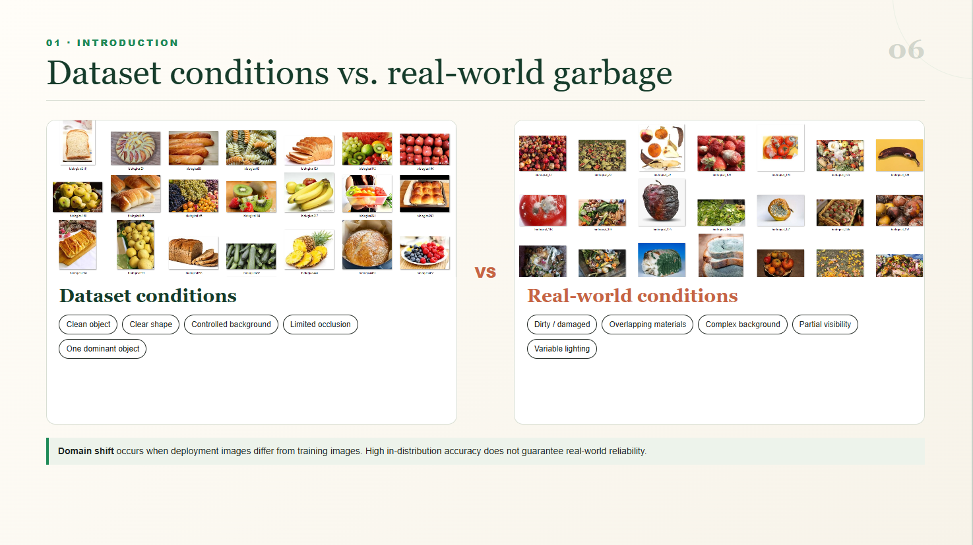

Slide 5
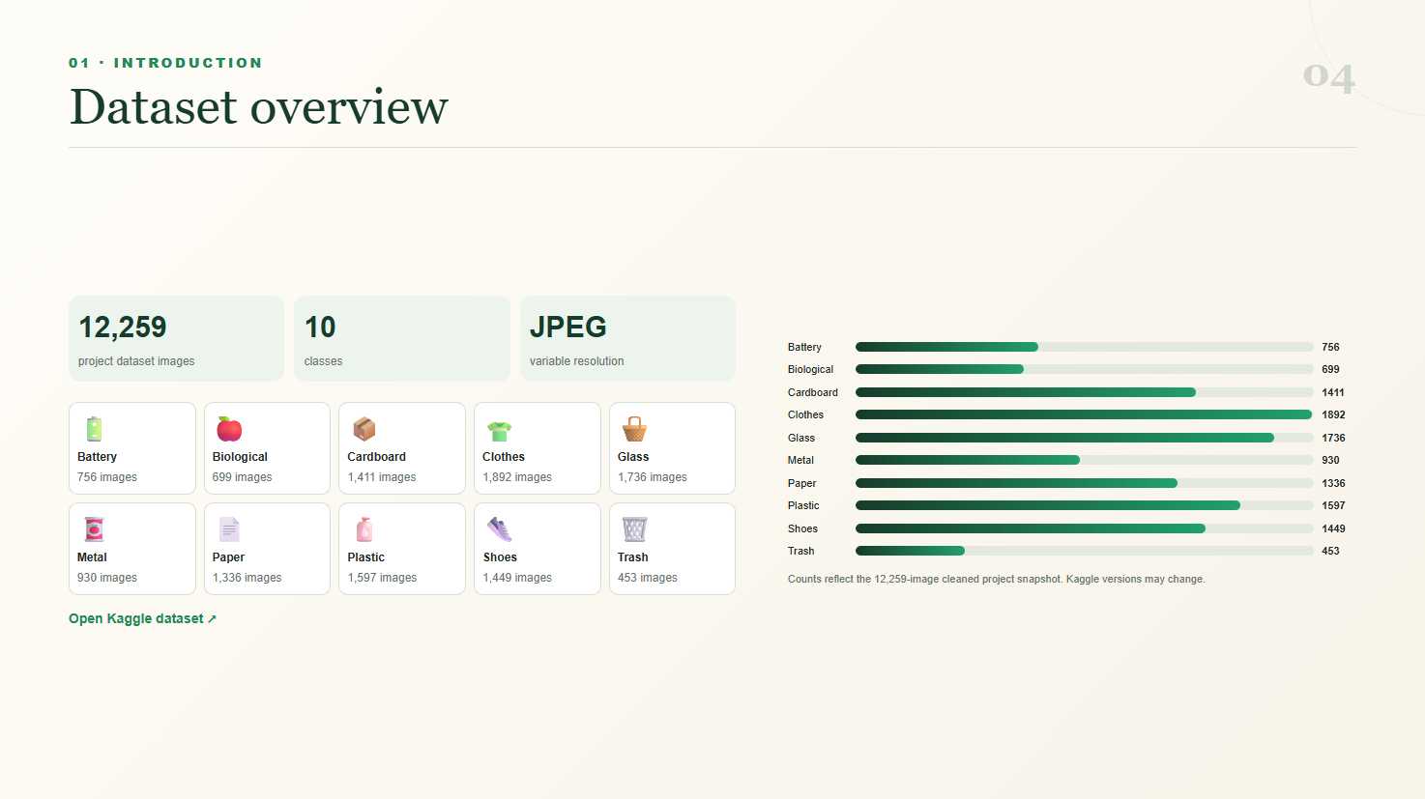

Slide 6
04 · RELATED WORK
09
Real clutter makes waste vision substantially harder
STUDY
DATASET / TASK
APPROACH
REPORTED RESULT
Kunwar, 2026
10-class GD
EfficientNetV2-S
96.19% accuracy
TACO, 2020
Litter in context
Mask R-CNN
26.2% AP
TrashCan, 2020
Marine debris
Mask / Faster R-CNN
55.4% mAP
Research gap
Strong curated-image scores still need testing under dirt, clutter, occlusion, and domain shift.
ECOSORT AI · GRADUATION PROJECT
9 / 17
Notes:
الدراسات السابقة تؤكد أن التصنيف على صور منظمة أسهل بكثير من litter in context.
[Sources]
https://arxiv.org/abs/2602.10500
https://arxiv.org/abs/2003.06975
https://arxiv.org/abs/2007.08097

Slide 7
06 · PROPOSED SOLUTION
11
A controlled pipeline keeps evaluation honest
Input
→
Validate
→
Resize + normalize
→
Train-only augmentation
→
Deep model
→
Probabilities
→
Prediction
→
Guidance
ConvNeXt-Tiny · 96.33%
EfficientNetV2-S · 93.84% validation
MobileNetV2 · 94.21%
Low-confidence cases should be flagged for review.
ECOSORT AI · GRADUATION PROJECT
11 / 17
Notes:
نثبت الـsplit قبل augmentation، ونحافظ على validation وtest بصور أصلية فقط.
[Sources]
Project-authored content; no external source.

Slide 8











01 • WORKFLOW PIPELINE
01
ConvNeXt Garbage Classification Pipeline
Dataset & Splits 10 classes | Balanced Train (9,194 images), Val (1,839 images), Test [locked] (1,226 images).
Training Settings
Optimizer AdamW
Hyperparameter Setup Grid search on validation split: LR = 0.0001, Weight Decay = 0.05, AdamW Optimizer.
Batch Size 32
(ImageNet Mean/Std)
Max Epochs 40 (Early Stop)
Stage 1 — Fine-Tuning Unfreeze last 4 ConvNeXt blocks | Differential LR: backbone 1e-4, head 1e-3.
(Feature Extraction)
Image Size 384 × 384
Validation Strategy 5-Fold Stratified Cross-Validation on Train + Validation set (Strict Data Isolation).
Validation Status
5-Fold CV: PASSED Mean Val Acc: 95.49%
Final Evaluation Evaluate single best checkpoint once on held-out Test set (1,226 samples).
(1024 → 256 + ReLU)
Test Isolation: LOCKED Zero Data Leakage Detected

Slide 9

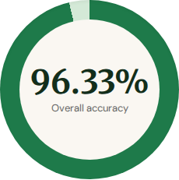





02 • EXPERIMENTAL RESULTS
02
Verified ConvNeXt test performance
ConvNeXt Classification Pipeline & Results
Accuracy 96.33%
Split | Accuracy
Training Accuracy | 99.65%
Validation Accuracy | 95.49%
Test Accuracy (Final) | 96.33%
Precision (macro) 95.74%
Recall (macro) 95.54%
F1-Score (macro) 95.60%
Diagnosis: Well Generalized Train (99.65%) and Val (95.49%) are close; Test (96.33%) confirms strong generalization.
Top-5 Accuracy 99.76%
ROC-AUC (macro) 99.84%
Data Leakage Audit 100% Isolated held-out test set verified.
95.74%
95.54%
95.60%
Macro precision
Macro recall
Macro F1
99.65%
95.49%
PASS

Slide 10
06 · PROPOSED SOLUTION
12
Three architectures answer three deployment needs
MODEL 01
MODEL 02
MODEL 03
ConvNeXt-Tiny
EfficientNetV2-S
MobileNetV2
Modern CNN
Efficient scaling
Inverted residuals
Strong feature representation
Accuracy–efficiency balance
Lightweight edge inference
96.33% test
93.8% test
94.21% test
ECOSORT AI · GRADUATION PROJECT
12 / 17
Notes:
نقارن ConvNeXt للقوة، EfficientNet للتوازن، وMobileNet لخفة التشغيل.
[Sources]
Project-authored content; no external source.

Slide 11
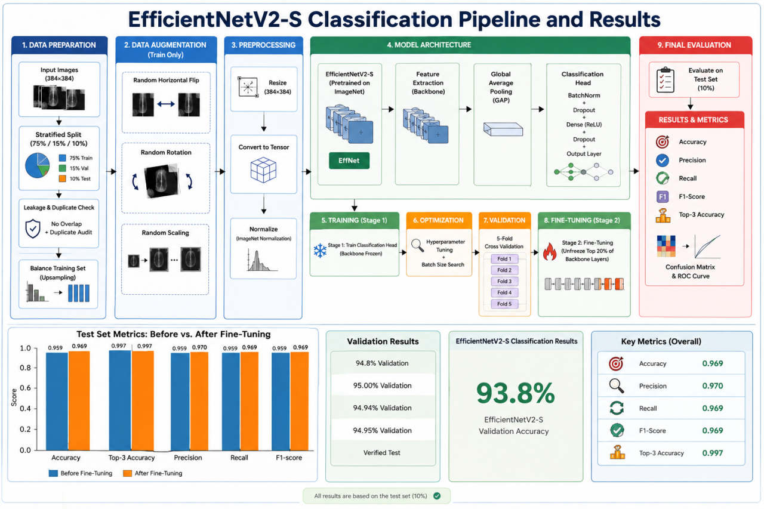

Slide 12
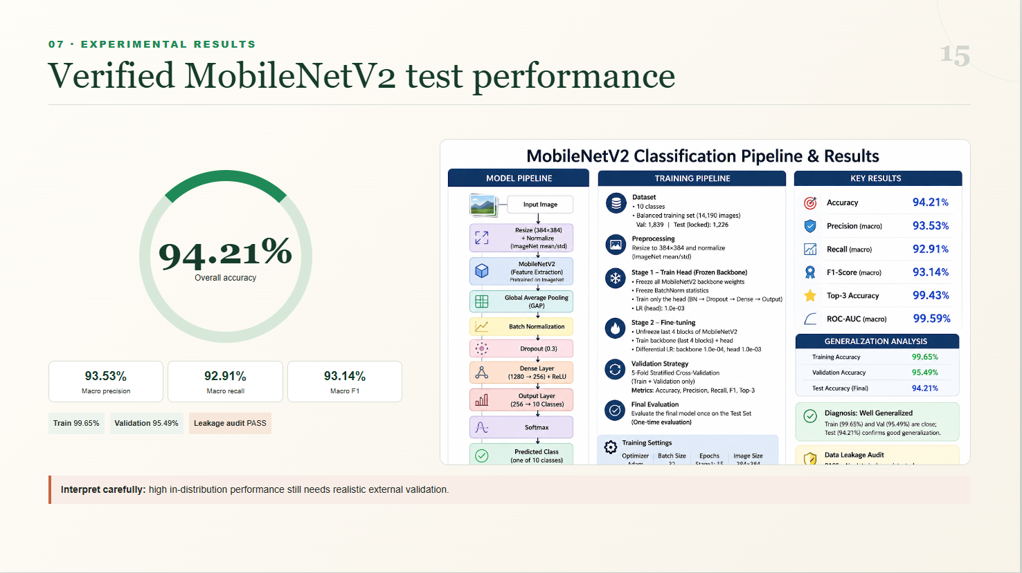

Slide 13
07 · EXPERIMENTAL RESULTS
15
MobileNetV2 stays strong with a lighter profile
93.53%
92.91%
93.14%
94.21%
Macro precision
Macro recall
Macro F1
TEST ACCURACY
Generalization path
Train
99.65%
Validation
95.49%
Test
94.21%
Leakage audit: PASS
ECOSORT AI · GRADUATION PROJECT
15 / 17
Notes:
MobileNet مناسب للتطبيقات الخفيفة، لكن الفرق بين train وtest يستدعي تقييمًا واقعيًا إضافيًا.
[Sources]
Project-authored content; no external source.

Slide 14
07 · EXPERIMENTAL RESULTS
14
ConvNeXt leads the verified test results
96.33%
93.8%
94.21%
ConvNeXt test accuracy
EfficientNet validation accuracy
MobileNet test accuracy
Metric
ConvNeXt-Tiny
EfficientNetV2-S
MobileNetV2
Accuracy
96.33% test
94.8% validation
94.21% test
Precision
95.74% macro
95.00% validation
93.53% macro
Recall
95.54% macro
94.94% validation
92.91% macro
F1
95.60% macro
94.95% validation
93.14% macro
Status
Verified test
Verified test
Verified test
ECOSORT AI · GRADUATION PROJECT
14 / 17
Notes:
مهم: نتيجة EfficientNet المتاحة Validation وليست Test، لذلك لا نعلن فائزًا نهائيًا قبل اختبار مستقل.
[Sources]
Project-authored content; no external source.

Slide 15


