Slide 1


StudyOrElse
Eman Abu-Ali | CS 6384

Slide 2

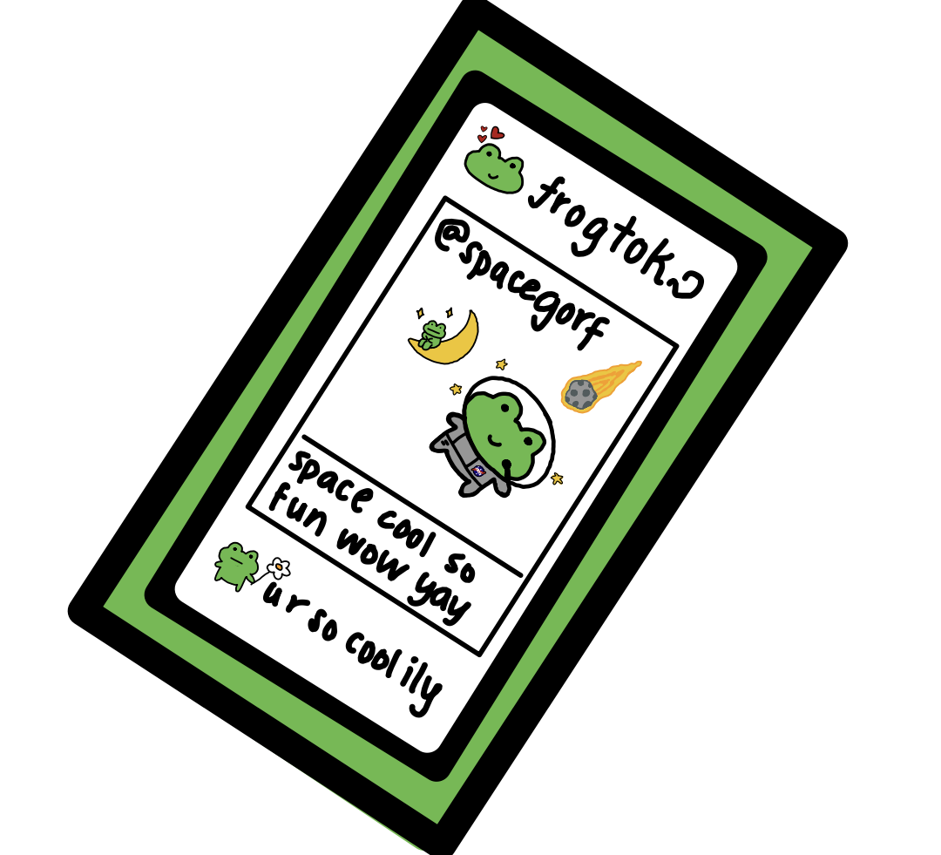




Problem Overview & Motivation!
Students often struggle to maintain focus during study sessions.
Common issues:
Frequent phone distractions
Leaving workspace
Lack of accountability
Inefficient study habits
Existing tools track time, but not behavior.
This motivates the need for real-time behavioral monitoring systems.

Slide 3




Solution!
Real-time webcam-based system
Estimates user attention
Outputs:
Focused
Warning
Distracted

Slide 4
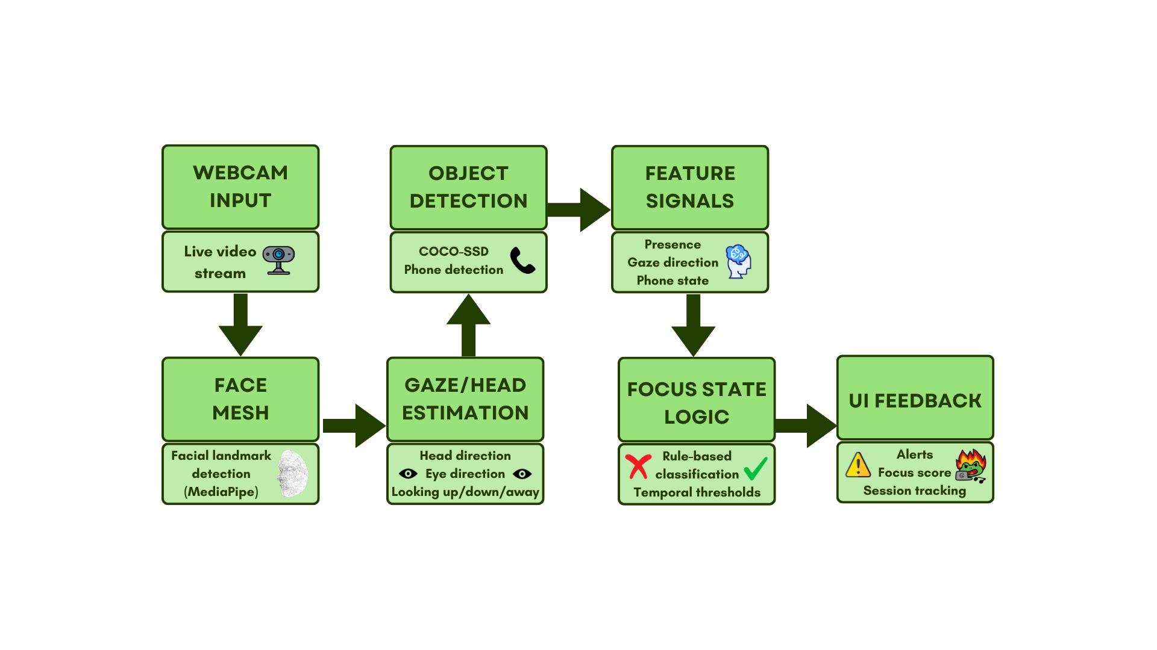
System Pipeline / Method

Slide 5

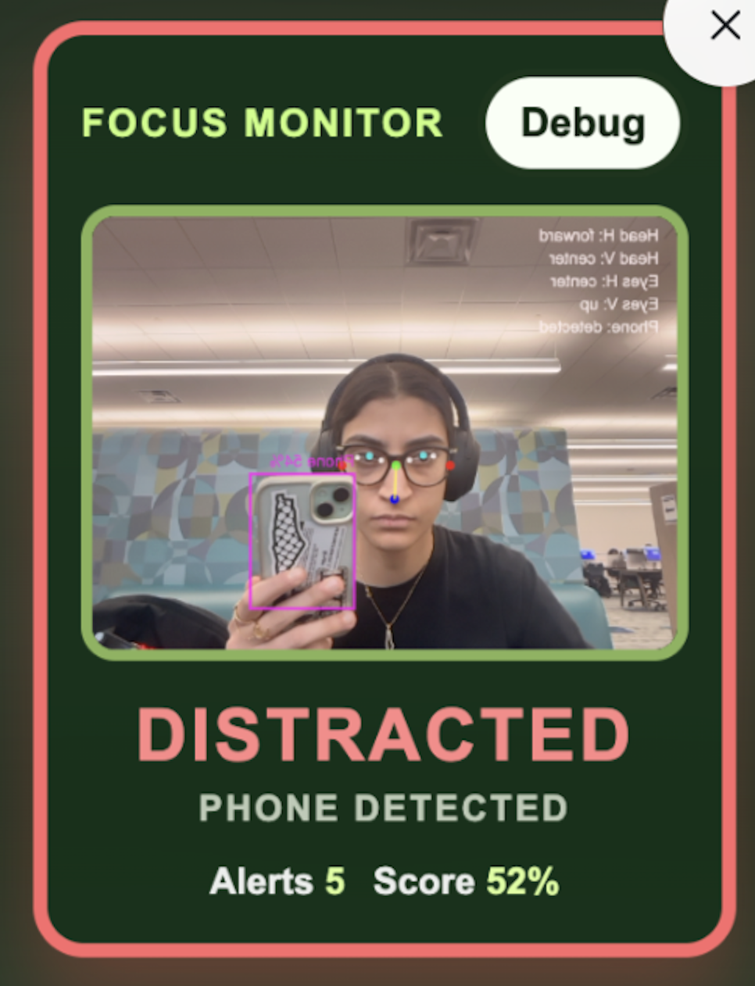
Results & Evaluation
Scenarios tested:
Focused
Looking away
Phone usage
Leaving frame
Observations:
Reliable presence detection
Effective phone detection
Stable classification (thanks to thresholds)

Slide 6

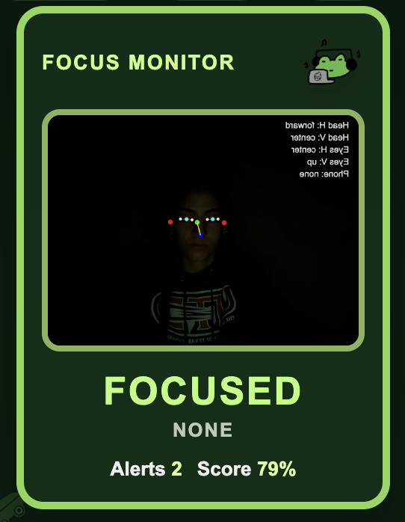

Limitations & Future Work
Future:
Learning-based models
Better temporal modeling
Multi-user evaluation
Limitations:
Lighting sensitivity
Approximate gaze
False positives (phone-like objects)

Slide 7
Demo!

Slide 8

Thank You!
Questions?
https://emananana.github.io/study-buddy/

