Slide 1
Churn For Bank Customers

Slide 2
Team Member | ID
Youssef Shaaban El-Sayed | 20201701163
Youssef Mohamed Mansour | 20201701036
Abdelrhman Amr Mohamed | 20201700478
Maryam Reda Ali | 20201701218
Marwa Sameh Ali | 20201700799
Eman Mamdouh Awad | 20201701063

Slide 3
Introduction (the problem, idea)
Problem : Churn detection for bank customers refers to the process of identifying and predicting customers who are likely to stop using the bank's services or close their accounts in the near future , Churn in this context, is the phenomenon where customers discontinue their relationship with a bank, and it is a critical concern for financial institutions.
Idea :The goal of churn detection is to proactively identify customers at risk of churning so that the bank can take preventive actions to retain them. Retaining existing customers is often more cost-effective than acquiring new ones, and it helps maintain a stable and profitable customer base.

Slide 4
Dataset Description and preprocessing
RowNumber—corresponds to the record (row) number
CustomerId—contains random values
Surname—the surname of a customer
CreditScore—can have an effect on customer churn, since a customer with a higher credit score is less likely to leave the bank.
Geography—a customer’s location can affect their decision to leave the bank.
Gender—it’s interesting to explore whether gender plays a role in a customer leaving the bank.
Age—this is certainly relevant, since older customers are less likely to leave their bank than younger ones.
Tenure—refers to the number of years that the customer has been a client of the bank. Normally, older clients are more loyal and less likely to leave a bank.

Slide 5
Dataset Description and preprocessing (Cont.)
Balance—also a very good indicator of customer churn, as people with a higher balance in their accounts are less likely to leave the bank compared to those with lower balances.
NumOfProducts—refers to the number of products that a customer has purchased through the bank.
HasCrCard—denotes whether or not a customer has a credit card. This column is also relevant, since people with a credit card are less likely to leave the bank.
IsActiveMember—active customers are less likely to leave the bank.
EstimatedSalary—as with balance, people with lower salaries are more likely to leave the bank compared to those with higher salaries.
Exited—whether or not the customer left the bank

Slide 6
Dataset Description and preprocessing (Cont.)
RowNumber , CustomerId and Surname columns has no effect on the output so we dropped them from our dataset

Slide 7
Models from scratch.
1-CNN Model
The Reason of Choosing Convolutional Neural Networks (CNNs) : automatically extract relevant features from complex numeric datasets, eliminating the need for manual feature engineering and allowing them to learn hierarchical representations of the data.
CNN are robust to variations, noise, outliers, and differences in scale or distribution within numeric datasets. They can still extract meaningful patterns for classification under such conditions

Slide 8
Modification Made On It :
Dense Layers: In a Convolutional Neural Network (CNN), you typically use convolutional layers (Conv2D) instead of dense layers for processing spatial information in images.
Dropout: Dropout is often used in dense layers to prevent overfitting. In CNNs, it's more common to use dropout after dense layers or convolutional layers.
Activation Function in Output Layer: For binary classification problems, it's common to use a sigmoid activation function in the output layer instead of relu. The sigmoid activation function squashes the output to the range [0, 1], which is suitable for binary classification.
Model Evaluation: The evaluation part is modified to use the evaluate method instead of manually thresholding the predicted values.

Slide 9
2-RNN Model
The Reason of Choosing Recurrent Neural Networks (RNNs) : could be a suitable choice for churn prediction in banking due to their ability to capture sequential dependencies in data
Modification Made On It :
Activation Function in Output Layer: For binary classification problems, using a sigmoid activation function in the output layer is appropriate, as it squashes the output to the range [0, 1].
Loss Function: For binary classification, using binary_crossentropy as the loss function is common. However, you might also consider other options based on your problem, such as categorical_crossentropy for multi-class classification.

Slide 10
Classification Models
Decision Tree , Random Forest , Xgboost , SVM Models :
We use this classification models because our data depend on binary class (Exited) and Random Forest had the highest accuracy value

Slide 11
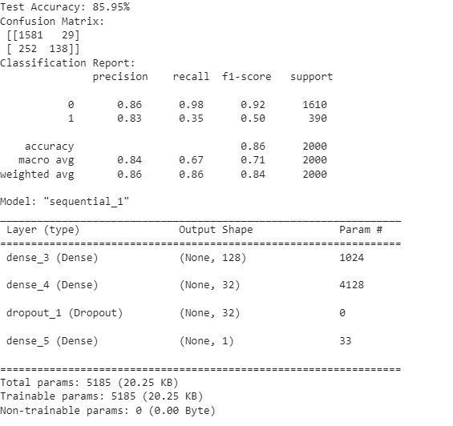
Results
CNN Model

Slide 12
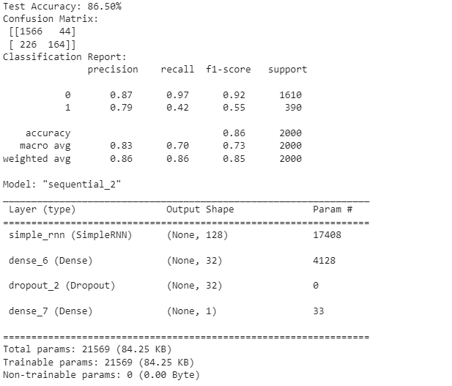
RNN Model

Slide 13
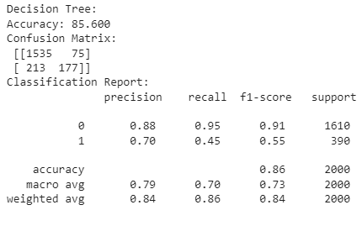
Decision Tree

Slide 14
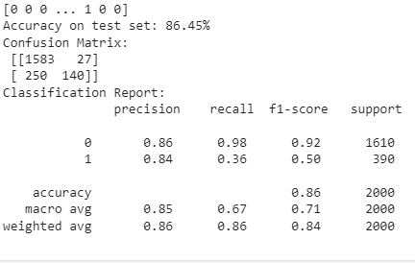
Random Forest

Slide 15
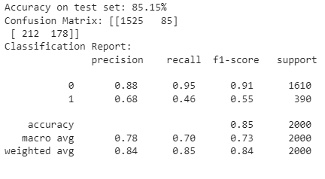
Xgboost Model

Slide 16
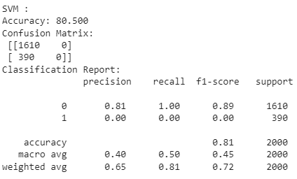
SVM Model

Slide 17
Thank you

