Slide 2
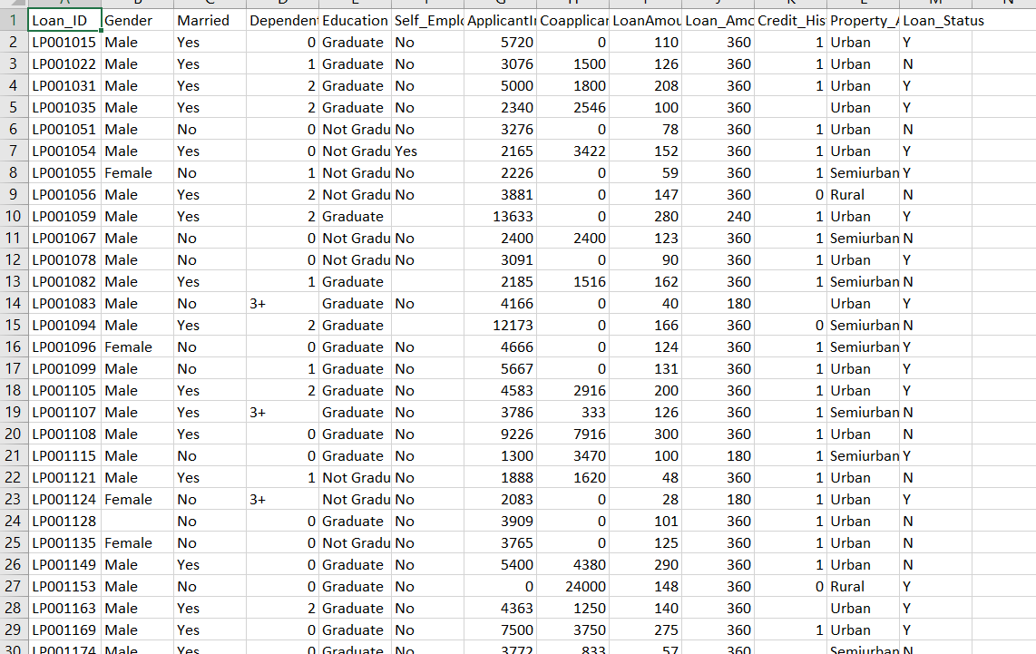
Loan Dataset:

Slide 3
Describe Dataset Attributes
1- Gender: The gender of the loan applicant, usually recorded as "Male" or "Female".
2- Married: The marital status of the loan applicant, usually recorded as "yes" or "no".
3- Dependents: The number of dependents that the loan applicant has, such as children or elderly parents.
4- Education: The level of education attained by the loan applicant, usually recorded as "Graduate" or "Not Graduate".
5-Self-Employed: the loan applicant is self-employed or not, usually recorded as "Yes" or "No".
6-ApplicantIncome : This attribute refers to the income of the borrower applying for the loan
7-CoapplicantIncome: This attribute refers to the income of any co-borrower applying for the loan along with the primary borrower .
8-Loan Amount: The amount of money requested
9-Loan_Amount_Term: This attribute refers to the time period over which the loan will be repaid .
10-Credit History : the loan applicant has a history of repaying loans on time, usually recorded as "1" for a good credit history or "0" for a poor credit history.
11-Property Area: The location of property that loan is being requested for , usually recorded as "Rural", "Semiurban", or "Urban".
12-Loan Status: The current status of the loan application, usually recorded as "yes" if it approved or "no" if it denied.

Slide 4
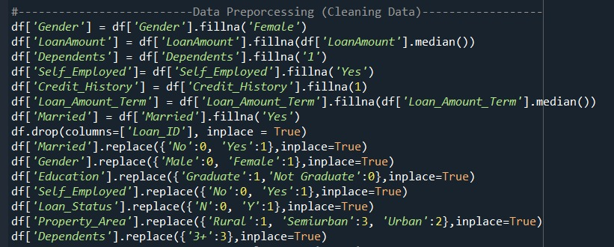
Data preprocessing:

Slide 5
Describtion of Data preprocessing
1-df['Gender'] = df['Gender'].fillna('Female'): fill missing values in the "Gender" column with "Female".
2-df['LoanAmount'] = df['LoanAmount'].fillna(df['LoanAmount'].median()): fill missing values in the "LoanAmount" column with the median of this column.
3-df['Dependents'] = df['Dependents'].fillna('1'): fill missing values in the "Dependents" column with '1‘
4-df['Self_Employed']= df['Self_Employed'].fillna('Yes'): fills missing values in the "Self_Employed" column with "Yes".
5-df['Credit_History'] = df['Credit_History'].fillna(1): fills missing values in the "Credit_History" column with 1.
6-df['Loan_Amount_Term'] = df['Loan_Amount_Term'].fillna(df['Loan_Amount_Term'].median()): fill missing values in the "Loan_Amount_Term" column with the median value of this column.
7-df['Married'] = df['Married'].fillna('Yes'): fills missing values in the "Married" column with "Yes".
8-df.drop(columns=['Loan_ID'], inplace = True): drop the "Loan_ID" column from the Data base
9-df['Married'].replace({'No':0, 'Yes':1},inplace=True): replace the values "No" and "Yes" in the "Married" column with values 0 and 1.
7-df['Gender'].replace({'Male':0, 'Female':1},inplace=True): replaces the values "Male" and "Female" in the "Gender" column with values 0 and 1.
8-df['Education'].replace({'Graduate':1,'Not Graduate':0},inplace=True): replaces values "Graduate" and "Not Graduate" in the "Education" column with values 1 and 0.
9-df['Self_Employed'].replace({'No':0, 'Yes':1},inplace=True): replaces the values "No" and "Yes" in the "Self_Employed" column with values 0 and 1.
10-df['Loan_Status'].replace({'N':0, 'Y':1},inplace=True): replaces the values "N" and "Y" in the "Loan_Status" column with values 0 and 1.

Slide 6
Data preprocessing (cont.)
11-df['Property_Area'].replace({'Rural':1, 'Semiurban':3, 'Urban':2},inplace=True): replaces values "Rural", "Semiurban", and "Urban" in the "Property_Area" column with values 1, 3, and 2,.
12-df['Dependents'].replace({'3+':3},inplace=True): replaces the value "3+" in the "Dependents" column with the value 3.

Slide 7
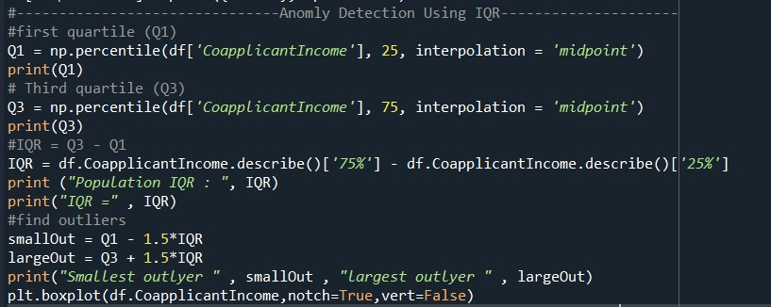
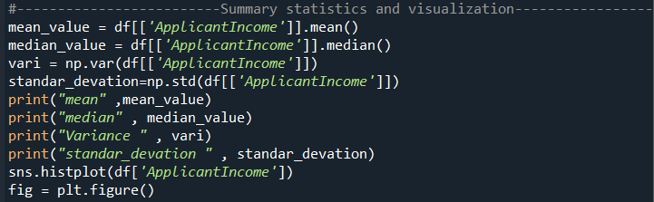
Anomaly Detection & Summary statistics and visualization :

Slide 8
Describtion of Anomaly Detection
It calculates the first quartile (Q1), third quartile (Q3), and interquartile range (IQR) . It then finds the smallest and largest outliers using the formula: Q1 - 1.5IQR and Q3 + 1.5IQR, respectively. The outliers are not explicitly defined by the code, but the range between Q1 - 1.5IQR and Q3 + 1.5IQR is typically used to identify them.
After that, the code calculates summary statistics (mean, median, variance, and standard deviation) of the 'ApplicantIncome' column in the same DataFrame and visualizes its distribution using a histogram and a boxplot. The mean, median, variance, and standard deviation provide information about the central tendency, spread, and shape of the distribution. The histogram and boxplot show the frequency and distribution of the data, respectively

Slide 9
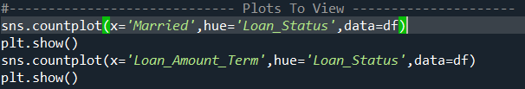
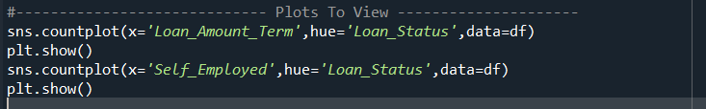
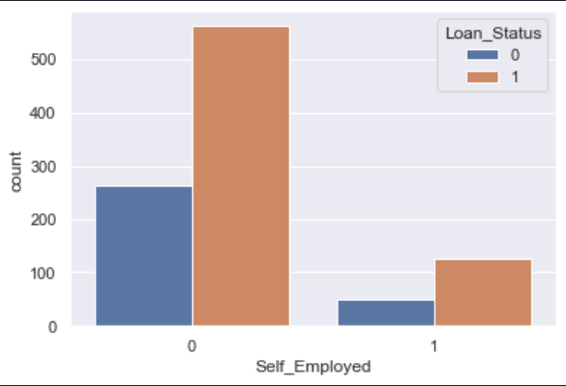
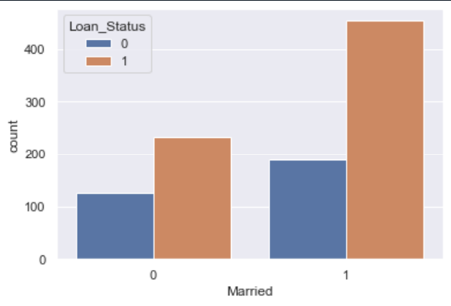

Slide 10
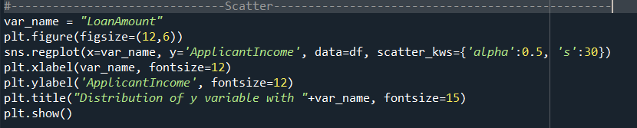

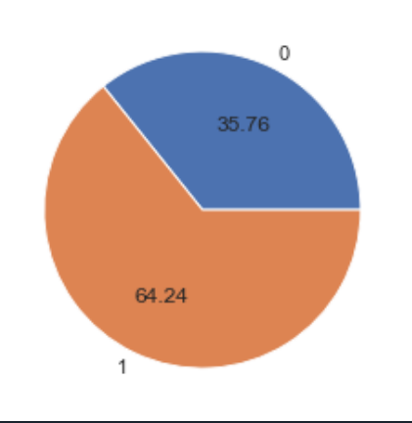
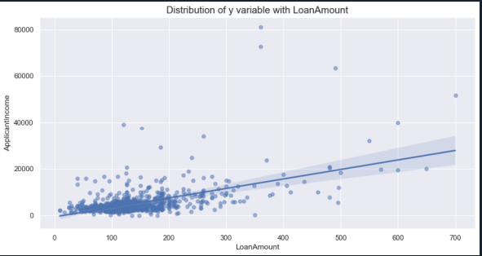

Slide 11
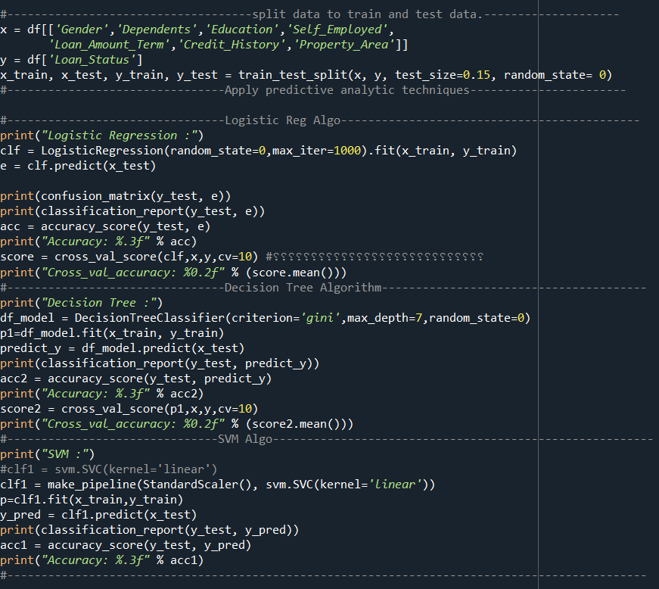
Spliting Data:
The dataset is first split into training subset (x) to 85% and testing subset (y)to 15% variables.- `x`: contains the features that will be used to predict the target variable ,the features are 'Gender', 'Dependents', 'Education', 'Self_Employed','Loan_Amount_Term', 'Credit_History', and 'Property_Area'.- `y`: contains target variable that we want to predict ,the target variable is 'Loan_Status'.- `train_test_split`: This function is used to randomly split the dataset into training and testing subsets.

Slide 13
Logistic Reg Algo:
It then evaluates the performance of the model using a confusion matrix, classification report, and accuracy score. //it calculates the cross-validation accuracy of the model using 10-fold cross-validation.LogisticRegression: This is a class that implements logistic regression classification. The random_state parameter is set to 0 to ensure reproducibility of the results, and the max_iter parameter is set to 1000 to specify the maximum number of iterations for the solver to converge.fit: This method is called on the LogisticRegression object clf to train the model on the training subset of the data, (x_train and y_train).predict: This method is called on the trained clf object to predict the target variable for the testing subset of the data, x_test.confusion_matrix: This function returns a confusion matrix, which is a table that shows the number of true positives, true negatives, false positives, and false negatives produced by the model.classification_report: This function returns a text report that shows the precision, recall, F1 score, and support for each class in the target variable.accuracy_score: This function returns the accuracy of the model, which is the proportion of correctly classified instances out of the total number of instances in the testing subset.cross_val_score: This function performs cross-validation on the entire dataset (x and y) using 10-fold cross-validation. It splits the data into 10 parts, trains the model on 9 parts, and evaluates it on the remaining part.
Decision Tree:
It then evaluates the performance of the model using a classification report, accuracy score, and cross-validation accuracy.- `DecisionTreeClassifier`: This is a class implements decision tree classification. The `criterion` parameter is set to 'gini' to use the Gini impurity measure, which is a measure of how often a randomly chosen element from the dataset would be incorrectly labeled if it were randomly labeled according to the distribution of labels in the subset. The `max_depth` parameter is set to 7 to limit the depth of the decision tree and prevent overfitting. The `random_state` parameter is set to 0 to ensure reproducibility of the results

Slide 14
SVM:
It then evaluates the performance of the model using a classification report and accuracy score.- `make_pipeline`: This function is used to create a pipeline that scales the data using `StandardScaler` and then applies the SVM classifier. The `StandardScaler` function is used to standardize the features by removing the mean and scaling to unit variance.- `svm.SVC`: This is a class that implements the SVM algorithm for classification. The `kernel` parameter is set to 'linear' to use a linear kernel function, which is suitable for datasets with a large number of features.- `fit`: This method is called to to train the model on the training subset of the data, `x_train` and `y_train`.- `predict`: This method is called to predict the target variable for the testing subset of the data, `x_test`.- `classification_report`: This function returns a text report that shows the precision, recall, F1 score, and support for each class in the target variable, and the report shows the precision, recall, F1 score,and support for each class in the target variable. - `accuracy_score`: This function returns the accuracy of the model, which is the proportion of correctly classified instances out of the total number of instances in the testing subset. In contrast to the logistic regression and decision tree models, the SVM model is implemented as a pipeline that includes feature scaling using `StandardScaler`. This helps to improve the performance of the SVM algorithm by ensuring that all features are on the same scale. The `p` variable stores the trained model, which can be used for further analysis or predictions.

