Slide 1






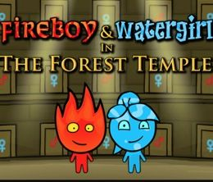




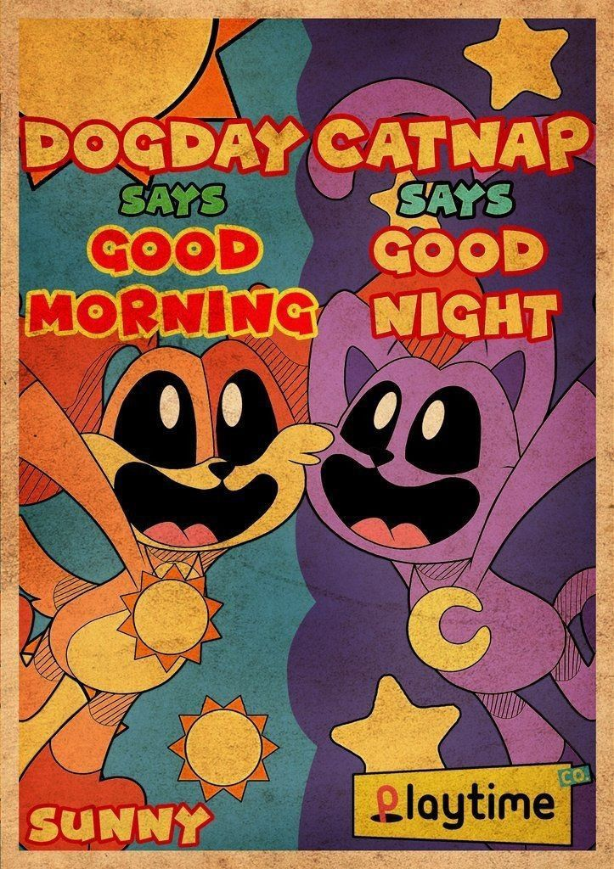
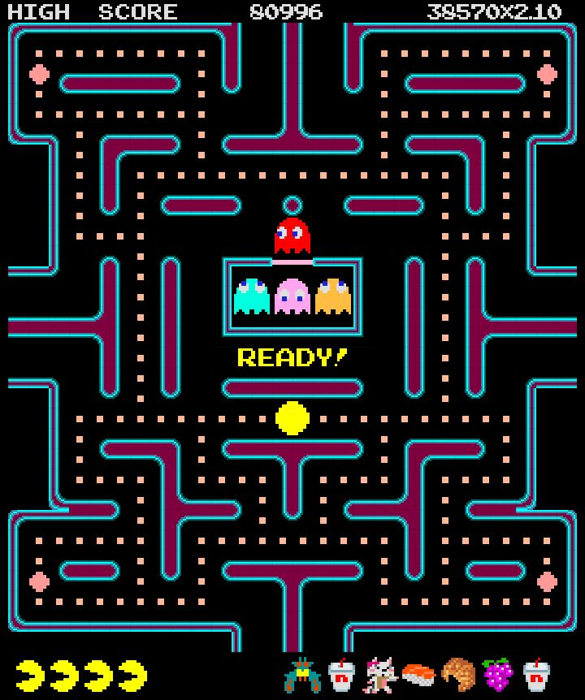

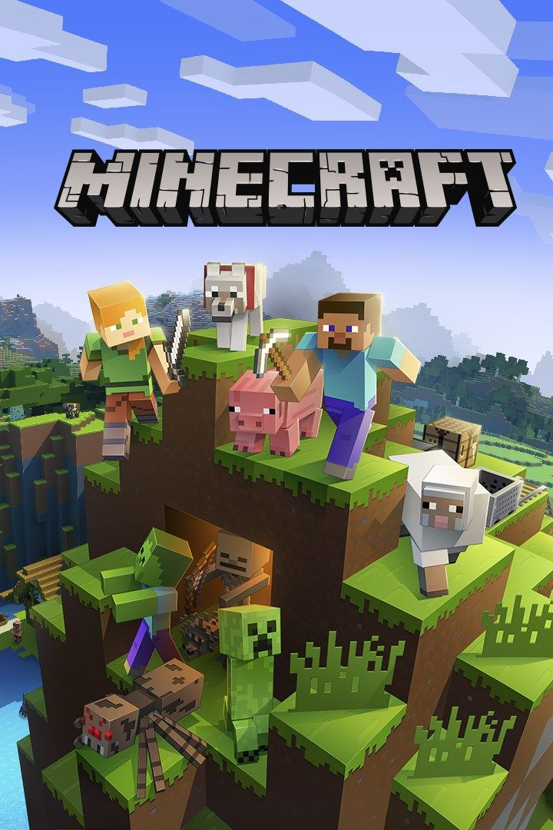


Slide 2

Multiplayer Game Engine

Slide 3
Project Structure
Header Files (.h)
Header files contain class declarations, function prototypes, and variable definitions. They serve as an interface that allows other files to access a class without exposing its implementation. Any source file that requires access to a class simply includes its corresponding header file.
Source Files (.cpp)
Source files contain the full implementation of the functions and classes declared in the header files. This is where the actual logic and functionality of the program resides.
Why separate Header and Source Files?
Separating the code into multiple files allows team members to work independently without conflicts. It also improves code maintainability, reduces compilation time, and makes debugging significantly easier by isolating each component of the system.
Note
To align with this modular architecture, the development team was structured into 3 sub-teams, each managing specific components independently

Slide 4
THE CORE ENGINE TEAM
Collective Responsibilities
Team Members
Game Loop Architecture: Syncing input, physics, and rendering for stability
Yassin Athula
Mohraeel Khalaf
Entity Manager: Managing object life-cycles and dynamic memory allocation
Physics Engine: Implementing custom AABB collision detection and resolution
System Integration: Connecting core modules with Gameplay and Networking

Slide 5
GAMEPLAY & LOGIC TEAM
Collective Responsibilities
Team Members
Character Class System: Designing Heavy, Tall, and Nimble abilities
Eman Mohammad
Abanoub Hany Fahim
Helen Hany
Haneen Amr
Puzzle Interaction Logic: Developing pressure plates and timed doors
Entity State Management: Handling movement physics and interaction triggers
Cooperative Mechanics: Implementing multi-player environmental challenges.

Slide 6
NETWORK SYNCHRONIZATION
Collective Responsibilities
Team Members
Relay Server Infrastructure: Establishing raw Socket communication
Youssef Sameh
Seif Allah Wael
Data Serialization: Designing efficient packet transfer protocols
State Synchronization: Ensuring zero latency between players

Slide 7
Core Libraries
While working on this project, we utilized over 12 fundamental libraries to build our entire engine from scratch, ensuring high performance and modularity.
Standard I/O & Logic
  <iostream> : Handles basic standard input and output streams.
  <string> : Provides advanced string manipulation and storage.
  <sstream> : Facilitates seamless conversion between strings and other data types.
  <algorithm> : Offers highly optimized functions for sorting, searching, and partitioning.
  <cstdlib> : Manages random number generation and general system utilities.
2. Memory & Data Management
<vector> : Implements dynamic arrays for managing game entities efficiently.
<memory> : Ensures memory safety through Smart Pointers (unique_ptr, shared_ptr).

Slide 8
3. Multi-threading & Synchronization
<thread> : Enables parallel execution for concurrent game and network logic.
<mutex> : Prevents data races by locking shared resources between threads.
<atomic> : Guarantees thread-safe operations on primitive data types without locking.
4. Networking & Connectivity
<winsock2.h> : The primary API for Windows Socket programming and internet communication.
<ws2tcpip.h> : Provides structures and functions for handling IP addresses and protocols.
5. Timing & High Performance
<chrono> : Utilized for high-precision timing to manage frame-rate independent movement.
<ctime> : Used for accessing system time and date utilities.

Slide 9
Why Vector over Array?
During the research phase of our project, we identified a critical limitation of standard C++ arrays: their size must be defined at compile time and cannot be modified during runtime. In the context of a game engine, where the number of active entities — including players, push-able boxes, and buttons — changes dynamically throughout gameplay, this constraint is unacceptable.
We therefore adopted vector from the C++ Standard Template Library, which provides a dynamically resizable array. This allows the engine to efficiently manage game objects in real time, adding and removing entities as needed without any predefined size restrictions.
Array | Vector
Fixed size | Dynamic size
Defined at compile time | Resizes at runtime
Cannot add/remove | Add/remove freely

Slide 10
Vec2 Struct Analysis
Initialization: Uses a Member Initializer List for efficient x,y assignment with default values.
Math Logic: Overloads Arithmetic Operators (+,−) to simplify vector calculations into intuitive math expressions.
State Updates: Implements Compound Assignments (+=,−=) to modify object coordinates directly in memory.
Performance: Utilizes Const References to prevent unnecessary data copying and ensure memory efficiency.
Equality Check: Provides a Boolean Operator (==) for precise coordinate comparison between entities.
“Vec2.h”

Slide 11
Abstract Foundation:
Define an Abstract Base Class that serves as a blueprint for all game objects, ensuring a unified interface for movement and rendering through Pure Virtual Functions.
Encapsulated State:
Maintains essential entity data (Position, Velocity, Health) using Protected Access Modifiers, allowing derived classes to inherit state while preventing unauthorized external modification.
Polymorphic Behavior:
Implements a Virtual Destructor and overridable methods (update, render) to enable Dynamic Dispatch, allowing the engine to manage diverse entity types through a single pointer type.
Memory Integrity:
Leverages Resource Acquisition Is Initialization (RAII) principles to ensure that when an entity is flagged as inactive, its memory is safely reclaimed by the system without leaks.

