Slide 1
Smart Room Light Control

Slide 2
A smart, energy-saving room light system: it detects when the door opens, then checks for motion inside the room, and only turns the light ON when both conditions are true.
The Problem
The Solution
The Extra
Forgetting to turn off the light when leaving a room wastes energy.
Automatically sense whether someone is actually in the room before turning the light on.
Remote monitoring and control through a Node-RED dashboard.
2

Slide 3
System Components
01
ESP32 Board
The main controller; reads sensors and connects to Wi-Fi
02
Door Switch
Detects whether the door is open or closed (GPIO 12)
03
PIR Motion Sensor
Detects a person's presence inside the room (GPIO 14)
04
LED / Relay Light
The actual light being controlled (GPIO 27)
3

Slide 4
How the System Works
Door open?
Motion detected?
Turn LED ON
The light only turns on when both conditions are true at the same time.
Every change in door / motion / LED state is published instantly over MQTT so Node-RED sees it in real time.
4

Slide 5
The Code
Door open + motion detected -> light turns ON
door_opened = door_switch.value()
motion = pir_sensor.value()
if door_opened:
if motion:
led.value(1) # LED ON
else:
led.value(0) # LED OFF
else:
led.value(0) # LED OFF
Door open, no motion -> light stays OFF
Door closed -> light turns OFF instantly (saves energy)
5

Slide 6
Connecting with MQTT
Each state (door / motion / light) is published on a different "topic" — any device subscribed to that topic receives it in real time.
Topic
Direction
Values
home/door
ESP32 -> Node-RED
OPEN / CLOSED
home/motion
ESP32 -> Node-RED
DETECTED / CLEAR
home/led/state
ESP32 -> Node-RED
ON / OFF
home/led/cmd
Node-RED -> ESP32
ON / OFF / AUTO
6

Slide 7
The Node-RED Dashboard
Node-RED receives the MQTT data and shows it on a simple dashboard, while also allowing manual control of the light.
Door
Motion
Light
Manual Control
ON
OFF
AUTO
7

Slide 8
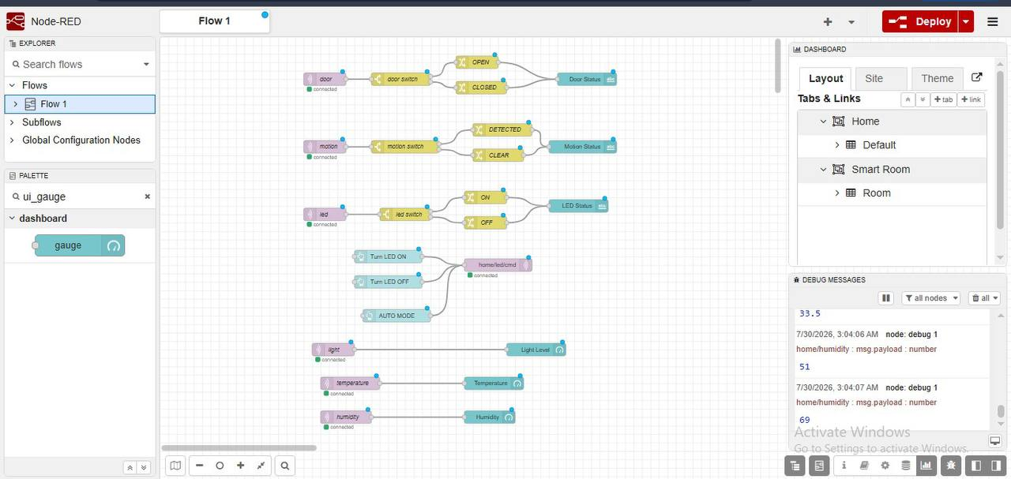
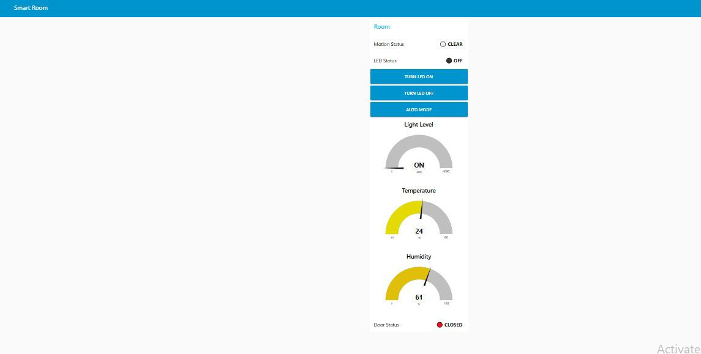
Real Implementation
Control Dashboard (Node-RED Dashboard)
Node-RED Flow (sensors and control)

Slide 9
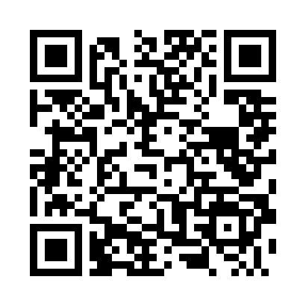
Conclusion
Saves energy by turning the light on only when actually needed
Enables remote monitoring and control through Node-RED
Can be extended later with more sensors or additional rooms using the same idea
Scan to open the project
wokwi.com/projects/470887190300809217
Thank You

