Slide 1
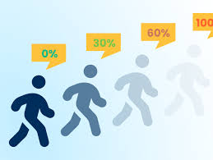
Python Data Analysis Project-Churn
Emanuel Shacham - ID 031817067
Dror Haim Mardo - ID 301382032

Slide 2

The Problem
Prediction:
Which customer is likely to churn
Based on customer profile and data analysis tools we supply the probability that a customer will churn the company.
Motivation:
It is cheaper to retain an existing customer than to recruit a new one!

Slide 3

The Data
Data available: 7043 Observations
Data features: 19 different categories that can be divided to 3 subcategories:
Services customer data
Finance customer data
Personal customer data
PhoneService, MultipleLines InternetService OnlineSecurity OnlineBackup
DeviceProtection
TechSupport
StreamingTV
StreamingMovies
PaymentMethod MonthlyCharge Contract
TotalCharges
PaperlessBilling
Gender
Senior Citizen
Partner
Dependents
Tenure
No missing data was found few cells in “total charges” were empty we replace them with 0.
divided to train/test in 80/20 ratio, train = 5634 test = 1049

Slide 4

Data Engineering
Old column/s
New column/s
Data transformation
mothlycharges
Mnt_crg_rank
Creating a scale
total charges
Tot_crg_rank
Creating a scale
tenure
tenure years
Creating a hierarchy
single
couple
single parent
family
Partner
dependents
family_statuess
Columns removed - partner, dependents, tenure, monthlycharges, totalcharges, customerid

Slide 5
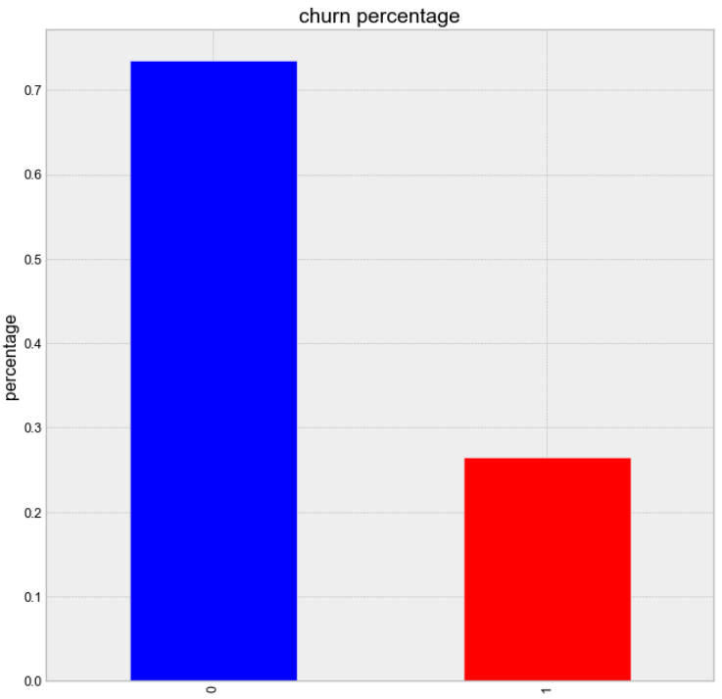
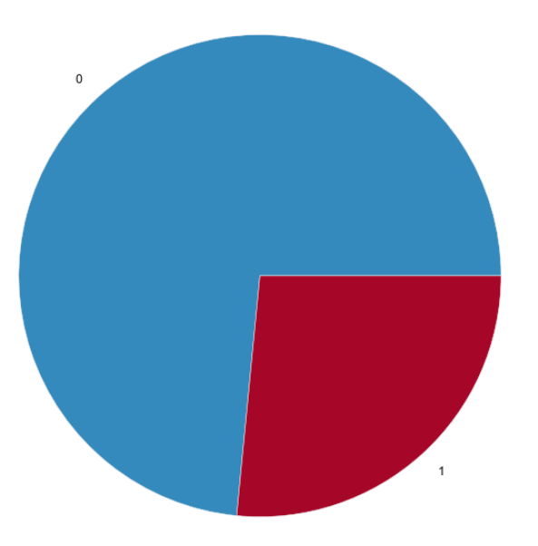
Data analysis
Churn value of company
26.5%
26.5%
26.5%

Slide 6
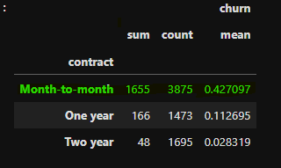
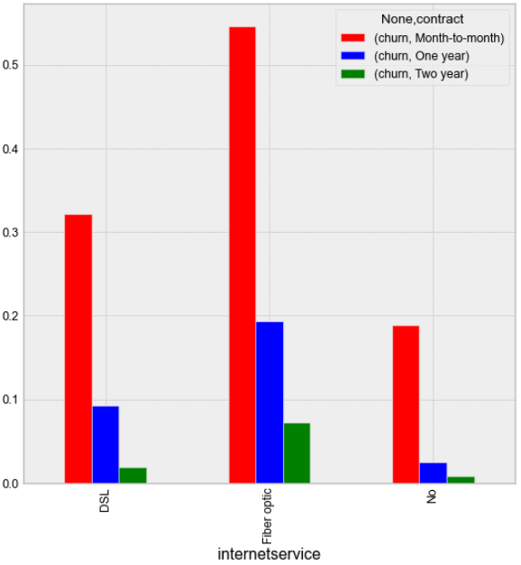
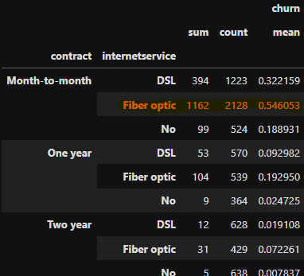
Data analysis
By contract
Month to month contract has 42.7% churn
Month to month contract filter by Fiber optic internet service has 54.6% churn

Slide 7
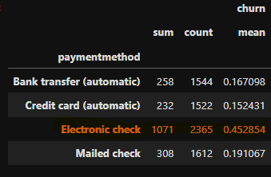
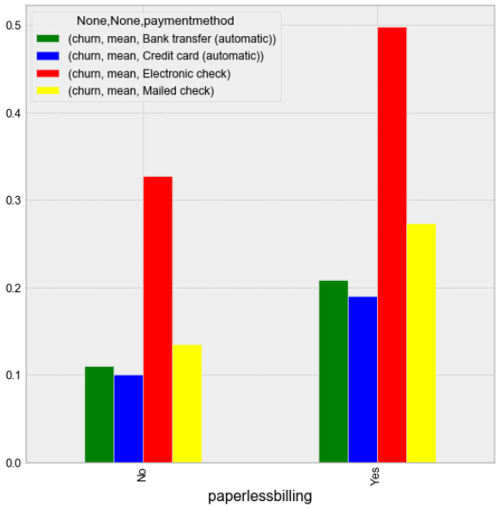
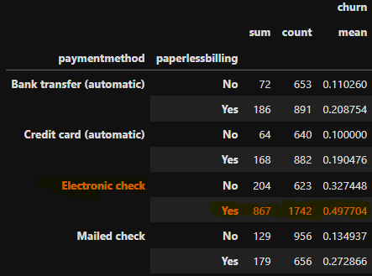
Data analysis
By Payment method
Electronic check Payment has 45.2% churn
Electronic check Payment filter by paper less billing has 49.7% churn

Slide 8
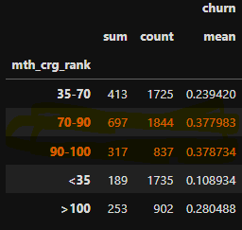
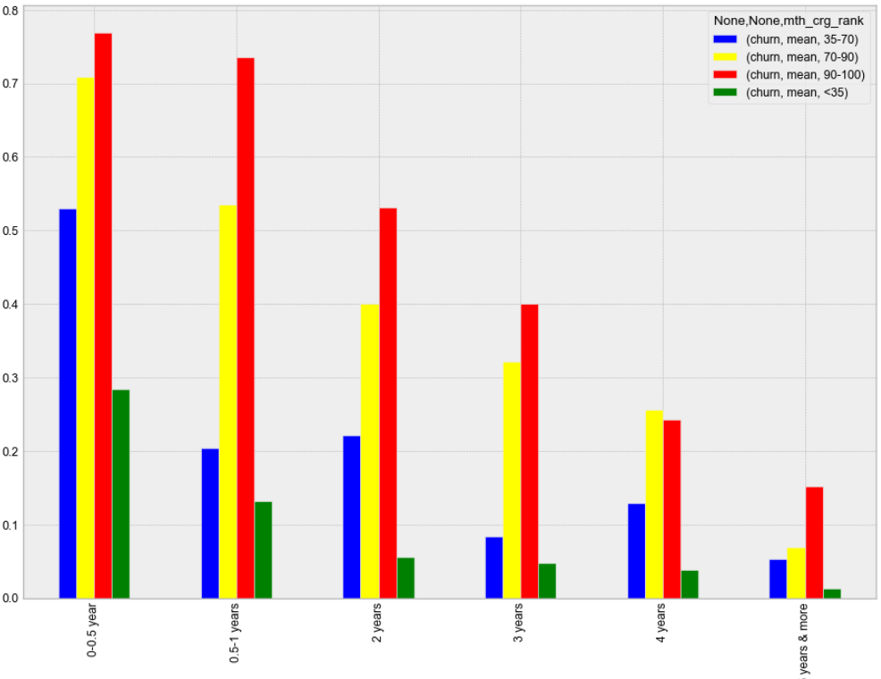
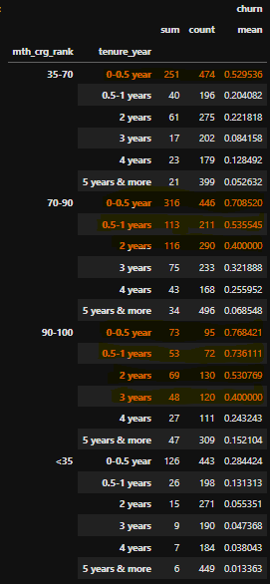
Data analysis
By Monthly charges
Monthly charges between 70 to 100 has 37.8% churn
Monthly charges between 70 to 100 filtered by tenure period has levels above 70%

Slide 9
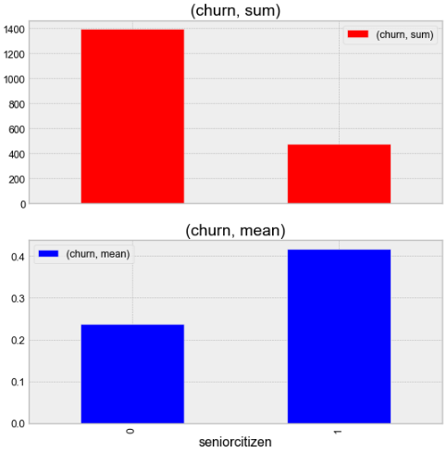
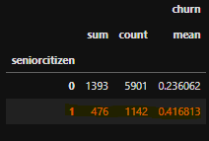
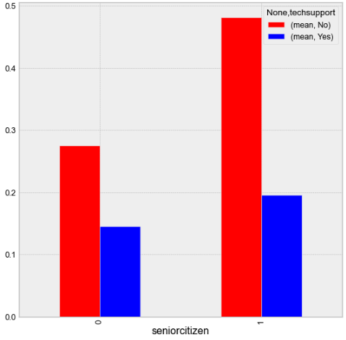
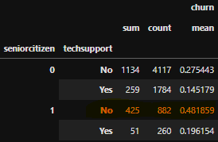
Data analysis
By Senior citizen
Senior citizen has 41.6% churn
Senior citizen filtered by tech support has 48.1% churn

Slide 10

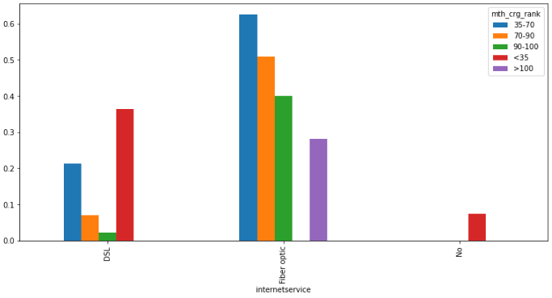
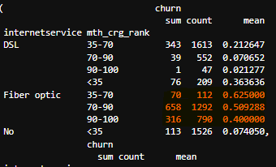
Data analysis
By Internet Service
Fiber optic has 41.9% churn
Fiber optic filter by Monthly charges can reach 62.5% churn

Slide 11
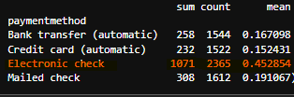
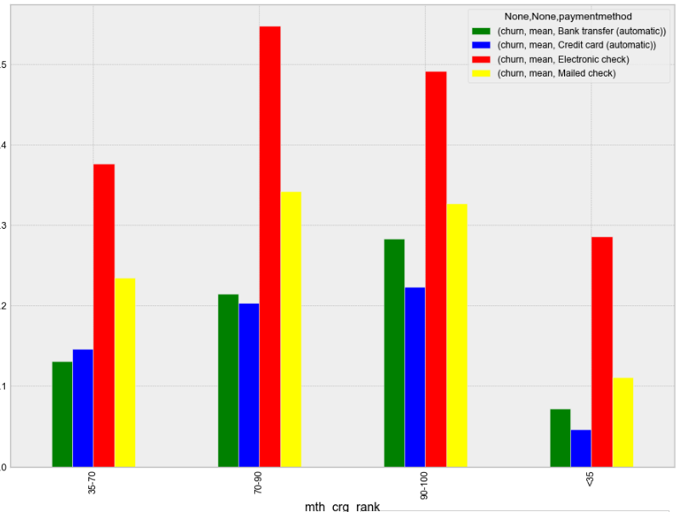
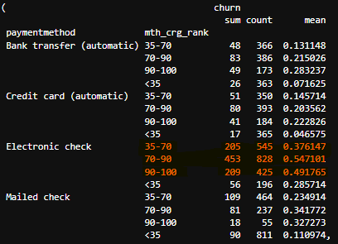
Data analysis
By Payment Method
Electronic Check has 45.2% churn
Electronic Check filtered with monthly charges can reach up to 54.7% churn

Slide 12
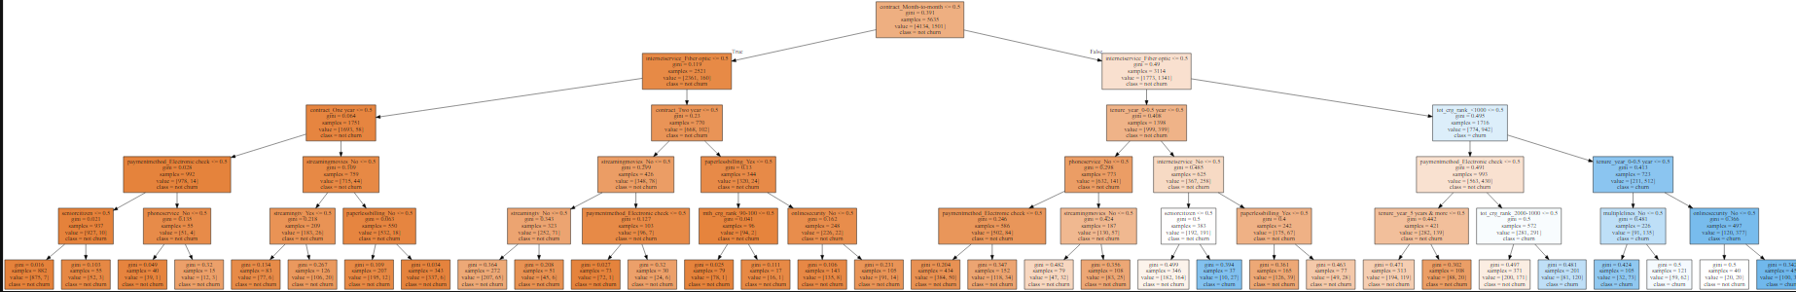
Decision Tree

Slide 13
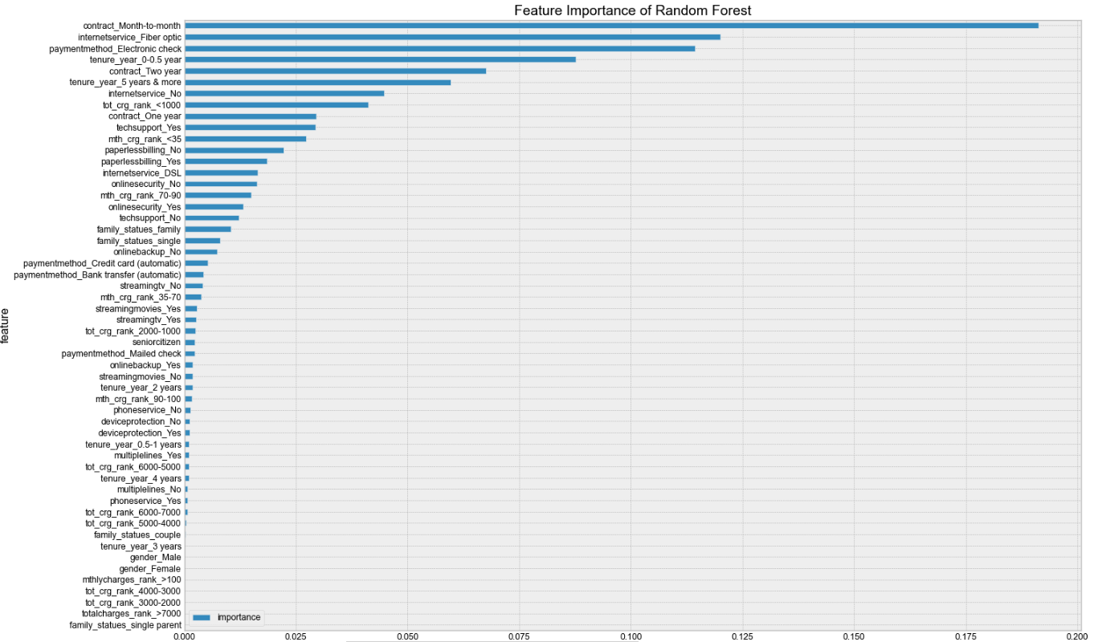
Random Forest

Slide 14
Algorithm
benchmark | Knn | Random Forest | Decision Tree
73.8% | 78.7% | 79.4% | 78.5% | Accuracy Level
 | neighbors=20 | Depth =8 Estimator=9 | Depth = 5 | Properties
The most accurate algorithm, Random Forest, with accuracy level of 79.4%

