Slide 1
PROJECT WORK SOFTWARE ENGINEERING IFTTT-LIKE APPLICATION
Moccaldi Simone Pio
Nicolò Emanuele Alfonso
Ommenielllo Giovanni
Pappalarlo Francesco

Slide 2
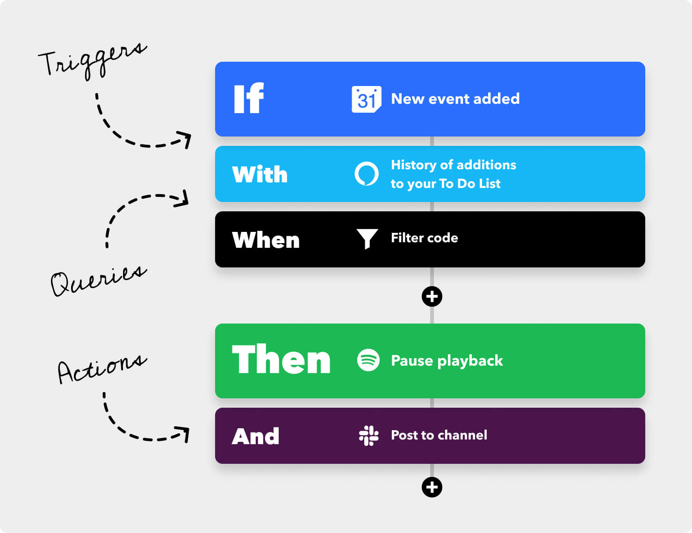
GOAL
The goal of the project is to create an application similar to IFTTT, i.e. a service that helps in the automation of simple tasks

Slide 3
TABLE OF CONTENTS
01
UML AND USED PATTERNS
02
PRODUCT BACKLOGS
In this section will explain how was built the UML diagram and consequently, also the patterns and why they were used.
Here you will see the initial product backlog, including the acceptance criteria and the final product backlog
03
BURNDOWN CHARTS
04
CONCLUSIONS
In this section the burndown charts of each sprint will be shown with associated speeds
Here the done and non-done elements will be exposed.

Slide 4
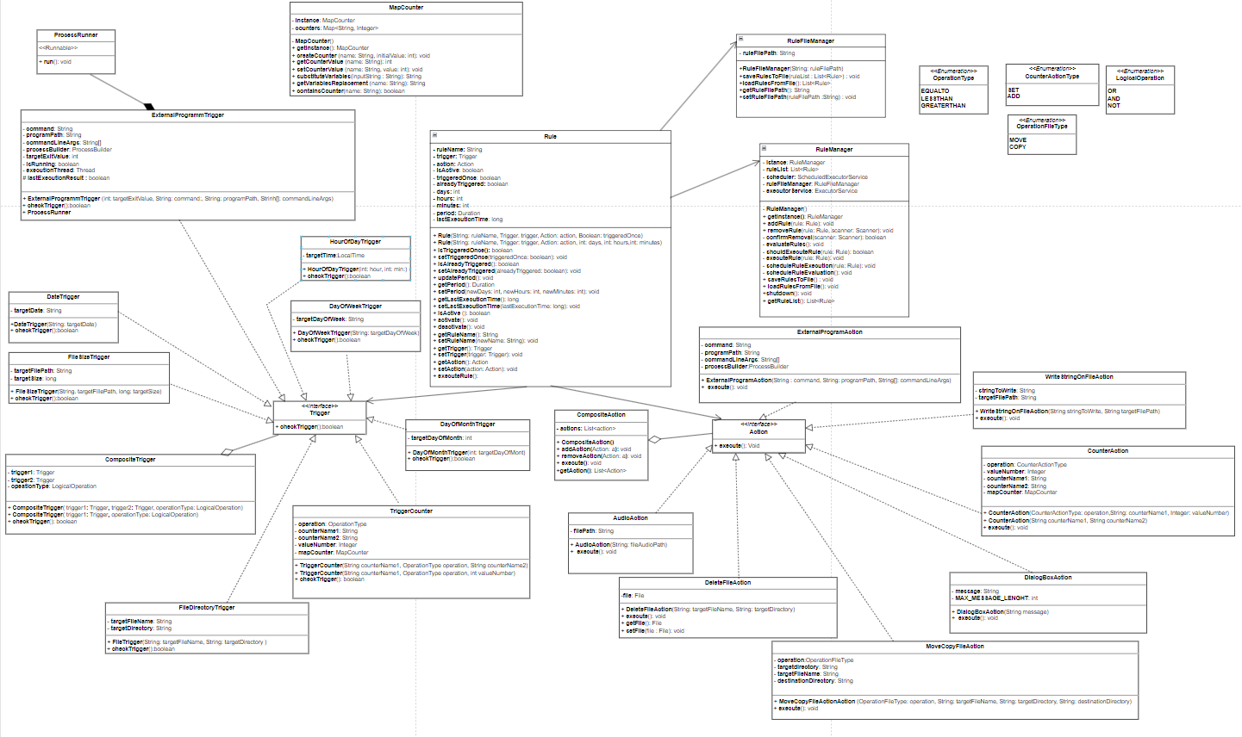

Slide 5
USED PATTERNS
COMPOSITE | Composite was used for triggers and actions. For triggers, composite is used to create logical triggers, which are triggers composed of a logical operation (Or, And, not) between two triggers. It has also been used to build compound actions, i.e. actions that are the concatenation of multiple actions.
SINGLETON | The singleton pattern was used on the RuleManager and MapCounter classes. RuleManager is a class that contains the list of rules (active and inactive) while MapCounter is a class that contains a map of all the application counters. The singleton pattern serves to create a single instance of these two elements, creating a single access point and ensuring that they are accessible globally.

Slide 6
INITIAL PRODUCT BACKLOG
1) As a customer I want the application must be similar to IFTTT, but it must be designed to run in stand-alone, single-user desktop mode.
2) As user, I want to be able to create rules to create trigger and associated actions.
3) As a customer I want the application to periodically check the rules to see if the trigger can be activated and if so, execute the specified action(s).
4) As a user, I want to set a specific time to trigger a rule that becomes true when the time is equal to or greater than the specified time, having the ability to decide whether to trigger an audio file or a message in a dialog box, that I can close.
5) As user, I want to be able to delete rules.
6) As user, I want to be able to deactivate and activate a rule.
7) As customer, I want the set of rules to be saved to a file and automatically reloaded when the application is restarted.
8) As user, I want to be able to define whether a rule should be triggered only once after the trigger or whether it can be triggered immediately after or after a specified period of time.
9) As user, I want to do some operations on files (writing a specified string at the end of a specified text file, copying or moving specified file from a specified directory to a specified destination directory, deleting a specified file from a specified directory).
10) As user, I want to execute a specified external program with specified command-line arguments.
11) As user, I want a 'current day-of-week' trigger that fires when the current day of the week is equal to the one specified (Name day).
12) As user, I want the 'current day-of-month' trigger that fires when the current day of the month is equal to the one specified (Number day).
13) As user, I want the 'current date' trigger that fires when the current date is equal to the one specified (format dd/mm/yyyy).
11) As user, I want a 'current day-of-week' trigger that fires when the current day of the week is equal to the one specified (Name day).
12) As user, I want the 'current day-of-month' trigger that fires when the current day of the month is equal to the one specified (Number day).
13) As user, I want the 'current date' trigger that fires when the current date is equal to the one specified (format dd/mm/yyyy).
14) As user, I want the following triggers on files: a file with a specified name exists in a specified directory; the size of a specified file is larger than a specified value.
15) As user, I want a trigger that activates if the exit value of an executed external program is equal to a specified value.
16) As user, I want to be able to define a set of elementary actions or other sequences of actions as a result of a rule.
17) As user, I want to be able to use logical operators to combine elementary triggers or combined triggers.
18) As user, I want to be able to create, view and edit integers counters.
19) As user I want to be able to perform the following operations on the counters: set, add a value to this counter, and add the value of one counter to another.
20) As user, I want to be able to create triggers on counters so that I can use comparison operations with each other or with a specified integer.
21) As user I want, when using strings, to be able to use a replacement variable to insert the current value of a counter into the string.
22) As customer, I want a graphical user interface.

Slide 7
ACCEPTANCE CRITERIA
User Story 1: Stand-Alone Desktop App like IFTTT.
User Story 2: Rule Creation for Trigger-Action.
Acceptance Criteria:
Given: A user in the system.
When: The user creates a rule with a trigger and one associated action(s).
Then: The rule is automatically added to the rule set. The rule set contains the newly created rule.
User Story 3: Periodic Rule Checking and Execution.
Acceptance Criteria:
Given: The application is running.
When: The system performs periodic rule checking every 5 seconds.
Then: If a trigger can be activated, the specified action(s) associated with the rule are executed.
User Story 4:Time-Based Rule Trigger with Audio or Dialog Action.
Acceptance Criteria:
Given: A user in the system.
When: The user sets a specific time for a rule to trigger.
The user specifies whether the trigger should play an audio file (wav) or show a dialog box with a specific message.
The user provides the path to the audio file.
Then: When the specified time is reached, the rule becomes true.
If the trigger is set to play an audio file, the system plays the specified audio file.
If the trigger is set to show a dialog box, the system displays the dialog box with the specified message, and the user can close it.
User Story 5: Rule Deletion Capability.
Acceptance Criteria:
Given: A user with existing rules.
When: The user attempts to delete a rule.
Then: The system prompts the user for confirmation before the final deletion.
If confirmed, the rule is removed from the set of rules.
User Story 5: Rule Deletion Capability.
Acceptance Criteria:
Given: A user with existing rules.
When: The user attempts to delete a rule.
Then: The system prompts the user for confirmation before the final deletion.
If confirmed, the rule is removed from the set of rules.
User Story 6: Rule Activation and Deactivation.
Acceptance Criteria:
Given: A user with existing rules.
When: The user edits a rule, changing its status.
Then: After activation, if the trigger condition is true the corresponding action is executed, if the trigger is deactivated even with the trigger condition verified the action does not start.
User Story 7: Save and Auto-Load Rules on Application Restart. Acceptance Criteria:
Given: A set of rules in the system.
When: The customer requests to save the set of rules to a file. The application is restarted.
Then: The set of rules is automatically reloaded from the saved file. User Story 8: Rule Trigger Options: Once, Immediately, or After a Set Time.
Acceptance Criteria:
Given: A user creating a rule.
When: The user defines whether a rule should be triggered:
Only once after the trigger.
Immediately after the trigger.
After a specified period of time.
Then: The rule behaves according to the specified triggering condition.

Slide 8
User Story 9: File Operations: Write, Copy, Move, Delete. Acceptance Criteria: Given: A user interacting with the system. When: The user performs file operations, including: Writing a specified string at the end of a specified text file. Copying or moving a specified file from a specified directory to another specified destination directory. Deleting a specified file from a specified directory. Then: The specified file operations are executed successfully. User Story 10: Execute External Program with Command-line Arguments. Acceptance Criteria: Given: A user creating a rule. When: The user specifies an external program and command-line arguments to execute. Then: The specified external program is executed with the specified command-line arguments. User Story 11:DayOfWeek-Based Trigger. Acceptance Criteria: Given: A user creating a rule. When: The user specifies triggers:'Current day-of-week' trigger for a specific day. Then: The triggers activate when the current day matches the specified values. User Story 12: DayOfMonth-Based Trigger. Acceptance Criteria: Given: A user creating a rule. When: The user specifies triggers:'Current day-of-month' trigger for a specific day. Then: The triggers activate when the current day of the month matches the specified values. User Story 13: Date-Based Trigger. Acceptance Criteria: Given: A user creating a rule. When: The user specifies triggers:'Current date' trigger for a specific date (format dd/mm/yyyy). Then: The triggers activate when the current date matches the specified values.
User Story 14: File Triggers: Existence and Size. Acceptance Criteria: Given: A user creating a rule. When: The user defines triggers related to files, including: A file with a specified name exists in a specified directory. The size of a specified file is larger than a specified value. Then: The triggers activate based on the specified file conditions. User Story 15: Exit Value External Program Trigger. Acceptance Criteria: Given: A user creating a rule. When: The user specifies a trigger based on the exit value of an executed external program. Then: The trigger activates if the exit value is equal to the specified value.
User Story 16: Define Sequences of Actions for Rules. Acceptance Criteria: Given: A user creating a rule. When: The user defines a set of elementary actions or other sequences of actions. Then: The specified actions are executed as a result of the rule.
User Story 17: Logical Operator Support for Combined Triggers. Acceptance Criteria: Given: A user creating a rule. When:The user uses logical operators to combine elementary triggers or combined triggers. Then: The rule behaves according to the specified logical conditions.
User Story 18: Integer Counter Creation and Management. Acceptance Criteria: Given: A user interacting with the system. When: The user creates, views, and edits integer counters. Then: The user can perform operations on counters, including setting, adding a value to a counter, and adding a value to a counter, and adding the value of one counter to another.

Slide 9
User Story 19: Counter Operations: Set, Add, Add to Another Counter. Acceptance Criteria: Given: A user with existing counters. When: The user performs operations on counters, including: Setting a counter. Adding a value to a counter. Adding the value of one counter to another. Then: The specified operations are performed successfully on the counters. User Story 20: Triggers on Counters for Comparison Operations. Acceptance Criteria: Given: A user creating a rule. When: The user defines triggers on counters, allowing for comparison operations with each other or with a specified integer. Then: The triggers activate based on the specified conditions involving counters. User Story 21: Use of Replacement Variables to Insert Counter Values into Strings. Acceptance Criteria: Given: A user creating a rule involving strings. When: The user uses a replacement variable to insert the current value of a counter into the string. Then: The replacement variable is replaced with the current value of the specified counter. User Story 22: Graphical User Interface Implementation. Acceptance Criteria: Given: A customer using the application. When: The customer interacts with the system. Then: The application provides a graphical user interface (GUI) for easy interaction and usability.

Slide 10
FINAL PRODUCT BACKLOG
1) As a customer I want the application must be similar to IFTTT, but it must be designed to run in stand-alone, single-user desktop mode.
2) As user, I want to be able to create rules to create trigger and associated actions.
3) As a customer I want the application to periodically check the rules to see if the trigger can be activated and if so, execute the specified action(s).
4) As a user, I want to set a specific time to trigger a rule that becomes true when the time is equal to or greater than the specified time, having the ability to decide whether to trigger an audio file or a message in a dialog box, that I can close.
5) As user, I want to be able to delete rules.
6) As user, I want to be able to deactivate and activate a rule.
7) As customer, I want the set of rules to be saved to a file and automatically reloaded when the application is restarted.
8) As user, I want to be able to define whether a rule should be triggered only once after the trigger or whether it can be triggered immediately after or after a specified period of time.
9) As user, I want to do some operations on files (writing a specified string at the end of a specified text file, copying or moving specified file from a specified directory to a specified destination directory, deleting a specified file from a specified directory).
10) As user, I want to execute a specified external program with specified command-line arguments.
11) As user, I want a 'current day-of-week' trigger that fires when the current day of the week is equal to the one specified (Name day).
12) As user, I want the 'current day-of-month' trigger that fires when the current day of the month is equal to the one specified (Number day).
13) As user, I want the 'current date' trigger that fires when the current date is equal to the one specified (format dd/mm/yyyy).
11) As user, I want a 'current day-of-week' trigger that fires when the current day of the week is equal to the one specified (Name day).
12) As user, I want the 'current day-of-month' trigger that fires when the current day of the month is equal to the one specified (Number day).
13) As user, I want the 'current date' trigger that fires when the current date is equal to the one specified (format dd/mm/yyyy).
14) As user, I want the following triggers on files: a file with a specified name exists in a specified directory; the size of a specified file is larger than a specified value.
15) As user, I want a trigger that activates if the exit value of an executed external program is equal to a specified value.
16) As user, I want to be able to define a set of elementary actions or other sequences of actions as a result of a rule.
17) As user, I want to be able to use logical operators to combine elementary triggers or combined triggers.
18) As user, I want to be able to create, view and edit integers counters.
19) As user I want to be able to perform the following operations on the counters: set, add a value to this counter, and add the value of one counter to another.
20) As user, I want to be able to create triggers on counters so that I can use comparison operations with each other or with a specified integer.
21) As user I want, when using strings, to be able to use a replacement variable to insert the current value of a counter into the string.
22) As customer, I want a graphical user interface.
23) Several actions at the same time. As customer, I want that when different rules trigger actions at the same time these are executed at the same time, without waiting for the end of the other one.
Given: multiple rules are triggered simultaneously. When: the system processes these triggered rules. Then: the actions associated with each rule are executed concurrently without waiting for the completion of other actions.
24) Modification of the rule. As user, I want to be able to change the trigger and actions associated with the rules.
Given: a user is customizing a rule. When: the user modifies trigger conditions. Then: the rule is update.

Slide 11
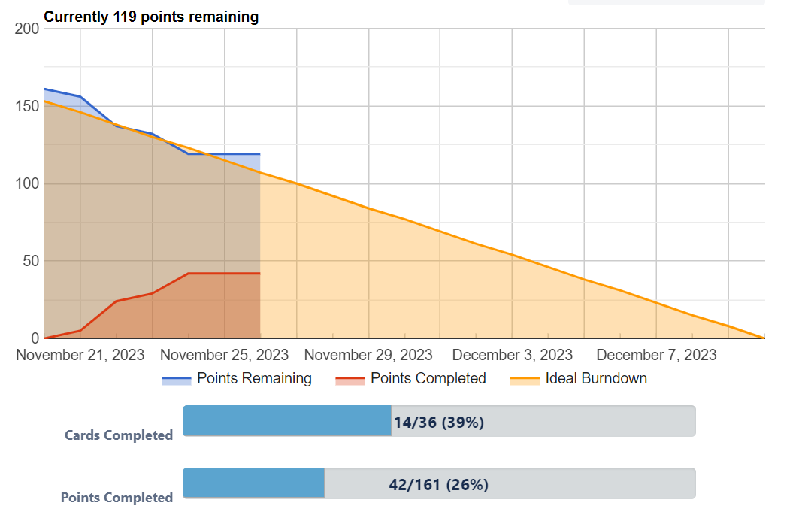
BURNDOWN CHART
SPRINT 1 REVIEW
The estimated velocity of the first sprint was 42, as seen from the burndown chart, where all 42 points were completed.
IMPLEMENTED FUNCTIONALITY The following features have been successfully implemented:
Creation of a "HourOfDay" trigger;
Creation of "DialogBox" and "Audio" actions;
Creation of a rule with the ability to activate and deactivate it;
Management of rule activation and control in "RuleManager";
Addition and removal of rules from the rule set;

Slide 12
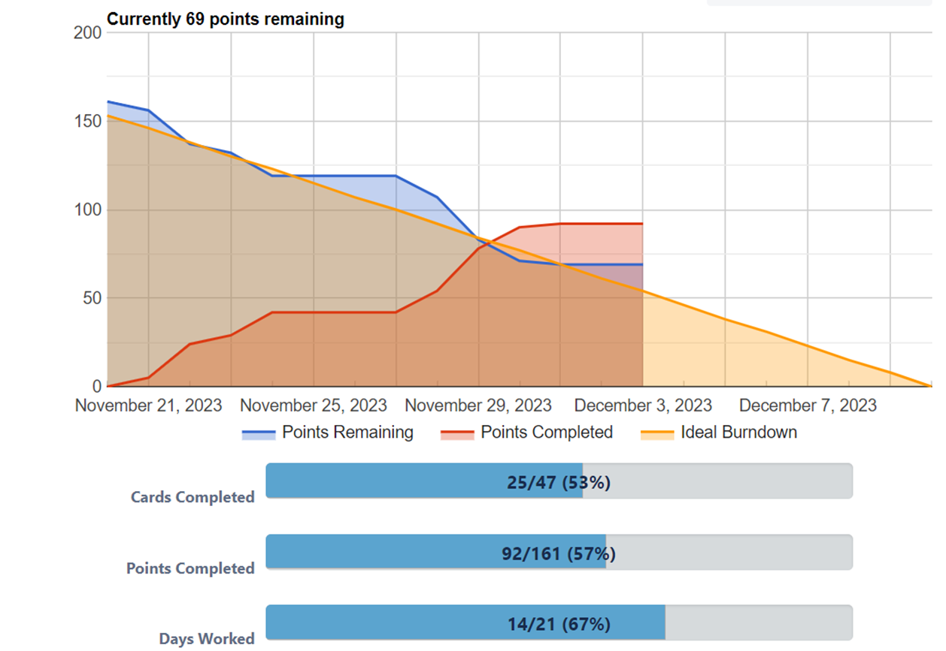
BURNDOWN CHART
SPRINT 2 REVIEW
The estimated velocity of the second sprint was 50, as seen from the burndown chart, where all 50 points were completed.
IMPLEMENTED FUNCTIONALITY The following features have been successfully implemented:
Save and load rule functionality.
Functionality for triggeredOnce and Periodic rules.
Creating the following actions on files: Move, Copy, Delete and writing a string to a file.
Created the “ExternalProgramAction” with Command-line Arguments.
Creation of “DayOfWeekTrigger”.
Creation of “DayOfMonthTrigger”
Creation of “DateTrigger”.

Slide 13
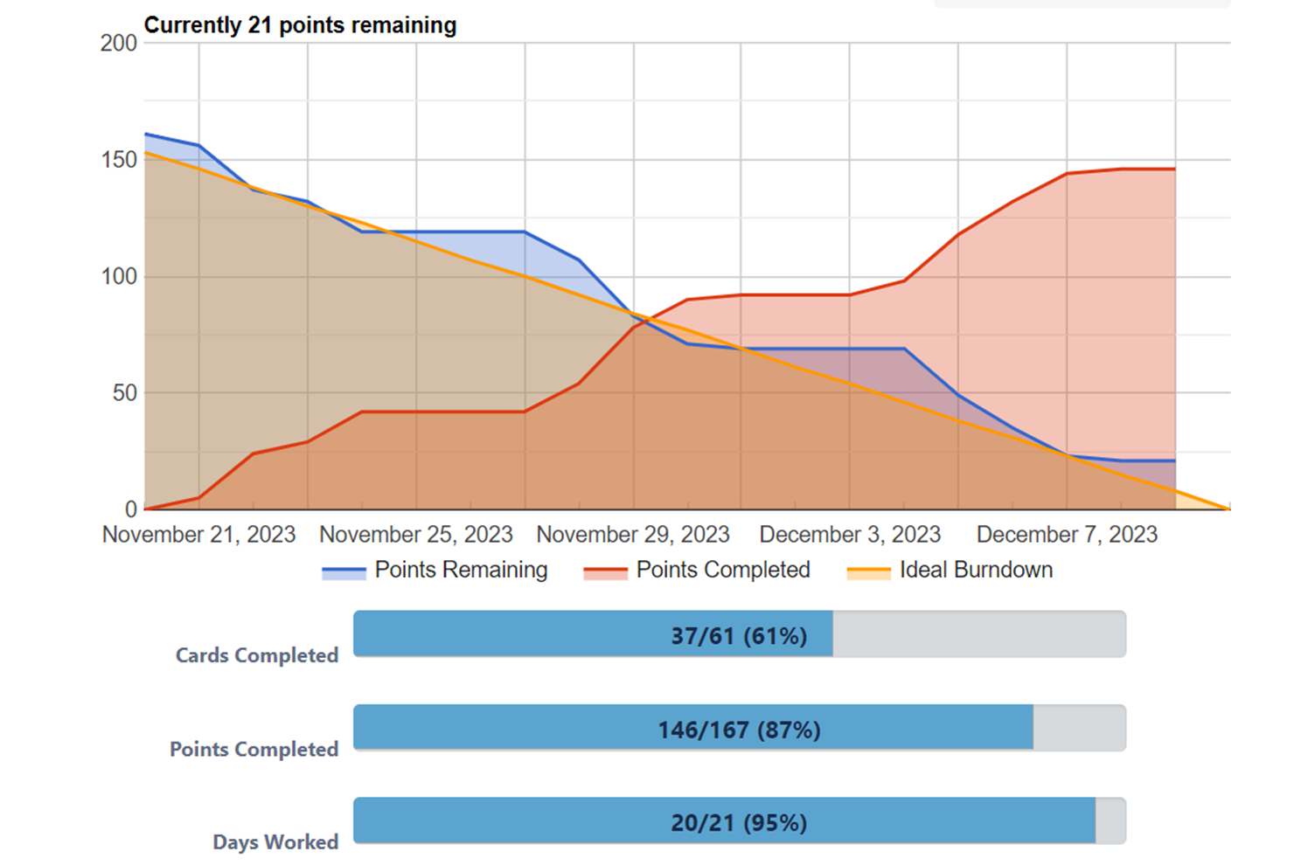
BURNDOWN CHART
SPRINT 3 REVIEW
The estimated velocity of the third sprint was 56, as seen from the burndown chart, where all 56 points were completed.
IMPLEMENTED FUNCTIONALITY The following features have been successfully implemented:
Creation of fileTrigger existence and size.
Creation of ExitValueExternalProgram Tirgger.
Implemented the functionality to define sequences of actions for rules.
Implemented the functionality to use logical operator for combined triggers.
Creation of integer counter and Management.
Creation of counter operations: Set, Add, Add to Another Counter.
Creation of Triggers on counters for comparison operations.
Implemented the functionality of replacement variables to insert counter values into strings.
Implemented the functionality to do several actions at the same time.
Implemented the functionality to modify the rules.

Slide 14
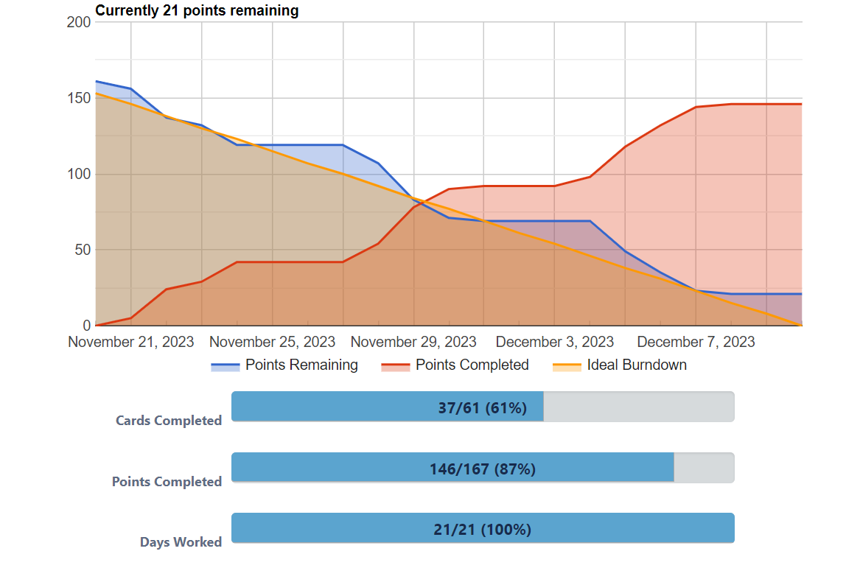
FINAL BURNDOWN CHART
SPRINT REVIEW

Slide 15
CONCLUSIONS
APPLICATION FEATURES
NOT IMPLEMENTED FEATURES
The application allows you to create actions (simple or compound) and triggers (simple or composed of logical operations between multiple triggers).
The user can associate triggers and actions within rules, which can be always active, periodic and which must be triggered only once.
Rules can be put into active or inactive status, as well as modified.
Counters can also be created, which the user can use and modify within specific triggers and actions.
it is also possible to save all the rules within a file, so that they will already be present the next time the application is started
As can also be seen in the burndown chart of the last sprint, it was not possible to complete all the user stories. In fact, as required by the scrum methodology, priority was given to the user stories to which the product owner assigned higher value points.
22) As customer, I want a graphical user interface.
Therefore, the following user story remained missing from the implementation, to which the product owner assigned the lowest priority.

Slide 16
THANKS!

