Slide 1
Continual Learning Strategies and Avalanche
Federico Giannini
Ph.D. Student
DEIB – Politecnico di Milano
federico.giannini@polimi.it

Slide 2
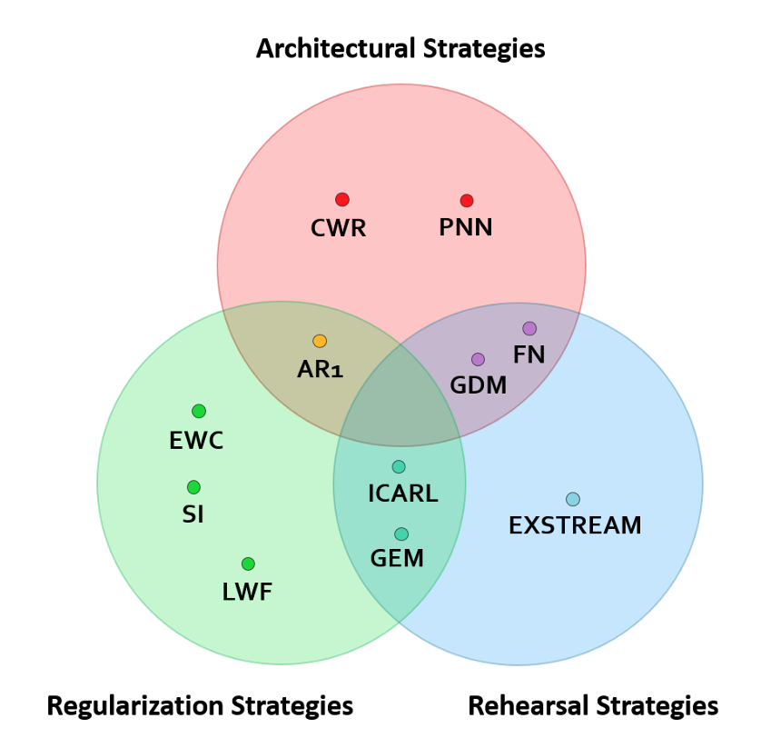
The most popular CL strategies
Baselines:
Naïve strategy It simply continues the training on the new experience.
Cumulative During each experience’s training concatenate the current experience’s training set with all the previous ones.
Joint strategy (Offline)
Train the model on all the experiences’ training sets together.
Maltoni, Davide, et al. "Continuous learning in single-incremental-task scenarios." Neural Networks 116 (2019): 56-73.

Slide 3
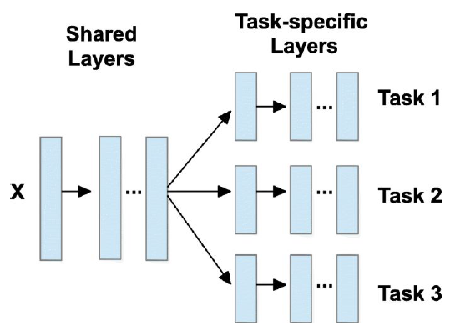
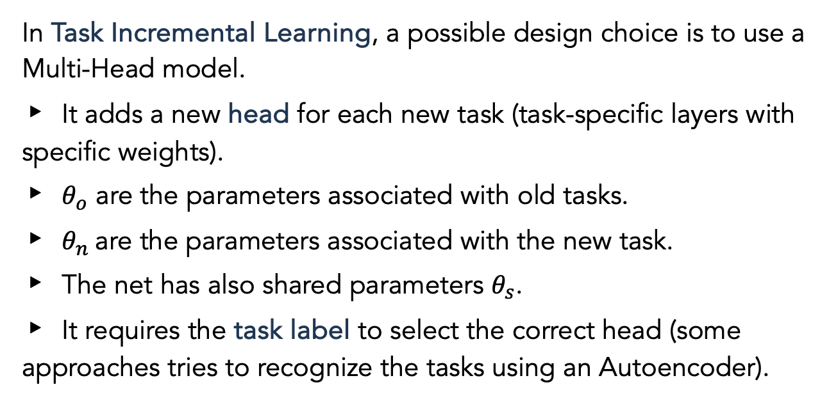
Task Incremental Learning: Multi-Head models
In Task Incremental Learning, a possible design choice is to use a Multi-Head model.
It adds a new head for each new task (task-specific layers with specific weights).
$θ_{o}$ are the parameters associated with old tasks.
$θ_{n}$are the parameters associated with the new task.
The net has also shared parameters $θ_{s}$.
It requires the task label to select the correct head (some approaches tries to recognize the tasks using an Autoencoder).
Thung, K., et al. "A brief review on multi-task learning." Multimedia Tools and Applications 77 (2018): 29705-29725.

Slide 4
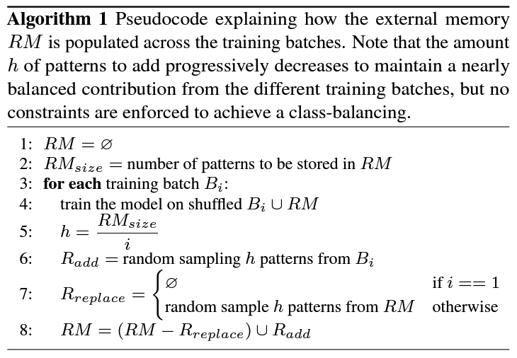
Replay: Random Replay
It uses a fixed-size Random Memory (RM) to store a subset of random previous experiences' data points.
During the training on the i-th experience, it trains the model on the i-th training set shuffled with RM.
RM contains a random subset of the data points of the previous experiences' training sets.
After the training, it randomly substitutes some data points with a random subset of the current experience's training set in RM.
Pellegrini, L., et al. "Latent replay for real-time continual learning." 2020 IEEE/RSJ International Conference on Intelligent Robots and Systems (IROS). IEEE, 2020.

Slide 5
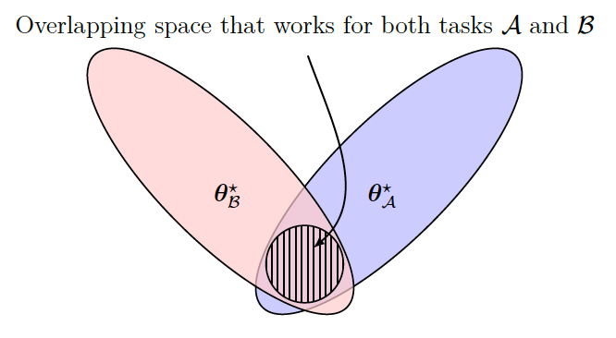
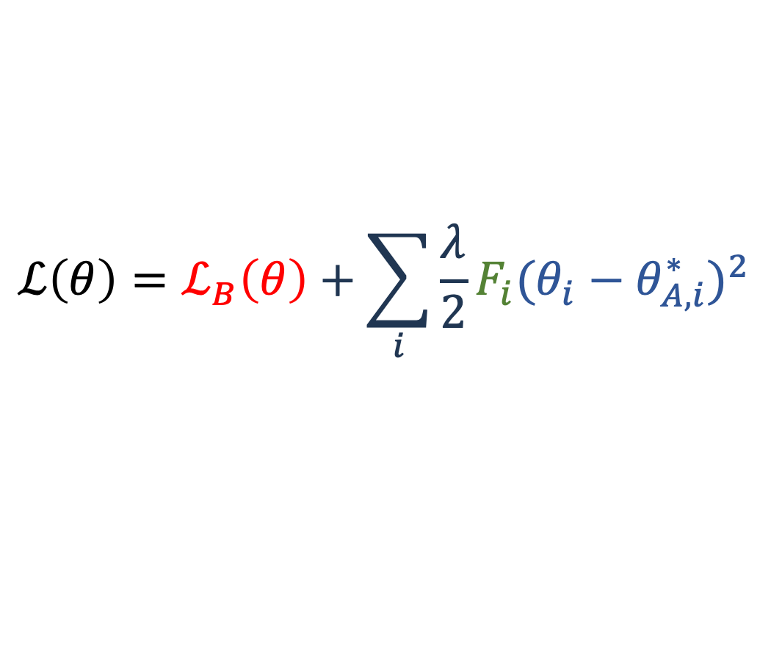
Regularization: Elastic Weight Consolidation (EWC) – 1/2
It adds a regularization term to the loss to penalize changes on important parameters for previous tasks.
The idea is to search the optimal configuration on the overlapping of different tasks’ solution spaces.
Importance index of parameter i for task A
Loss on task B
$$ℒ\left(θ\right)=ℒ_{B}\left(θ\right)+\sum_{i}{\frac{λ}{2}F_{i}{({θ_{i}−θ}_{A,i}^{∗})}^{2}}$$
Distance between the current value of parameter i and the optimal one for task A.
Adding the weighted distance means that we want to minimize it for important parameters.
Kirkpatrick, J., et al. Overcoming catastrophic forgetting in neural networks. CoRR abs/1612.00796 (2016)

Slide 6
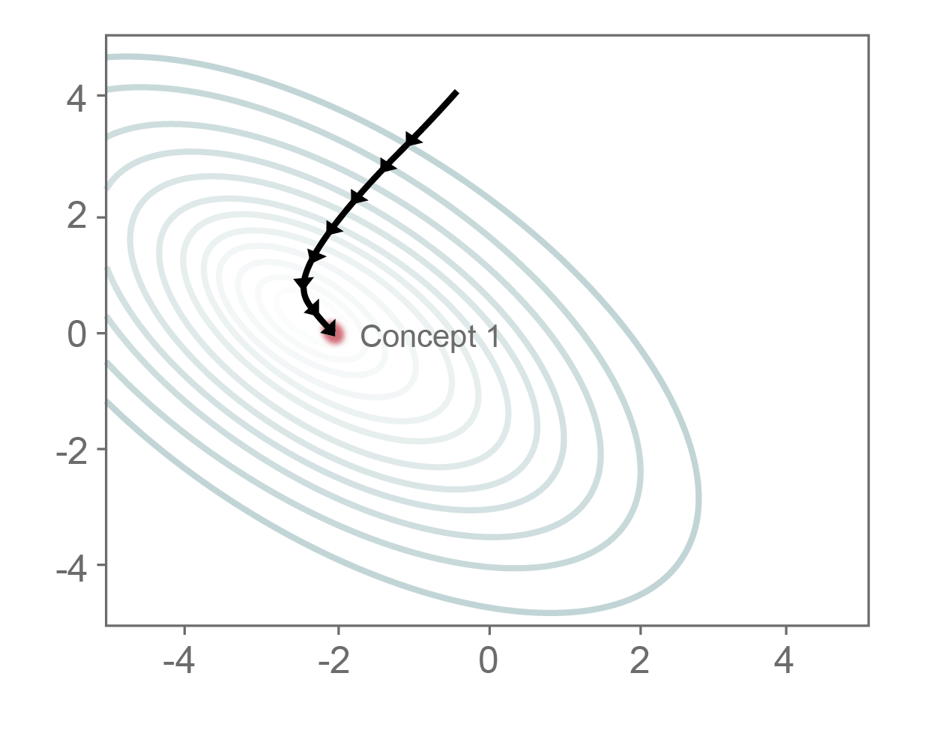
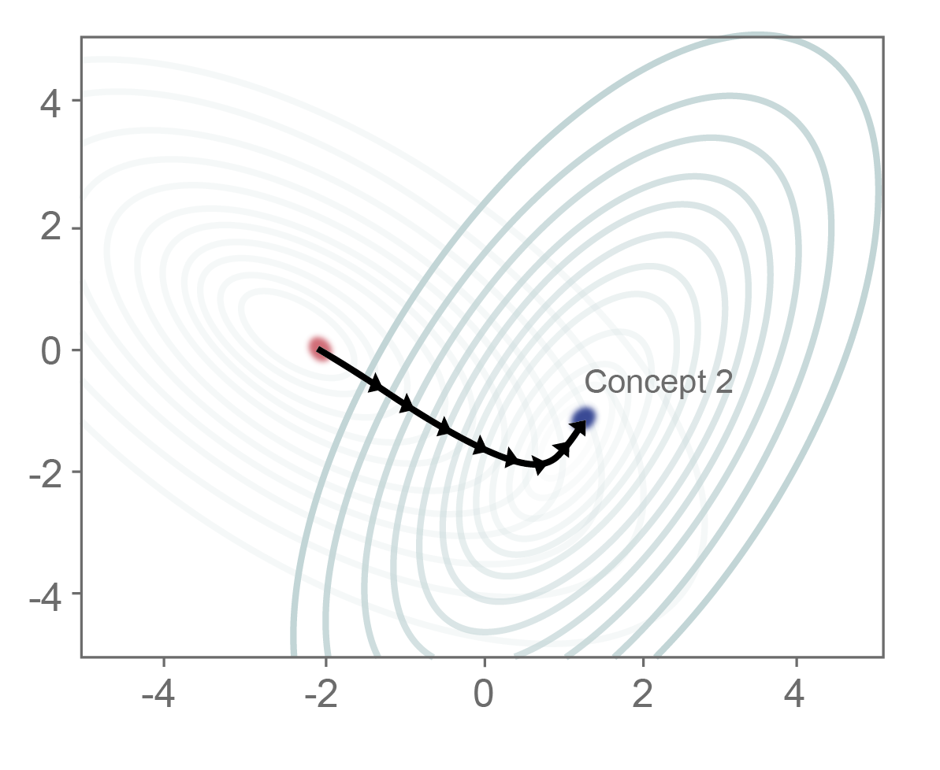
Regularization: Elastic Weight Consolidation (EWC) – 2/2
Optimizing very different tasks together could result in not finding a good trade-off:
Some tasks may perform well, while others badly.
In the worst scenario, we could find a solution that does not fit all the tasks.
EWC results, in fact, in a tug-of-war over the direction of change of each task.
Kirkpatrick, J., et al. Overcoming catastrophic forgetting in neural networks. PNAS, 2017
AICH, Abhishek. Elastic weight consolidation (EWC): Nuts and bolts. arXiv, 2021.

Slide 7
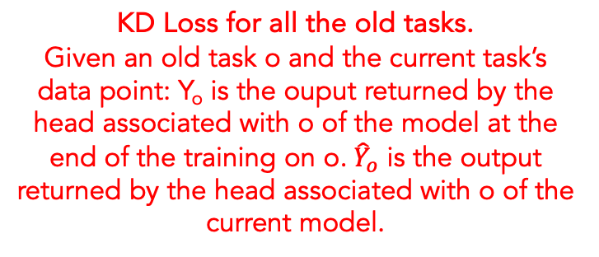
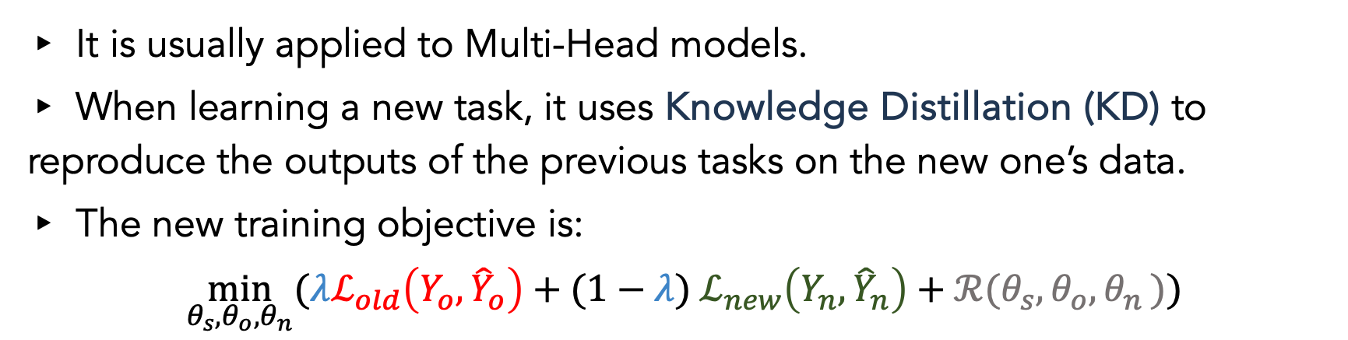
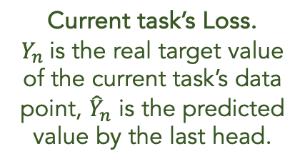
Regularization: Learning without Forgetting (LwF) – 1/2
It is usually applied to Multi-Head models.
When learning a new task, it uses Knowledge Distillation (KD) to reproduce the outputs of the previous tasks on the new one’s data.
The new training objective is:
$$\min_{θ_{s},θ_{o}{,θ}_{n}}{(λℒ_{old}\left(Y_{o},{\hat{Y}}_{o}\right)+(1−λ) ℒ_{new}\left(Y_{n},{\hat{Y}}_{n}\right)+ℛ(θ_{s},θ_{o}{,θ}_{n}))}$$
KD Loss for all the old tasks. Given an old task o and the current task’s data point: Y_{o} is the ouput returned by the head associated with o of the model at the end of the training on o. ${\hat{Y}}_{o}$ is the output returned by the head associated with o of the current model.
Weighted sum’s coefficient that indicates the relevance of the KD loss.
Current task’s Loss. $Y_{n}$is the real target value of the current task’s data point, ${\hat{Y}}_{n}$ is the predicted value by the last head.
Regularization term
Li, Z, et al. "Learning without forgetting." IEEE transactions on pattern analysis and machine intelligence 40.12 (2017): 2935-2947.

Slide 8
Regularization: Learning without Forgetting (LwF) – 2/2
The loss function combines two objectives:
Reproducing the old tasks’ outputs on the previous heads.
Learning the new task’s classifications.
It can suffer from the EWC problems if the tasks classification problems are different.
It does not require storing the previous data (it only uses the current task’s dataset).
It must store the old tasks’ models to reproduce their outputs.
There is also a version that deals with a single head and no task labels.
Li, Z, et al. "Learning without forgetting." IEEE transactions on pattern analysis and machine intelligence 40.12 (2017): 2935-2947.

Slide 9
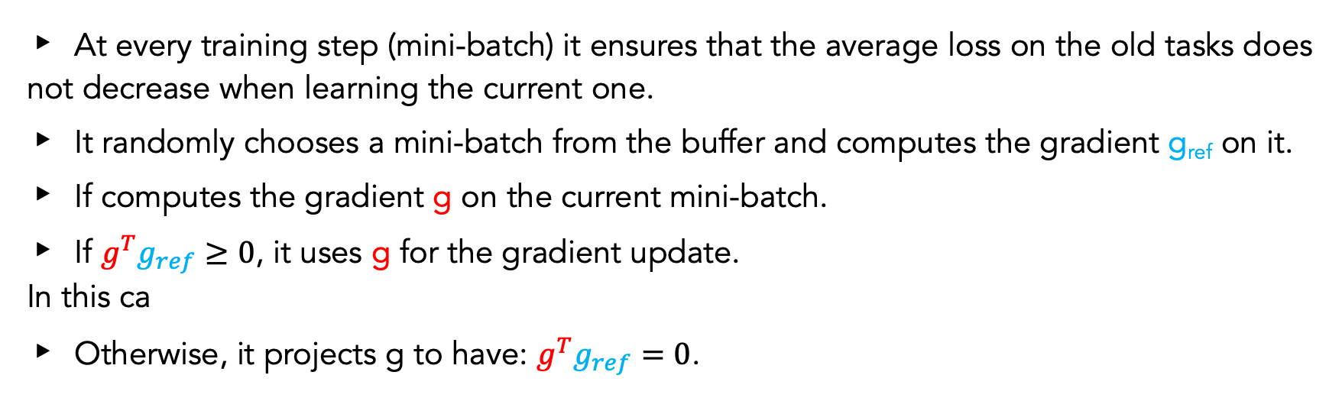
Replay+Regularization: Average Gradient Episodic Memory (AGEM)
At every training step (mini-batch) it ensures that the average loss on the old tasks does not decrease when learning the current one.
It randomly chooses a mini-batch from the buffer and computes the gradient g_{ref} on it.
If computes the gradient g on the current mini-batch.
If ${g^{T}g}_{ref}≥0$, it uses g for the gradient update. In this ca
Otherwise, it projects g to have: ${g^{T}g}_{ref}=0$.
A. Chaudhry, et al. Efficient lifelong learning with a-GEM, in: International Conference on Learning Representations, 2019.

Slide 10
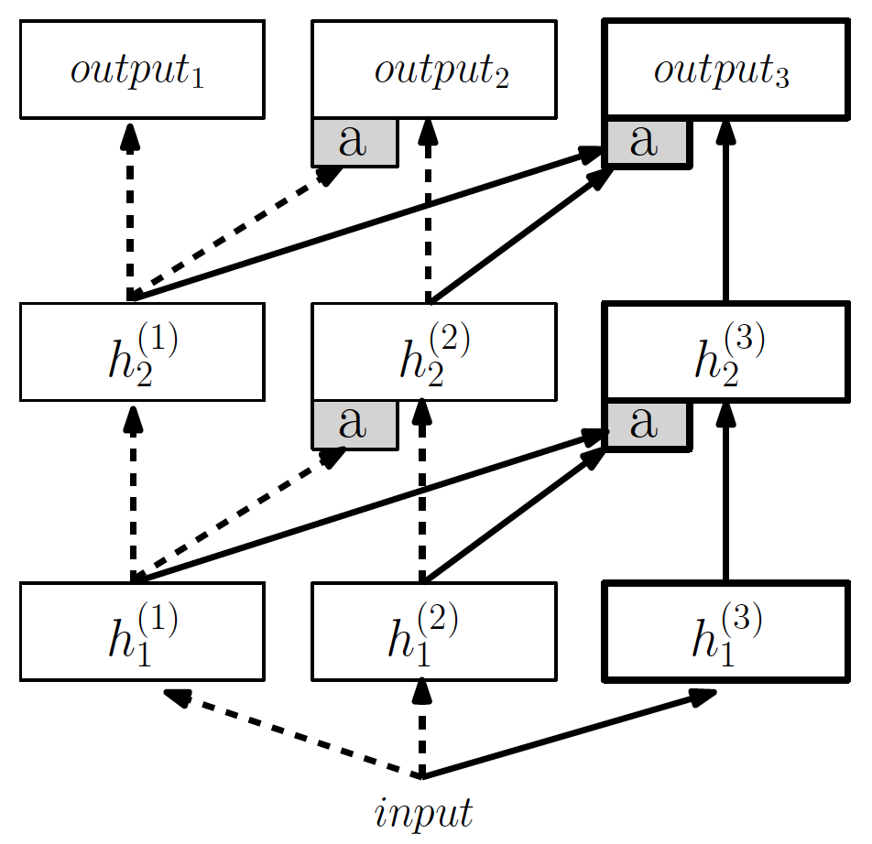
Architectural: Progressive Neural Networks (PNN)
The architecture starts with a single Neural Network (column).
Whenever a new task appears:
It freezes the parameters of the old columns.
It adds a new column to the architecture.
The hidden layer i (i>1) of the column k receives:
The output of the hidden layer i-1 of the column k
The outputs of the hidden layers i-1 of all the previous column j (j<k).
It uses transfer learning to combine the knowledge of the previous tasks with that acquired directly from the current task.
It reuses useful old knowledge and old columns are frozen to avoid CF.
As the Multi-Head models, it needs to know the current task’s label.
Rusu, A.A et al. Progressive neural networks. CoRR abs/1606.04671 (2016)

Slide 11
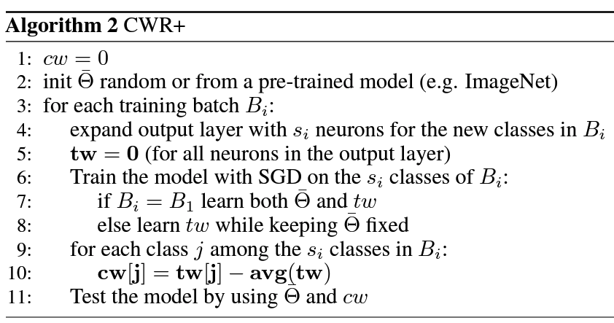
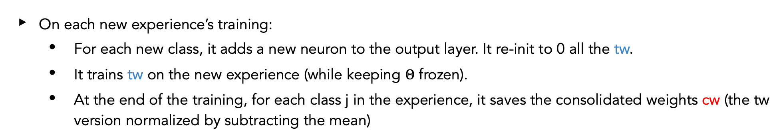
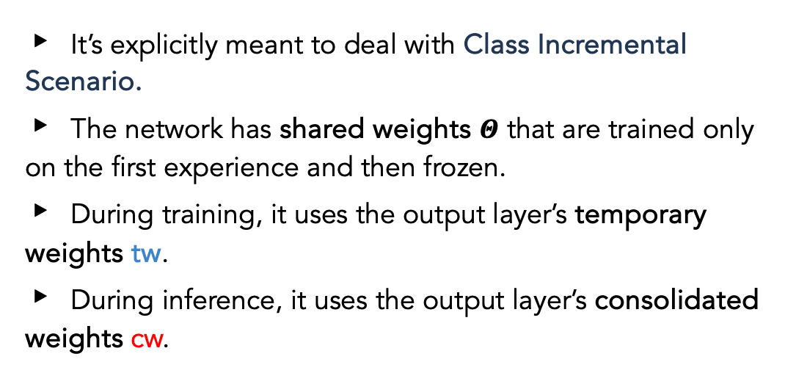
Architectural: Copy Weights with Re-init+ (CWR+)
It’s explicitly meant to deal with Class Incremental Scenario.
The network has shared weights $Θ$ that are trained only on the first experience and then frozen.
During training, it uses the output layer’s temporary weights tw.
During inference, it uses the output layer’s consolidated weights cw.
On each new experience’s training:
For each new class, it adds a new neuron to the output layer. It re-init to 0 all the tw.
It trains tw on the new experience (while keeping $Θ$ frozen).
At the end of the training, for each class j in the experience, it saves the consolidated weights cw (the tw version normalized by subtracting the mean)
Maltoni, Davide, et al. "Continuous learning in single-incremental-task scenarios." Neural Networks 116 (2019): 56-73.

Slide 12

Avalanche
It is an end-to-end library based on Pytorch with the goal of providing a codebase for CL:
fast prototyping
training
reproducible evaluation of algorithms.
Born within ContinualAI with the goal of providing a shared and collaborative open-source codebase.
https://avalanche.continualai.org/

Slide 13
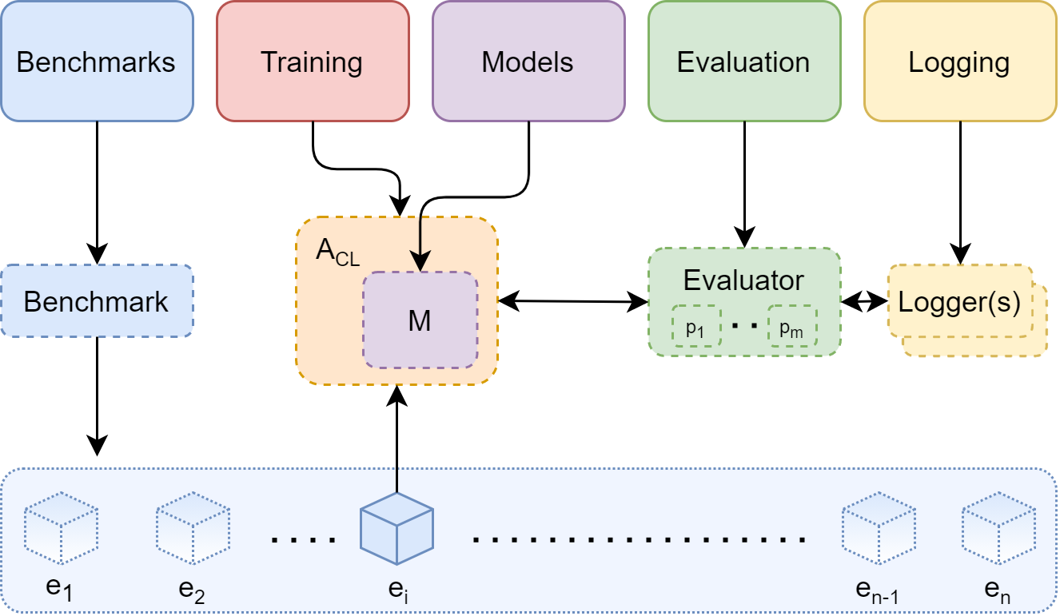
Avalanche’s Modules
Benchmarks: It provides data handling. You can generate a data stream from one or more datasets. It contains all the standard benchmarks.
Training: It provides model training. You can implement new CL strategies as well as use a set pre-implemented CL baselines and state-of-the-art algorithms.
Evaluation: It provides all the utilities and metrics that can help in evaluating.
Models: It contains several model architectures and pre-trained models.
Logging: It includes advanced logging and plotting features, including native stdout, file and Tensorboard support.
https://avalanche.continualai.org/

Slide 14



And now… Let’s have some fun!

