Slide 1
Time-series Analytics
Giacomo Ziffer
Politecnico di Milano

Slide 2
Decomposition & Detrending

Slide 3

Let’s change perspective
Photo by Chokniti Khongchum from Pexels
Giacomo Ziffer

Slide 4
Thinking …
If
  stationary implies predictable
and
  changes in mean, variance
  presence of seasonality
  imply non-stationary
can we try to remove what causes of non-stationarity?

Slide 5
Thinking …
If
  stationary implies predictable
and
  changes in mean, variance
  presence of seasonality
  implies non-stationary
can we try to remove what causes of non-stationarity?
YES! Decomposing a time series

Slide 6
Time Series Decomposition

Slide 7
Time-Series Components
Time Series
Trend Component
Seasonal Component
Residual Component
⊗
⊗
Overall, persistent,
long-term change
Regular periodic fluctuations
Residual fluctuations
(hopefully stationary)
⊗ this charather is a placeholder for various mathematical operation used to assemble the components

Slide 8
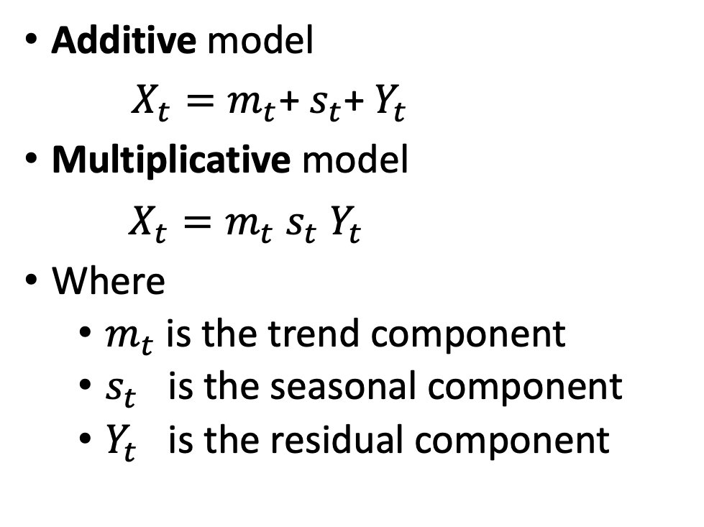
Models to decompose time series:
Additive model
$X_{t}=m_{t}$+ $s_{t}$+ $Y_{t}$
Multiplicative model
$X_{t}=m_{t}$ $s_{t}$ $Y_{t}$
Where
  $m_{t}$ is the trend component
  $s_{t}$ is the seasonal component
  $Y_{t}$ is the residual component
How to Choose Between Additive and Multiplicative Decompositions
  The additive model is useful when the seasonal variation is relatively constant over time.
  The multiplicative model is useful when the seasonal variation increases over time.
Giacomo Ziffer

Slide 9

Let’s first go black-box
Giacomo Ziffer

Slide 10


Use statsmodels as a black-box able to decompose a time-series
Try both methods
  Additive
  Multiplicative
NOTE: for more information check out https://www.statsmodels.org/stable/examples/notebooks/generated/statespace_seasonal.html

Slide 11
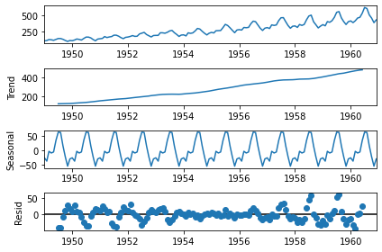
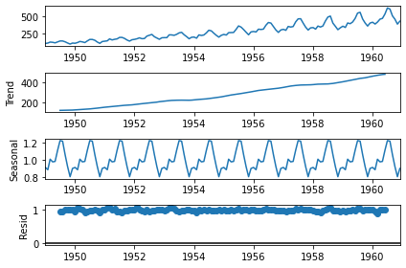
Time series decomposition
A comparison
Additive vs. Multiplicative

Slide 12
Time series decomposition
Let’s see if you are following …
Q: Is additive better than multiplicative?
Q: Why?

Slide 13

Let’s now go white-box
Giacomo Ziffer

Slide 14
Two simplified time series models
Non-seasonal Decomposition Model with Trend
Decomposition Model with Trend and Seasonal Components
X_{t} = m_{t} ⊗ Y_{t}
X_{t} = m_{t} ⊗ s_{t} ⊗ Y_{t}
Time-series
trend
residual
Time-series
trend
seasonal
residual
components
components

Slide 15
Non-seasonal Decomposition Models with Trend
There are three basic methods for estimating/removing trend:
Method 1: Trend elimination by differencing
  Differencing one or more times removes the trend
Method 2: Trend estimation by model fitting & removal
  We estimate the trend fitting a model and then we remove it
Method 3: Trend estimation by using “centered” moving averages
  We estimate the trend using a “centered” moving average and we remove it

Slide 16
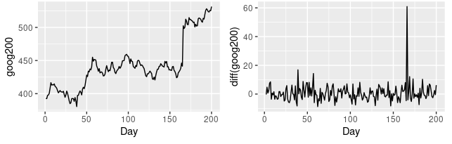
Non-seasonal Decomposition Models with Trend - Method 1
Trend elimination by differencing
Differencing of a time series { 𝑋_{𝑡} } in discrete time t is the transformation of the series to a new time series { D_{𝑡} } where the values are the differences between consecutive values of { 𝑋_{𝑡} } .
d_{𝑡} = x_{𝑡} - x_{𝑡 - 1}

Slide 17
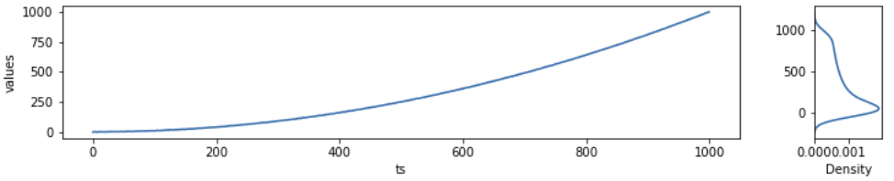
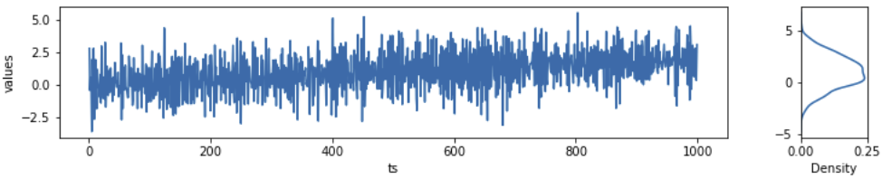
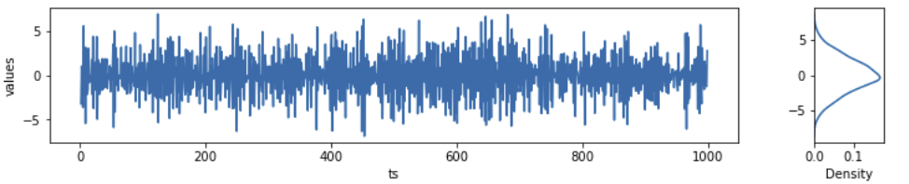
Non-seasonal Decomposition Models with Trend - Method 1
Trend elimination by differencing (cont.)
If a trend is linear differencing once is sufficient to remove it
If a trend is quadratic, you need two difference twice
If a trend can be model with a polynomial of order n, then you need to difference n times
original
diff once
diff twice

Slide 18
Non-seasonal Decomposition Models with Trend - Method 1
Trend elimination by differencing
Generate synthetic data
Differencing one to remove a linear trend
Differencing twice to remove a quadratic trend

Slide 19
Non-seasonal Decomposition Models with Trend - Method 2
Trend estimation by model fitting & removal
X_{t} = b₀ + b₁t
X_{t} = b₀ + b₁t + b₂t²
X_{t}
X_{t}
t
t
Downward linear trend
Upward quadratic trend

Slide 20
Non-seasonal Decomposition Models with Trend - Method 2
Trend estimation by model fitting & removal
Generate synthetic data
Fit a linear regression
Fit a quadratic regression

Slide 21
Non-seasonal Decomposition Models with Trend Combining Method 1 and 2
Generate synthetic data with quadratic trend
Differentiate
Observe the time-series still shows a trend
Detrend fitting a linear Regression

Slide 22
Decomposition Models with Trend and Seasonality
There are three basic methods for estimating/removing the trend and seasonal components:
Method 1 – Differencing
  First we difference one or mote time to remove the trend
  Then we perform “seasonal differencing” to directly removes the season
Method 2 - Filtering
  First we estimate and remove the trend using a “centered” moving average
  then we estimate and remove the seasonal component using “periodic averages”
Method 3 - Joint-fit method
  fitting a combined polynomial and dynamic harmonic regression

Slide 23
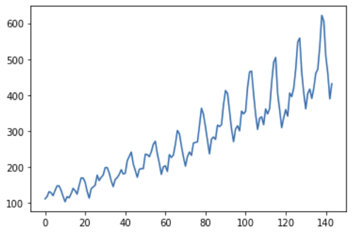
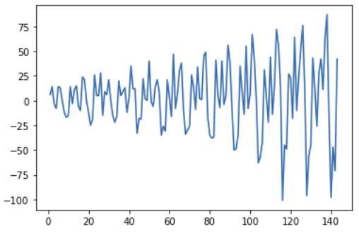
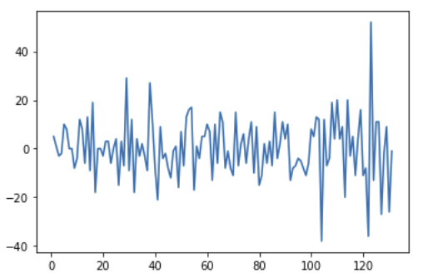
Decomposition Models with Trend and Seasonality - Method 1
Seasonal differencing
Seasonal differencing of a time series { 𝑋_{𝑡} } in discrete time t given the seasonality’s period d is the transformation of the series to a new time series { S_{𝑡} } where the values are the differences between the value of
{ 𝑋_{𝑡} } at time t and the the value of { 𝑋_{𝑡} } a period d before.
s_{𝑡} = x_{𝑡} - x_{𝑡 - d}
original
diff once
seasonal diff

Slide 24
Decomposition Models with Trend and Seasonality - Method 1
Seasonal differencing
Generate synthetic data using a sine form
Apply ”seasonal differencing”
Observe you removed the seasonality

Slide 25
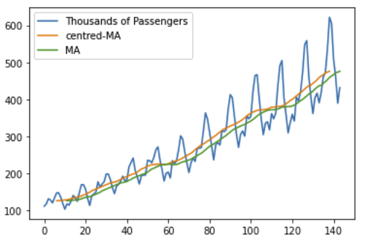
Decomposition Models with Trend and Seasonality - Method 2
Estimate the trend using “centered” moving average
Given the seasonality’s period d
  If d is even, the «centered» moving average is defined as
  If d is odd, the «centered» moving average is defined as
Notes:
  there are no values for either the first q or the last q data
  points, because we do not have enough observations on
  either side to define the moving average for those values
  of t.
  This «centered» moving average is different from the
  «normal» moving average

Slide 26

Decomposition Models with Trend and Seasonality - Method 2
Estimate the seasonal component
To estimate the seasonal component using “periodic averages”
  Divide the detrended value in seasons of length d
  Compute the seasonal component values w_{k} by averaging each of the d points of the season (i.e., k = 1, …, d)
  Compute adjusted the seasonal component values s_{k} to ensure that they add to zero
  String together the adjusted seasonal component values in a sequence
  Replace the sequence for each season

Slide 27
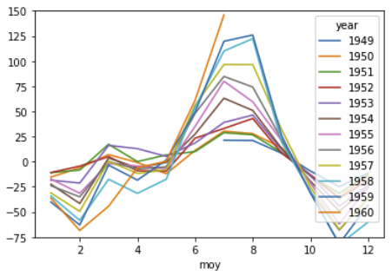
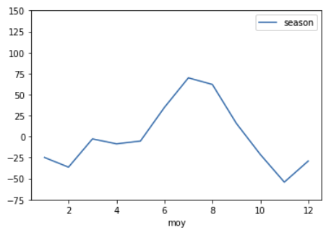
Decomposition Models with Trend and Seasonality - Method 2
Estimate the seasonal component
The case of air travel time-series
Notes:
TODO: add comment!!!

Slide 28
Decomposition Models with Trend and Seasonality - Method 2
Filtering
Load the time series
estimate the trend by the “centered” moving average
Remove the trend from the time series
Estimate the seasonal component using “periodic averages”
Remove it from the detrended series

Slide 29
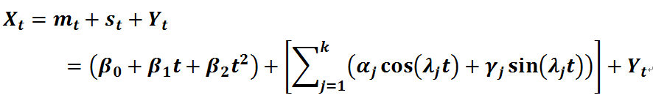
Decomposition Models with Trend and Seasonality - Method 3
Joint-fit method
we can fit a combined polynomial linear regression and harmonic functions to estimate and then remove the trend and seasonal component simultaneously as the following

Slide 30
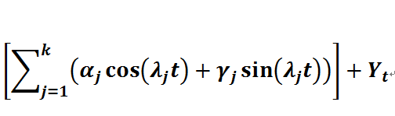
Decomposition Models with Trend and Seasonality - Method 3
Anatomy of the harmonic function
Add k harmonics
sin and cosin deals with phases of the partials
Number of the armonic
Coefficients gives energies to the partial

Slide 31
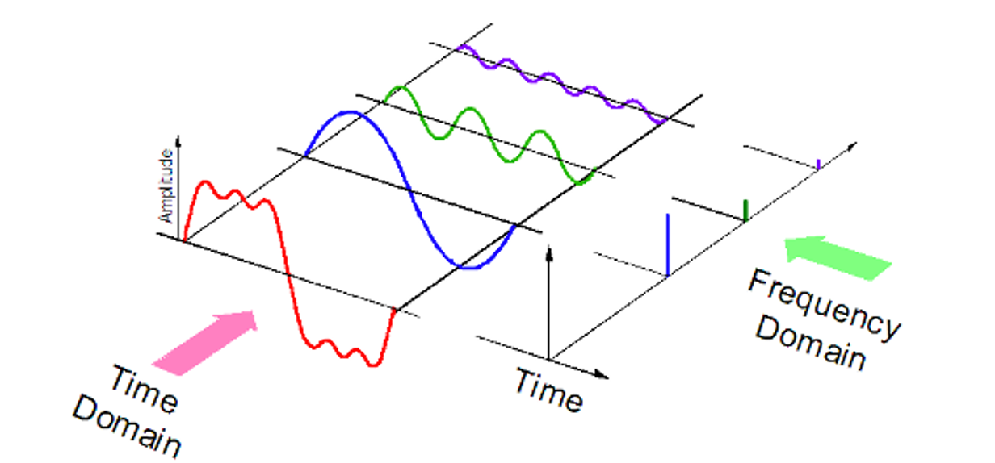
Decomposition Models with Trend and Seasonality - Method 3
Intuitively ….
[src: https://kinder-chen.medium.com/denoising-data-with-fast-fourier-transform-a81d9f38cc4c ]

Slide 32
Decomposition & Detrending
Quiz

Slide 33
Time-series Analytics
Giacomo Ziffer
Politecnico di Milano

