Slide 1
Streaming Machine Learning Classification
Alessio Bernardo
Post-doc @ Politecnico di Milano
CTO & Co-founder @ Motus ml

Slide 2
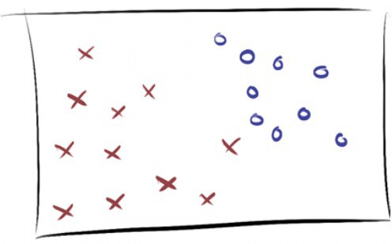
SML Classification models

Slide 3
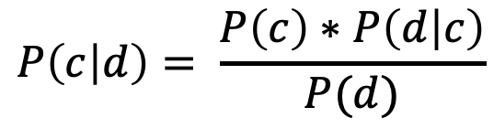
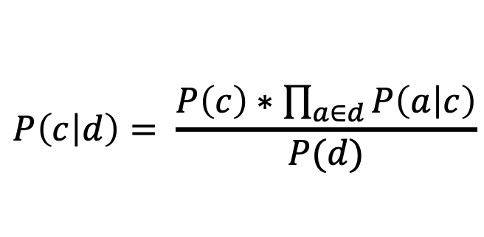
Naïve Bayes
Based on Bayes Theorem, where 𝑐 is the class and 𝑑 is the instance to classify:
$$P\left(c | d\right)= \frac{P\left(c\right)∗P\left(d | c\right)}{P(d)}$$
Estimate the probability of observing attribute 𝑎 and the prior probability 𝑃(𝑐):
$$P\left(c | d\right)= \frac{P\left(c\right)∗\prod_{a∈d}{P\left(a | c\right)}}{P(d)}$$
John, G. H., & Langley, P. Estimating continuous distributions in Bayesian classifiers. arXiv preprint 2013.

Slide 4
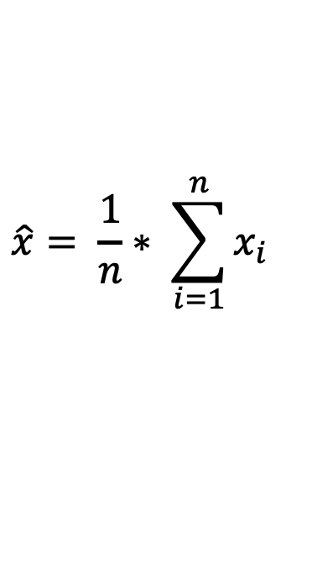
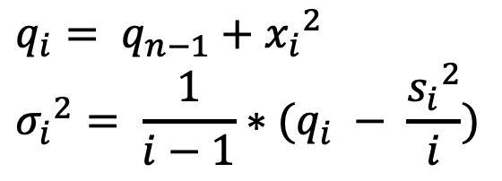
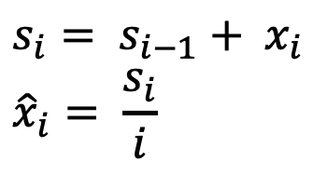
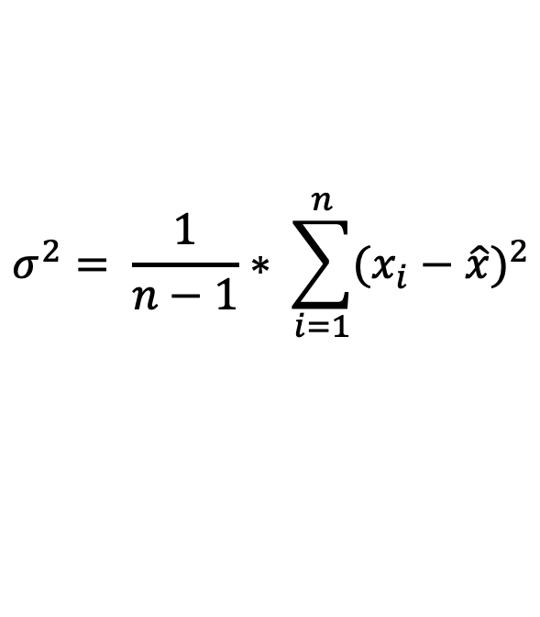
Naïve Bayes
Mean and Variance with a batch of n samples
$$\hat{x}= \frac{1}{n}∗ \sum_{i=1}^{n}{x_{i}}$$
$$σ^{2}= \frac{1}{n−1}∗ \sum_{i=1}^{n}{{(x_{i}−\hat{x})}^{2}}$$
Mean and Variance with a stream 𝒙_{𝟏}, … , 𝒙_{𝒊}, … , 𝒙_{𝒏}
$$s_{i}= s_{i−1}+ x_{i} \\ {\hat{x}}_{i}= \frac{s_{i}}{i}$$
$$q_{i}= q_{n−1}+{x_{i}}^{2} \\ {σ_{i}}^{2}= \frac{1}{i−1}∗(q_{i} − \frac{{s_{i}}^{2}}{i})$$
John, G. H., & Langley, P. Estimating continuous distributions in Bayesian classifiers. arXiv preprint 2013.

Slide 5





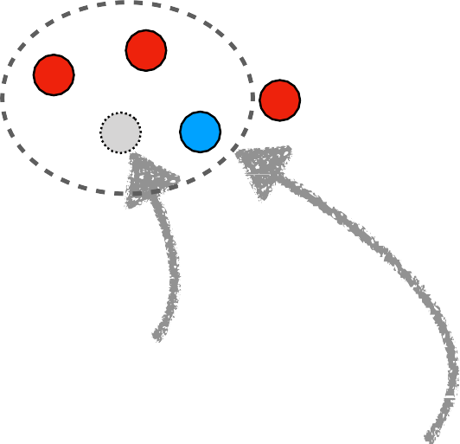
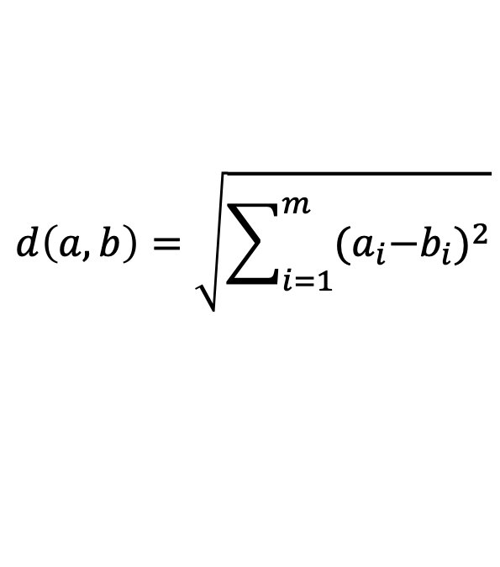
K-Nearest Neighbours (KNN)
The most common label of the k instances closer to a new instance determines its label
The distance between instances is calculated (commonly) using the Euclidean Distance:
$$d\left(a,b\right)=\sqrt{\sum_{i=1}^{m}{{{(a}_{i}−b_{i})}^{2}}}$$
New Instance
3 nearest neighbours
Predict
as class label
Bifet, A., Pfahringer, B., Read, J., & Holmes, G. Efficient data stream classification via probabilistic adaptive windows. ACM symposium on applied computing, 2013

Slide 6



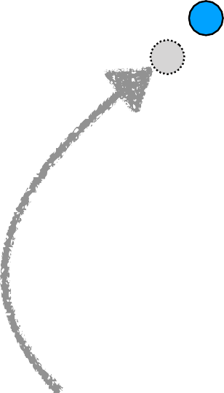
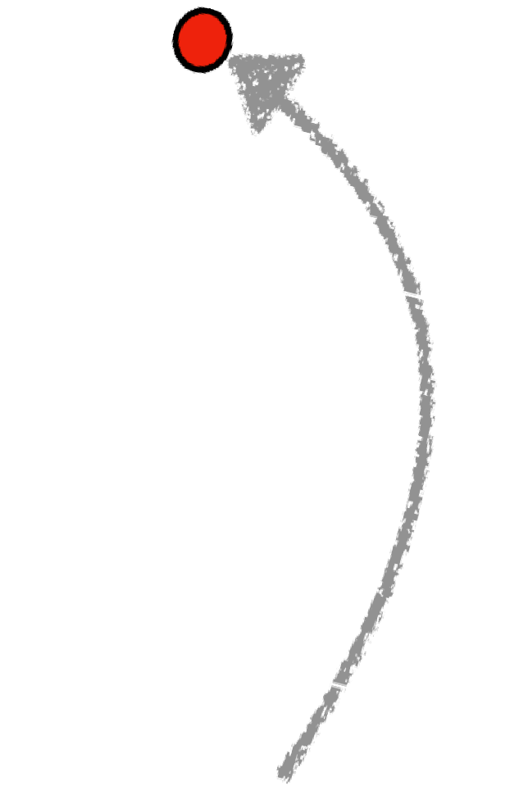
Online K-Nearest Neighbours (KNN)
Use a fixed size sliding window to save the instances
Time t, w = 12
Time t+1
Forgot the oldest instance
Latest instance added
Bifet, A., Pfahringer, B., Read, J., & Holmes, G. Efficient data stream classification via probabilistic adaptive windows. ACM symposium on applied computing, 2013

Slide 7
Online KNN with ADWIN (KNN-ADWIN)
If a concept drift occurs, with KNN there is the risk that the instances saved into the window belong to the old concept
Use ADWIN to automatically set the size of the sliding window to save the instances
Bifet, A., Pfahringer, B., Read, J., & Holmes, G. Efficient data stream classification via probabilistic adaptive windows. ACM symposium on applied computing, 2013

Slide 8
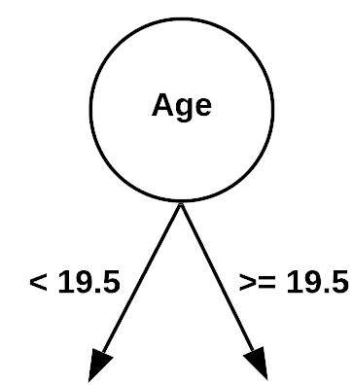



Decision Trees
Recommending drinks
Which feature best determines the drink?
Age
Gender | Age | Drink
F | 13
M | 13
F | 23
M | 32
F | 42
M | 16
https://en.wikipedia.org/wiki/Decision_tree_learning

Slide 9
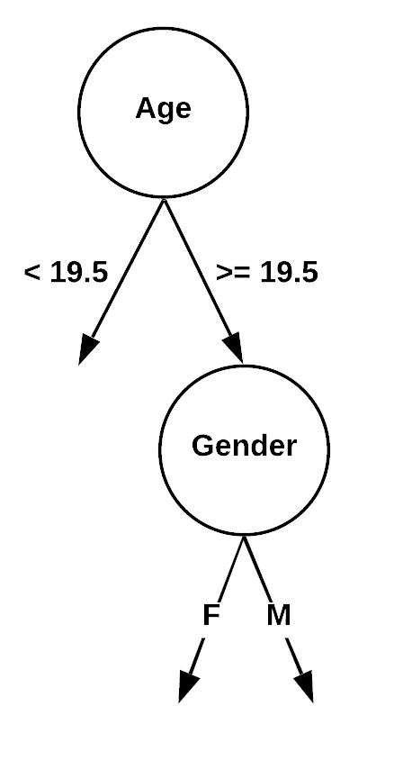
Decision Trees
Recommending drinks
Which feature best determines the drink?
Age
Gender | Age | Drink
F | 13
M | 13
F | 23
M | 32
F | 42
M | 16
https://en.wikipedia.org/wiki/Decision_tree_learning

Slide 10
Decision Trees
Each node tests a features
Each branch represents a value
Each leaf assigns a class
Greedy recursive induction:
Sort all examples through tree
Xi = most discriminative attribute using the Gini index or Information Gain (H)
New node for Xi, new branch for each value, leaf assigns majority class
Stop if no error or limit on #instances
https://en.wikipedia.org/wiki/Decision_tree_learning

Slide 11
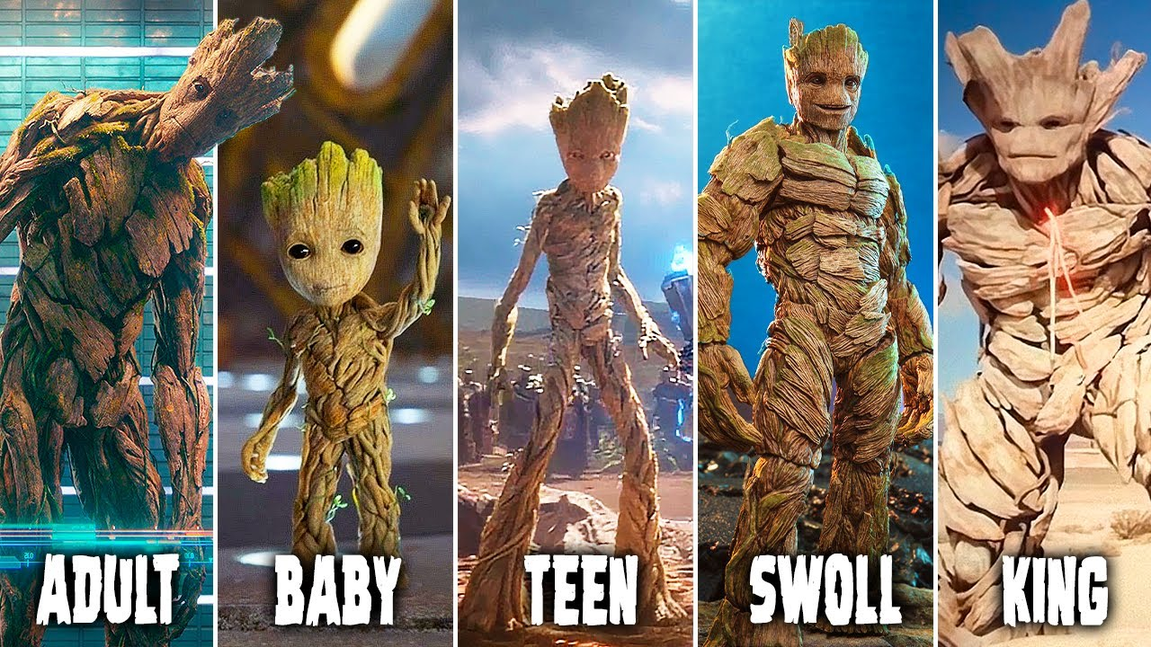
Hoeffding Trees (VFDT)
Build the decision tree incrementally
The final tree must be identical (with high probability) to a tree built using a batch decision tree algorithm
With theoretical guarantees on the error rate
src: https://www.bilibili.tv/en/video/4787736782838275
Pedro Domingos and Geoff Hulten. Mining high-speed data streams. 2000

Slide 12
Hoeffding Trees (VFDT)
Which attribute to choose at each splitting node?
A small sample can often be enough to choose the optimal splitting attribute
Collect sufficient statistics from a small set of examples
Estimate the merit of each attribute
How large should be the sample?
Fixed size: defined a-priori without looking for the data
src: https://www.bilibili.tv/en/video/4787736782838275
Pedro Domingos and Geoff Hulten. Mining high-speed data streams. 2000

Slide 13


Hoeffding Trees (VFDT)
Which attribute to choose at each splitting node?
A small sample can often be enough to choose the optimal splitting attribute
Collect sufficient statistics from a small set of examples
Estimate the merit of each attribute
How large should be the sample?
Fixed size: defined a-priori without looking for the data
Moving size: Choose the sample size that allow to differentiate between the alternatives.
src: https://www.bilibili.tv/en/video/4787736782838275
Pedro Domingos and Geoff Hulten. Mining high-speed data streams. 2000

Slide 14
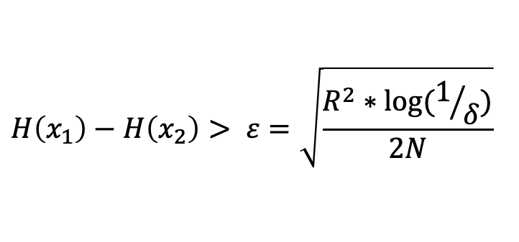
Hoeffding Trees (VFDT)
Moving size: Use Hoeffding bound to guarantee that the best attribute is really the best:
Let X₁ and X₂ be, respectively, the two most informative attribute
Split if:
where R is the H range, 𝛿 is the confidence bound and N is the number of instances seen by that node
$$H\left(x_{1}\right)−H\left(x_{2}\right)> ε=\sqrt{\frac{R^{2}∗\log{(1/δ)}}{2N}}$$
src: https://www.bilibili.tv/en/video/4787736782838275
Pedro Domingos and Geoff Hulten. Mining high-speed data streams. 2000

Slide 15
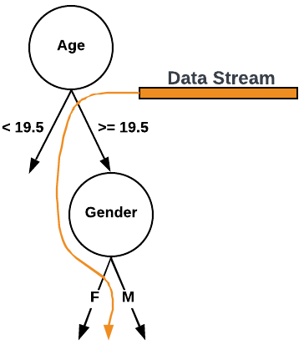
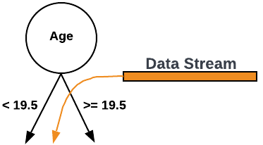

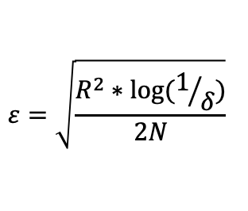
Hoeffding Trees (VFDT)
3 samples
$$H\left(Gender\right)−H\left(Age\right)> ε$$
$$ε=\sqrt{\frac{R^{2}∗\log{(1/δ)}}{2N}}$$
6 samples
Attributes:
Age
Gender
Label: Drink

Slide 16
Concept Adapting VFDT (CVFDT)
What happens when a concept drift occurs?
The nodes are no longer representative of the current concept
CVFDT keeps its model consistent with a sliding window of w samples
It constructs “alternative branches” as preparation for changes
If the alternative branch becomes more accurate, switch of tree branches
Cons:
No theoretical guarantees on the error rate of CVFDT
W is fixed
src: https://giphy.com/gifs/dance-dancing-groot-JwTqLNfrx4OPe
G. Hulten, L. Spencer, and P. Domingos. Mining time-changing data streams. 2001

Slide 17
Hoeffding Adaptive Tree (HAT)
Replace frequency statistics counters by estimators
Don’t need a window to store examples, since it maintains the statistics data needed with estimators
Change the way of checking the substitution of alternate subtrees, using a change detector with theoretical guarantees (ADWIN)
Keeps sliding window consistent with the no-change hypothesis
Pro:
Theoretical guarantees
No Parameters
src: https://giphy.com/gifs/dance-dancing-groot-JwTqLNfrx4OPe
A. Bifet, R. Gavald`a. Adaptive Parameter-free Learning from Evolving Data Streams. IDA, 2009

Slide 18
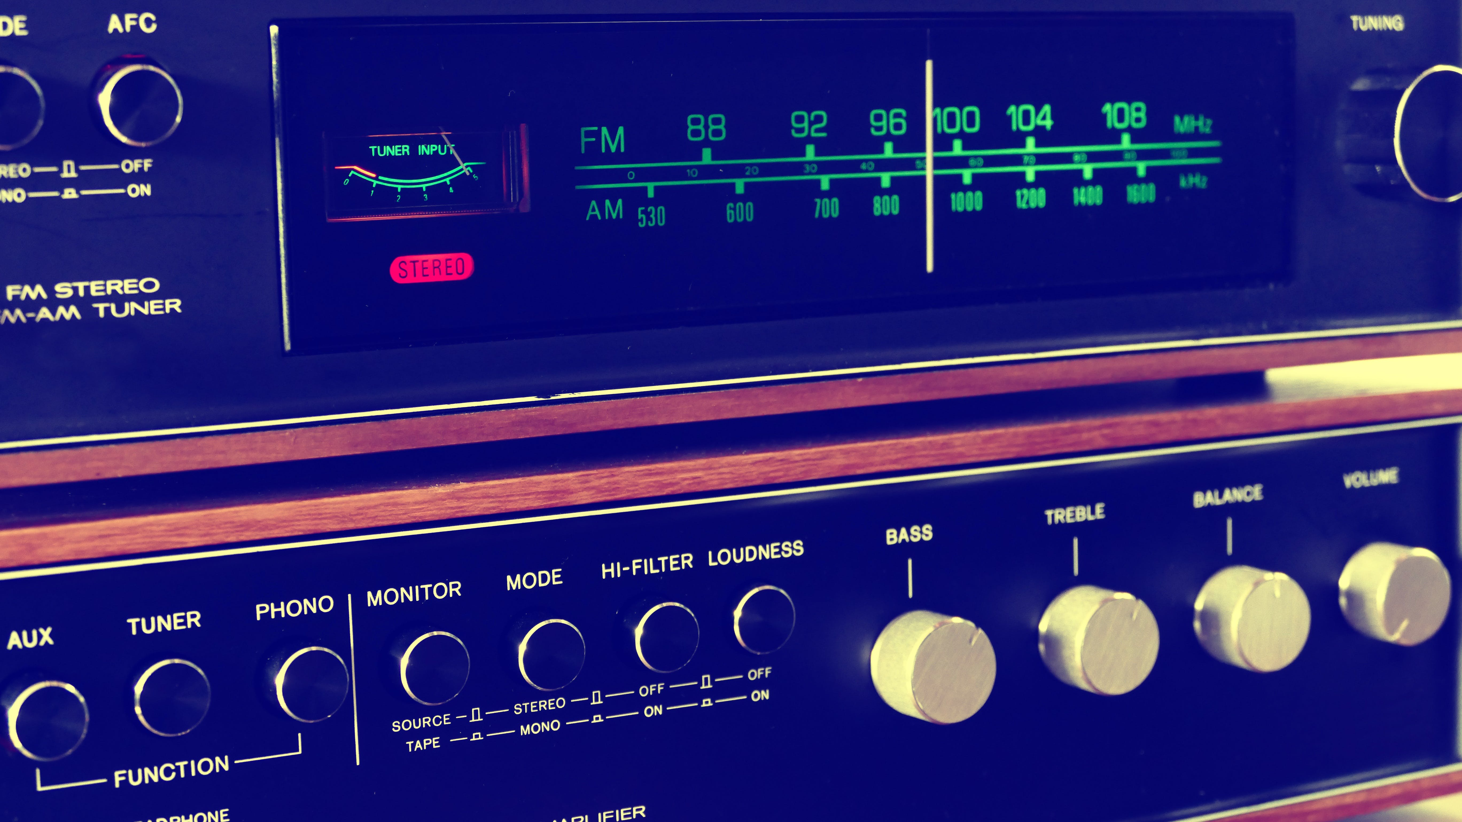
CASH problem and AutoML
CASH problem: Combined Algorithm Selection and Hyperparameter.
AutoML aims to automate the data mining pipeline:
Data cleaning
Feature engineering
Algorithm selection
Hyperparameters tuning
Different implementations with different search spaces and hyperparameter optimizations:
Auto Weka 2.0
Autosklearn
TPOT
GAMA
H2O
src: https://www.pexels.com/it-it/foto/radio-a-transistor-grigia-e-nera-157557/

Slide 19
CASH problem with SML
CASH solution does not consider the adaptation of parameters in an evolving data stream.
Actual applications to a streaming scenario:
Train AutoML only the first portion of the data stream
Retrain AutoML from scratch after a concept drift
Computational expensive
Large number of parallel trainings
Only consider algorithm selection

Slide 20
EvoAutoML
It naturally adapts the population of algorithms and configurations
It avoids expensive retraining
It addresses the Online CASH problem by finding the joint algorithm combination and hyperparameter setting that minimizes a predefined loss over a stream of data
It considers:
Pipeline structure
Algorithms
Configuration space
It makes predictions by majority voting
C. Kulbach, J. Montiel, M. Bahri, M. Heyden, & A. Bifet. Evolution-Based Online Automated Machine Learning. PAKDD, 2022

Slide 21

Exercise 3: Stream Classification

Slide 22
Credits
Albert Bifet DATA STREAM MINING 2020-2021 course at Telecom Paris
Alessio Bernardo & Emanuele Della Valle

Slide 23
Streaming Machine Learning Classification
Alessio Bernardo
Post-doc @ Politecnico di Milano
CTO & Co-founder @ Motus ml

