Slide 1
Streaming Machine Learning Regression
Alessio Bernardo
Post-doc @ Politecnico di Milano
CTO & Co-founder @ Motus ml

Slide 2
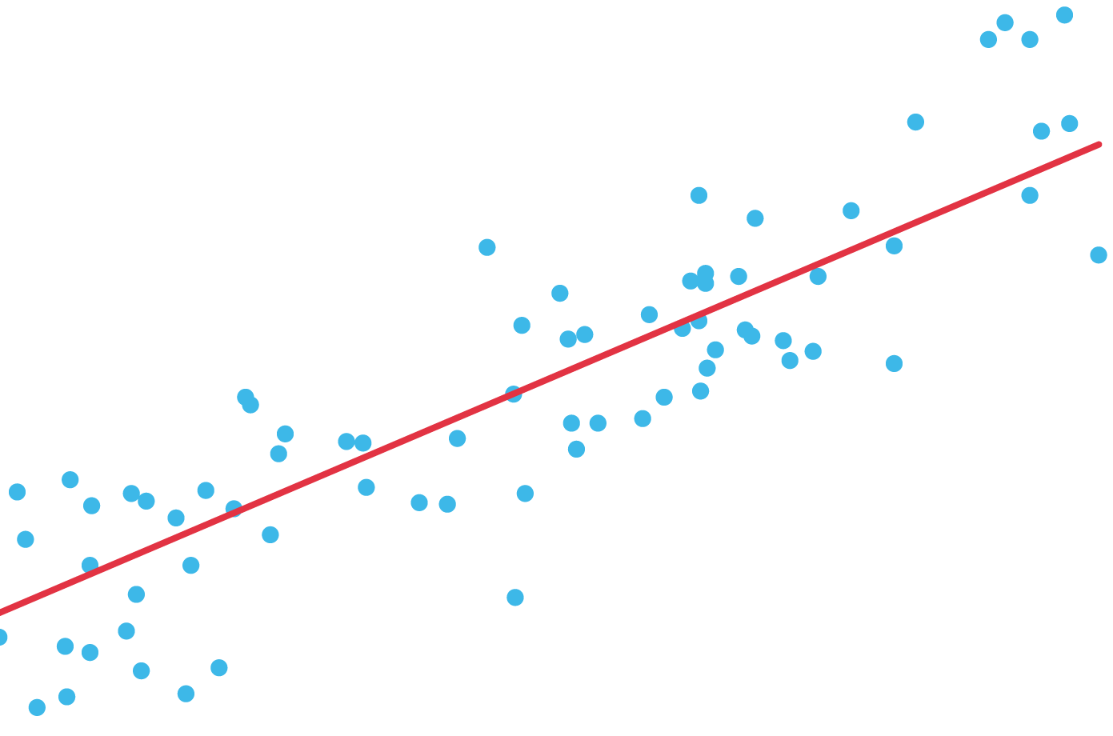
SML Regression models

Slide 3



From Classification to Regression
Instead of using a majority voting approach, use the mean or median to aggregate results e compute the predicted target feature
Classification
Regression
Data point
Data point
Model₁
[…]
[Model_{n}]
Model₁
[…]
[Model_{n}]
Majority Voting
Mean, Weighted mean, Median
Class prediction
Numerical prediction

Slide 4



Online K-Nearest Neighbours Regressor
Use a fixed size sliding window to save the instances
Find the k nearest neighbours to the new sample in input
The predicted target feature is the mean / weighted mean / median of the k nearest neighbours’ target features
Latest instance added
K-Nearest Neighbours to use to compute the mean / median
Bifet, A., Pfahringer, B., Read, J., & Holmes, G. Efficient data stream classification via probabilistic adaptive windows. ACM symposium on applied computing, 2013

Slide 5
Adaptive Model Rules (AMRules)
The antecedent of a rule is a set of literals (conditions based on the attribute values)
The consequent of a rule is a function that minimizes the mean square error of the target attribute computed from the set of samples covered by rule
Each rule uses a Page-Hinkley test to detect changes and react to changes by pruning the rule set
Each rule is also equipped with outliers' detection mechanisms to avoid model adaption using anomalous examples
Multiple rules form a set of rules, similarly to a tree. Hoeffding Bound is used to grow the set
Duarte, J., Gama, J. & Bifet, A. Adaptive Model Rules From High-Speed Data Streams. ACM TKDD, 2016

Slide 6
ARF Regressor
Base Learners: Hoeffding Tree Regressors
Diversity: Leveraging Bagging + Local Random Subspaces
Combination:
Flat architecture
Weighted mean or median as voting strategy
Adaptation: Adaptive window + warning period (train background learners)
Gomes, H. M., et al. Adaptive random forests for data stream regression. ESANN, 2018

Slide 7

Exercise 5: Stream Regression [optional]

Slide 8
Credits
Albert Bifet DATA STREAM MINING 2020-2021 course at Telecom Paris
Alessio Bernardo & Emanuele Della Valle

Slide 9
Streaming Machine Learning Regression
Alessio Bernardo
Post-doc @ Politecnico di Milano
CTO & Co-founder @ Motus ml

