Slide 1
Streaming Machine Learning (SML)
Alessio Bernardo
17-11-2022
1

Slide 2
Part IV
Ensemble Classification
Alessio Bernardo
2

Slide 3
Credits
Albert Bifet DATA STREAM MINING 2020-2021 course at Telecom Paris
Alessio Bernardo & Emanuele Della Valle
Alessio Bernardo
3

Slide 4
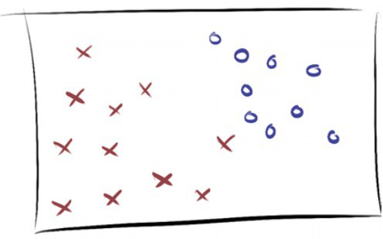
SML Ensemble Classification models
Alessio Bernardo
4

Slide 5
Ensemble Classifiers
“An ensemble can be described as a composition of multiple weak learners to form one with (expected) higher predictive performance (strong learner), such that a weak learner is loosely defined as a learner that performs slightly better than random guessing”
Freund and Schapire, 1997
Alessio Bernardo
5

Slide 6
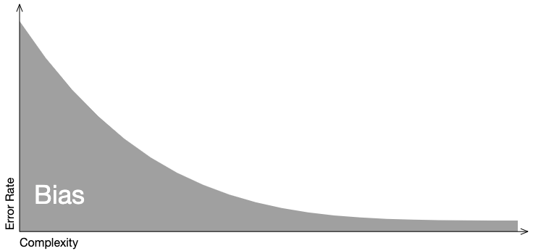
Bias-Variance trade-off
Bias
When a model is less complex, it ignores relevant information, and error due to bias is high. As the model becomes more complex, error due to bias decreases.
http://www.r2d3.us/visual-intro-to-machine-learning-part-2/
Alessio Bernardo
6

Slide 7
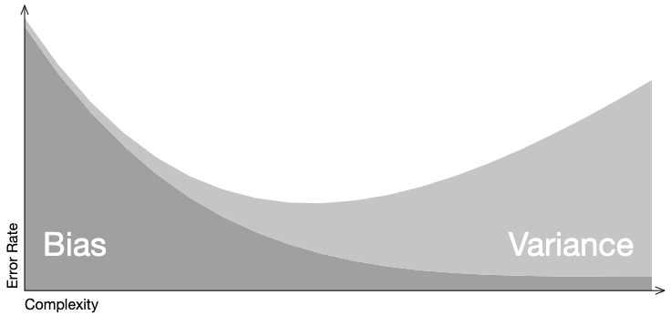
Bias-Variance trade-off
Variance
On the other hand, when a model is less complex, error due to variance il low. Error due to variance increases as complexity increases.
http://www.r2d3.us/visual-intro-to-machine-learning-part-2/
Alessio Bernardo
7

Slide 8
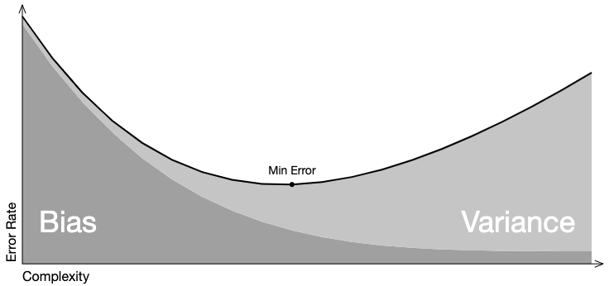
Bias-Variance trade-off
Trade-off
Overall model error is a function error due to bias and variance. The ideal model minimized error from each.
http://www.r2d3.us/visual-intro-to-machine-learning-part-2/
Alessio Bernardo
8
Notes:
https://medium.com/@mp32445/understanding-bias-variance-tradeoff-ca59a22e2a83
http://www.r2d3.us/visual-intro-to-machine-learning-part-2/
https://brookewenig.com/RandomForests.html#/2

Slide 9
Ensemble Classifiers in ML
Bagging
Fits M independent models and “average” their predictions in order to obtain a model with a lower variance…
But we have only one dataset, how can we build independent models?
Bootstrapping
Create M bootstrap samples (one for each model) from the original dataset of size N, created by drawing random samples with replacement. Each bootstrap contains each original sample K times, where Pr(K=k) follows a binomial distribution.
0.632 of the data points in the original sample show up in the bootstrap sample (the other 0.368 won't be present in it)
L. Breiman. Bagging predictors. Machine Learning, 1996
Alessio Bernardo
Notes:
https://brookewenig.com/RandomForests.html#/5

Slide 10
Ensemble Classifiers in ML
Bagging → Random Forests
The random forest approach is a bagging method where M trees, fitted on bootstrap samples, are combined to produce an output with lower variance.
To make the M trees a bit less correlated with each others: random forest also samples over features and keep only a random subset of them to build the tree.
L. Breiman. Random Forests. Machine Learning, 2001
Alessio Bernardo
Notes:
https://brookewenig.com/RandomForests.html#/5

Slide 11
Ensemble Classifiers in ML
Boosting
Sequential method that combines weak models no longer fitted independently from each others.
It fits models iteratively such that the training of model at a given step depends on the models fitted at the previous steps: it gives more importance to observations in the dataset that were badly handled by the previous models in the sequence.
It produces an ensemble model that is in general less biased than the weak learners that compose it.
Y. Freund & R. Schapire. Experiments with a new boosting algorithm. ICML, 1996
Alessio Bernardo

Slide 12
Ensemble Classifiers in ML
Boosting → Adaptive Boosting (AdaBoost)
It puts more weight on difficult to classify instances and less on those already handled well:
First, it updates the observations weights in the dataset and train a new weak learner with a special focus given to the observations misclassified by the current ensemble model.
Second, it adds the weak learner to the weighted sum according to an update coefficient that expresses the performances of this weak model: the better a weak learner performs, the more it contributes to the strong learner.
Y. Freund & R. Schapire. Experiments with a new boosting algorithm. ICML, 1996
Alessio Bernardo
Notes:
- fit the best possible weak model with the current observations weights
- compute the value of the update coefficient that is some kind of scalar evaluation metric of the weak learner that indicates how much this weak learner should be taken into account into the ensemble model
- update the strong learner by adding the new weak learner multiplied by its update coefficient
- compute new observations weights that expresse which observations we would like to focus on at the next iteration (weights of observations wrongly predicted by the aggregated model increase and weights of the correctly predicted observations decrease)

Slide 13
Ensemble Classifiers in ML
Boosting → Gradient Boosting
Instead of fitting a weak learner on the data at each iteration, it actually fits a new weak learner to the residual errors made by the previous one:
For every instance in the training set, it calculates the residuals for that instance, or, in other words, the observed value minus the predicted value.
Once it has done this, it adds a weak learner that tries to predict the residuals that was previously calculated.
J. H. Friedman. Stochastic gradient boosting. Computational statistics & data analysis, 2022
Alessio Bernardo
Notes:
(visual exemple)
https://brookewenig.com/RandomForests.html#/23
- fit the best possible weak learner to pseudo-residuals (approximate the opposite of the gradient with respect to the current strong learner)
- compute the value of the optimal step size that defines by how much we update the ensemble model in the direction of the new weak learner
- update the ensemble model by adding the new weak learner multiplied by the step size (make a step of gradient descent)
- compute new pseudo-residuals that indicate, for each observation, in which direction we would like to update next the ensemble model predictions

Slide 14
Ensemble Classifiers in ML
Stacking
It considers heterogeneous weak learners (different learning algorithms are combined).
It learns to combine the base models using a meta-model.
It produces an ensemble model that is in general less biased than the weak learners that compose it.
K. M. Ting & I. H. Witten. Stacking bagged and dagged models. 1997
Alessio Bernardo
Notes:
- split the training data in two folds
- choose L weak learners and fit them to data of the first fold
- for each of the L weak learners, make predictions for observations in the second fold
- fit the meta-model on the second fold, using predictions made by the weak learners as inputs

Slide 15
Ensemble Classifiers in SML
Diversity: induce diversity among learners
Combination: combine the predictions
Adaptation: adapt to evolving data
Pro
High Predictive performance
Flexibility
Cons
Computational resources
Gomes, H. M., Barddal, J. P., Enembreck, F., & Bifet, A. (2017). A survey on ensemble learning for data stream classification. ACM, 50(2), 1-36.
Alessio Bernardo
Notes:
Dire che quindi in SML ci sono più opportunità di creare cose perché i dati evolvono nel tempo w.r.t. ML

Slide 16
Induce Diversity
Horizontal Partitioning
Bagging: build a set of M base models, with a bootstrap sample from the original dataset of size N, created by drawing random samples with replacement. Each bootstrap contains each original sample K times, where Pr(K=k) follows a binomial distribution.
Gomes, H. M., Barddal, J. P., Enembreck, F., & Bifet, A. (2017). A survey on ensemble learning for data stream classification. ACM, 50(2), 1-36.
Alessio Bernardo

Slide 17
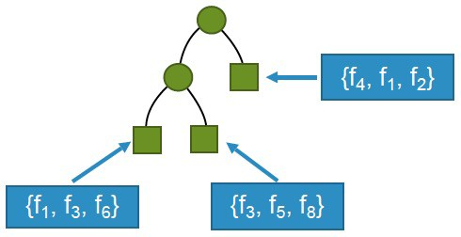
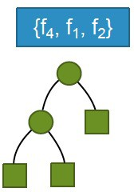
Induce Diversity
Vertical Partitioning
Random Subspaces: train learners on different subsets of features
Local Randomization
Global Randomization
Gomes, H. M., Barddal, J. P., Enembreck, F., & Bifet, A. (2017). A survey on ensemble learning for data stream classification. ACM, 50(2), 1-36.
Alessio Bernardo

Slide 18
Induce Diversity
Others
Base Learner Manipulation: varying parameters of the same base learner
Heterogeneous Base Learners (Stacking): use heterogeneous base learners and obtain ensemble members with different biases
Gomes, H. M., Barddal, J. P., Enembreck, F., & Bifet, A. (2017). A survey on ensemble learning for data stream classification. ACM, 50(2), 1-36.
Alessio Bernardo

Slide 19

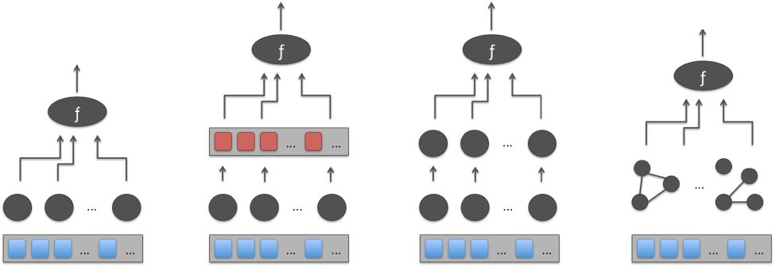
Combination
Architecture
Base learners
Instances
Flat
Meta-Learner
Hierarchical
Network
Gomes, H. M., Barddal, J. P., Enembreck, F., & Bifet, A. (2017). A survey on ensemble learning for data stream classification. ACM, 50(2), 1-36.
Alessio Bernardo

Slide 20
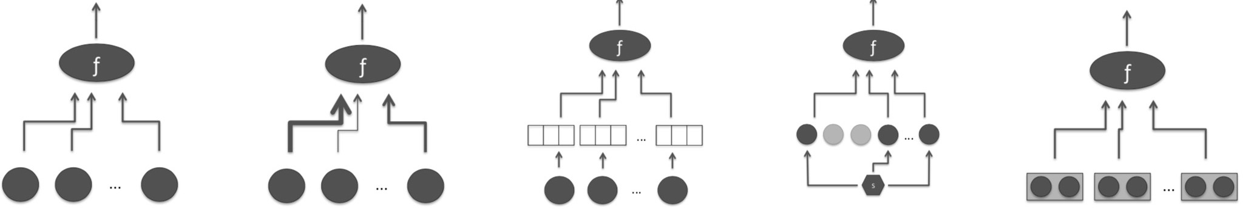
Combination
Voting
Base learners
Instances
Majority
Weighted Majority
Rank
Abstaining
Relational
Gomes, H. M., Barddal, J. P., Enembreck, F., & Bifet, A. (2017). A survey on ensemble learning for data stream classification. ACM, 50(2), 1-36.
Alessio Bernardo

Slide 21
Adaptation
Cardinality
Fixed: fixed numbers of base learners
Dynamic: add classifiers on the fly
Gomes, H. M., Barddal, J. P., Enembreck, F., & Bifet, A. (2017). A survey on ensemble learning for data stream classification. ACM, 50(2), 1-36.
Alessio Bernardo

Slide 22
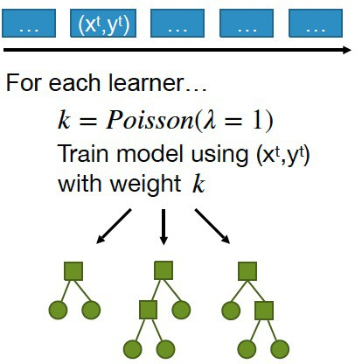
Online Bagging
Since data streams are supposed to be unbounded (large N), the binomial distribution tends to a Poisson(1) distribution.
Train learners on different subsets of instances
Oza and Russel, “Online bagging and boosting,” in Artificial Intelligence and Statistics 2001.
Alessio Bernardo
22

Slide 23
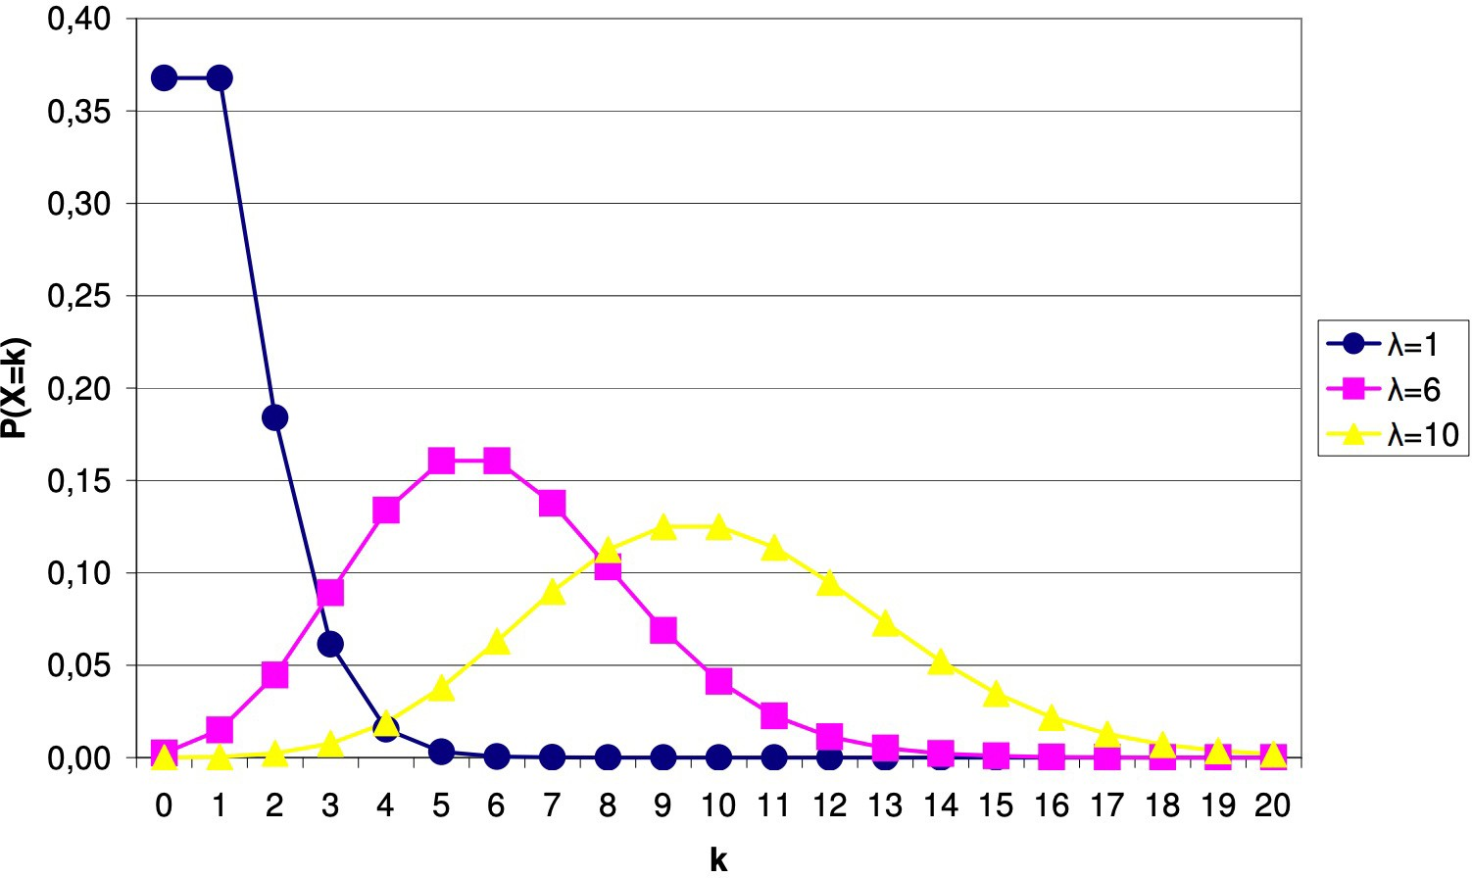
Leveraging Bagging
Add an ADWIN drift detector per base learner
Use more weight during training - Poisson(6)
Bifet, G. Holmes, and B. Pfahringer, “Leveraging bagging for evolving data streams,” in PKDD, 2010
Alessio Bernardo
23

Slide 24
Adaptive Random Forest (ARF)
Base Learners: Hoeffding Trees
Diversity: Leveraging Bagging + Local Random Subspaces
Combination:
Flat architecture
Weighted majority voting
Adaptation: Adaptive window + warning period (train background learners)
H. M. Gomes et al, “Adaptive random forests for evolving data stream classification,” Machine Learning, 2017.
Alessio Bernardo
16

Slide 25
Streaming Random Patches (SRP)
Base Learners: User choice
Diversity: Leveraging Bagging + Global Random Subspaces
Combination:
Flat architecture
Weighted majority voting
Adaptation: Adaptive window + warning period
Gomes, Read and Bifet, “Streaming Random Patches for Evolving Data Stream Classification”, ICDM, 2019
Alessio Bernardo
25

Slide 26
EXERCISE 4: Stream Ensemble Classification
Alessio Bernardo

