Slide 1
Streaming Machine Learning Introduction
Alessio Bernardo
Post-doc @ Politecnico di Milano
CTO & Co-founder @ Motus ml

Slide 2

Me
Alessio Bernardo, Ph.D.
Post-doc @ Politecnico di Milano
CTO & Co-founder @ Motus ml
5 years of experience in research in the Streaming Machine Learning field with evolving data streams, concept drifts, and class imbalance;
Focus on applying Streaming Machine Learning techniques in constrained environments at the network's edge.
https://alessiobernardo.github.io/
https://motusml.com/

Slide 3
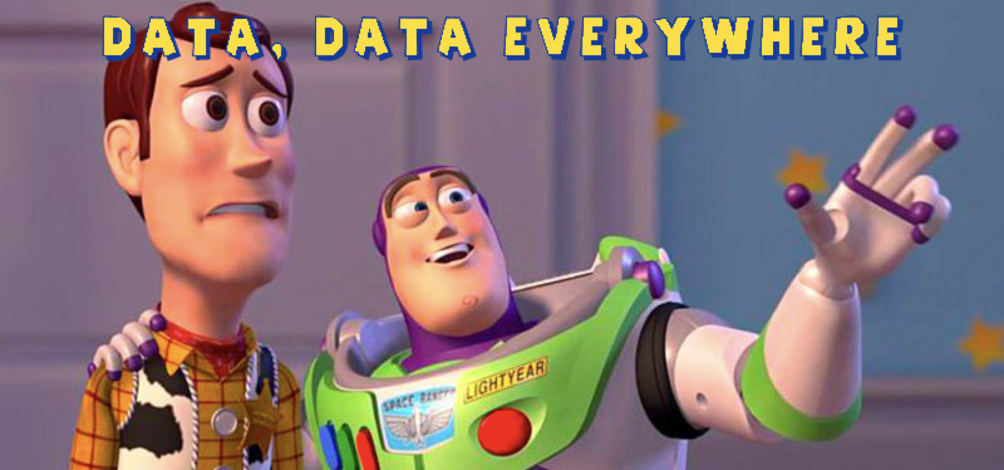
It is a Streaming World …

Slide 4
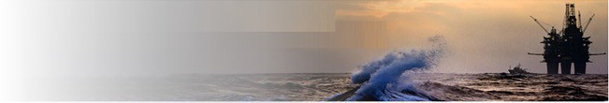
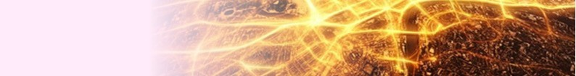
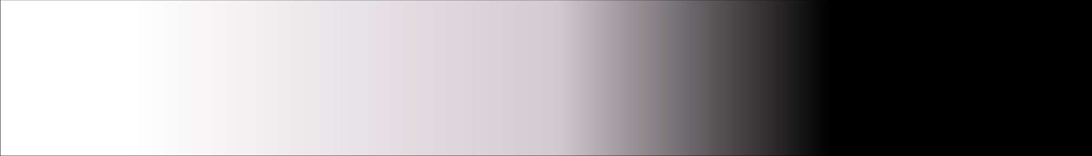
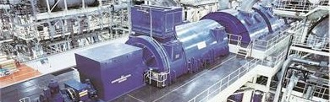


It is a Streaming World …
Off-shore oil operations
Smart Cities
Power turbine
Social networks
Generate data streams!
E. Della Valle, S. Ceri, F. van Harmelen, D. Fensel It's a Streaming World! Reasoning upon Rapidly Changing Information. IEEE Intelligent Systems 2009
4

Slide 5
… looking for reactive answers …
When a sensor on a drill indicates that it is about
to get stuck, how long can I keep drilling?
Where am I likely going to run into a
traffic jam during my commute tonight?
Which electrical turbine has sensor readings
like any turbine that had a critical failure?
Who is driving the discussion about the
top 10 emerging topics ?
Require continuous processing and reactive answer
E. Della Valle, S. Ceri, F. van Harmelen, D. Fensel It's a Streaming World! Reasoning upon Rapidly Changing Information. IEEE Intelligent Systems 2009
5

Slide 6
… but with conflicting requirements …
A system able to answer those queries must be able to
handle volume
handle velocity
handle variety
cope with incompleteness
cope with noise
provide reactive answers
support fine-grained access
integrate complex domain models
offer high-level languages

Slide 7
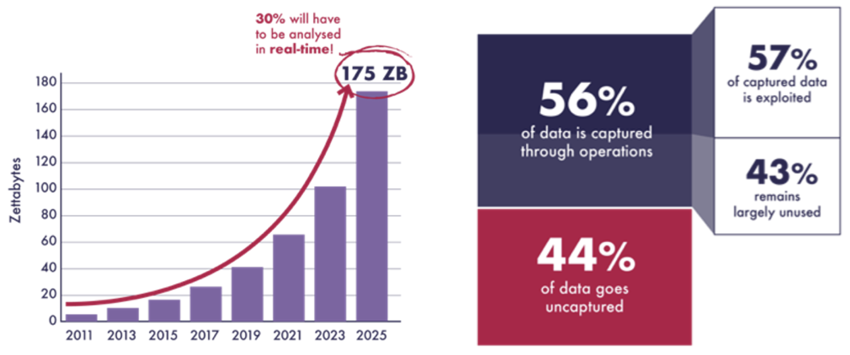
… and 68% of data are not used
Src: Seagate

Slide 8
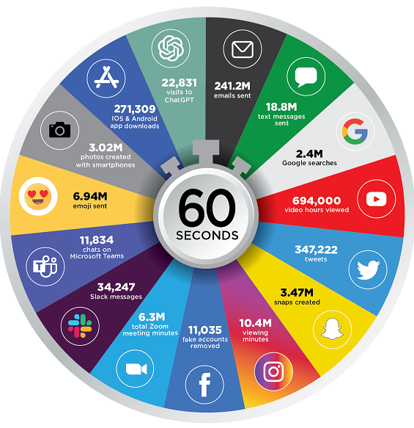
Internet minute in 2023
Src: eDiscovery Today & LTMG

Slide 9
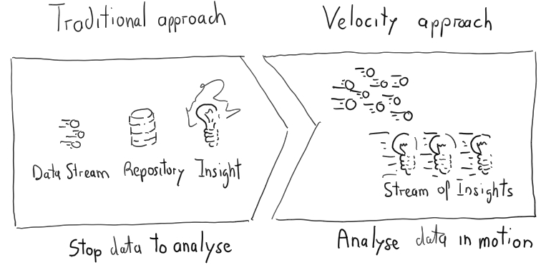
Traditional approach vs …

Slide 10



Batch of data
Random access to data
Well defined training phase
X₀
X₁
X₂
No restrictions on memory/time for training
Access to all labelled data used for training
X₃
...
X_{n}

Slide 11
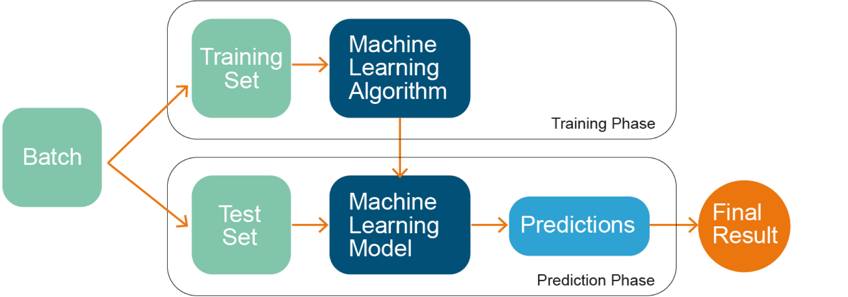
ML models

Slide 12
Traditional vs. Velocity-oriented approach

Slide 13
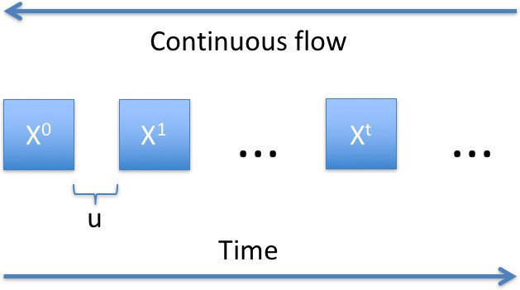
Data Stream
Continuous flow of data generated at high-speed in dynamic, time-changing environments
Sequential access only
Evolving data
Strict time/memory requirements
Characteristics of data seen so far

Slide 14
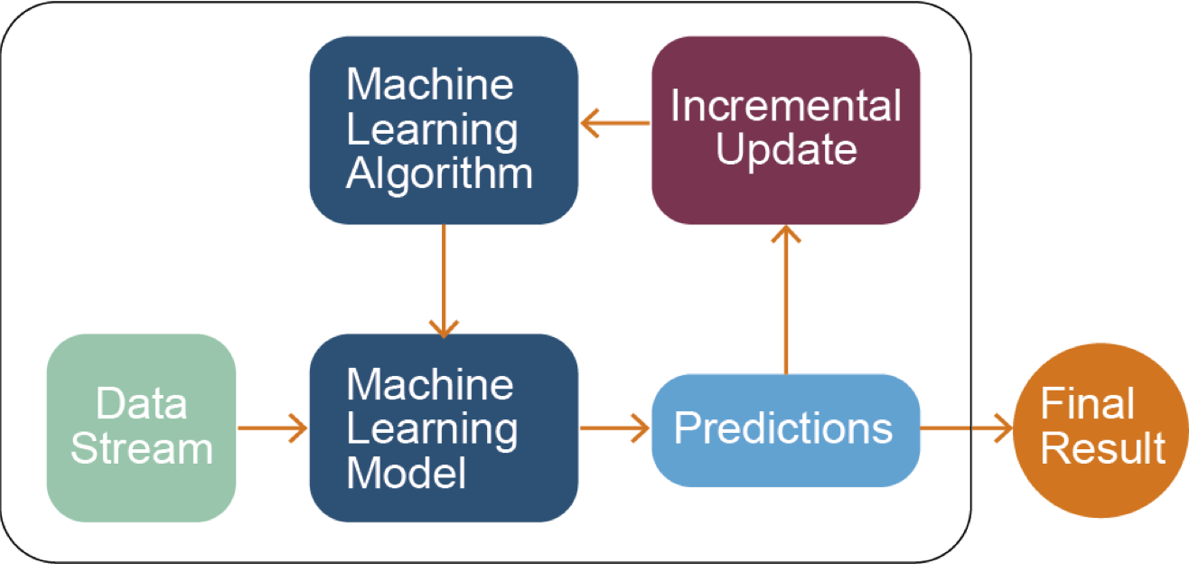
SML models
A. Bifet, G. de Francisci Morales, J. Read, G. Holmes, and B. Pfahringer Efficient online evaluation of big data stream classifiers. ACM SIGKDD 2015

Slide 15
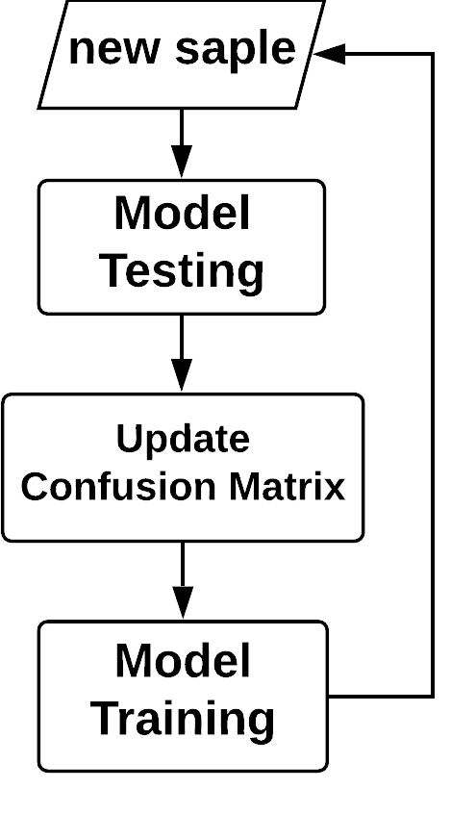
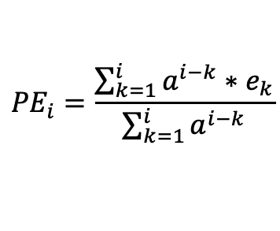
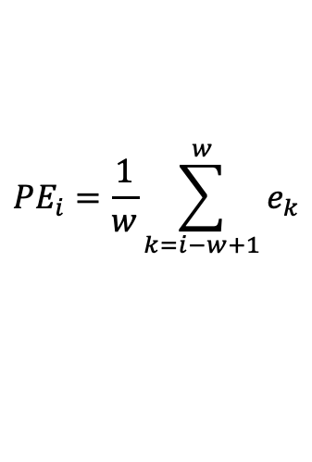
Prequential evaluation
New sample
Estimate prequential error (PE):
Sliding window of size w
Fading factor
e₁
e₂
e₃
e₄
e₅
$${PE}_{i}=\frac{1}{w}\sum_{k=i−w+1}^{w}{e_{k}}$$
e₂
e₃
e₄
e₅
e₆
e₃
e₄
e₅
e₆
e₇
$${PE}_{i}=\frac{\sum_{k=1}^{i}{a^{i−k}∗e_{k}}}{\sum_{k=1}^{i}{a^{i−k}}}$$
with 0 ≪ 𝛼 ≤ 1
Gama, J., Sebastião, R. and Rodrigues, P.P.: Issues in evaluation of stream learning algorithms. In ACM KDD, 2009.

Slide 16
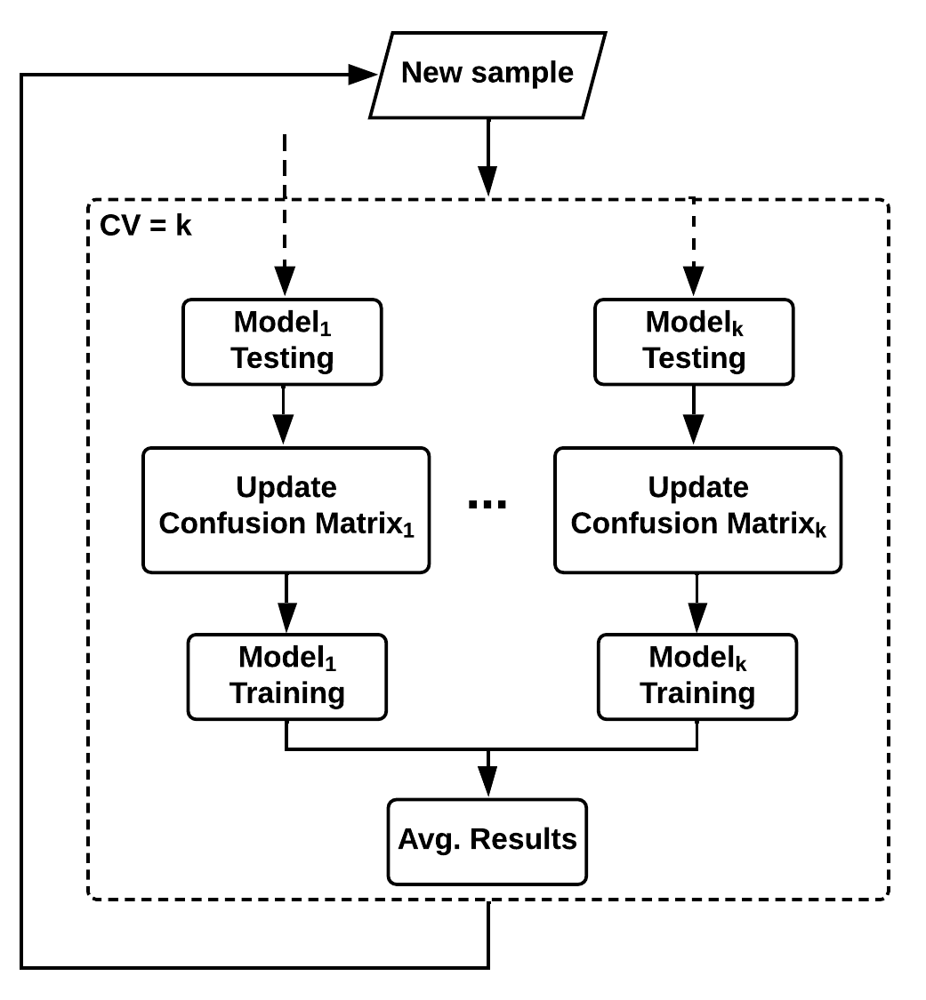
Prequential evaluation - Cross Validation
K-fold distributed cross-validation: each sample is used for testing in one classifier selected randomly, and used for training and testing all the others
K-fold distributed split-validation: each sample is used for training in one classifier selected randomly, and for testing in all the classifiers
K-fold distributed bootstrap-validation: each sample is used for training in approximately 2⁄3 of the classifiers, with a separate weight in each classifier, and for testing in all the classifiers
Bifet, A., et al: Efficient Online Evaluation of Big Data Stream Classifiers. In ACM SIGKDD, 2015.

Slide 17
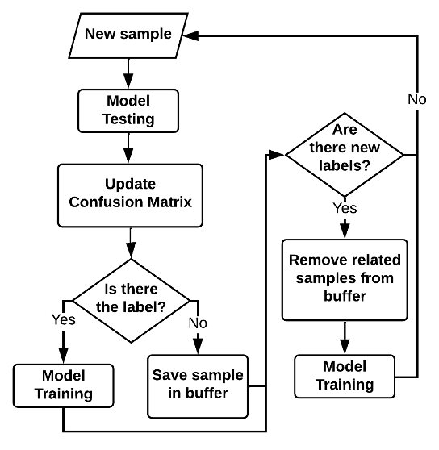
Prequential evaluation - Delayed
In real environments, can happen that the label arrives delayed w.r.t. the features
Test the model with the features and wait for the label to train it
Gomes, HM., et al: Adaptive random forests for evolving data stream classification. In Machine Learning, 2017.

Slide 18
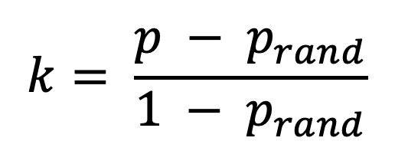
Evaluation metric - Kappa statistic
$$k= \frac{p − p_{rand}}{1 − p_{rand}}$$
where p is the accuracy of the classifier under consideration and p_{rand} is the accuracy of the Random classifier.
If the classifier is perfectly correct, then k = 1.
If the classifier achieves the same accuracy as the Random classifier, then k = 0.
I. Žliobaitè et al. Evaluation methods and decision theory for classification of streaming data with temporal dependence. In Machine Learning, 2015.

Slide 19
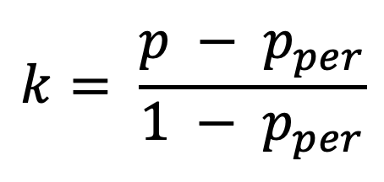
Evaluation metric - Kappa-Temporal statistic
$$k= \frac{p − p_{per}}{1 − p_{per}}$$
where p is the accuracy of the classifier under consideration and p_{per} is the accuracy of the Persistent classifier.
If the classifier is perfectly correct, then k = 1.
If the classifier achieves the same accuracy as the Persistent classifier, then k = 0.
If the classifier performs worse than the Persistent classifier, then k < 0.
I. Žliobaitè et al. Evaluation methods and decision theory for classification of streaming data with temporal dependence. In Machine Learning, 2015.

Slide 20

SML models
Incrementally incorporate data on the fly
Unbounded real-time data
Resource efficient
Dynamic models

Slide 21
SML models
Benefits
Challenges
One sample at a time
Incremental models
Time & Memory management
Data stationarity (concept drift)
Class imbalance
Hyper-parameter tuning

Slide 22

Exercise 1: From batch to stream learning

Slide 23
Credits
Albert Bifet DATA STREAM MINING 2020-2021 course at Telecom Paris
Alessio Bernardo & Emanuele Della Valle

Slide 24
Streaming Machine Learning Introduction
Alessio Bernardo
Post-doc @ Politecnico di Milano
CTO & Co-founder @ Motus ml

