Slide 1
Streaming Data Analysis Administrative Items
Emanuele Della Valle
prof @ Politecnico di Milano
founder @ Quantia Consulting
founder & CRO @ motus ml

Slide 2
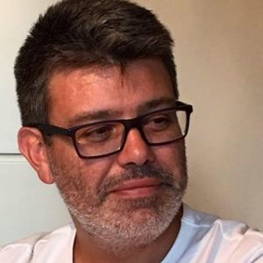
Me
Emanuele Della Valle, Ph.D.
prof @ Politecnico di Milano
founder @ Quantia Consulting
founder & CRO @ motus ml
+20 years of experience in research and innovation projects
Expert in Semantic Technologies, Stream Computing, and Data Visualization
Brander of Stream Reasoning: an approach to tame the velocity and variety dimension of Big Data simultaneously
Serial startupper:
https://www.fluxedo.com/ https://www.quantiaconsulting.com/
https://motusml.com/

Slide 3

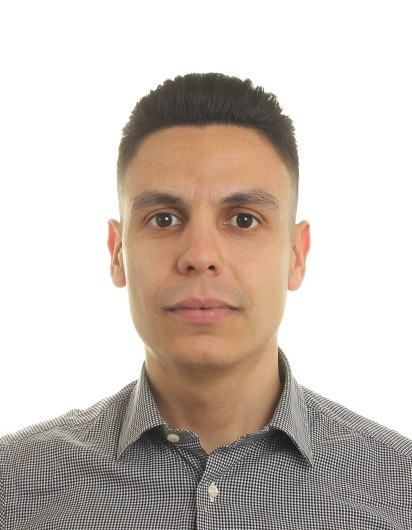
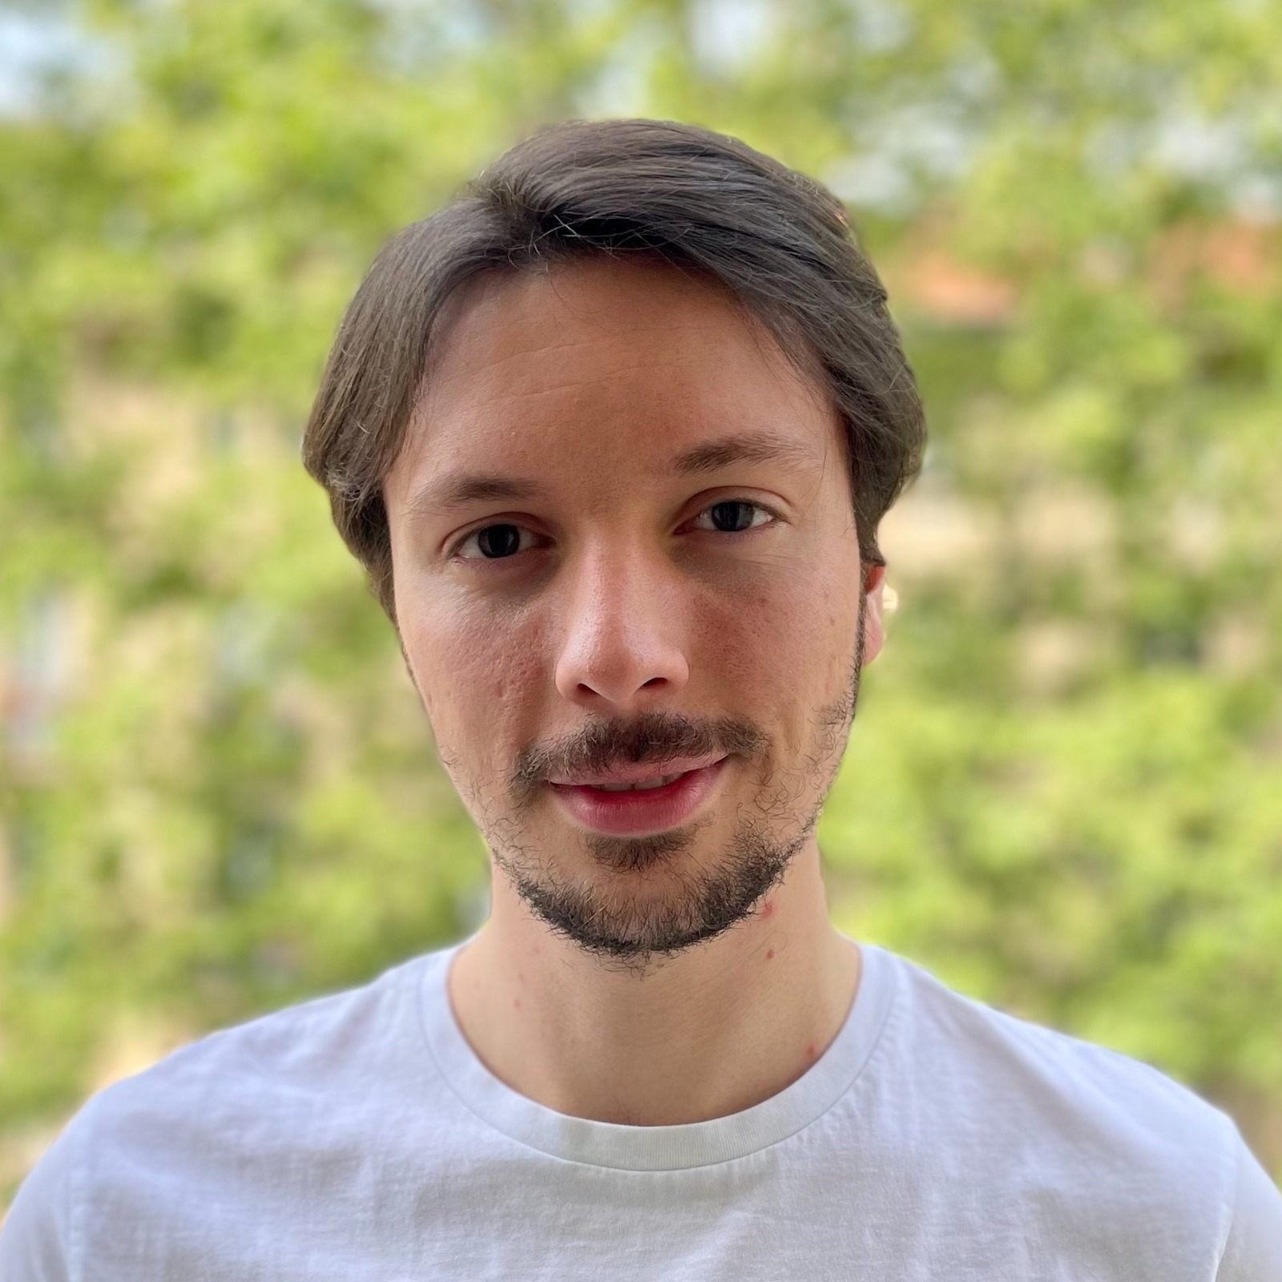
The other lecturers
Alessio Bernardo, Ph.D.
Federico Giannini, Dr.
Giacomo Ziffer, Dr.
postdoc @ Politecnico di Milano
founder & CTO @ motus ml
Research in the Streaming Machine Learning field with evolving data streams, concept drifts, and class imbalance. Focus on applying Streaming Machine Learning techniques in constrained environments at the network's edge
PhD student @ Politecnico di Milano
Researcher in the Streaming Machine Learning and Continual Learning fields. Focus on applying Deep Learning techniques to data streams to address concept drifts, temporal dependence, and catastrophic forgetting
PhD student @ Politecnico di Milano
founder & CEO @ motus ml
Researcher in the Time-Evolving Analytics field, focusing on applying Streaming Machine Learning techniques to (un)structured data streams with concept drifts and temporal dependence

Slide 4
The Course
Public course Web page with official calendar of lecture
http://emanueledellavalle.org/teaching/streaming-data-analytics-2023-24/
Private Webeep page with official recordings and announces
https://webeep.polimi.it/course/view.php?id=11293
Public github repo with all lectures’ slides and code
https://github.com/emanueledellavalle/streaming-data-analytics

Slide 5
Lectures' Timetable
Official
Wednesday 14:15 - 16:15 in classroom 26.11
Thursday 16:15 - 18:15 in classroom 3.0.3
Pragmatically
Wednesday 14:30 - 16:00 in classroom 26.11
Thursday 16:30 - 18:00 in classroom 3.0.3
Important NOTES
there is no clear cut between theory and practice
bring your laptops we will often code
I record ALL lectures but I do not stream them

Slide 6

Objetives
The course provides the foundational concepts, methods, languages, and systems for ingesting, processing, and analyzing data that flows to enable real-time decisions.
The course aims to tame the velocity dimensions of Big Data without forgetting the volume and variety dimensions.

Slide 7
Topics covered Streaming Data Engineering
From the foundations of streaming algorithms to real-world languages and systems
Languages for Data Stream Management Systems (DSMS) and Complex Event Processing (CEP) illustrated via EPL
Horizontally scalable DSMS illustrated via Apache Kafka, Apache Spark, and ksqlDB
Vertically scalable CEP illustrated via Esper

Slide 8
Topics covered Streaming Data Science
From the foundations of Streaming Data Science to real-world Python libraries
Streaming Machine Learning using River and MOA
Time Series Analytics using statsmodels.tsa, and darts
Continual AI using Avalanche

Slide 9
Evaluation
The exam consist of three parts
a mandatory written exam (max 30 marks)
an optional continuous evaluations (max 1 mark)
an optional practical project work with oral presentation (max 3 marks)
Example:
written exam 27 +
optional continuous evaluation 1 +
optional practical project work 3 = 30L

Slide 10
Evaluation The "mandatory" written exam
The written exam is composed of a mix of
theoretical questions regarding any course subjects and
exercises regarding the technical content and how to apply it in practice
Students can get up to 30/30 with the written exam

Slide 11
Evaluation The "optional" continuous evaluations
The optional continuous evaluations are in-presence quizzes proposed during the lessons
I will use Microsoft Forms offered by Politecnico di Milano as part of your Office 365 subscription
The quizzes are meant as a self-assessment; only participation matters
Students can get up to 1 mark with the continuous evaluations

Slide 12
Evaluation The "optional" practical project
The optional practical project requires using one or more of the technologies presented in the lectures to solve a realistic streaming data analytics problem based on data streams publicly available or provided by me and my assistants
Only students, who will get at least 27/30 in the written exam, can opt for it.
The mark obtained with the optional continuous evaluation does not count.
Students can get up to 3 marks with the practical project

Slide 13
Streaming Data Analysis Administrative Items
Emanuele Della Valle
prof @ Politecnico di Milano
founder @ Quantia Consulting
founder & CRO @ motus ml

