Slide 1
ksqlDB
Emanuele Della Valle
prof @ Politecnico di Milano

Slide 2
Why use ksqlDB?

Slide 3
Why use ksqlDB? Too many cooks in the kitchen.

Slide 4
Why use ksqlDB? Divide and conquer

Slide 5
Why use ksqlDB? Cut from the same mold

Slide 6
Why use ksqlDB? Reunited

Slide 7
Key operations

Slide 8
Key operations A running example about riders

Slide 9

Key operations Capture events
CREATE SOURCE CONNECTOR riders WITH (
'connector.class' = 'JdbcSourceConnector',
'connection.url' = 'jdbc:postgresql://...',
'topic.prefix' = 'rider',
'table.whitelist' = 'riderLocations, profiles',
'key' = 'profile_id',
...);

Slide 10
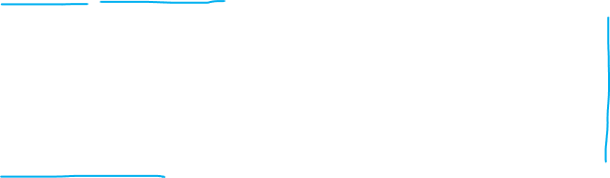
Key operations Perform continuous transformations
CREATE STREAM locations AS
SELECT rideId, latitude, longitude,
GEO_DISTANCE(latitude, longitude,
dstLatitude, dstLongitude
) AS kmToDst
FROM ridersLocation
EMIT CHANGES;

Slide 11
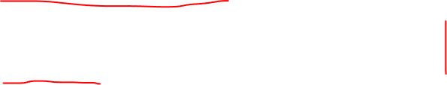
Key operations Create materialized views
CREATE TABLE activePromotions AS
SELECT rideId,
qualifyPromotion(kmToDst) AS promotion
FROM locations
GROUP BY rideId
EMIT CHANGES;

Slide 12

Key operations Serve lookups against materialized views
SELECT rideId, promotion
FROM activePromotions
WHERE rideId = '6fd0fcdb';

Slide 13

Concepts

Slide 14
Concepts Basics
Event: the fundamental unit of data in stream processing
Stream: an immutable, append-only* collection of events that represents a series of historical facts
Table (a.k.a. materialized view): a mutable collection of events. They let you represent the latest version of each value per key.
Queries: how you transform, filter, aggregate, and join collections together to derive new collections or materialized views that are incrementally updated in real-time as new events arrive.

Slide 15
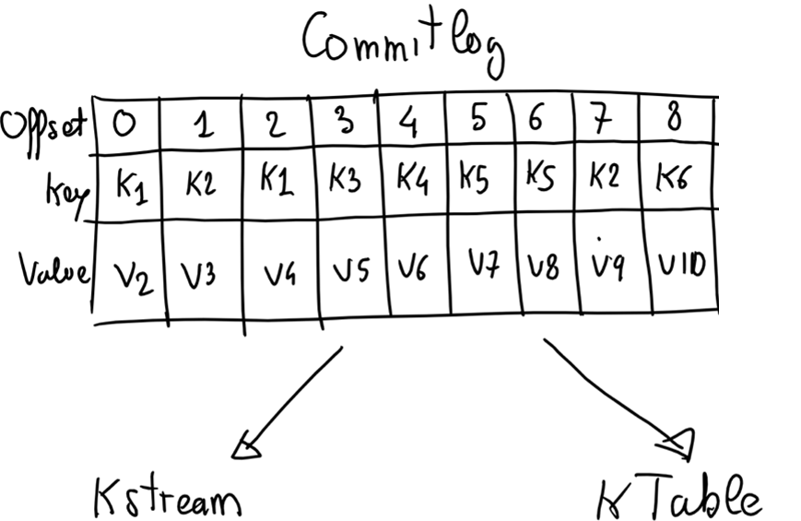
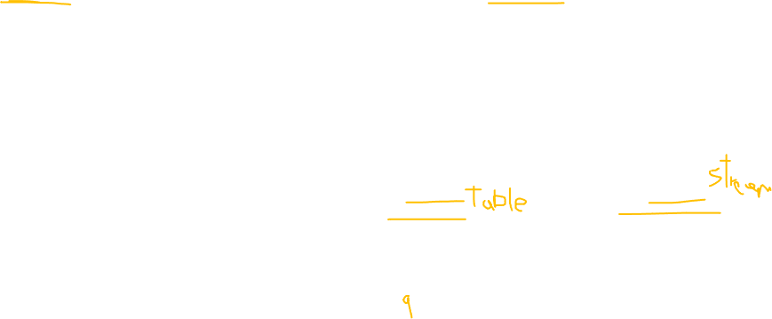

Concepts Topics vs. Streams vs. Tables
topics can have two origins in Kafka
independent observations
change logs captured from a DB
independent observations can be captured in a stream
change logs can be captured in a stream but can also in a time-varying table (a.k.a. materialized views)

Slide 16
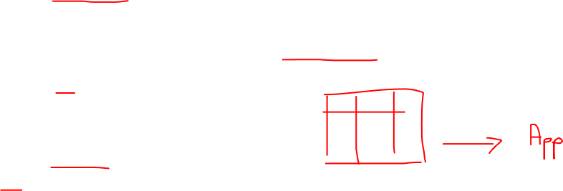
Concepts Push queries
let you subscribe to a query's result as it changes in real-time
When new events arrive, push queries emit refinements, which allow reacting to new information
Fit for asynchronous application flows
SELECT riderId, latitude, longitude
FROM Locations
WHERE rider = '6fd0fcdb'
EMIT CHANGES;

Slide 17
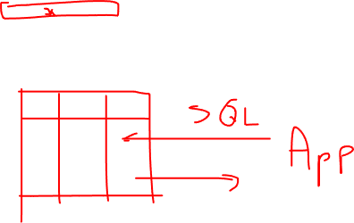
Concepts Pull queries
Fetch the current state of a materialized view
Incrementally updated as new events arrive
fit for request/response flows
SELECT riderId, latitude, longitude
FROM currentCarLocations
WHERE ROWKEY = '6fd0fcdb';

Slide 18
How it works

Slide 19
How it works ksqlDB Architecture

Slide 20
How it works ksqlDB vs Kafka Streams 1/3

Slide 21



How it works ksqlDB vs Kafka Streams 2/3
For example, the following KSQL query ...
CREATE STREAM fraudulent_payments AS
SELECT fraudProbability(data)
FROM payments
WHERE fraudProbability(data) > 0.8
EMIT CHANGES;

Slide 22
How it works ksqlDB vs Kafka Streams 3/3
... is equivalent to the following Scala code
bject FraudFilteringApplication extends App {
val builder: StreamsBuilder = new StreamsBuilder()
val fraudulentPayments: KStream[String, Payment] = builder
.stream[String, Payment]("payments")
.filter((_ ,payment) => payment.fraudProbability > 0.8)
fraudulentPayments.to("fraudulent-payments-topic")
val config = new java.util.Properties
config.put(StreamsConfig.APPLICATION_ID_CONFIG, "fraud-filtering-app")
config.put(StreamsConfig.BOOTSTRAP_SERVERS_CONFIG, "kafka-broker1:9092")
val streams: KafkaStreams = new KafkaStreams(builder.build(), config)
streams.start()
}

Slide 23

How it works Differences Between ksqlDB and Kafka Streams
What | ksqlDB | Kafka Streams
You write
Console
REST API
Runtime

Slide 24
How it works Deployment Modes

Slide 25
How it works Fault tolerance and scale-out

Slide 26
Notes
For each query there is a src topic (with its partitions, say 3)
Each ksqlDB server creates a consumer referring to the consumer group of the query
As far as there a partitions to assign, Kafka assign them to the consumers created by the ksqlDB Serves
Up to 3 in the example
Any other consumer created by the ksqlDB Serves will remain in idle state waiting for a fault or for a scale out operation

Slide 27
How it works Query Lifecycle

Slide 28
Walking through basic tutorials

Slide 29
Walking through basic tutorials Materialized Views
The hard way
The ksqlDB way

Slide 30
Walking through basic tutorials Streaming ETL
The hard way
The ksqlDB way

Slide 31
Learn m ore
https://ksqldb.io/
https://ksqldb.io/examples.html
https://github.com/confluentinc/ksql
https://twitter.com/ksqldb

Slide 32
Thank you for your attention! Questions?

Slide 33
ksqlDB
Emanuele Della Valle
prof @ Politecnico di Milano

