Slide 1
Streaming Data Analytics Preview of the part of the exam about Streaming Data Science
Emanuele Della Valle
Politecnico di Milano

Slide 2
Exam content
Questions on all lectures about Streaming Data Science to test
The breadth of your knowledge
The depth of your knowledge
(6 points)
Exercises
Given a python code snippet that addresses a streaming binary classification problem or a time series forecasting problem comment what the code tries to achieve and fill in missing parts explaining why you did so
Given a particular problem/task/situation, explain how you would solve it (methods, metrics, evaluation used) and comment why
(9 points)

Slide 3
Questions to test the breadth of your TSA knowledge
What is the i.i.d. assumption? How do SML and TSA allow the loosening of part of it?
Which characteristics can a non-stationary time series have? Illustrate it with an example.
Why is the white noise a predictable time series? What is its forecast? What is its error? Explain it w.r.t. the possible components of a time series.
Which are the methods to test for stationarity? Explain one of them in detail
Which are the typical time series components? Illustrate your explanation with an example
Which are the methods to detrend a time series? Explain one of them in detail
Which are the methods to identify seasonality in a time series? Explain one of them in detail
Which are the methods to forecast a time series? Compare two methods of your choice (excluding the basic ones)
What are the components of a SARIMAX model?

Slide 4
Questions to test the depth of your TSA knowledge
What’s the difference between an additive and a multiplicative model for time series decomposition? Illustrate your explanation with an example
Why is exponential smoothing named in this way? Discuss the formula of at least one of the three methods presented in the course.
What’s the difference between simple, double, and triple exponential smoothing? Illustrate your explanation with an example
What’s the difference between the meaning of moving average in time series decomposition and the MA component in ARMA models? Illustrate your explanation with an example
What’s the definition of Autocorrelation? How does it differ from the definition of correlation? Illustrate your explanation with an example
What’s the difference between the AR and the MA part of an ARMA model? What is their relation to Autocorrelation and Partial Autocorrelation? Illustrate your explanation with an example.
How does the Box-Jenkins Methodology for ARMA models allow us to estimate the orders of the model? Illustrate your explanation with an example
What are the exogenous variables in TSA? How do they contribute to the forecasting? What’s their impact on the confidence interval? Illustrate your explanation with an example

Slide 5
Questions to test the breadth of your SML knowledge
What are the differences between batch-oriented Machine Learning and Streaming Machine Learning?
What are the benefits and the challenges of Streaming Machine Learning?
What is a concept drift? Which are the types of concept drift? Why is it so important to detect it? Illustrate the difference using the Bayes Theorem and with an example
How can you classify a concept drift with respect to the speed of change? Illustrate the difference with several examples
Which are the typical Streaming Machine Learning algorithms for classification? Illustrate one of them in detail.
What are the components of an SML Ensemble Classification model?
How does SML regression compare to time series forecasting w.r.t. types of input features, training, forecasting horizon, and adaptability?

Slide 6
Questions to test the depth of your SML knowledge
Which are the concept drift detectors that monitor the error rate? Illustrate how one of them works.
Which are the data drift detectors? Illustrate how one of them works.
How does ADWIN detect a concept drift? Illustrate it with an example.
How does the SML version of KNN work? Illustrate it with an example.
What is Hoeffding Bound? How and why is it used in SML to build a decision tree?
Why is the Poisson distribution used in SML ensemble methods? What’s the impact of the value of lambda? Illustrate how lambda is used in the SML methods.

Slide 7
Questions to test the breadth & depth of your CL knowledge
What’s the stability-plasticity dilemma? Illustrate your explanation with an example and discuss the different learning abilities.
What are the main differences between Streaming Machine Learning and Continual Learning paradigms? Discuss it w.r.t to the objective of the methods and the type of data they process
What are the three main categories of Continual Learning strategies? Explain one in detail.
Which are the primary evaluation metrics used in Continual Learning? Illustrate what they measure and why they are all useful to assess the properties of a method.

Slide 8
Exercises on TSA
Code-snippets fill-in & comment
Given the plot from the additive and the multiplicative decomposition, tell which decomposition suits better and why.
Given a line chart that illustrate a time series, tell if it is stationary and why.
Given an ACF and a PACF plot, discuss the order of the AR and MA components.
mul_decomposition = sm.tsa.seasonal_decompose(……, ………)
………………. # plot the multiplicative decomposition
add_decomposition = sm.tsa.seasonal_decompose(……, ………)
………………. # plot the additive decomposition
For the solution see TSA_02_Decomposition.ipynb

Slide 9
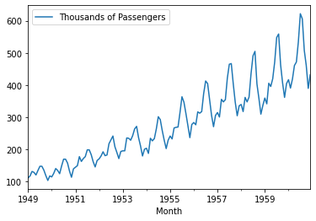
Exercises on TSA
Problem solving
Given the following time series, describe which algorithms you would use and why, listing the expected results
Given specific outputs from ACF and PACF plots, describe which order you would use for a SARIMA model, and what conclusion you would come to with the model diagnostic
For a facsimile solution see TSA_09_SARIMA.ipynb and TSA_06_Forecasting_Sol.ipynb

Slide 10
Exercises on SML
Given a data distribution plot, a code-snippet representing the algorithm training and testing phases, and the resulting error rate plot over time:
Comment each line of the code-snippet;
Discuss the ability of the proposed code to address the data distribution and the error rate illustrated in the two plots;
How would you modify the code to obtain … (a different situation w.r.t. the illustrated one)

Slide 11
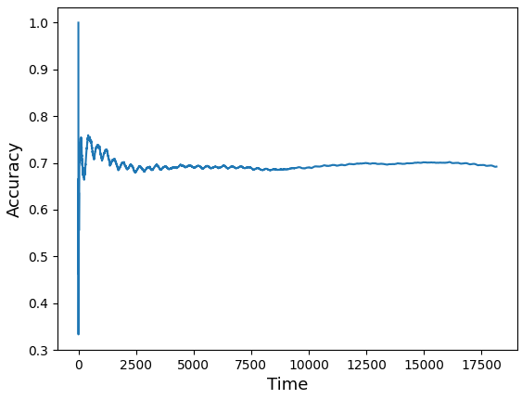
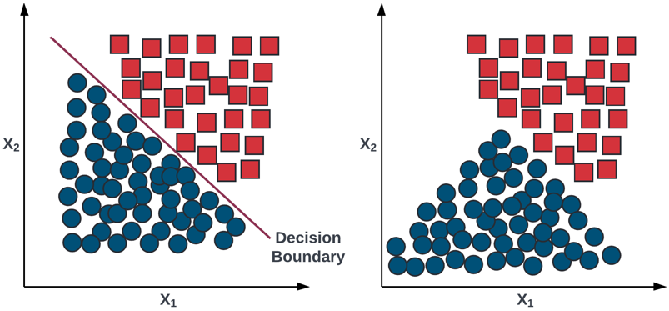
Solution 1/2
Given a data distribution plot, a code-snippet representing the algorithm training and testing phases, and the resulting error rate plot over time:
1. 2. 3. 4. 5. 6. 7. | data = pd.read_csv("stream.csv") features = data.columns[:-1] label = data.columns[-1] stream = iter_pandas(X=data[features], y=data[label]) model = GaussianNB() metric = Accuracy() progressive_val_score(dataset=stream, model=model, metric=metrics, print_every=1000)

Slide 12
Solution 2/2
Comment each line of the code-snippet
1. | read pandas dataframe from csv file
2. | select the features
3. | select the labels
4. | create the stream from the pandas dataframe
5. | define the model, a gaussian naïve bayes
6. | define the metric, the accuracy
7. | use the prequential evaluation to test and train the model, given in output the accuracy every 1000 samples
Discuss the ability of the proposed code to address the data distribution and the error rate illustrated in the two plots
The performance of the model are stable over time and converged to 70% of accuracy. This means that the data drift shown in the first plot does not affect the model decision boundary and, so, the model performance
How would you modify the code to obtain a model able to adapt to a concept drift?
I would use a model with a concept drift detector able to monitor the classification error, like ADWIN

Slide 13
Exercises on SML
Code-snippets fill-in & comment
model = …………………………………………………………… metric = …………………………………………………………… stream = iter_pandas(X=data[features], y=data['class’]) progressive_val_score(……………………………………., ……………………………………., ……………………………………., print_every=1000)
For the solution see Stream_Classification.ipynb

Slide 14
Exercises on SML
Problem solving
Given a particular data stream, describe which method, evaluation mode, concept drift detector and metric you would use and why, listing the expected results
Given a particular data stream, describe which concept drift detector you would use and why, listing the expected results
For a facsimile solution see Stream_Classification.ipynb and Concept_Drift.ipynb

Slide 15
Given the plot of data distribution, tell which kind of drift occurred and if it necessary to change the decision boundary.
Given the plot of the model performance, tell if there is a drift and if the model is able to adapt to it.

Slide 16
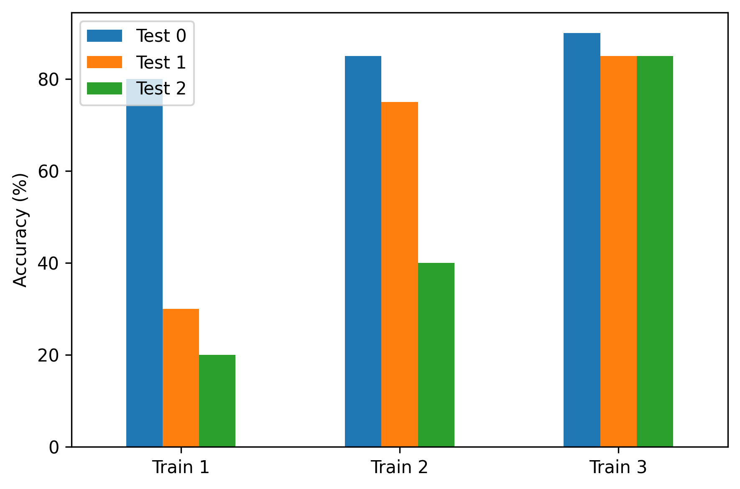
Exercises on TSA
???Tipo di problema???? Given the following plot showing the performance of a Continual Learning model, describes the learning abilities of the model.
For the solution see slides 9-11 of 10_1_CL.pdf and intro_to_CL.ipynb

Slide 17
Streaming Data Analytics Preview of the part of the exam about Streaming Data Science
Emanuele Della Valle
Politecnico di Milano

