Slide 1
Streaming Data Analytics Preview of the part of the exam about Streaming Data Science
Emanuele Della Valle
Politecnico di Milano

Slide 2
Exam content
Questions on all lectures about Streaming Data Science to test
The breadth of your knowledge
The depth of your knowledge
(6 points)
Exercises
Given a python code snippet that addresses a streaming binary classification problem or a time series forecasting problem comment what the code tries to achieve and fill in missing parts explaining why you did so
Given a particular problem/task/situation, explain how you would solve it (methods, metrics, evaluation used) and comment why
(9 points)

Slide 3
Questions to test the breadth of your TSA knowledge
What is the i.i.d. assumption? How do SML and TSA allow the loosening of part of it?
Which characteristics can a non-stationary time series have? Illustrate it with an example.
Why is the white noise a predictable time series? What is its forecast? What is its error? Explain it w.r.t. the possible components of a time series.
Which are the methods to test for stationarity? Explain one of them in detail
Which are the typical time series components? Illustrate your explanation with an example
Which are the methods to detrend a time series? Explain one of them in detail
Which are the methods to identify seasonality in a time series? Explain one of them in detail
Which are the methods to forecast a time series? Compare two methods of your choice (excluding the basic ones)
What are the components of a SARIMAX model?

Slide 4
Questions to test the depth of your TSA knowledge
What’s the difference between an additive and a multiplicative model for time series decomposition? Illustrate your explanation with an example
Why is exponential smoothing named in this way? Discuss the formula of at least one of the three methods presented in the course.
What’s the difference between simple, double, and triple exponential smoothing? Illustrate your explanation with an example
What’s the difference between the meaning of moving average in time series decomposition and the MA component in ARMA models? Illustrate your explanation with an example
What’s the definition of Autocorrelation? How does it differ from the definition of correlation? Illustrate your explanation with an example
What’s the difference between the AR and the MA part of an ARMA model? What is their relation to Autocorrelation and Partial Autocorrelation? Illustrate your explanation with an example.
How does the Box-Jenkins Methodology for ARMA models allow us to estimate the orders of the model? Illustrate your explanation with an example
What are the exogenous variables in TSA? How do they contribute to the forecasting? What’s their impact on the confidence interval? Illustrate your explanation with an example

Slide 5
Questions to test the breadth of your SML knowledge
What are the differences between batch-oriented Machine Learning and Streaming Machine Learning?
What are the benefits and the challenges of Streaming Machine Learning?
What is a concept drift? Which are the types of concept drift? Why is it so important to detect it? Illustrate the difference using the Bayes Theorem and with an example
How can you classify a concept drift with respect to the speed of change? Illustrate the difference with several examples
Which are the typical Streaming Machine Learning algorithms for classification? Illustrate one of them in detail.
What are the components of an SML Ensemble Classification model?
How does SML regression compare to time series forecasting w.r.t. types of input features, training, forecasting horizon, and adaptability?

Slide 6
Questions to test the depth of your SML knowledge
Which are the concept drift detectors that monitor the error rate? Illustrate how one of them works.
Which are the data drift detectors? Illustrate how one of them works.
How does ADWIN detect a concept drift? Illustrate it with an example.
How does the SML version of KNN work? Illustrate it with an example.
What is Hoeffding Bound? How and why is it used in SML to build a decision tree?
Why is the Poisson distribution used in SML ensemble methods? What’s the impact of the value of lambda? Illustrate how lambda is used in the SML methods.

Slide 7
Questions to test the breadth & depth of your CL knowledge
What’s the stability-plasticity dilemma? Illustrate your explanation with an example and discuss the different learning abilities.
What are the main differences between Streaming Machine Learning and Continual Learning paradigms? Discuss it w.r.t to the objective of the methods and the type of data they process
What are the three main categories of Continual Learning strategies? Explain one in detail.
Which are the primary evaluation metrics used in Continual Learning? Illustrate what they measure and why they are all useful to assess the properties of a method.

Slide 8
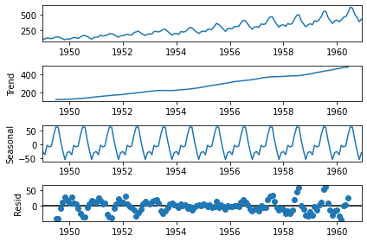
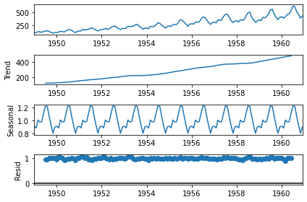
Exercises on TSA, 1st Type
Given an additive decomposition plot and a multiplicative decomposition plots:
discuss which decomposition is the most suitable;
discuss which of the TSA model(s) seen in lectures you would apply to this time series to make forecasts.

Slide 9
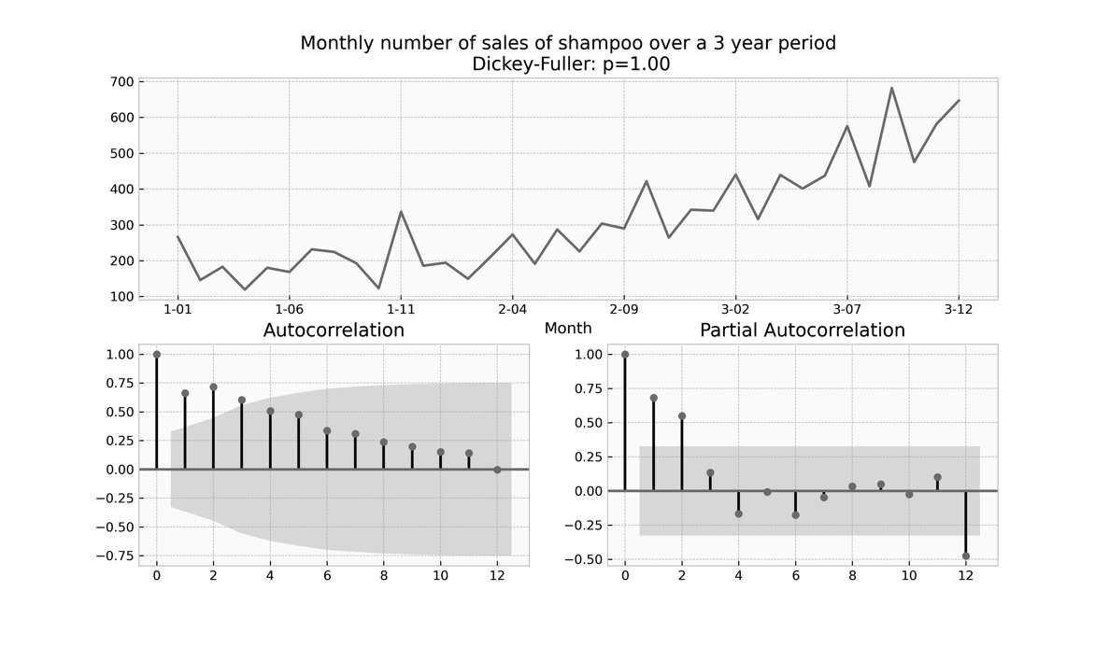
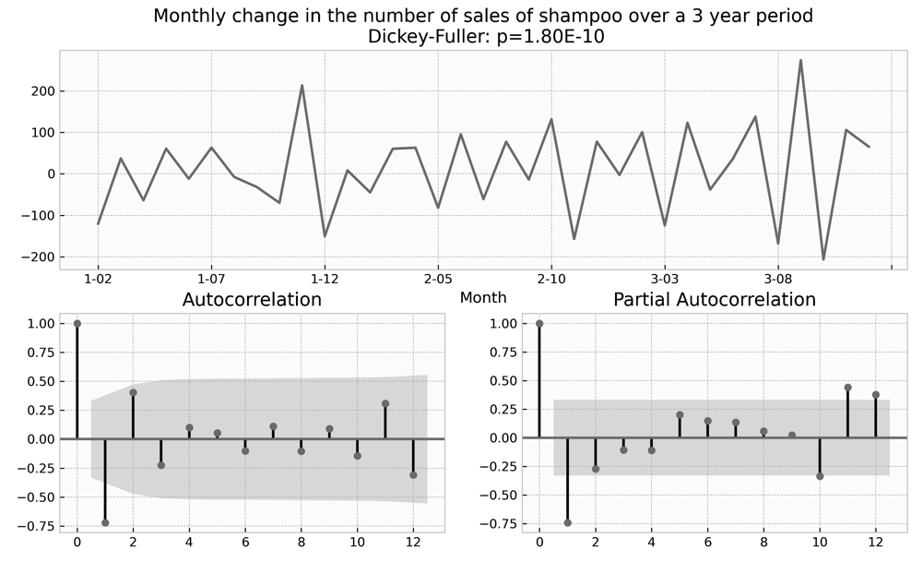
Exercises on TSA, 2nd Type part 1
Given a a code snippet that computes ACF and PACF plots illustrated:
Fill in the blank spaces
1. 2. 3. 4. 5. 6. 7. 8. 9. 10. | data_set = pd.read_csv( 'shampoo.csv’, infer_datetime_format=True, parse_dates=["Month"], index_col=["Month"]) # ACF and PACF plots of monthly number …………………………………………(data_set['Sales'], lags= ………………, ax=acf_ax) …………………………………………(data_set['Sales'], lags= ………………, ax=pacf_ax) # ACF and PACF plots of monthly changes (month_{i} – month_{i-1}) y = ……………………………………………………………… …………………………………………(y, lags= ………………, ax=acf_ax) …………………………………………(y, lags= ………………, ax=pacf_ax) plot.show()

Slide 10
Exercises on TSA, 2nd Type part 2
Comment each line of the code-snippet.
1.
2.
3.
4.
5.
6.
7.
8.
9.
10.
Discuss a possible order of an ARIMA model using the output of the plots.

Slide 11
Exercises on SML
Given a data distribution plot, a code-snippet representing the algorithm training and testing phases, and the resulting error rate plot over time:
Comment each line of the code-snippet;
Discuss the ability of the proposed code to address the data distribution and the error rate illustrated in the two plots;
Tell if a concept drift occurred, its type, and if it necessary to change the decision boundary;
How would you modify the code to obtain … (a different situation w.r.t. the illustrated one).

Slide 12
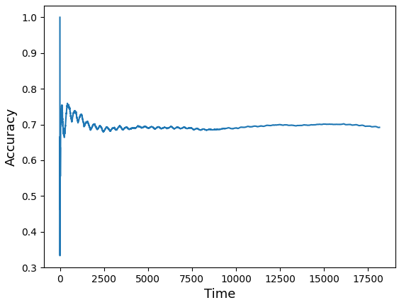
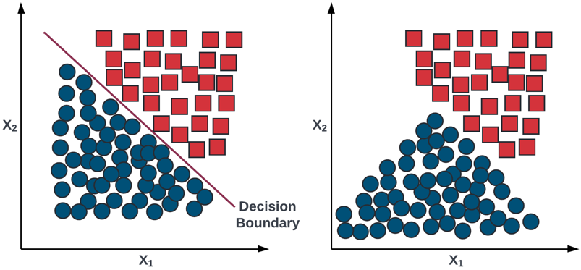
Solution 1/2
Given a data distribution plot, a code-snippet representing the algorithm training and testing phases, and the resulting error rate plot over time:
1. 2. 3. 4. 5. 6. 7. | data = pd.read_csv("stream.csv") features = data.columns[:-1] label = data.columns[-1] stream = iter_pandas(X=data[features], y=data[label]) model = GaussianNB() metric = Accuracy() progressive_val_score(dataset=stream, model=model, metric=metrics, print_every=1000)

Slide 13
Solution 2/2
Comment each line of the code-snippet
1.
2.
3.
4.
5.
6.
7.
Discuss the ability of the proposed code to address the data distribution and the error rate illustrated in the two plots
Tell if a concept drift occurred, its type, and if it necessary to change the decision boundary;
How would you modify the code to obtain a model able to adapt to a concept drift?

Slide 14
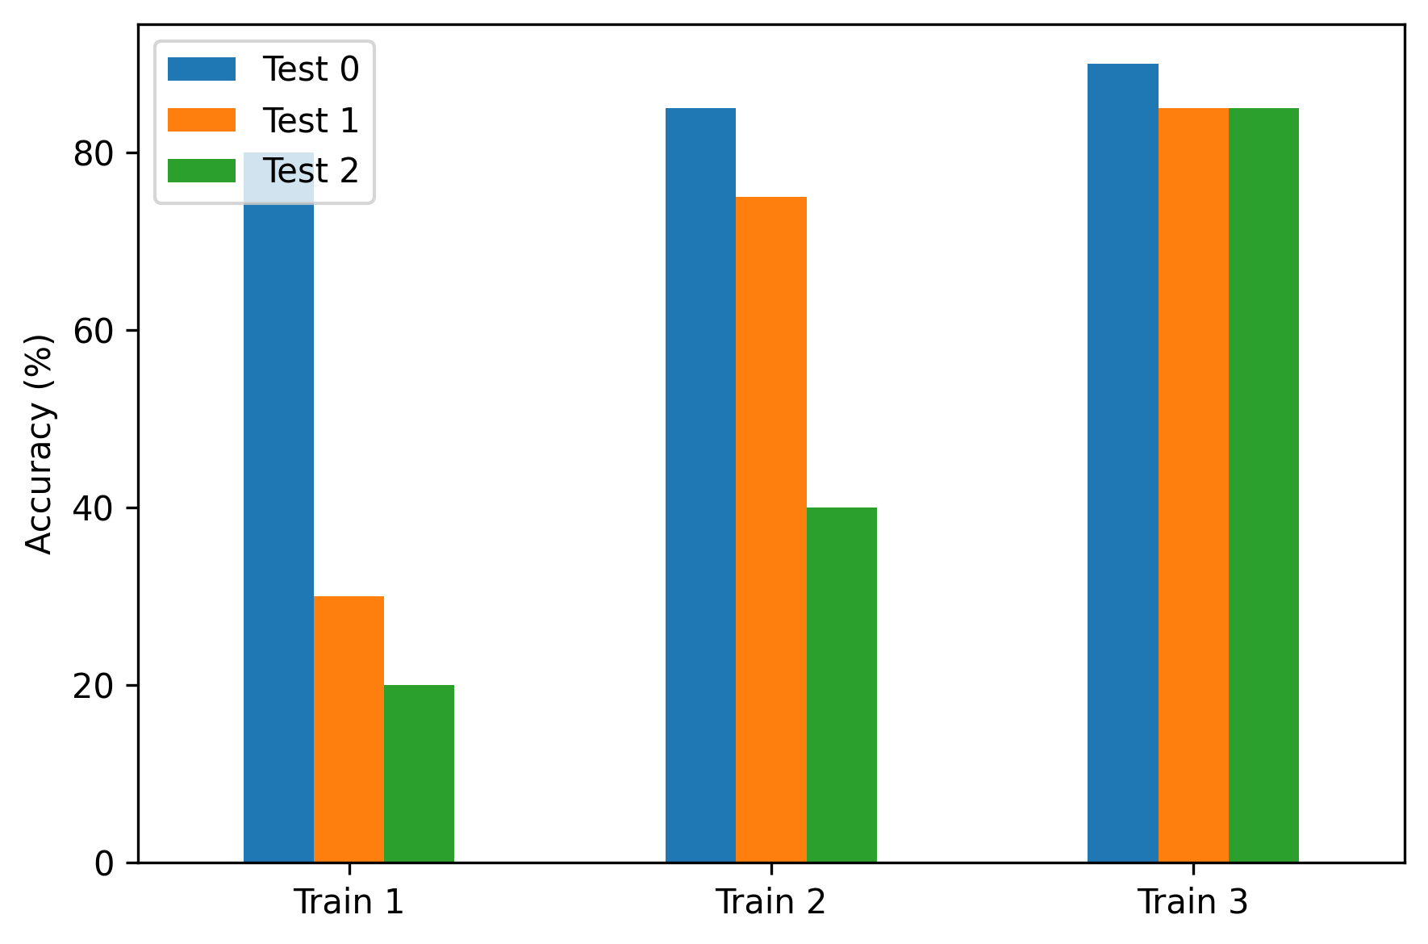
Exercises on CL
Given the following plot showing the performance of a Continual Learning strategy, describe the learning abilities of the model. Each experience contains 2 classes (consider ½ as the accuracy of the random model).
Test 1
Test 2
Test 3
For the solution see slides 11-12 of lectures/13_CL/13_01_Continual_Learning_Introduction.pdf and codes/CL/01_intro_to_CL.ipynb

Slide 15
Streaming Data Analytics Preview of the part of the exam about Streaming Data Science
Emanuele Della Valle
Politecnico di Milano

